Slide 1
MOTIVATION
Motivation is the process of stimulating human being through action so that he can achieve the desired goal.

Slide 2
TYPES
INTRINSIC MOTIVATION
EXTRINSIC MOTIVATION
POSITIVE MOTIVATION
NEGATIVE MOTIVATION

Slide 3
Factors Affecting Motivation
Recognition and Reward
Opportunities of Growth or Development
Financial Benefits
Non-Monetary Benefits
Work life balance
Work environment
Relationship with Colleagues
Leadership and relation with leaders

Slide 4
Framework of Motivation
Identify the needs
Engage in goal directed behavior
Perform
Receive reward / punishment
Reassessment
Search for ways

Slide 5
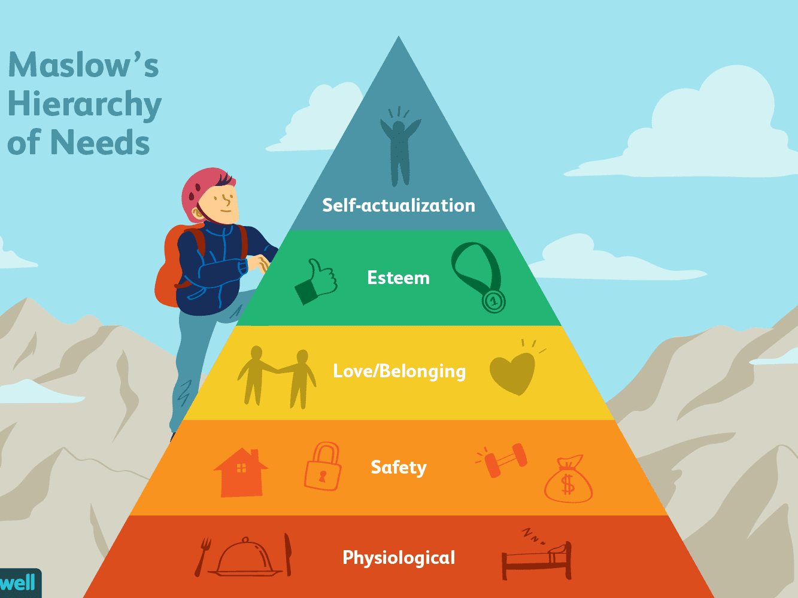
Maslow’s Hierarchy Theory

Slide 6
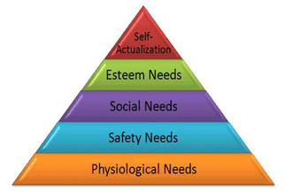
A H MASLOW

Slide 7
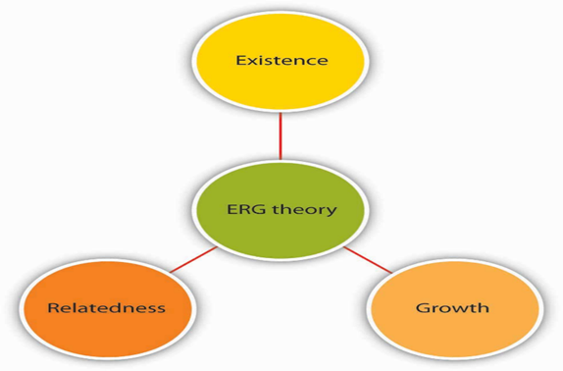
ERG Theory
Developed by Clayton Alderfer in 1969.
To overcome the deficiency of Maslow theory

Slide 8
Two factor theory
Frederick Herzberg in 1959
200 engineers and accountants by asking them 2 simple questions- what did you feel good about your job(satisfaction) and what did you feel bad about your job (dissatisfaction)?

Slide 9
Herzberg theory
HYGIENE FACTORS
When absent increase dissatisfaction, frustration and demotivate.
When present increase satisfaction and reduce frustration.
MOTIVATIONAL FACTORS
When absent increase dissatisfaction and demotivate.
When present increase satisfaction and motivate.

Slide 10
Money is Hygiene factor OR Motivator ?

Slide 11
McClelland’s Theory of Needs
David McClelland and his associates proposed McClelland’s theory of Needs/Achievement Motivation Theory.
Human behaviour affected by 3 needs: NEED FOR POWER, NEED FOR ACHIEVEMENT and NEED FOR AFFILIATION

Slide 12
Need for Power- desire to have control over others and to be influential, motivated by the need for reputation and self-esteem
Need for Achievement- These people are highly motivated by competing and challenging work. Such individuals try to get satisfaction in performing things better. High achievement is directly related to high performance.
Need for Affiliation-It is a need for open and sociable interpersonal relationships, co-operation and mutual understanding. Motivated with friendly and supportive environment

Slide 13
Vrooms Theory
Victor H.Vroom in 1964
3 components :
1. Valency (V) – expectation towards Output or Reward
2. Expectancy (E) – Self confidence
3. Instrumentality (I) – will I get the output
Motivation= V+E+I

Slide 14
PORTER AND LAWLER MODEL
Lyman W.Porter and Edward E.Lawler
inspired from Vroom’s theory
Elements are : EFFORT, VALUE OF REWARD, PERFORMANCE, PERCEIVE EFFORT REWARD, REWARD & SATISFACTION

Slide 15
ADAM’S EQUITY THEORY
John Stacey Adams in 1963
Also known as Personal Efforts Revolve theory.
Relationship between the employees perception of how fairly he is being treated and how he is motivated to work.
Compare their input with output
MOTIVATION = INDIVIDUAL OUTPUT / INDIVIDUAL INPUT = OTHERS OUTPUT / OTHERS INPUT

