Slide 1
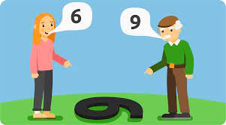
PERCEPTION

Slide 2
PERCEPTION
Perception is the process of receiving information, making sense of it and reacts to it.

Slide 3
Perceptual Process
Receiving Stimuli
Selecting Stimuli
Organizing Process
Interpretation
Checking
Reacting

Slide 4
Continue.,
STEP 1: RECEIVING STIMULI
Receiving different type of stimuli or information from various sources.
both internal and external sources.
STEP 2: SELECTING STIMULI
Filtering the stimuli
Factors for selection :
INTERNAL
Nature
Location
EXTERNAL
Physiological factor
Age factor
Color
Size
Contras
Reptation
Interest
Ambivalence

Slide 5
STEP 3: ORGANIZAING PROCESS
In this step whatever data has been selected in the previous step are arranged or organized properly so that we can collect a meaningful whole.
Factors:
Ambiguous figure-confusing and disorganized stimuli
Figure Background- perceived object stand out as separated from their general background
Perceptual grouping- include principle of similarity, continuity, closure. Despite of different shape, size, and color we assume an object as constant.

Slide 7
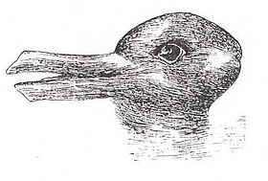

Slide 8
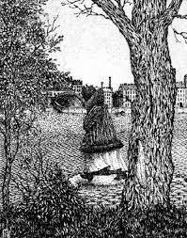

Slide 9
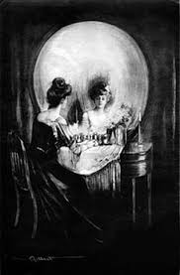

Slide 10
STEP 4: INTERPRETATION
generating meaning.
Factors:
Perceptual Set- previously held believes
Stereotyping- tendency to assign attributes on an individual on the basis of the category or group that individual belong
Halo Effect- tendency of perceiving a person in terms of his/her good or bad quality
Perceptual Context- situation or environment in which perception takes place
Perceptual Projection- condition people tends to see another person having the same trait that he is having.

Slide 11
STEP 5: CHECKING Check whether his/her interpretation is right or wrong. 2 ways: Self checking & asking others
STEP 6: REACTING
the individual reacts and put his/her reaction or opinion.

Slide 12
Factors influencing Perception
Nature
Location
Color
Size
Contrast
Repetition
Physiological factor
Age difference
Interest
Ambivalence
Ambiguous figure
Figure background
Perceptual grouping
Perceptual set
Stereotyping
Halo effect
perceptual context
Perceptual projection

Slide 13
Perceptual distortions
It is the lack of correspondence between the way a stimulus is commonly perceived and the way an individual perceives it under given conditions.
It occurs when a person response to environmental stimuli is different from what should be the normal reaction.
Sometimes it relate to physical damage to the brain, psychological impairment, and influence of the drug.
5 major forms are:
Halo effect
Perceptual defence
Projection
Self fulfilling prophecy
Stereotyping

