Slide 1
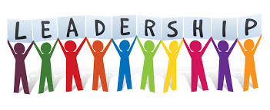

Slide 2
LEADERSHIP
Leadership is a part of influencing, motivating and directing the members in such a way, so that there will be willingness, co-operation, confidence and participating among the member to achieve their goal or task.

Slide 3
Who is favourite Leader ?

Slide 5
FEATURES :
It can be formal or informal
A group phenomenon
Interaction between 2 or more people
Dynamic art

Slide 6
Is there is any difference between Leader & Manager OR Leadership & Management (Managership) ?

Slide 7
Leaders has followers, but managers have sub-ordinates.
Leadership can be formal or informal, whereas managership is always formal.
Managership arises within the organization whereas leadership occurs anywhere.
Manger gets power from authority of the organization whereas leader gets power from his followers.
Manager may or may not influence or motivate his subordinates whereas leaders have the ability to influence his followers.

Slide 8
The main aim of manger is to achieve organizational objective, whereas leader’s main objective/aim is to satisfy the need of his followers.
Manger manages things whereas leader lead people.
Leadership is doing right things, whereas managership is doing things in right way.
Management work as a ladder for success, whereas leadership is the wall which support the ladder.

Slide 9
Theories of leadership
Leadership Theory
TRAIT THEORY
BEHAVIORIAL THEORY
Ohio state university
University of Michigan study
Managerial Grid
LMX
CONTIGENCY THEORY
Fiedler theory
Path goal theory
Situational theory

Slide 10
Trait Theory
Traditional theory
Focus on the individual characteristic of successful and unsuccessful leader.

Slide 11
Continue….
Traits for successful leader are: - Emotional stability, Good physical appearance, Technical knowledge, Sociable, Fore sightedness, Ability to influence others, Willingness to work along with people, Alert, Problem solver etc.
Similarly unsuccessful leader also causes few traits as per this theory:- Poor temperament, Self-centered, Lack of vision, Lack of sense of decision making, Inability to work along with people etc.

Slide 12
Behavioural Theory
The Ohio State of University
Leaders behaviour
Initiating Structure
(I)
Consideration
(C)

Slide 14
B. The University of Michigan Study
2 types of leader: Employees centered (employee oriented)& Task centered (task oriented leader)

Slide 15
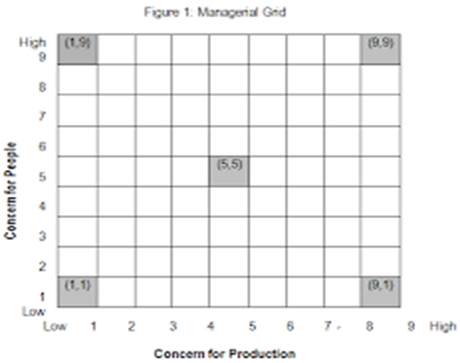
c. Managerial grid
Develop by Blake and Mountain
2 dimensions: Concern for people & Concern for production
5 types of leadership:
A. 9,1-TASK MANAGEMENT
B. 1,9- COUNTRY CLUB MANAGEMENT
C.5,5- MIDDLE OF ROAD MANAGEMENT
D. 9,9- TEAM MANAGEMENT
E. 1,1- IMPROVISE MANAGEMNT

Slide 16
D. LEADER MEMBER EXCHANGE THEORY
Also known as LMX Theory.
2 group: In Group & Out Group

Slide 17
CONTIGENCY THEORY
FIEDLER’S THEORY
Motivational style of Leader
Task orientation
Relation orientation
Favouableness of situaition
Leader member relation
Effectiveness of Leader
Task structure
Position power

Slide 18
B. PATH GOAL THEORY
Developed by Robert House

Slide 19
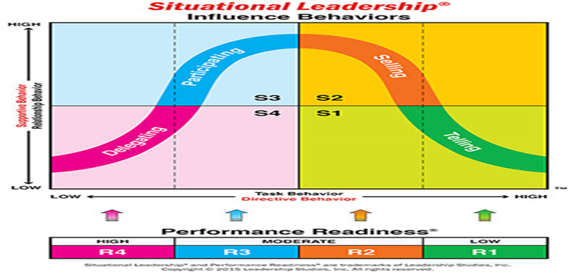
C. SITUAITIONAL THEORY
Also known as Hersey-Blanchard situational leadership theory.
Developed by Hershey & Blanchard.
2 types of leader behaviour: Task behaviour & Relation behaviour.

Slide 20
CONTEMPORARY THEORY
Behavioural theory
Contingency theory
Transformational theory
Transactional theory

Slide 21
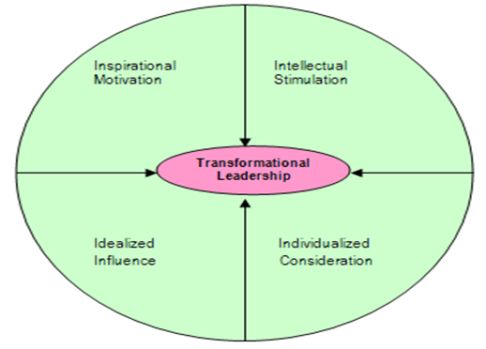
Transformational theory
1. Inspirational Motivation-leaders guide followers by providing them with a sense of meaning and challenge. foster the spirit of teamwork and commitment. promotion of consistent vision, mission, and a set of values to the members.
2. Intellectual Stimulation: leaders:encourage their followers to be innovative and creative. They encourage new ideas from their followers and never criticize them in public.
3. Idealized Influence:leaders act as role models for its followers. Win the trust and respect from the followers.
4. Individualized Consideration:Leaders act as mentors to their followers and reward them for creativity and innovation. The followers are treated differently according to their talents and knowledge.

Slide 22
TRANSACTIONAL THEORY
described by Max Weber in 1947.
based on the idea that managers give employees something they want in exchange for getting something they want.
motivation can be drawn through system of reward and punishment

Slide 23
STYLE OF LEADERSHIP
Laisser-Fairz Style
Autocratic Style
Participative Style
Transformational Style
Transactional Leadership

Slide 24
LAISSER-FAIRZ STYLE
AUTOCRATIC STYLE
Also known as Authoritarian style of leadership.
Here, the manager takes all the decisions.
The manager holds the total authority and imposes it on their employees.
No one change the decision of the leader.
Only downward communication is here.
This supervision is fit for those employees who need close supervision.
It is also known free rain style, which means leave alone.
In this type of leader, is lack in direct supervision to their employees.
He failed to provide regular feedback.
Give maximum freedom is allowed.
This style is good for highly experienced trained employees

Slide 25
PARTICIPATIVE STYLE
TRANSFORMATIONAL LEADERSHIP
It is also known as democratic leadership style.
Here the leader allows and encourage their employees to participate and involve in decision making process.
It is a popular style of leadership because followers get emotionally attached to the project and leader for better performance.
focused on motivation for employees to create change, innovate, and shape the future of the organizational structure
Leader associated with high growth oriented organization
It focus on organizational change.
Motivate the team members to work beyond their comfort zone.
Possess high level of integrity, emotional intelligence, shared vision of the future, good communication skill.

Slide 26
TRANSACTIONAL LEADERSHIP
Transactional leadership styles are more concerned with maintaining the normal flow of operations.
use disciplinary power and an array of incentives to motivate employees to perform at their best.
Transactional means motivate the subordinate by exchanging reward performance.
known as managerial leadership
Transactional leaders utilize rewards and punishments to motivate their followers.

