Slide 1
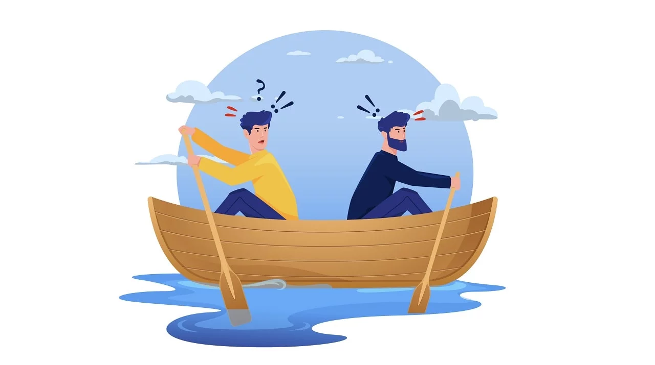

Slide 2
CONFLICT
Conflict is defined as a clash between individuals arising out of a difference in thought process, attitudes, understanding, interests, requirements and even sometimes perceptions.
Misunderstanding or Disagreement

Slide 3
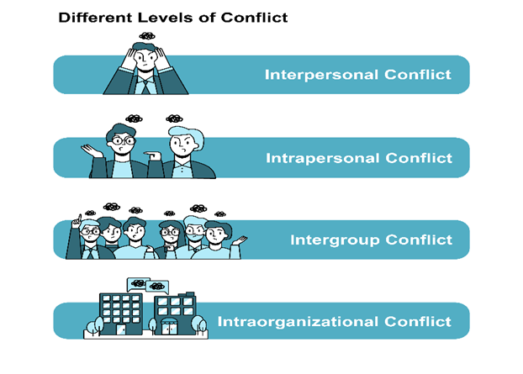
Types

Slide 4
Intra individual Conflict
Also known as Intra personal conflict.
The intrapersonal conflict is conflict experienced by a single individual, when his or her own goals, values or roles diverge.
This refers to a conflict within an individual.
Takes place in the person’s mind.

Slide 5
Inter individual conflict
Arise between two or more person.
Also known as inter personal conflict.
due to differences in goals, value, and styles between two or more people who are required to interact.

Slide 6
Intra Group Conflict
Within a group or team.
The incompatibilities and misunderstandings among these individuals lead to an intragroup conflict.
Arise from interpersonal disagreement, difference in views and idea

Slide 7
Inter group Conflict
When conflict between groups inside and outside an organization.
Mostly due to disagreement and misunderstanding.

Slide 8
Stages:

Slide 9
Conflict Resolution

Slide 10
a. COLLABORATION
Come forward to discuss the problem
Find alternative solution
Meaningful conversation
WIN WIN outcome
Mutual benefits
Also known as Problem solving/ Confronting
Ex. All members of family want to eat different type of food. So there should be a meaningful conversation in it

Slide 11
b. COMPROMISING
Also known as Reconciling.
Choose a middle path, where both the parties agree.
It’s a temporary solution
Both the parties lost something
Ex. Bargaining

Slide 12
c. AVOIDING
one of the parties in the conflict may decide to retract from the discussion and allows going with the other person’s opinion
One will decide and other will remain silent.
Can be due to emotional or through anger.
Symbolize that not paying attention or ignoring
Also known as withdrawing

Slide 13
d. COMPETING
person with authority and power can force his/her opinion and resolves the conflict without giving any chance to the other party/person.
WIN-LOSE
Also known as Forcing.

Slide 14
e. ACCOMMDATING
one of the parties can take charge and tries to smooth the surrounding by using nice words and by emphasizing the points of agreement, and playing down the points of disagreement.
work as a catalyst to break the discomfort between the parties

Slide 15
NEGOTIATION

Slide 16
Negotiation
Negotiation is a method by which people settle differences.
It is a process by which compromise or agreement is reached while avoiding argument and dispute.
The term negotiation refers to a strategic discussion intended to resolve an issue in a way that both parties find acceptable

Slide 17
Process/ Steps
Preparation
Open discussion
Clarification of Goal
Negotiation
Agreement
Implementation

