Slide 1
Module-III: Navigation and Data Passing
By,
Dr. DHAWALESWAR RAO

Slide 2
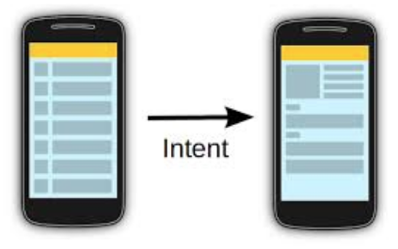
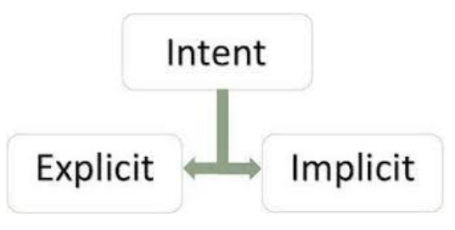
WHAT IS AN INTENT?
It is the message that is passed between components such as activities, content providers, broadcast receivers, services etc. Intents facilitate communication between different components in several ways. The intent is used to launch an activity, start the services, broadcast receivers, display a web page, dial a phone call, send messages from one activity to another activity, and so on. It is generally used with startActivity() method to invoke activity, broadcast receivers etc
TYPE OF INTENT
Intents are of two types:

Slide 3
EXPLICIT INTENT
Explicit intents are communicated between two activities inside the same application. We can use explicit intents when we need to move from one activity to another activity.
Example:- when a user wants to start a service to download a file or when a new activity gets started in response to a user action.
//Explicit Intent
Intent send = new Intent(FirstActivtiy.this, SecondActivity.class);
//Starts TargetActivity
startActivity(send);
Example:-

Slide 4
EXPLICIT INTENT
Explicit intents are communicated between two activities inside the same application. We can use explicit intents when we need to move from one activity to another activity.
Example:- when a user wants to start a service to download a file or when a new activity gets started in response to a user action.
IMPLICIT INTENT
Implicit intent is communicated between two activities of an application. One thing to note here is we should not name a specific component. In place of that we can declare a general action to perform which allows a component from another app to handle it.
Example:- To show the user a location on a map, we can use an implicit intent.

Slide 5
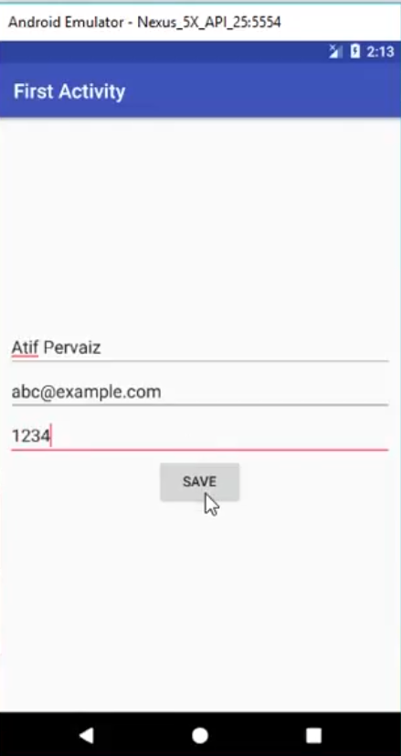
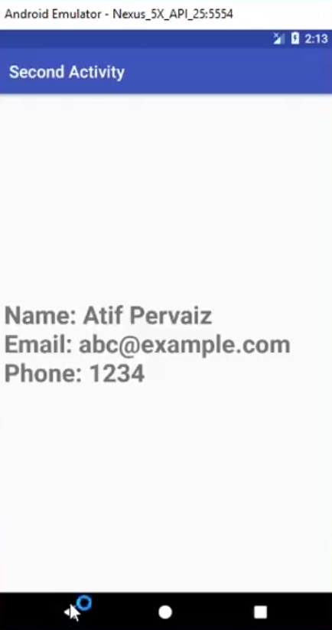
Transferring the data from one activity to another:
Step 1: Create Second Activity
Step 2: Create button and Edit Text
Step 3: Create TextView in the Second Activity to display the data

Slide 6
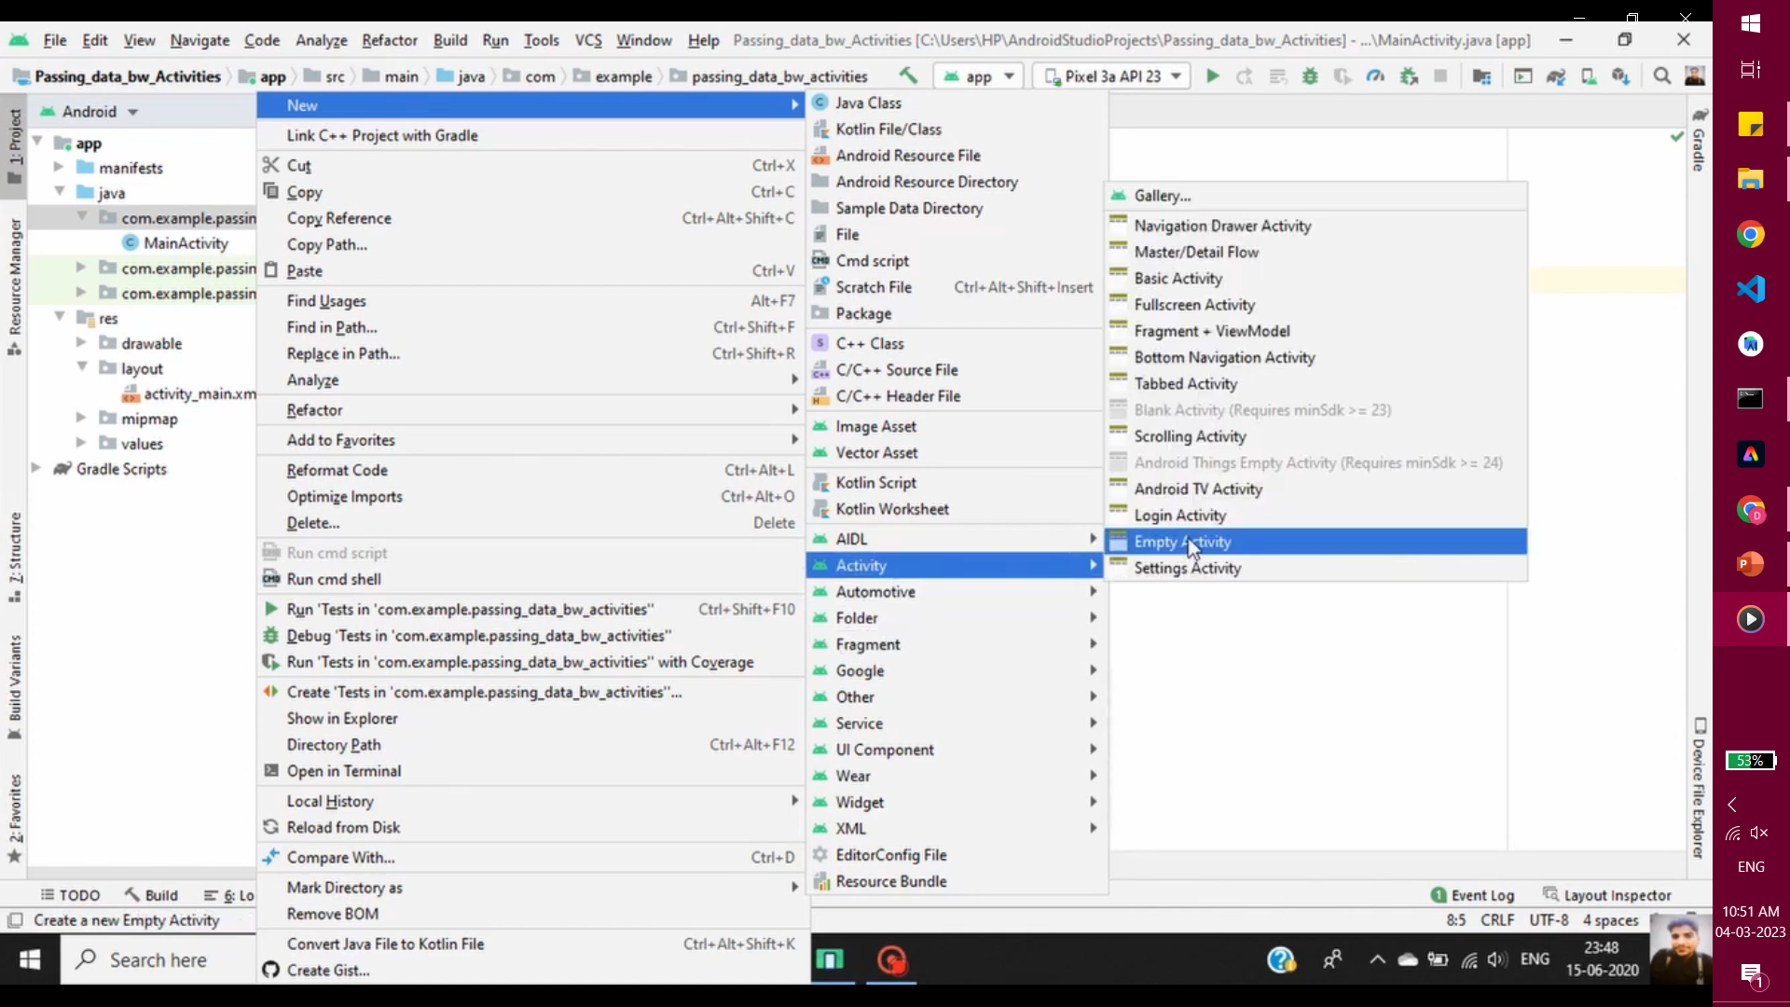
Step 1: Create Second Activity

Slide 7
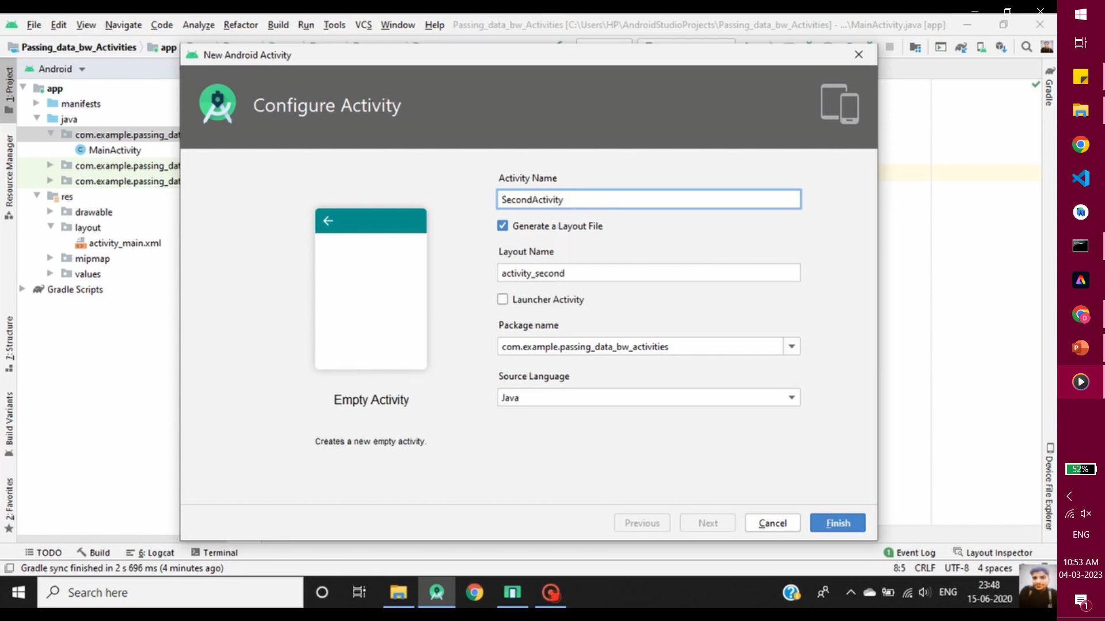

Slide 8
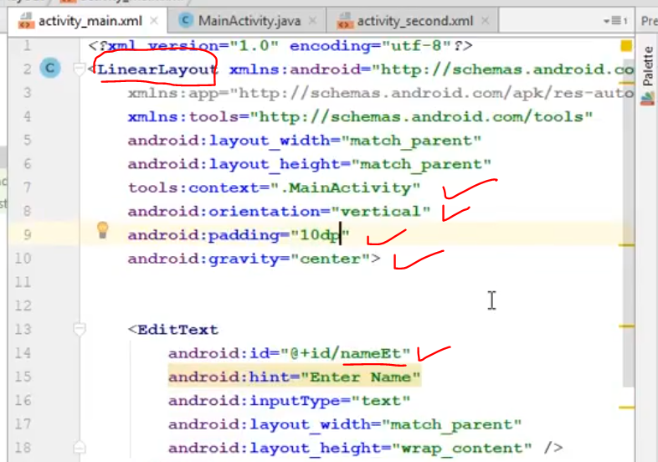
Step 2: Create button and Edit Text

Slide 9
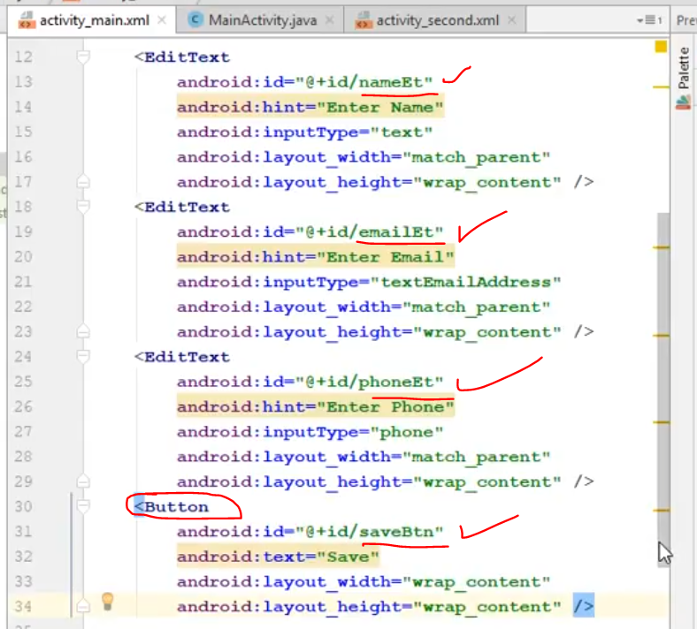

Slide 10
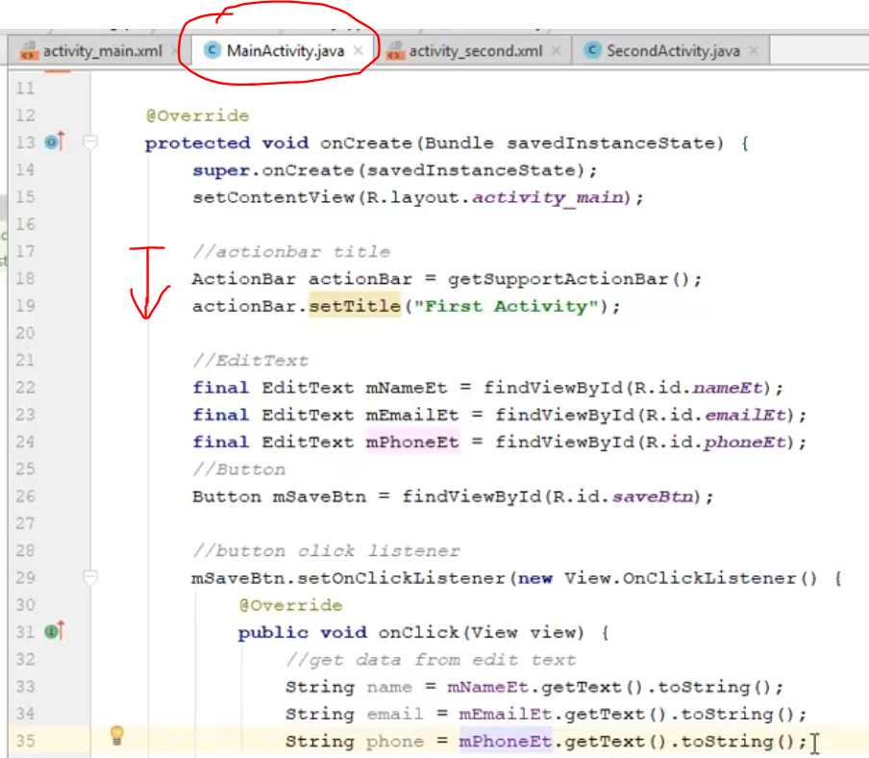

Slide 12
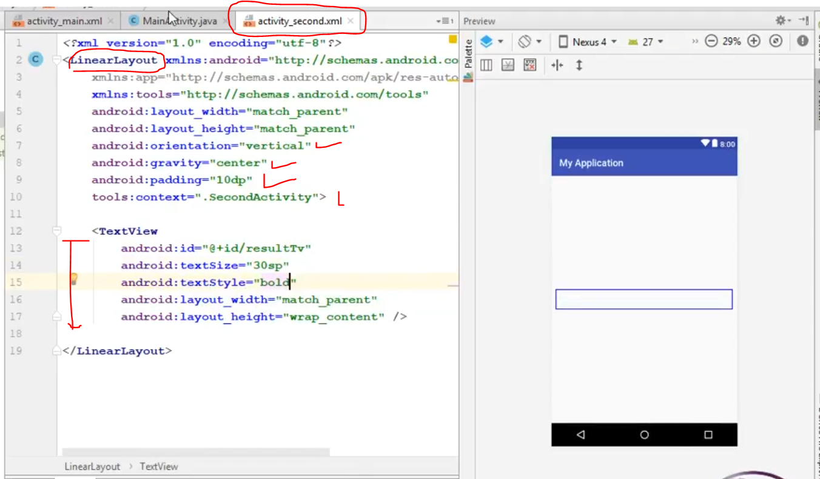
Step 3: Create TextView in the Second Activity to display the data

Slide 13
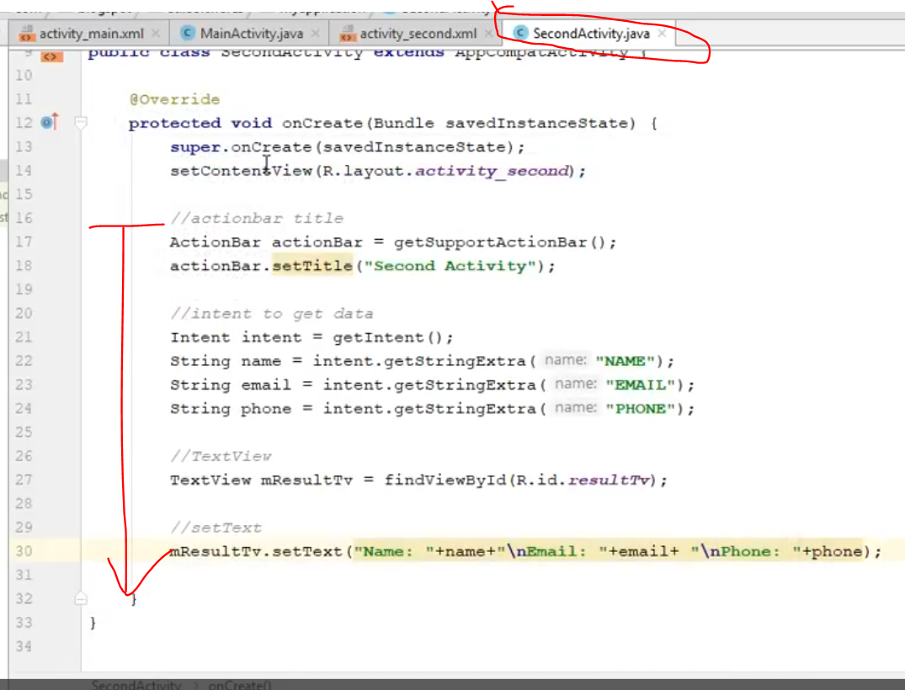

Slide 17
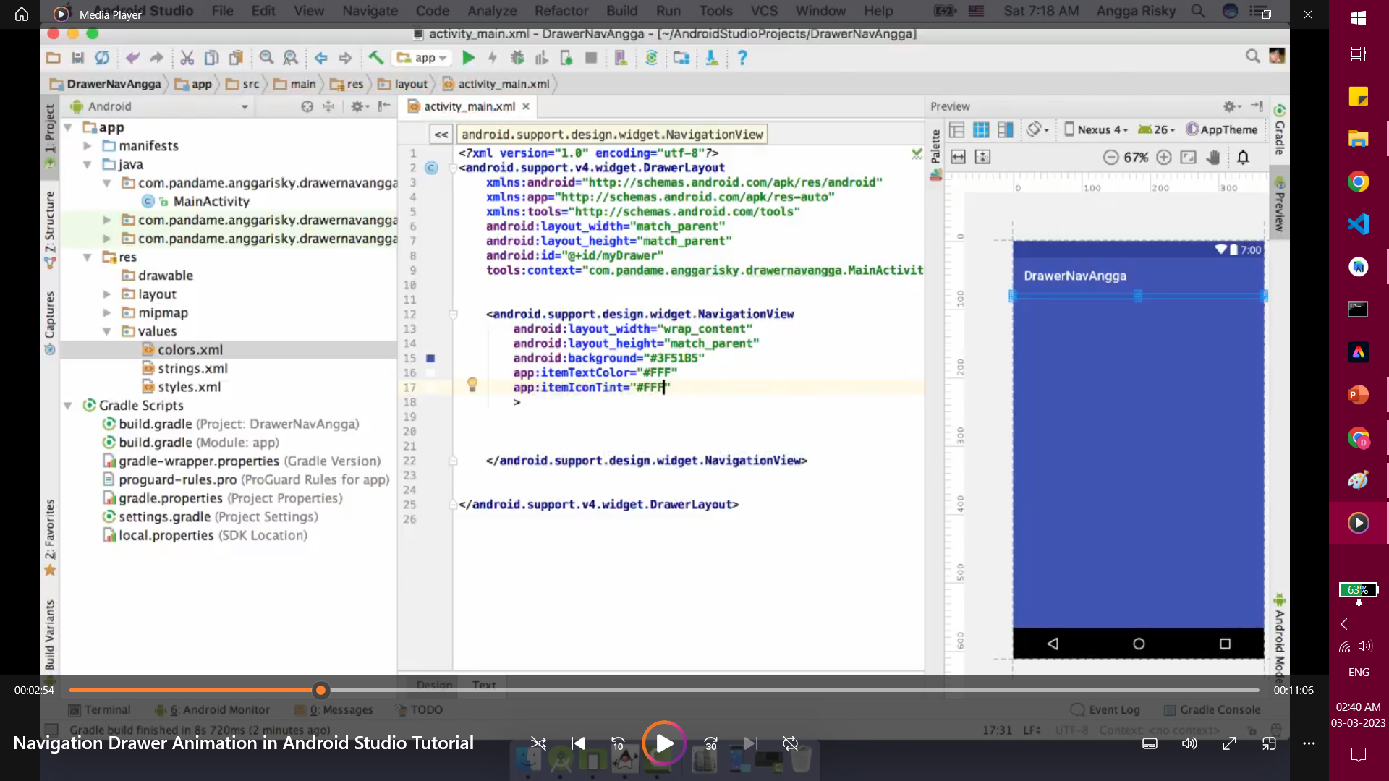

Slide 18
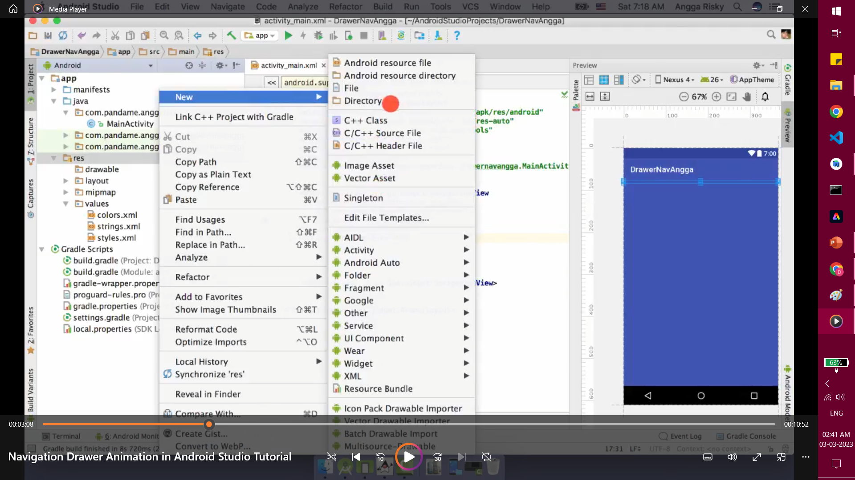

Slide 19
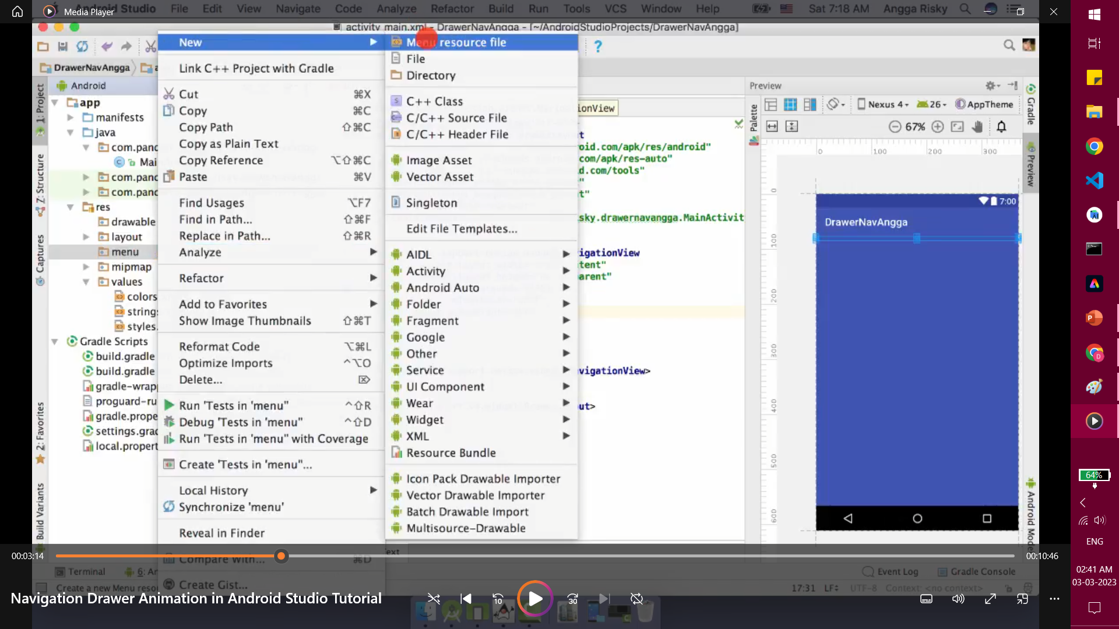

Slide 20
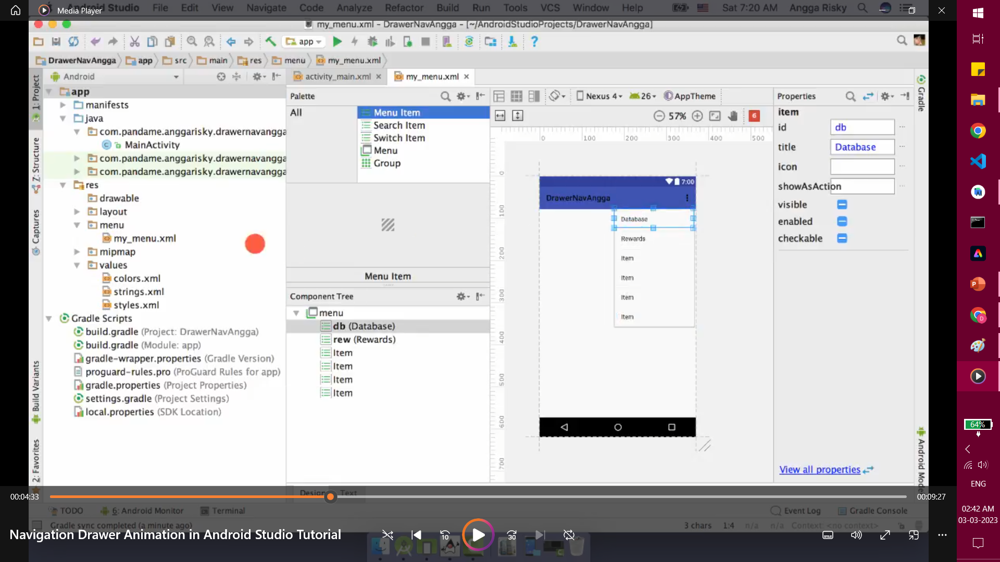

Slide 21
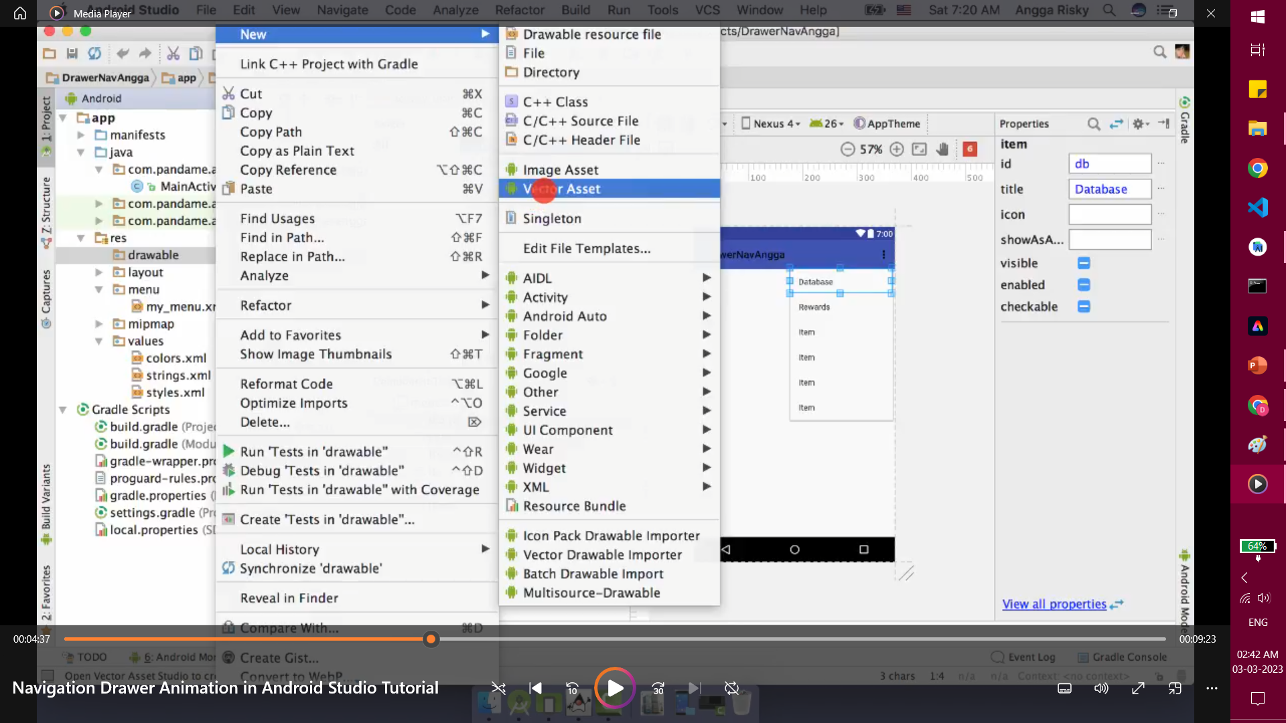

Slide 22
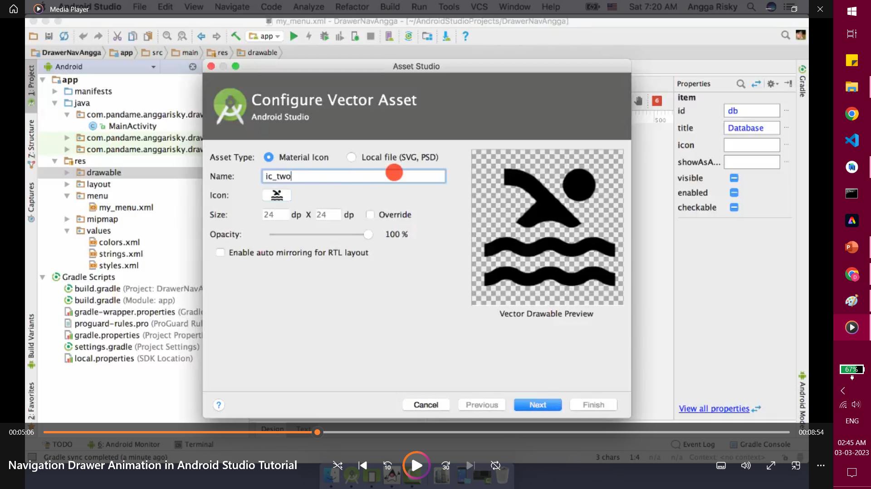

Slide 24
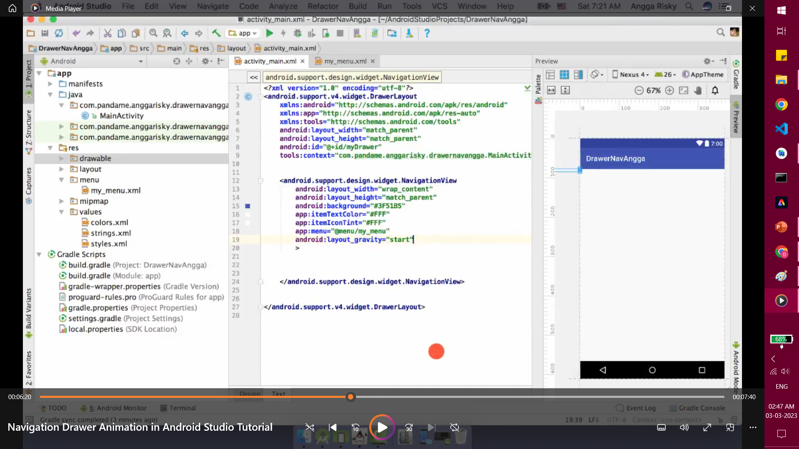

Slide 25
For a beautiful HEADER

Slide 26
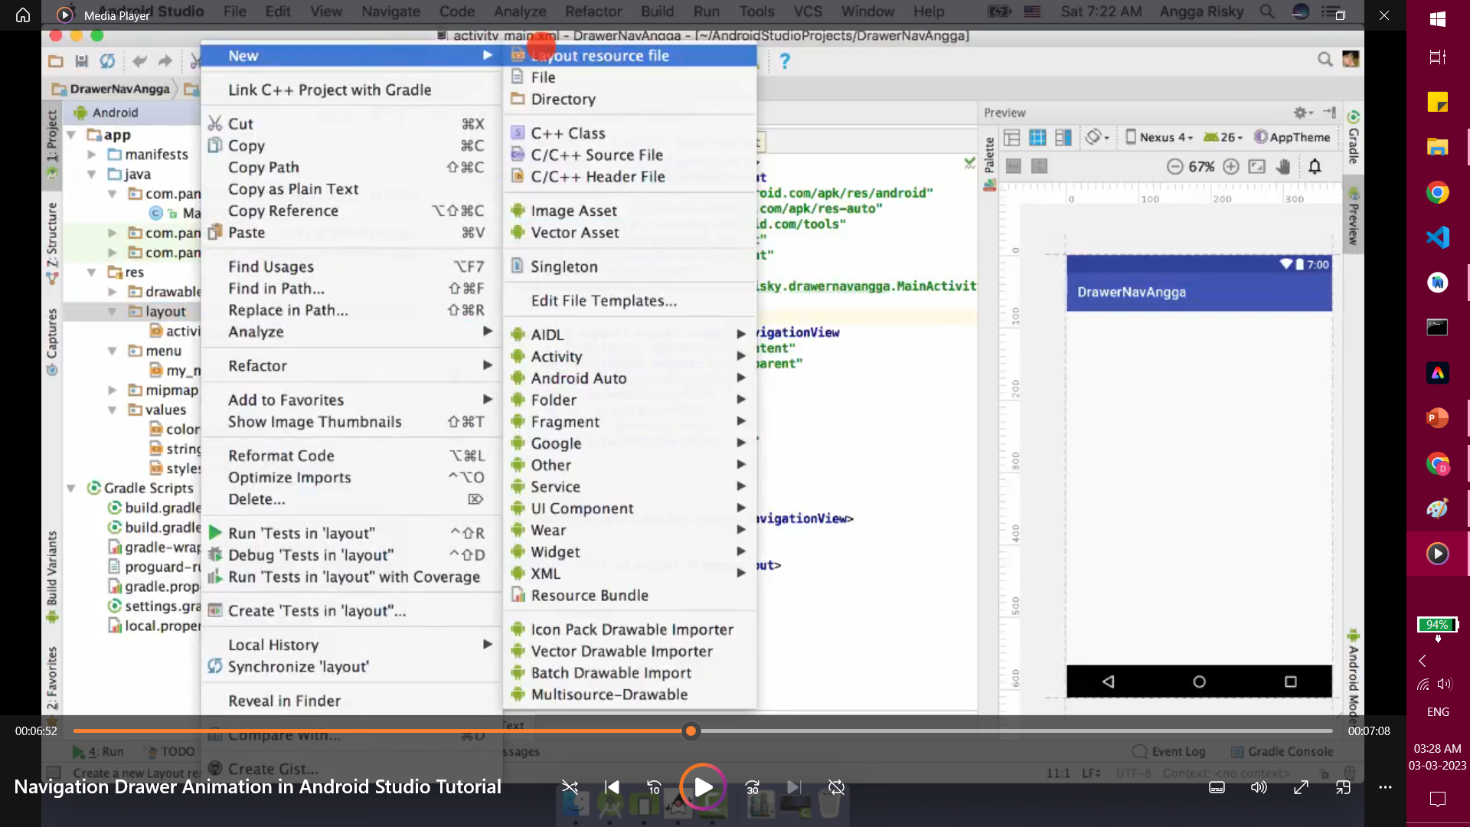

Slide 27
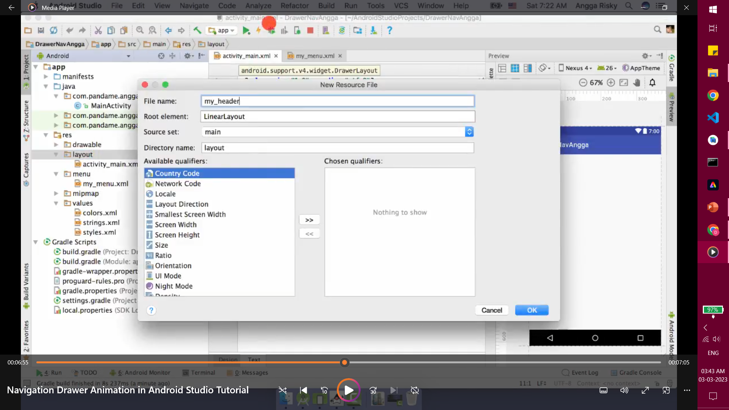

Slide 28
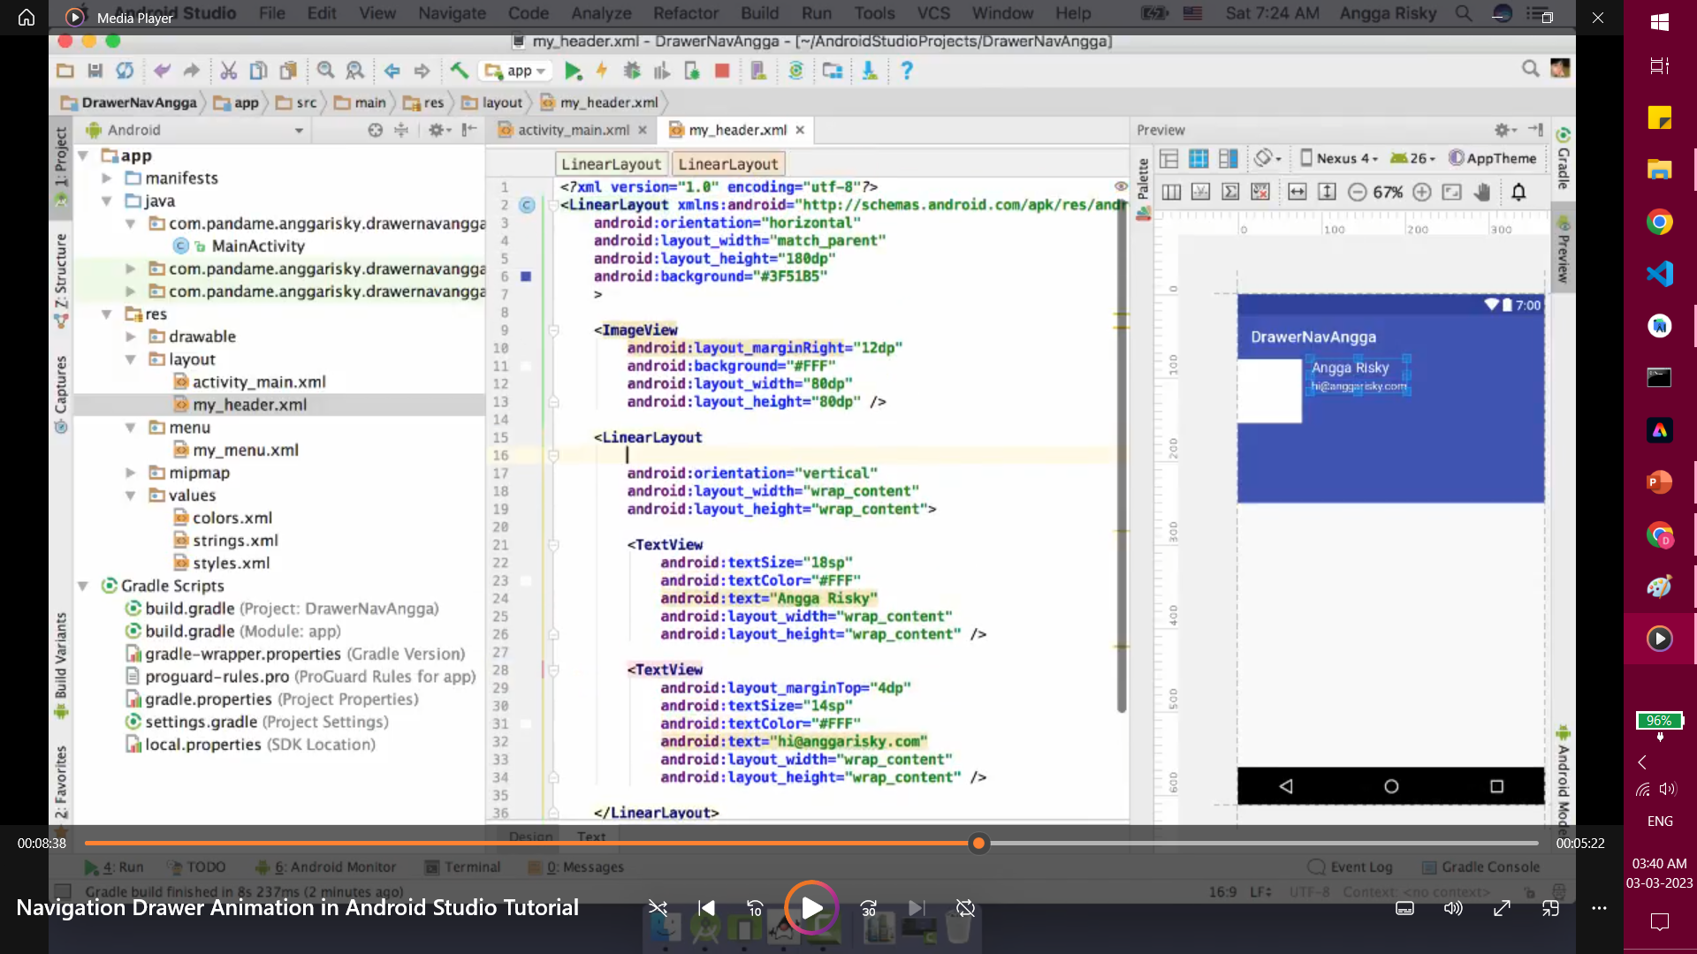

Slide 29
