Slide 1
Module-IV: Broadcast Receiver & Content Provider
By,
Dr. DHAWALESWAR RAO

Slide 2
Retrieve the device’s battery info. And show in a project
What is BroadcastReceiver?
A broadcast receiver is an Android component which allows you to register for system or application events or intents. All registered receivers for an event are notified by the Android application. When any of these events occur it brings the application into action by either creating a status bar notification or performing a task. Unlike activities, android BroadcastReceiver doesn’t contain any user interface. Broadcast receiver is generally implemented to delegate the tasks to services depending on the type of intent data that’s received.
Following are some of the important system wide generated intents.
android.intent.action.BATTERY_LOW : Indicates low battery condition on the device.
android.intent.action.BOOT_COMPLETED : This is broadcast once, after the system has finished booting
android.intent.action.CALL : To perform a call to someone specified by the data
android.intent.action.DATE_CHANGED : The date has changed
android.intent.action.REBOOT : Have the device reboot
android.net.conn.CONNECTIVITY_CHANGE : The mobile network or wifi connection is changed(or reset)

Slide 3
#Broadcast Receiver in Android
To set up a Broadcast Receiver in android application we need to do the following two things.
i) Creating a BroadcastReceiver
ii) Registering a BroadcastReceiver
i) Creating a BroadcastReceiver
A custom BroadcastReceiver as shown below.
BroadcastReceiver is an abstract class with the onReceiver() method being abstract. The onReceiver() method is first called on the registered Broadcast Receivers when any event occurs. The intent object is passed with all the additional data. A Context object is also available and is used to start an activity or service using context.startActivity(myIntent); or context.startService(myService); respectively.
The BatteryManager class contains strings and constants used for values in the ACTION_BATTERY_CHANGED Intent.

Slide 4
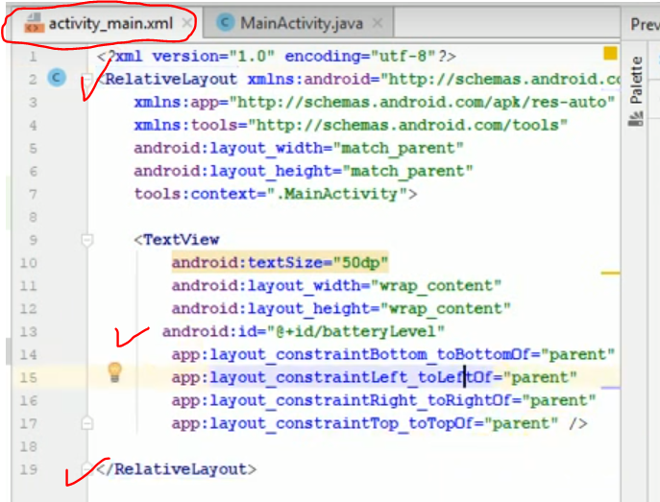
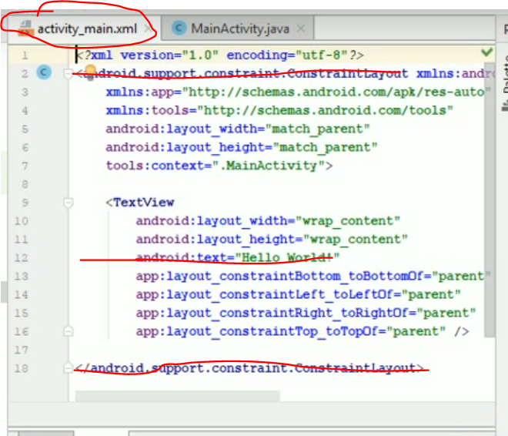
Retrieve the device’s battery info. And show in a project
work on layout in xml

Slide 5
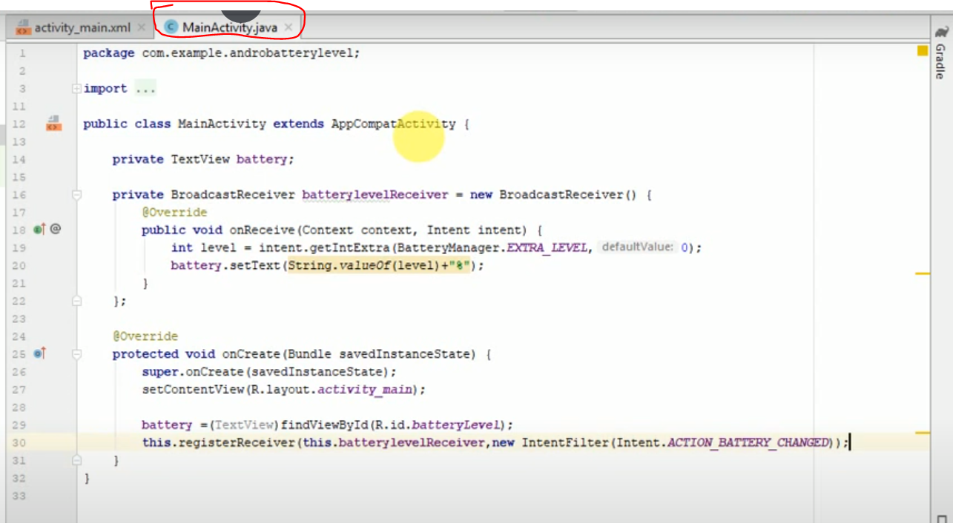
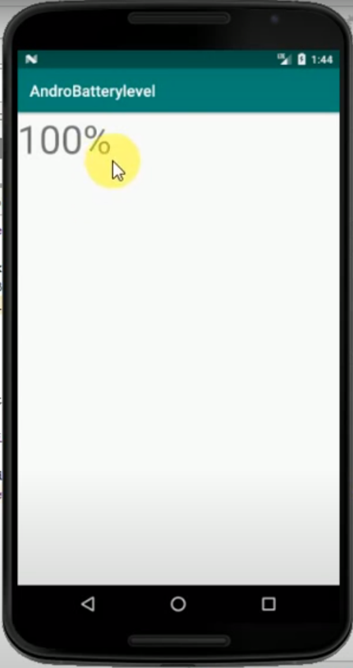
ii) Coding in Java file

Slide 6
Content Provider in a Project
public abstract class ContentProvider
- Content providers are one of the primary building blocks of Android applications, providing content to applications. They encapsulate data and provide it to applications through the single ContentResolver interface.
A content provider is only required if you need to share data between multiple applications.
For example, the contacts data is used by multiple applications and must be stored in a content provider. If you don't need to share data amongst multiple applications you can use a database directly via SQLiteDatabase.
When a request is made via a ContentResolver the system inspects the authority of the given URI and passes the request to the content provider registered with the authority. The content provider can interpret the rest of the URI however it wants. The UriMatcher class is helpful for parsing URIs.

Slide 7
The primary methods that need to be implemented are:
onCreate() which is called to initialize the provider
query(Uri, String[ ], Bundle, CancellationSignal) which returns data to the caller
insert(Uri, ContentValues) which inserts new data into the content provider
update(Uri, ContentValues, Bundle) which updates existing data in the content provider
delete(Uri, Bundle) which deletes data from the content provider
getType(Uri) which returns the MIME type of data in the content provider

Slide 9
Q&A
Abstract class in Java contain default method implementation. An abstract class can have an abstract method without body and it can have methods with implementation also. abstract keyword is used to create a abstract class and method. Abstract class in java can’t be instantiated. An abstract class is mostly used to provide a base for subclasses to extend and implement the abstract methods and override or use the implemented methods in abstract class.
Java is an object-oriented programming language. Everything in Java is associated with classes and objects, along with its attributes and methods. For example: in real life, a car is an object. The car has attributes, such as weight and color, and methods, such as drive and brake. A Java object is a member (also called an instance) of a Java class. Each object has an identity, a behavior and a state. The state of an object is stored in fields (variables), while methods (functions) display the object's behavior. The context object is an internal JSON structure that is available during an execution, and contains information about your state machine and execution. This allows your workflows access to information about their specific execution.
It's called a toast because like a piece of bread in a toaster, it momentarily pops up so that the user can see it. It gets displayed for a certain amount of time and then disappears on its own without any interaction from the user.
To make the broadcast receiver unavailable to external applications, we use “this” method. This can be prevented by specifying this limitation.

Slide 10
What is encapsulation with example?
In general, encapsulation is a process of wrapping similar code in one place. In C++, we can bundle data members and functions that operate together inside a single class. For example, class Rectangle { public: int length; int breadth; int getArea() { return length * breadth; } };
Polymorphism means "many forms", and it occurs when we have many classes that are related to each other by inheritance. Like we specified in the previous chapter; Inheritance lets us inherit attributes and methods from another class. Polymorphism uses those methods to perform different tasks.

Slide 11
REFERENCES
https://developer.android.com/reference/android/content/BroadcastReceiver

