Slide 1
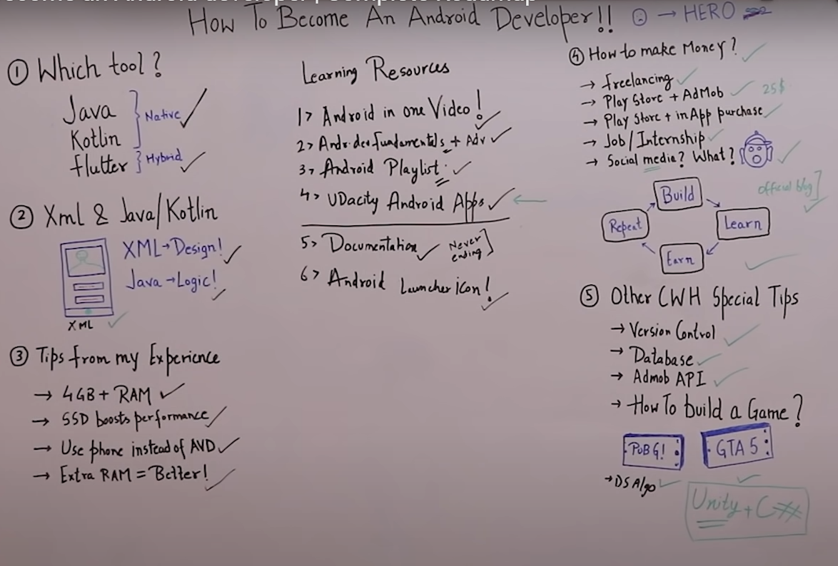
Search for:
-Interactive free designs
-login page designs

Slide 3
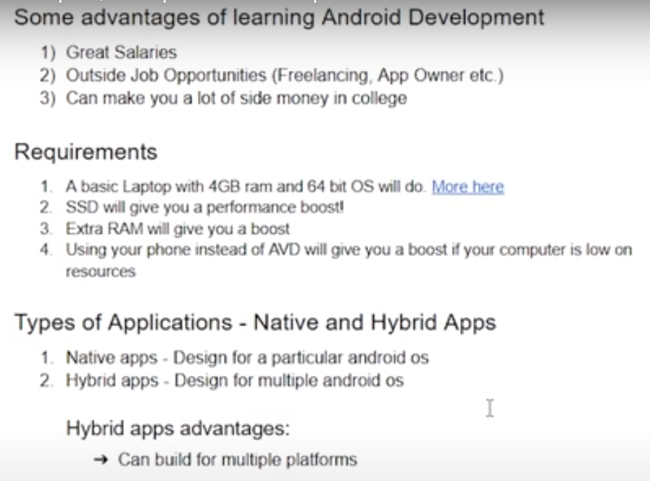

Slide 4
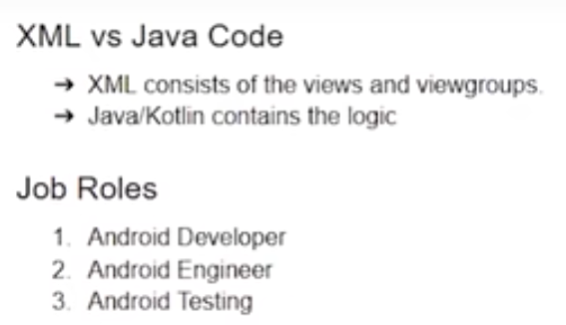
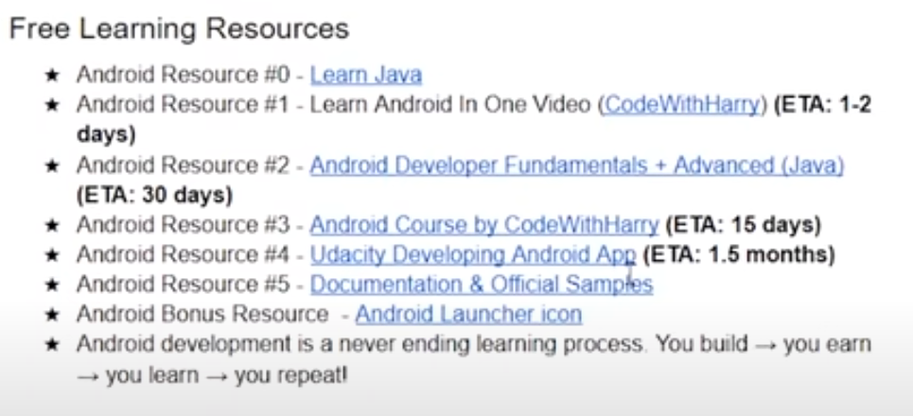

Slide 5
CUTM1036 : Android App Development
(Credits 2-2-2)
By,
Dr. DHAWALESWAR RAO

Slide 6
Courseware Syllabus: https://courseware.cutm.ac.in/courses/android-app-development/
You write Android apps in the Java programming language using an IDE called Android Studio. Android software contains a linux-based Operating System, middleware and key mobile applications. Android Studio is an IDE designed specifically for Android development. It is currently used in various devices such as mobiles, tablets, televisions etc.
Android Studio Features:
- Android Studio provides a complete IDE, including an advanced code editor and app templates. It also contains tools for development, debugging, testing, and performance that make it faster and easier to develop apps.
- You can use Android Studio to test your apps with a large range of preconfigured emulators, or on your own mobile device. You can also build production apps and publish apps on the Google Play store.

Slide 7
The following features are provided in the current stable version:
- Gradle-based build support
- Android-specific refactoring and quick fixes
- Lint tools to catch performance, usability, version compatibility and other problems
- ProGuard integration and app-signing capabilities
- Template-based wizards to create common Android designs and components
- A rich layout editor that allows users to drag-and-drop UI components, option to preview layouts on - multiple screen configurations
- Support for building Android Wear apps
- Built-in support for Google Cloud Platform, enabling integration with Firebase Cloud Messaging (Earlier 'Google Cloud Messaging') and Google App Engine
- Android Virtual Device (Emulator) to run and debug apps in the Android studio.
https://en.wikipedia.org/wiki/Android_Studio

Slide 9
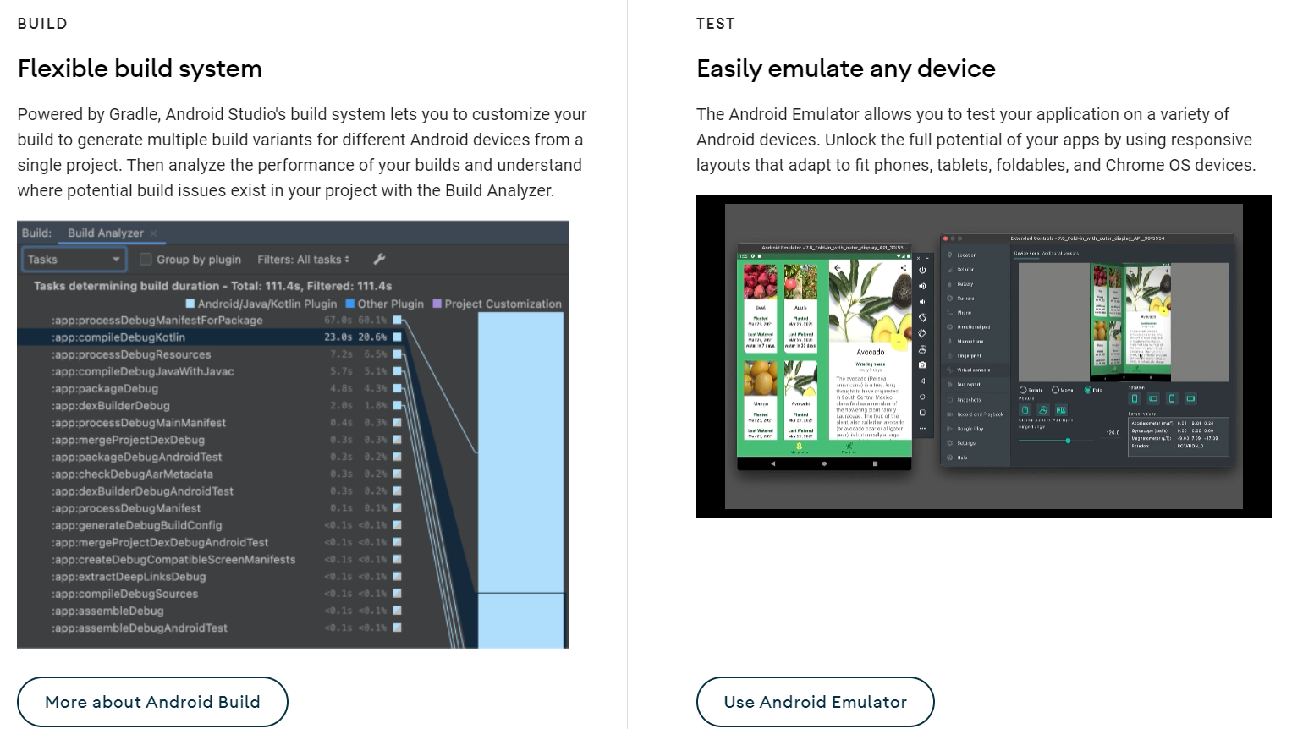

Slide 11
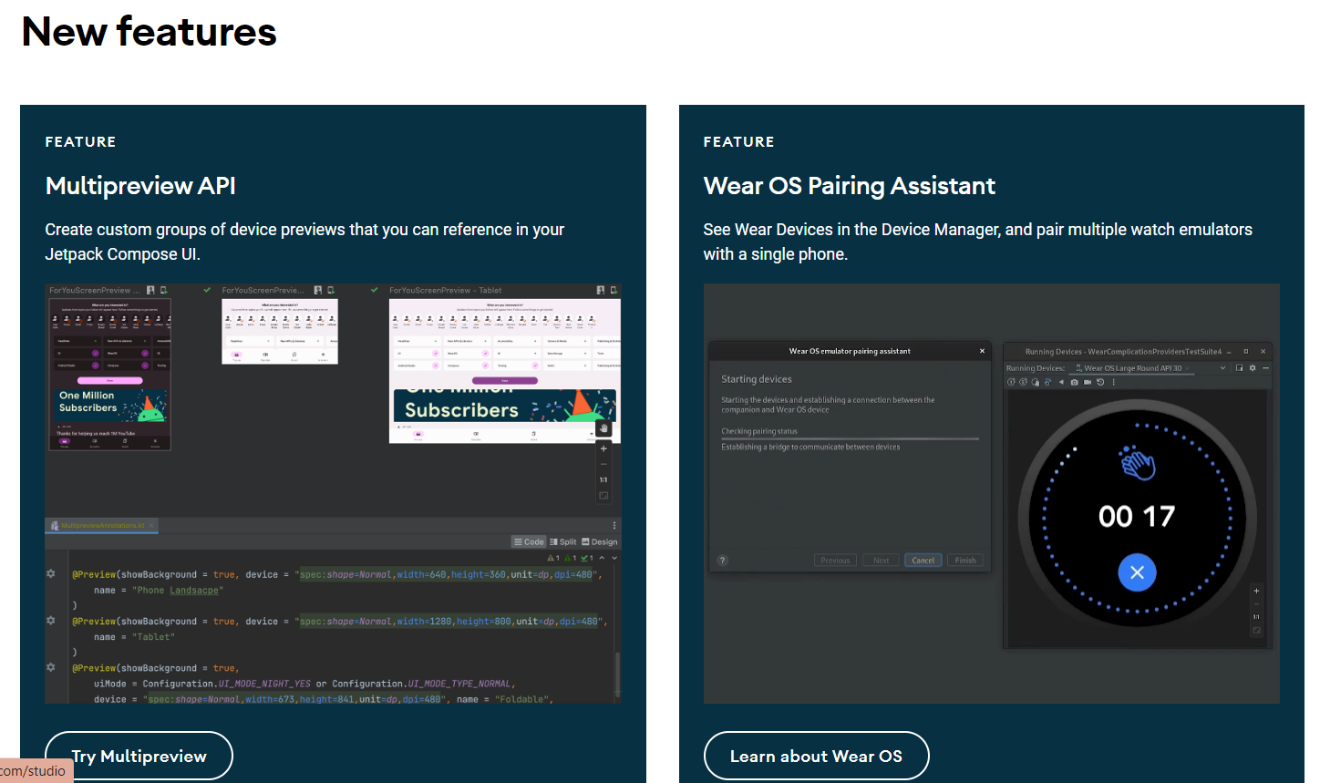

Slide 12
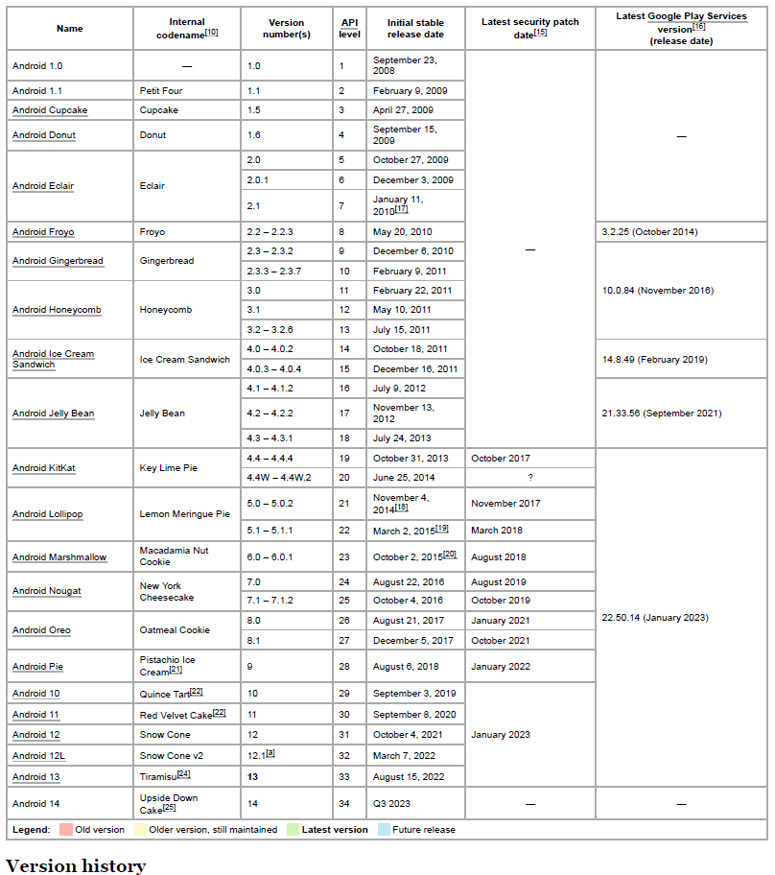
As an android programmer, Version 1.6 or version 2.0 of Android should we use as a minimum development target.
https://en.wikipedia.org/wiki/Android_version_history

Slide 13
Download, Install and Configure the Android App Environment
We are going to use Android Studio for developing Android apps. The prerequisites are:
JAVA JDK
- Download: https://www.oracle.com/java/technologies/downloads/#java8-windows
- Install : https://phoenixnap.com/kb/install-java-windows
- Set the path in Environment Variables→System variable→New :
Variable name: JAVA_HOME
Variable value: C:\Program Files\Java\jdk-19
(ii) ANDROID STUDIO
- Download: https://developer.android.com/studio?utm_source=android-studio
- Install : https://developer.android.com/studio/install
Windows: https://developer.android.com/static/studio/videos/studio-install-windows.mp4
Mac: https://developer.android.com/static/studio/videos/studio-install-mac.mp4
Linux: https://developer.android.com/static/studio/videos/studio-install-linux.mp4
- Run Android Studio as a ADMINISTRATOR:

Slide 14
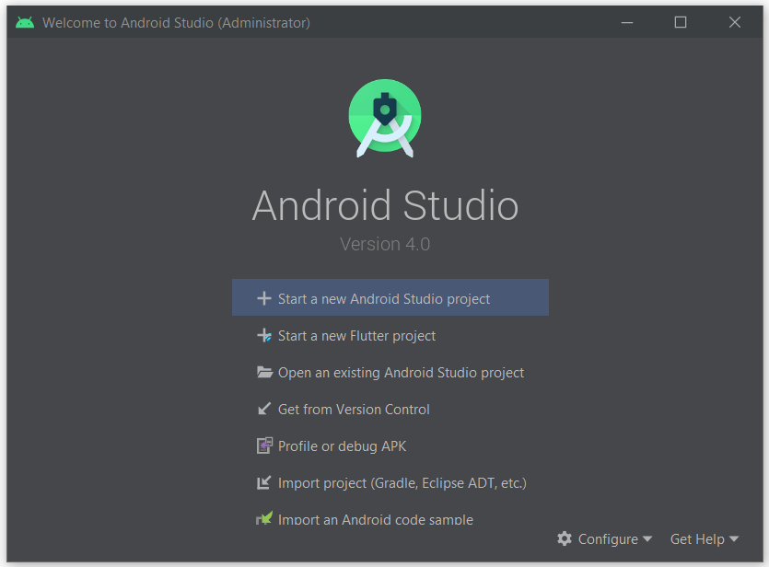
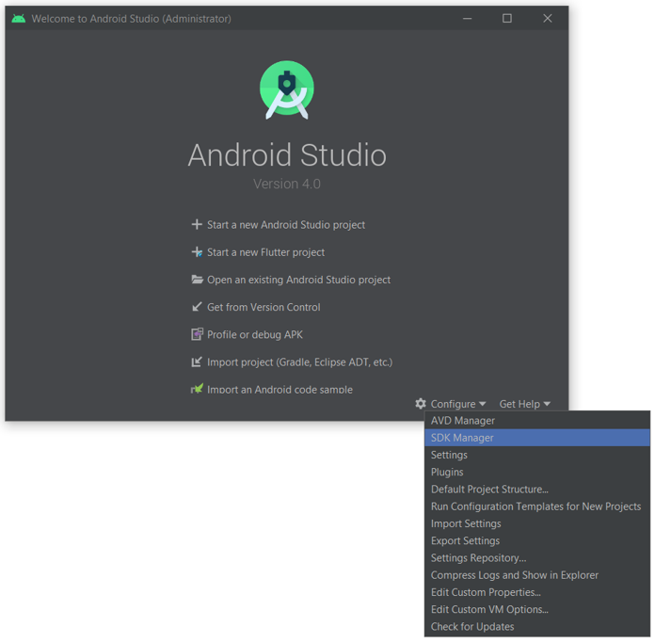

Slide 15
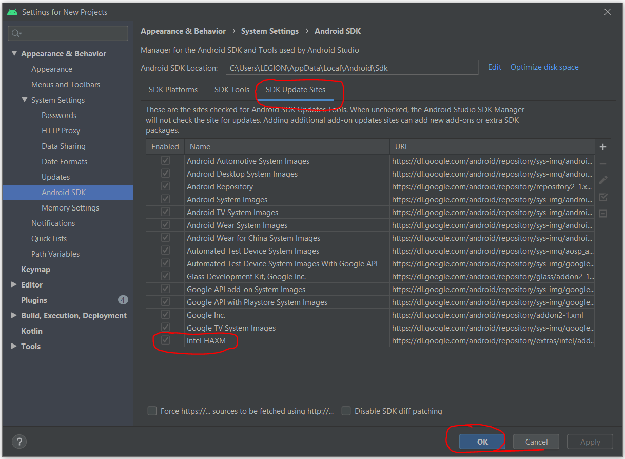
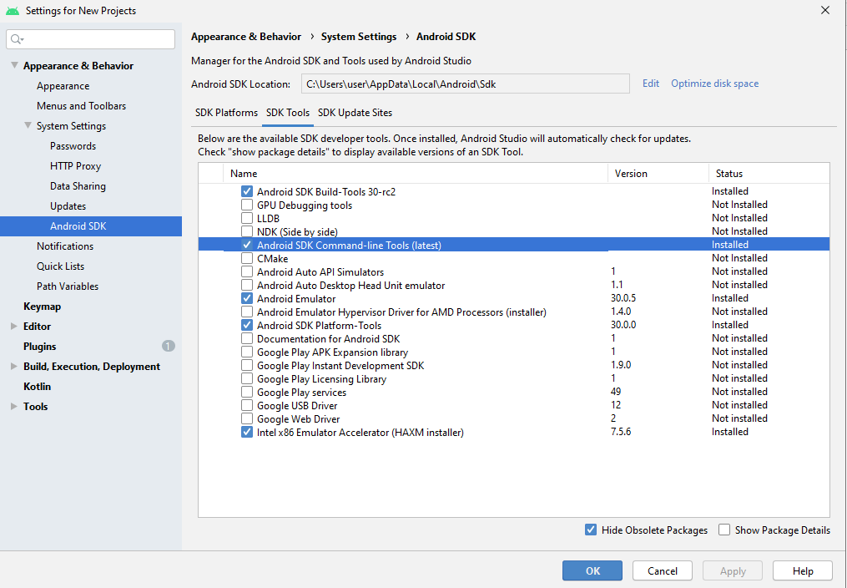
In Android Studio go to Tools -> SDK Manager.
Go to SDK Tools tab.
Select the Android SDK Command-line Tools (latest) and download by pressing Apply.

Slide 16
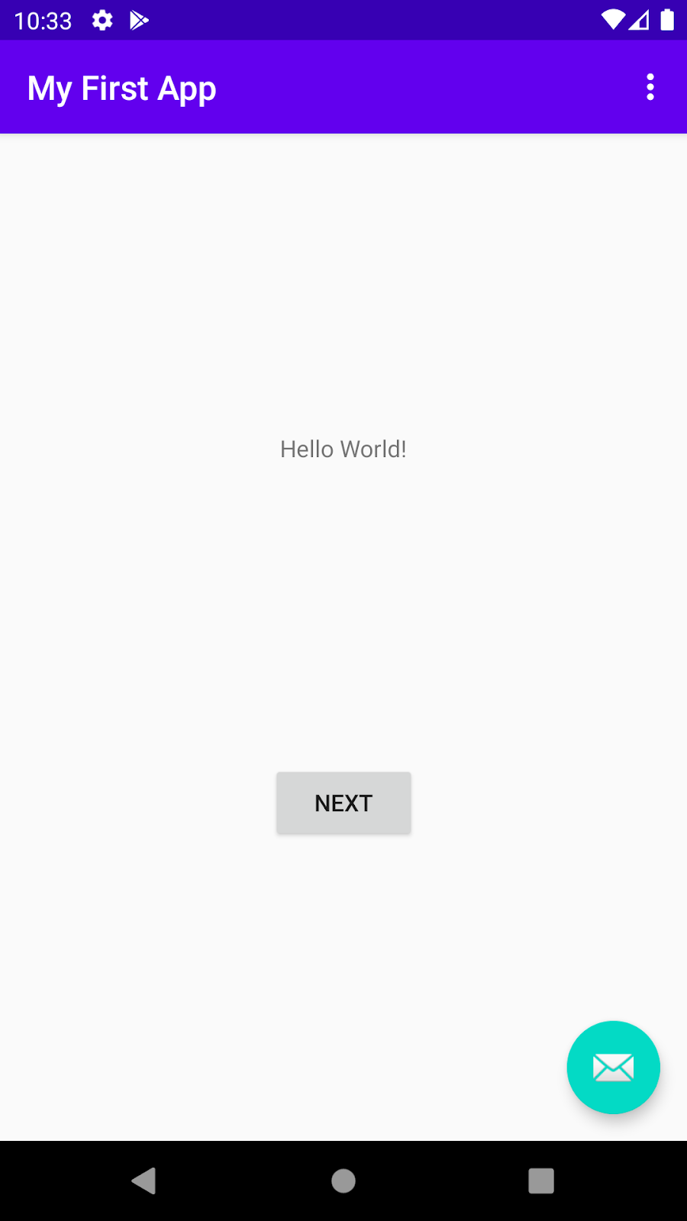
Practice#1: Create one “Hello World” Project
This simple app displays the string "Hello World" on the screen of an Android virtual or physical device. Here's what the finished app will look like:

Slide 17
Procedure:
Creating a new project
Device Targets, SDK, and Android Version
Exploring the code and running the app
Device selection
Setting up the virtual device
Launching the “Hello World” app.

Slide 18
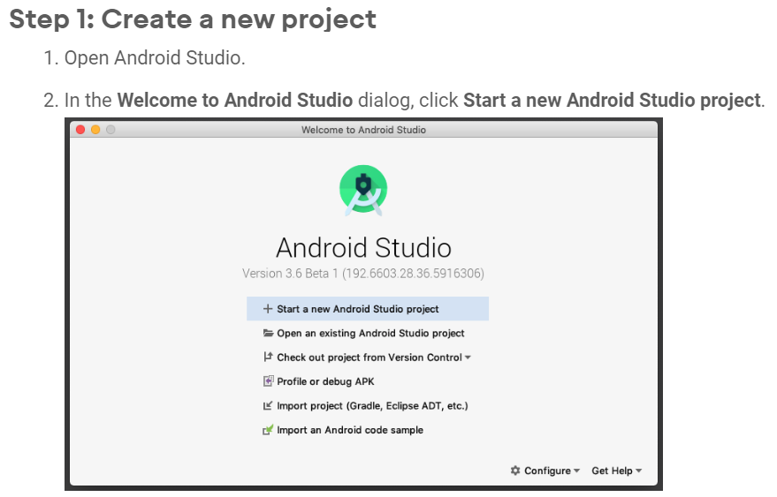
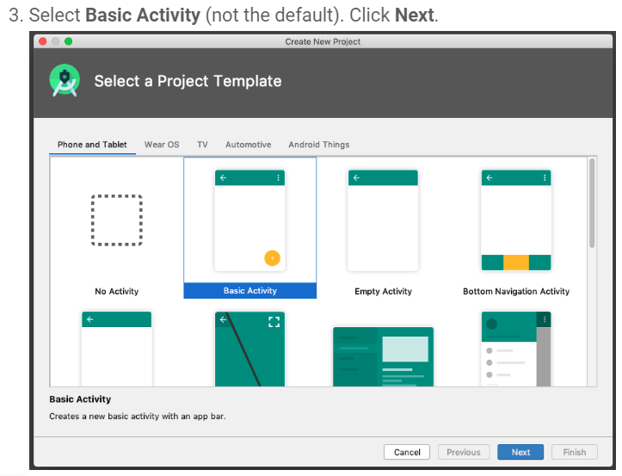

Slide 19
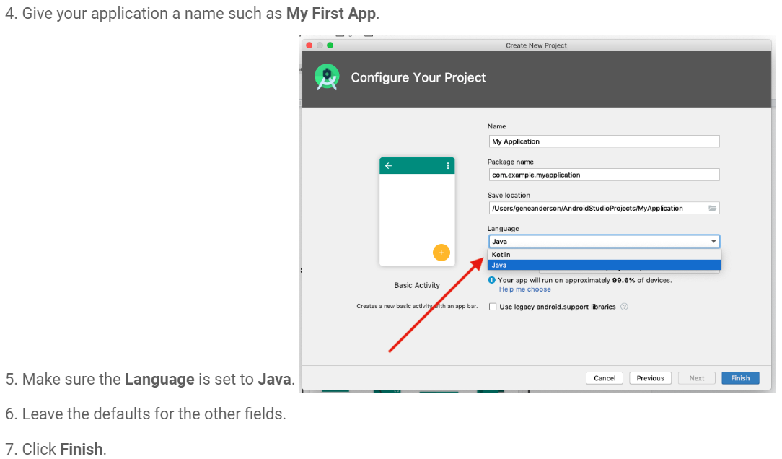

Slide 20
The Android SDK is a software development kit that includes a comprehensive set of development tools. These include a debugger, libraries, a handset emulator based on QEMU, documentation, sample code, and tutorials.
Android Studio uses Gradle, an advanced build toolkit, to automate and manage the build process while letting you define flexible, custom build configurations. Each build configuration can define its own set of code and resources while reusing the parts common to all versions of your app.

Slide 21
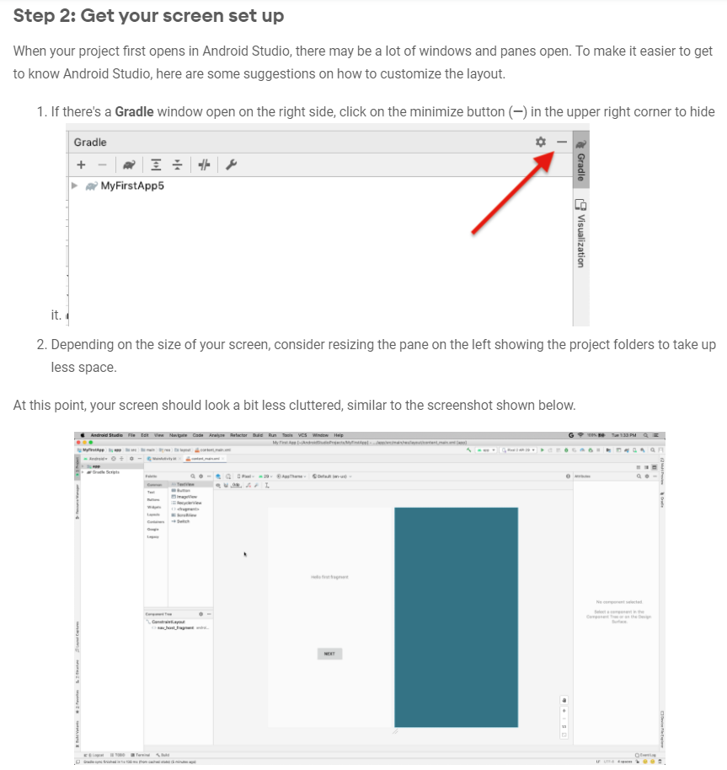

Slide 22
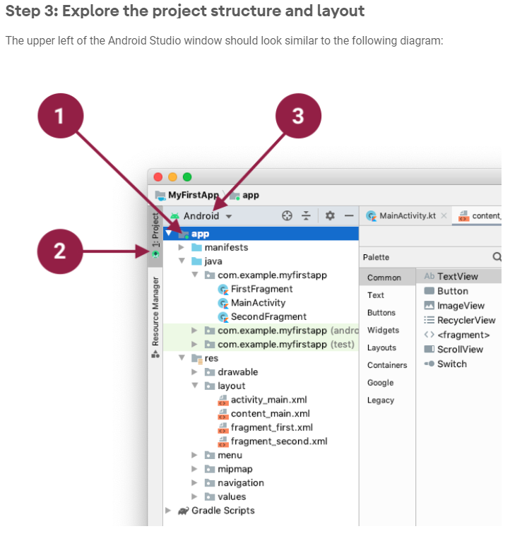

Slide 23
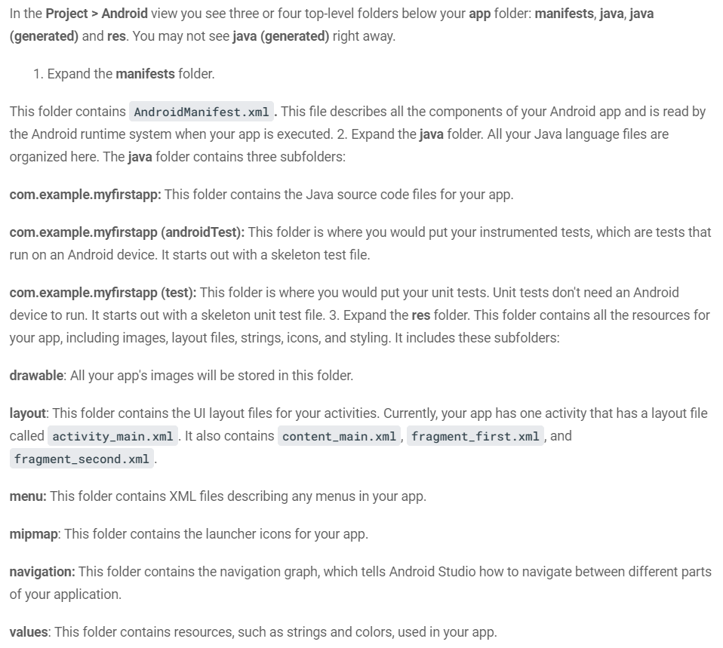

Slide 24
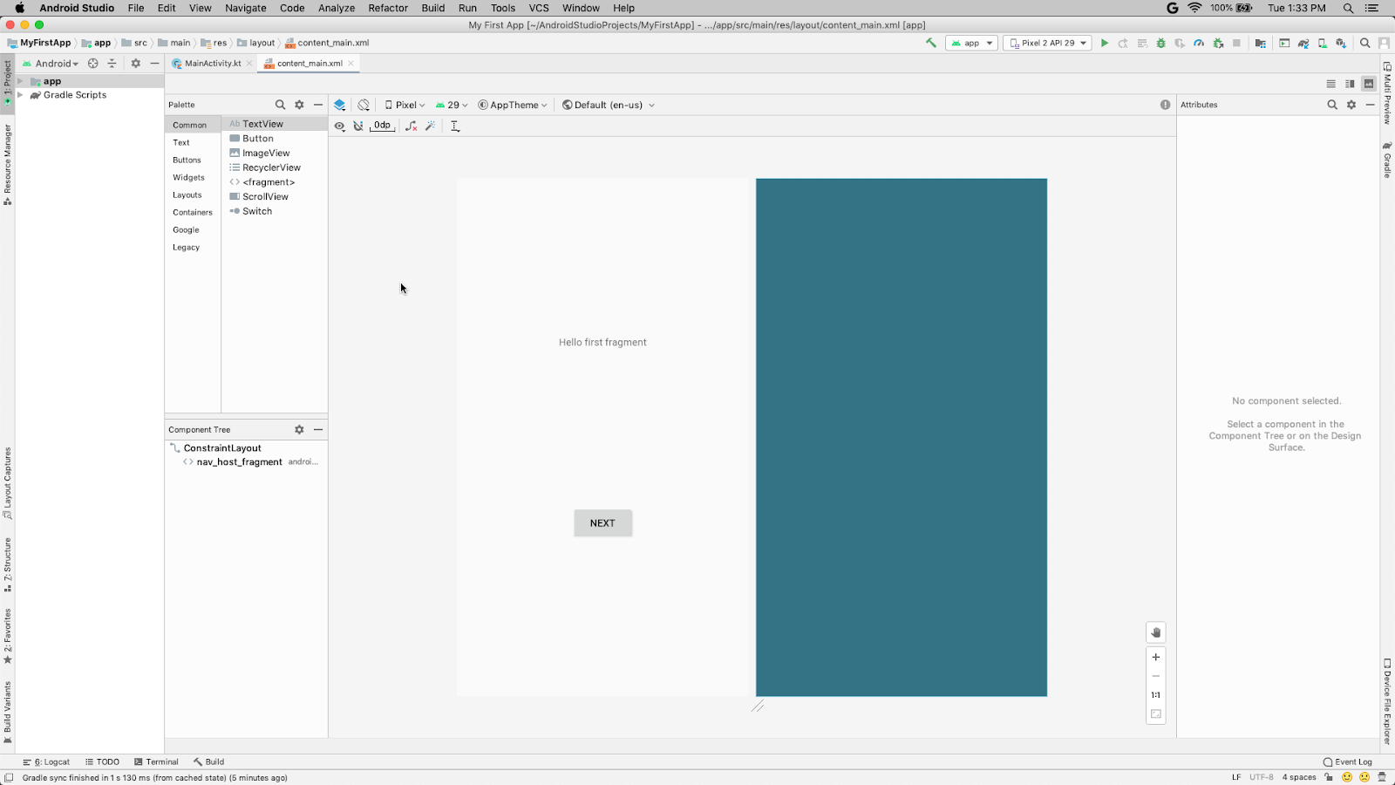

Slide 25
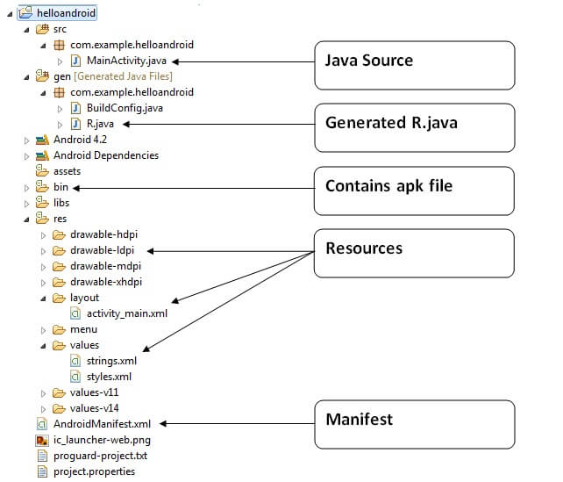
Internal Details of Hello Android Example
Android application contains different components such as java source code, string resources, images, manifest file, apk file etc. Let's understand the project structure of android application.

Slide 26
Activity is a java class that creates and default window on the screen where we can place different components such as Button, EditText, TextView, Spinner etc. It provides life cycle methods for activity such as onCreate, onStop, OnResume etc.
The onCreate method is called when Activity class is first created.
The setContentView(R.layout.activity_main) gives information about our layout resource. Here, our layout resources are defined in activity_main.xml file.

Slide 27
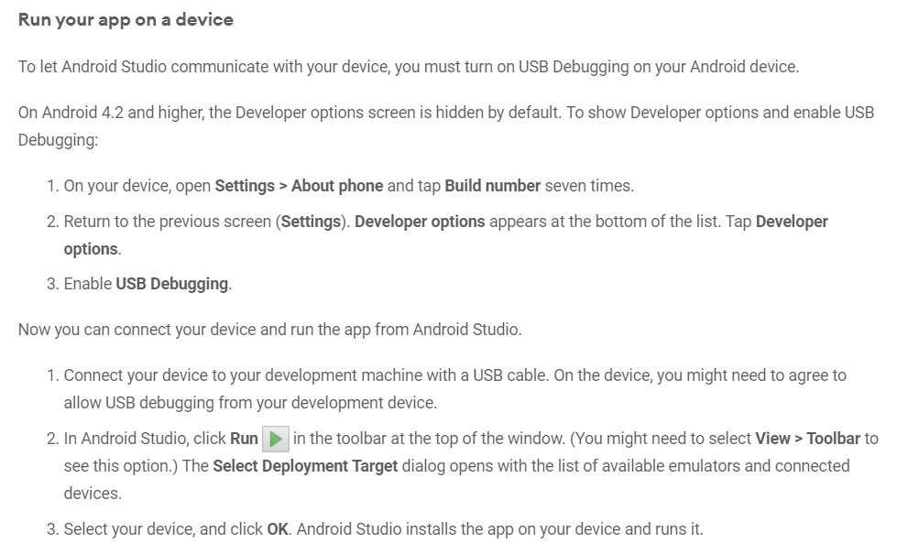

Slide 28
Troubleshooting
If you're stuck, quit Android Studio and restart it.
If Android Studio does not recognize your device, try the following:
Disconnect your device from your development machine and reconnect it.
Restart Android Studio.
If your computer still does not find the device or declares it "unauthorized":
Disconnect the device.
On the device, open Settings->Developer Options.
Tap Revoke USB Debugging authorizations.
Reconnect the device to your computer.
When prompted, grant authorizations.
If you are still having trouble, check that you installed the appropriate USB driver for your device. See the Using Hardware Devices documentation.

Slide 29
REFERENCES:
https://www.javatpoint.com/internal-details-of-hello-android-example

