Slide 1
Module-VII: Understand & Implement SQLite database
By,
Dr. DHAWALESWAR RAO

Slide 2
- A database is an organized collection of data stored and accessed electronically. Small databases can be stored on a file system, while large databases are hosted on computer clusters or cloud storage.
The relational model (RM) is an approach to managing data using a structure. A relational database is a (most commonly digital) database based on the relational model of data.
A system used to maintain relational databases is a relational database management system (RDBMS). Many relational database systems are equipped with the option of using SQL (Structured Query Language) for querying and updating the database
What is a mobile database?
Either a stationary database that can be connected to by a mobile computing device over a mobile network, or a database which is actually stored by the mobile device.
Why use a mobile database?
There are some advantages associated with using a mobile database:
Full offline modules for apps that depend on stored data
Enough on bandwidth for apps that depend on stored data
Stable and predictable performance independent from network availability
(personal data can be stored with the user, where some say they belong)

Slide 3
What are the advantages and disadvantages of working with SQLite?
SQLite provides features to create, read, update and delete records in the database. It stores the records in the form of text files locally on your device. It allows you to run several queries and enable you to access multiple records at a time. Searching for a record in an SQLite database is relatively fast and efficient.
Advantages
Toolchain, e.g. DB browser
No dependencies, is included with Android and iOS
Developers can define exactly the data schema they want
Developers have full control, e.g. handwritten SQL queries
SQL is a powerful and established query language, and SQLite supports most of it
Debuggable data: developers can grab the database file and analyze it
SQLite alternatives
Oracle Database Lite
SQL Anywhere
SQL Server Compact
InterBase ToGo / IBLite
Azure SQL Edge
LevelDB, LiteDB
Mongo Realm
ObjectBox

Slide 4
Architectural Difference – SQLite
• SQLite is an open source project which can be found in the public domain.
- SQLite is a server-less database and also, self-contained. Sometimes it is referred to as an embedded database which means the DB engine runs as a part of the app.
Data Type Support – SQLite
SQLite assists datatypes such as Blob, Integer, Null, Text, Real.
MySQL assists datatypes such as:
Tinyint, Smallint, Mediumint, Int, Bigint, Double, Float, Real, Decimal, Double precision, Numeric, Timestamp, Date, Datetime, Char, Varchar, Year, Tinytext, Tinyblob, Blob, Text, MediumBlob, MediumText, Enum, Set, Longblob, Longtext.
This shows that MySQL is highly flexible when it comes to data types.
SQLite is used as a on-device data store while MySQL would be used in conjunction with some sort of web API that has been built for you Android application.

Slide 5
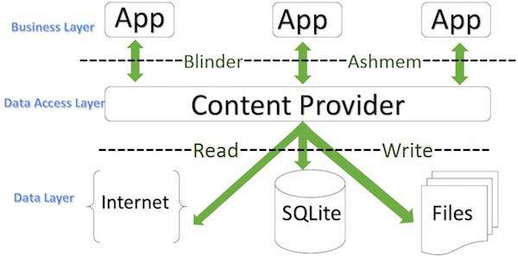
- A content provider component supplies data from one application to others on request. Such requests are handled by the methods of the ContentResolver class. A content provider can use different ways to store its data and the data can be stored in a database, in files, or even over a network.
- sometimes it is required to share data across applications. This is where content providers become very useful.

Slide 6
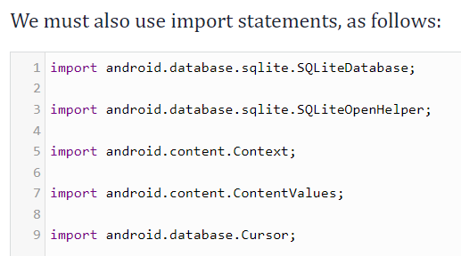

Slide 7
Create Content Provider
This involves number of simple steps to create your own content provider.
First of all you need to create a Content Provider class that extends the ContentProviderbaseclass.
Second, you need to define your content provider URI address which will be used to access the content.
Next you will need to create your own database to keep the content. Usually, Android uses SQLite database and framework needs to override onCreate() method which will use SQLite Open Helper method to create or open the provider's database. When your application is launched, the onCreate() handler of each of its Content Providers is called on the main application thread.
Next you will have to implement Content Provider queries to perform different database specific operations.
Finally register your Content Provider in your activity file using <provider> tag.

Slide 8
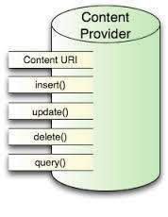
Here is the list of methods which you need to override in Content Provider class to have your Content Provider working −
ContentProvider
onCreate() This method is called when the provider is started.
query() This method receives a request from a client. The result is returned as a Cursor object.
insert()This method inserts a new record into the content provider.
delete() This method deletes an existing record from the content provider.
update() This method updates an existing record from the content provider.
getType() This method returns the MIME type of the data at the given URI.

Slide 9
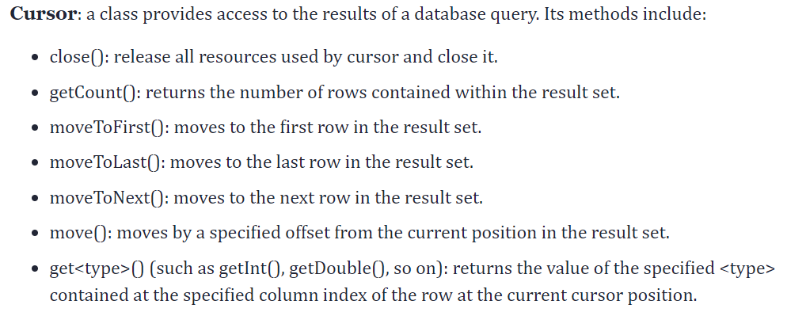
Android SQLite Java Classes

Slide 11
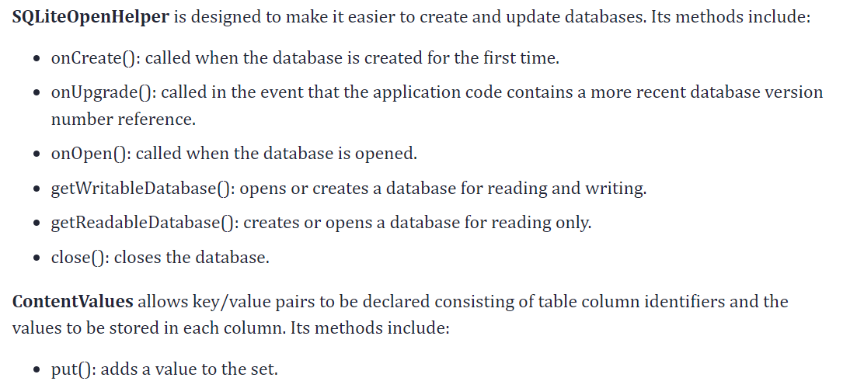

Slide 12
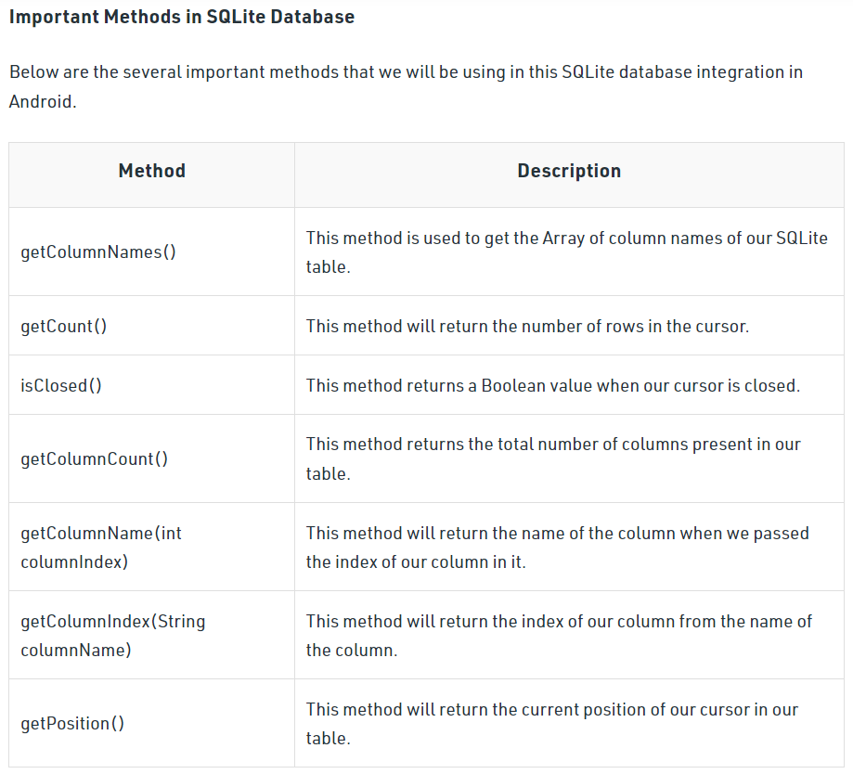

Slide 13
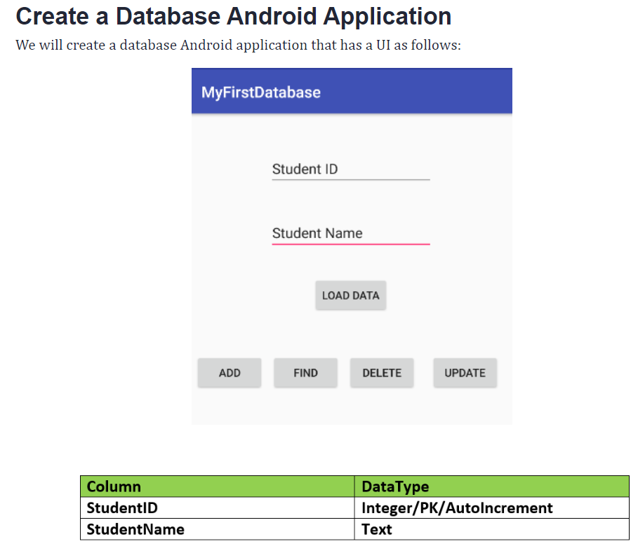

Slide 14
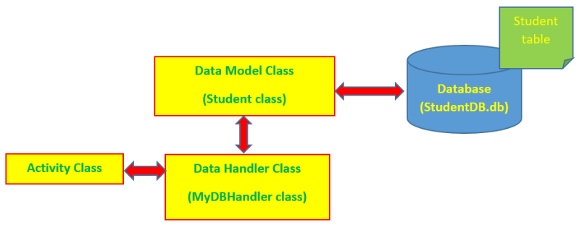
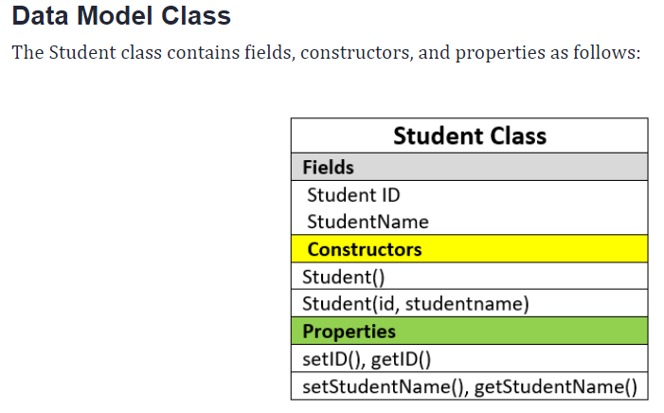
The application will consist of an activity and a database handler class (MyDBHandler class). The database handler will be a subclass of SQLiteOpenHelper and will provide an abstract layer between the underlying SQLite database and the activity class. A third class (Student class) will need to be implemented to hold the database entry data as it is passed between the activity and the handler. My application model can be shown in the following figure:

Slide 15
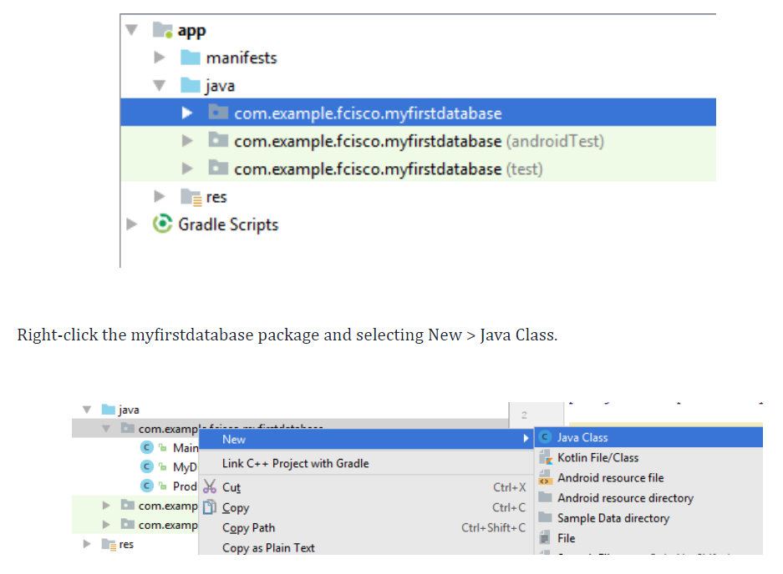
Type Student in the Name item, maintain the default options

Slide 16
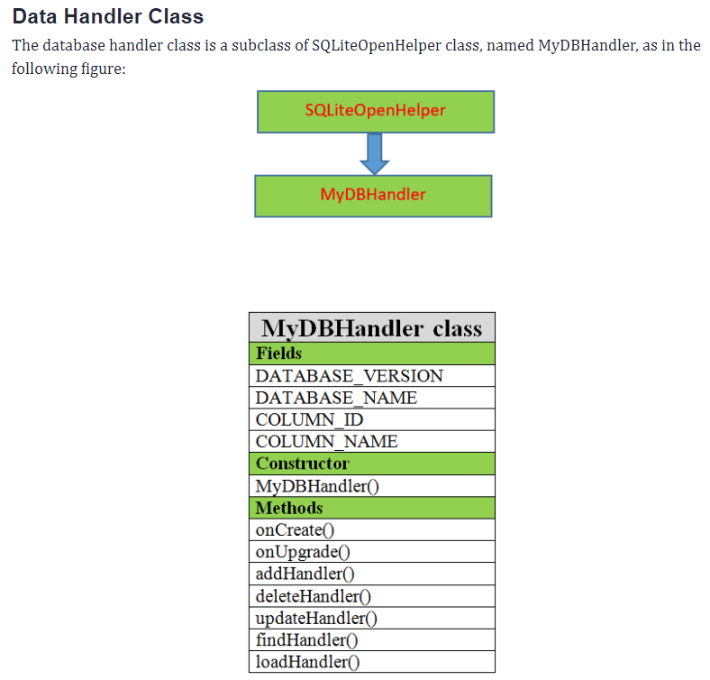

Slide 17
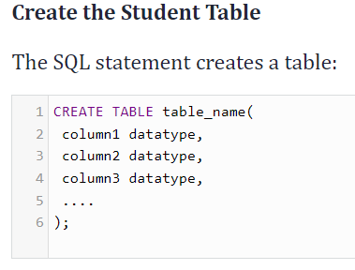
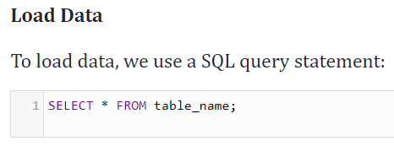

Slide 19
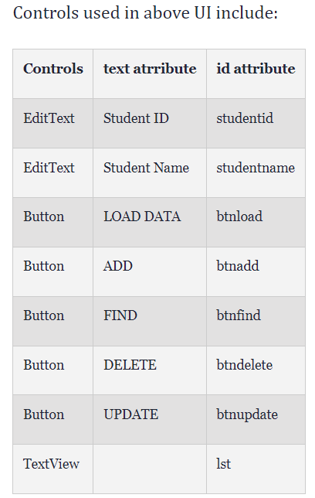
Main Activity
So far, let’s look at our application model again:

Slide 20
REFERENCE
https://www.geeksforgeeks.org/how-to-create-and-add-data-to-sqlite-database-in-android/
https://www.geeksforgeeks.org/how-to-view-and-locate-sqlite-database-in-android-studio/
SELECT * FROM sqlite_master;
https://dzone.com/articles/create-a-database-android-application-in-android-s
https://aboutreact.com/see-saved-data-of-the-sqlite-database-in-device/

