Slide 1
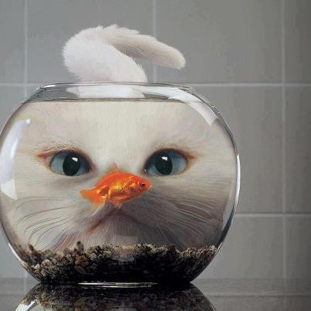














Slide 2

Water salinity based on dissolved salts in parts per thousand (ppt)
Fresh water
<0.5
Brackish water 0.5–30
Saline water
30–50
Brackish water is water that has more salinity than fresh water, but not as much as seawater.
In estuaries it result from mixing of seawater with fresh water.

Slide 3

Brackish water fish farming is a system of aquaculture that focuses on the production of quality fin and shell fish that are found in the creeks, lagoons, and estuaries.
In India, traditional system of brackishwater aquaculture is in vogue since time immemorial in West Bengal (Bheris) and Kerala (Pokkalifields).
Present day traditional systems
Bheris of West Bengal & Orissa
Kharlands (Ghazani) of Karnataka
Khazan fields of Goa

Slide 4

Cultivable Brackishwater Finfishes
Grey mullet (Mugil cephalus) Milk fish (Chanos chanos)
Pearl spot (Etroplus suratensis )

Slide 5
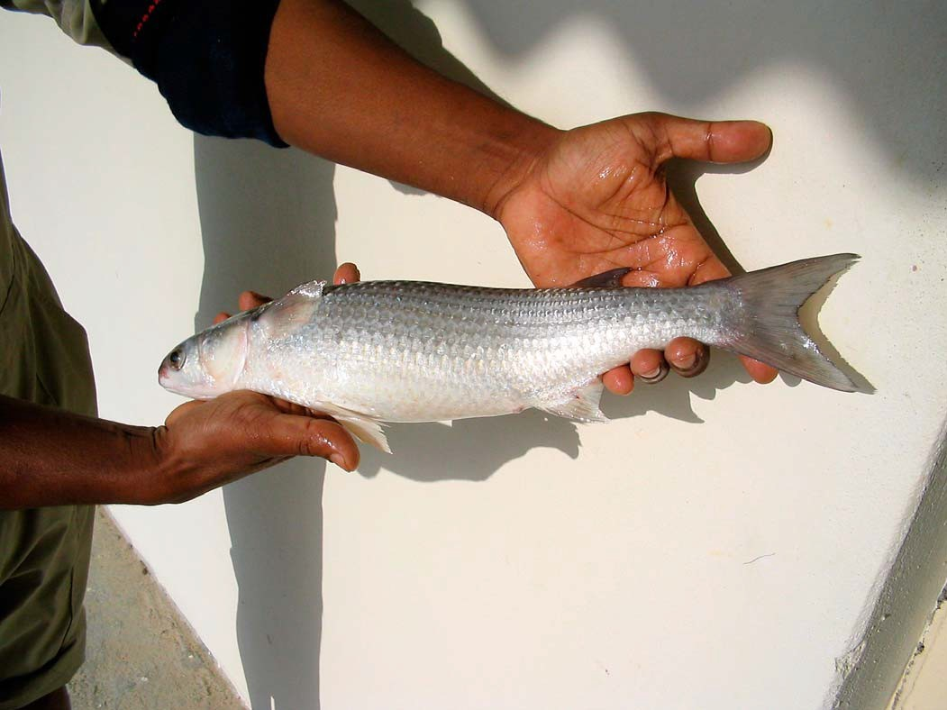
Grey mullet
(Mugil cephalus)

Slide 6
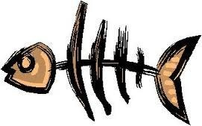
Fast growth rate & comparatively large size.
Fry & fingerlings of M.cephalus not as abuntantly available as of other species.
In India mullets are cultured in combination with milk fish,pearlspot and other estuarine species.

Slide 7

Fry Collection

Slide 8
Seines & dipnets.
Acclimatize the fry.
Or directly transfer to production ponds after brief period of conditioning.
If fry are to be transported long distances,it is advisable to condition them for a day.

Slide 9
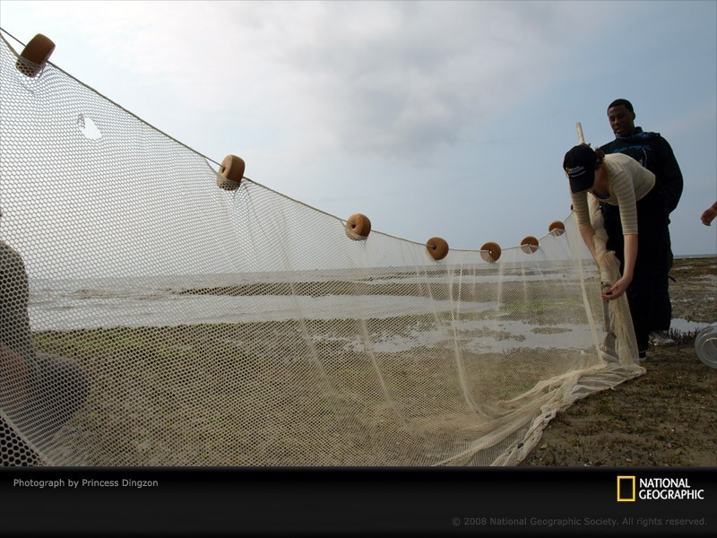
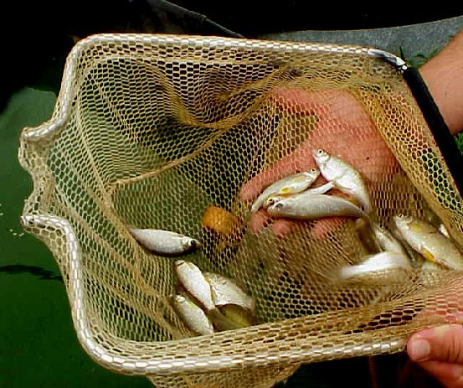
Seines & dipnets.

Slide 10
Artificial propagation

Slide 11
Artificial propagation
Grey mullets do not breed in confined waters
Induced breeding by administration of pituitary extracts or gonadotropins.
After rinsing in sea water ,fertilized eggs are transferred to incubators.
Hatchlings are fed with brine shrimp & zooplankton
Larvae grow to fry stage in about a month.

Slide 12
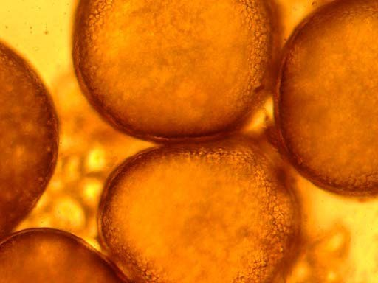
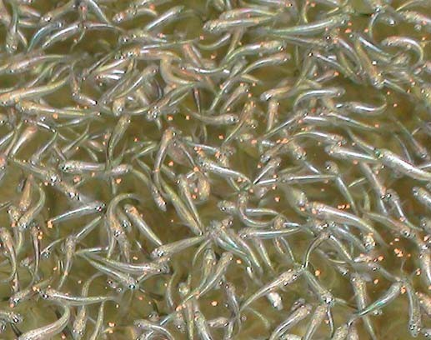
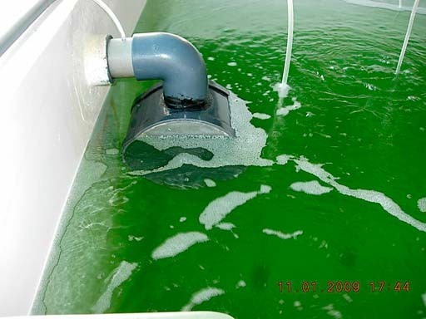
mullet oocytes
Postlarval mullet in the rearing tanks.
Outlet screen fixed to the larval rearing tank

Slide 13
Grow out

Slide 14
 Mono culture of mullets is seldom practised.
 Mullets form a constituent of stocks in milkfish farms of southeast asia although many farmers consider mullets to be incompatible with milk fish.Mullets seldom constitute more than 10% of stock in such ponds.
 Mullets are reared in polyculture with common carp,silver carp & tilapia.

Slide 15
 Fry mullets are collected from coastal waters.
 Grown in nursery ponds to a wt of about 1-2g for stocking in polyculture ponds.
 Fry of this size are stocked at rate of 5000/ha,where total stocking density is 12300/ha (3000 common carp,300 silver carp &4000 tilapia).
 Mullet reaches around 100g in wt in about 4 months & about 200g by the end of year.

Slide 16
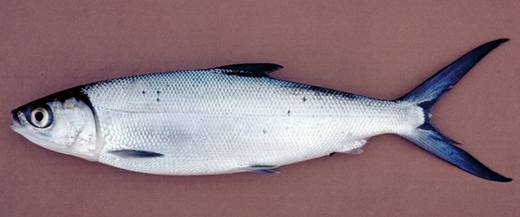




Slide 17

 One of the most ideal finfishes for farming in coastal areas.
 Fast growing, tolerates a wide range of temperature, oxygen and salinity.
 Feed mostly on filamentous algae from the bottom of the pond.
 Free from major diseases and parasites.

Slide 18

 Milkfish are cultured in large scales in countries like Indonesia, Philippines and Taiwan in ponds called “Tambak”.
 In India too the popularity of its farming is growing especially in Tamil Nadu and Kerala

Slide 19
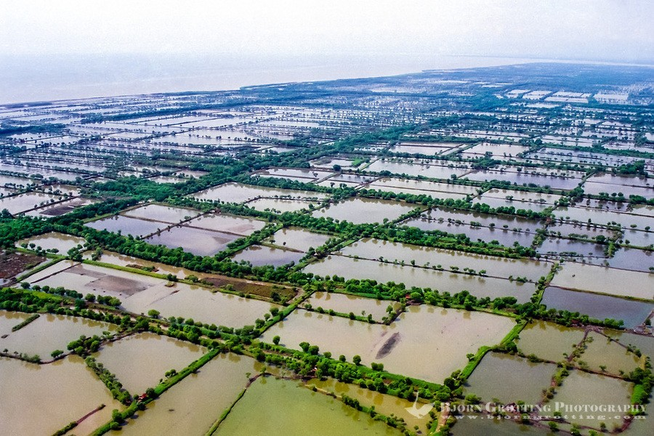

Slide 20
Seed Collection

Slide 21
Seed Collection
 Seeds are collected from natural sources.
 The main fry season extends from March to June.
 The seeds are collected using scoop nets, dip nets and hand nets. In estuaries and lagoons, drag nets or seine nets may be used.
 Soon after collected the seeds are conditioned by keeping in a limited volume of clear water for a definite period .
 Seeds are transported in containers with diluted seawater of 10-15 ppt salinity and at a rate of about 100 fry/L.

Slide 22
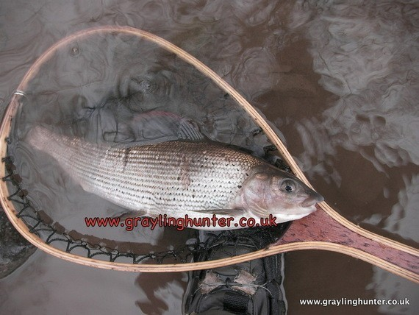
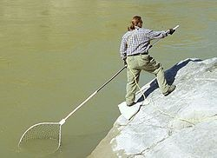
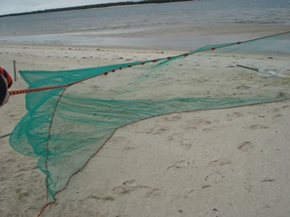
hand net
scoop net
drag net

Slide 23
Nursery Rearing

Slide 24
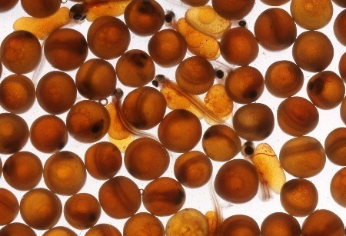
Nursery Rearing
 Nurseries are ponds for rearing the fry until they attain 5-7 cm in length.
 The area of nursery ponds ranges from 500 to 5,000 m2.
 At the nursery site the fry are acclimatized to the salinity of the pond water.

Slide 25
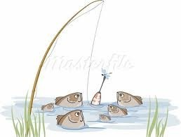
Preparation of pond for stocking
 The ponds are drained and dried for about 10 to 15 days and later tilled and raked.
 Lime is added @ 1000 kg/ha and water is let in.
 Pond water is fertilized with organic and inorganic fertilizers.

Slide 26
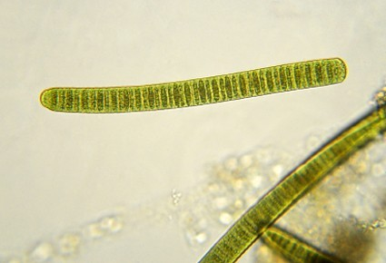
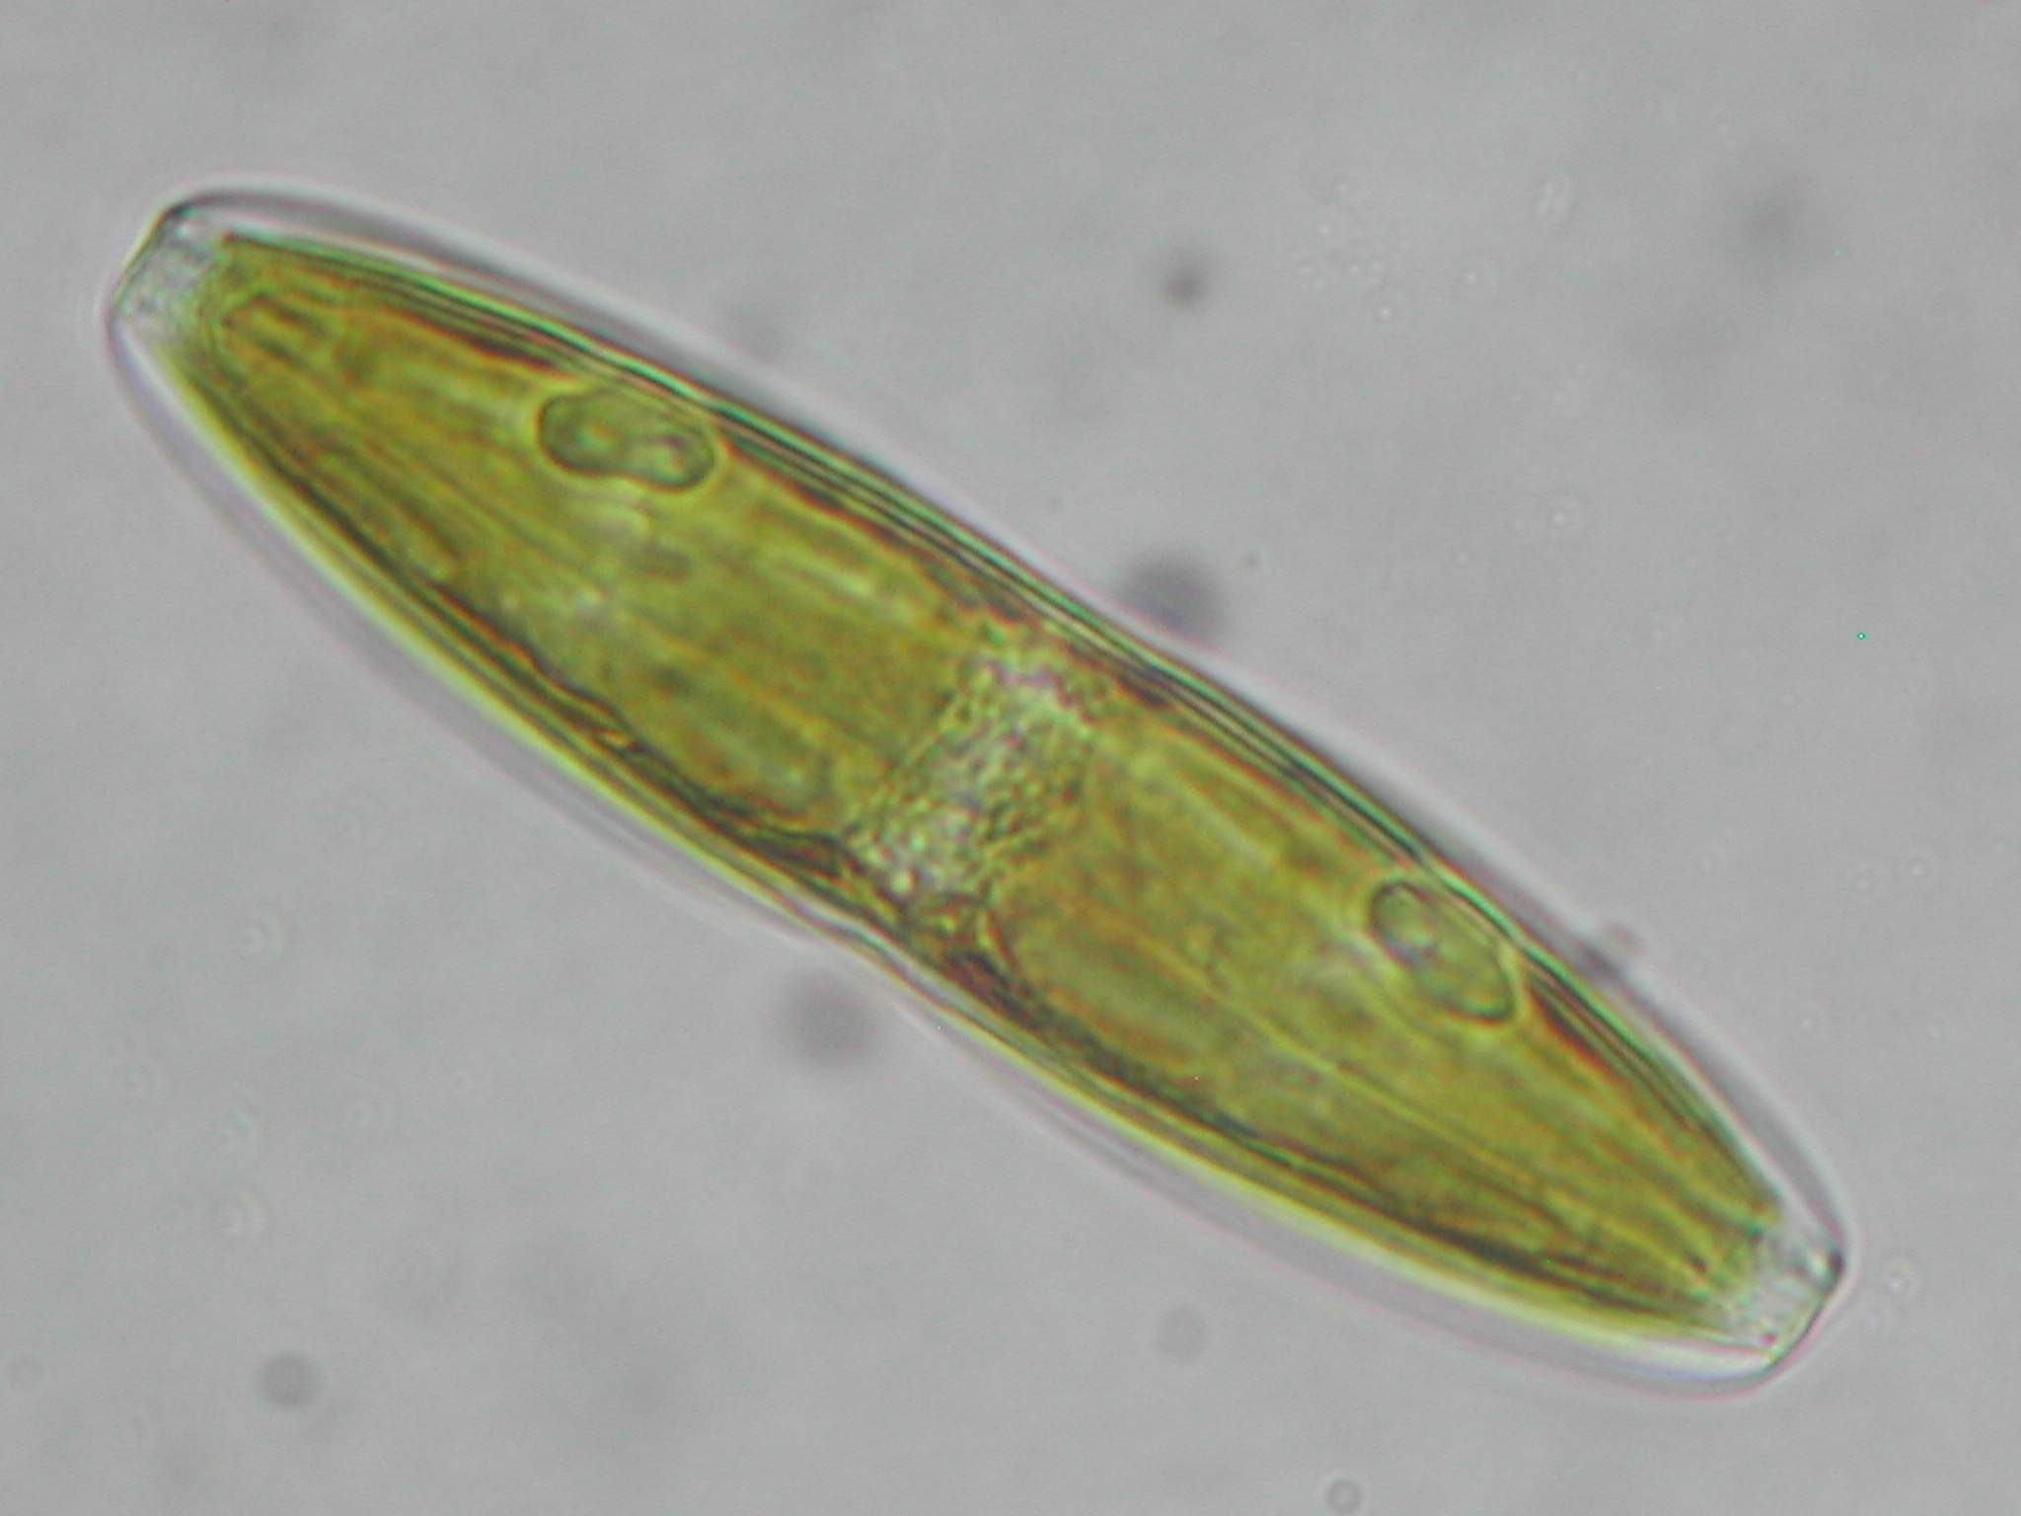
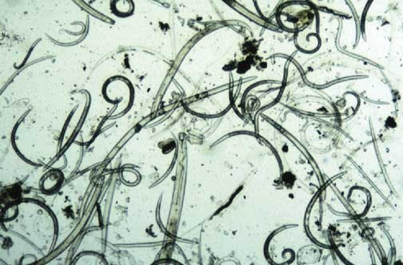
 Within 3-7 days, a complex of blue green algae, diatom, bacteria, nematode worms develop at the bottom of the pond called “Lab-Lab”. This algal consortium is most vital for developing frys of milkfish.
 The threat of predatory fishes, crabs and snakes can be screened from entering the pond using nets. Erecting poles along the embankments and crisscrossing with strings can discourage predatory birds.

Slide 27
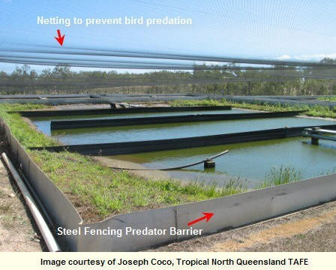

Slide 28
Pond Management

Slide 29
Pond Management
Farming in earthen ponds
The production pond ranges from 0.5 ha to 3 ha in area and are rectangular in shape, with water depth ranging from 0.3 to 0.7 m.
P.M similar to those practiced in nursery pond viz., draining of the water, drying, tilling, leveling and raking.
Manuring of the ponds is always carried out. Usually, green manure is used, such as leaves and twigs of mangrove plants, rice straw, copra, rice bran, oilcakes, pig manure, chicken manure etc.

Slide 30
Beside organic manure, inorganic fertilizers containing nitrates, phosphates and potassium (NPK) such as superphosphates, triple superphosphates, urea etc may also be applied .
Within two weeks the algal-periphyton complex (Lab-lab) develops at the pond bottom. Stocking in earthen pond follows only after the growth of Lab-lab.
Usually fingerlings of 7 to 15 cm length are stocked at a rate of 2,000 to 10,000 per ha.

Slide 31
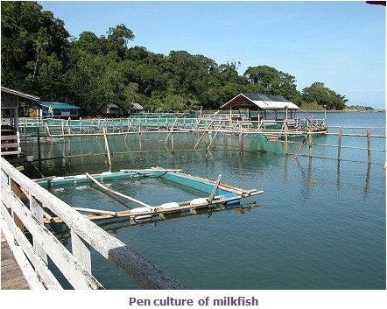
Farming in pens

Slide 32
Constructed in shallow natural creeks, swamps, lagoons, lakes and bays, ranging in depth from 1 to 3 m.
The bottom in pen culture sites should be of firm clay or mud so that poles and posts can be driven sufficiently deep to make them support the pen structure.
Traditionally pens are made up of wooden planks, split bamboo etc. But in recent times, nets materials made of synthetic materials such as nylon, polypropylene, polythene etc are used.

Slide 33
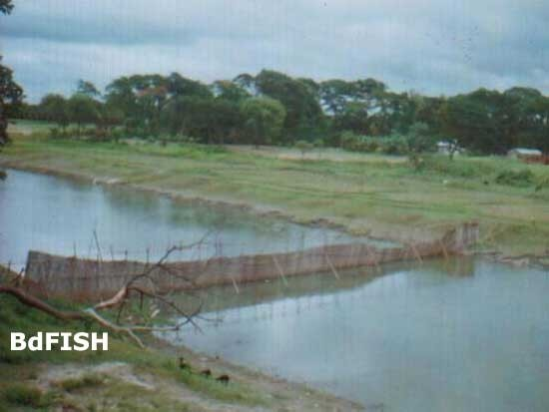
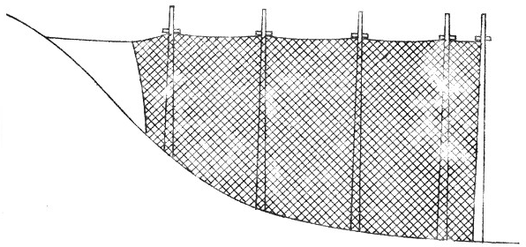
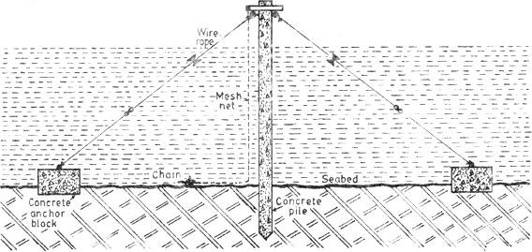
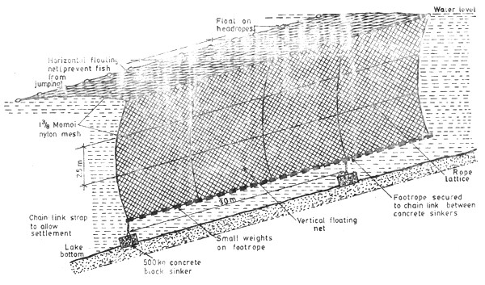

Slide 34
A part of the vertical net barrier is buried inside the mud or ground with the aid of a footrope and small weights.
At the upper level, floats are provided.
Fingerlings stocked in usually feed upon the natural food and no artificial food is provided.

Slide 35
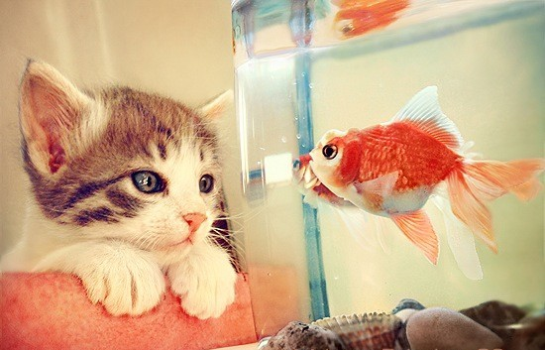

Harvesting

Slide 36
Harvesting
Milkfish has a higher growth rate in its first year in brackishwater, during when it grows to a marketable size of 30-45 cm long and 300-800 gm in weight.
During harvesting the pond is drained using pumps, while in the case of pens, the lowest tidal period is the best time for harvest. If trenches were provided in culture ponds, it would be easier to gather all the fish inside the trenches by draining the water and then capturing them.

Slide 37
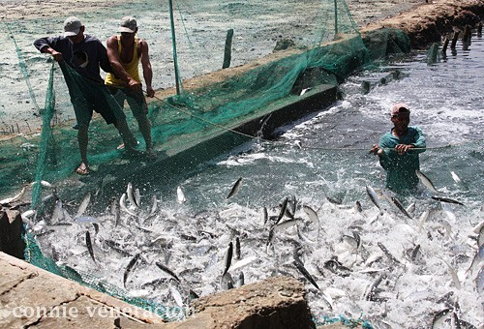

Slide 38
Usually, seine nets are operated for capturing farmed fish.
The survival rates ranges from 80 to 95% amounting to a production ranging from 500 to 1000 kg/ha in ponds and 250 to 500 kg/ha in pens.

Slide 39
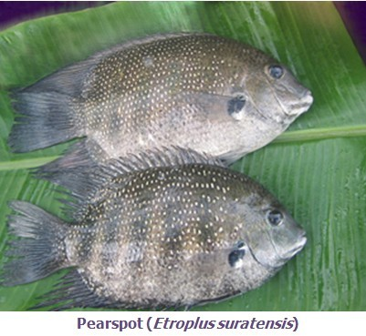
Pearl spot (Etroplus suratensis)

Slide 40



Pearl spot(Etroplus suratensis)
Commonly known as “Karimeen” in Kerala.
Cultured in both brackishwater and freshwater environments.
Though growth is slow, at a high stocking density table-size fish can be harvested in 9-12 months culture period.

Slide 41
Seed production

Slide 42
Seed available throughout the year along the east
andsouth-west coasts of India.
 Peak season of abundance - May-July and November- February.
A simple method of seed collection is adopted taking advantage of the tendency of the fish to congregate in large numbers for feeding on epiphytic growth.

Slide 43
In this method twigs or branches are kept submerged in the water a week ahead of day of collection.
Juveniles congregating for feeding trapped using an encircling net or trap.
Fecundity - low - around 3000-6000; hence a successful hatchery production of seeds is difficult.

Slide 44
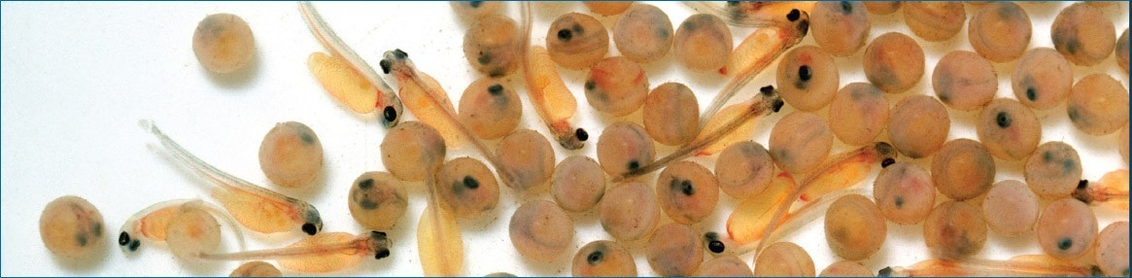
However, Central Institute of Brackishwater Aquaculture (CIBA), Chennai using the technique of environmental manipulation, has successfully demonstrated the hatchery seed production of pearl spot.

Slide 45
Pond preparation

Slide 46
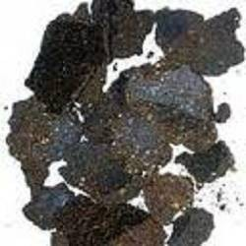
Before letting in water, the ponds are drained and lime is applied at the rate of 300 kg/ha.
In undrainable ponds, piscicide (Mohua oil cake @ 200-250 ppm) may be used to eliminate the weed fishes .

Slide 47
After a time gap of 10-15 days for the neutralization of the residual effect of the piscicide,
water is let in through screens to avoid the entry of undesirable fishes.
The pond is filled up to the appropriate level (1.2 m) and cow dung applied at the rate of 1500-2000 kg/ha
for promoting plankton production.

Slide 48
Acclimatization and stocking of breeders

Slide 49
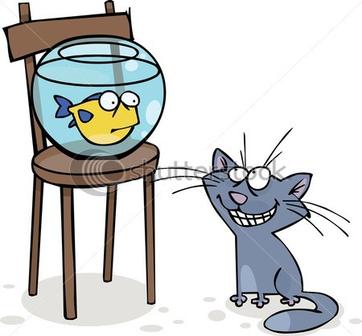
Adult Etroplus - weight range - 50-125 g - procured from the wild or culture ponds - stocked @ 5000/ha after one week of fertilization of the pond.
Disinfected by dipping in 1% commercial formalin and acclimatised .

Slide 50
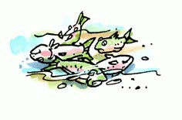
Additional breeders added from the second year onwards to compensate the natural mortality of breeders.
Breeders once stocked will be normally viable for three years.

Slide 51
Provision of spawning surfaces

Slide 52
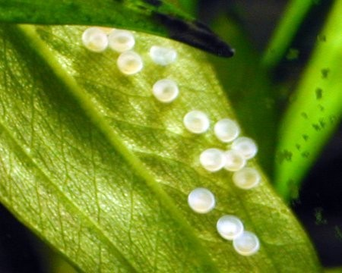
In the natural environment the fish attaches its eggs to submerged substrata like stones, aquatic plants etc.
As a prepared pond may not have such natural spawning surfaces, materials like palmyrah leaves tied in bunches to fixed poles, coconut leaf petioles, coconut husks, pieces of asbestos sheets etc., have to be provided in the ponds.

Slide 53
Water quality monitoring and management

Slide 54
Water quality parameters like
salinity (15-30 ppt),
dissolved oxygen (>3.5 ppm),
pH (7-8), temperature (24-32°C), transparency (>50 cm)
ammonia (<1 ppm) have to be maintained.
Optimum water level in the pond is 1.2 m.
The loss of water due to seepage and evaporation is to be compensated by pumping in water.

Slide 55
Feeding

Slide 56

Feeding of the breeders has to be initiated within 3-4 days after stocking
• .
•
groundnut oil cake 40% + rice bran 45% + fish meal 15% + vitamin and mineral mix (@ 2.5 kg per 100 kg feed)
supplied daily either in pelleted or in dough form.
supplied in feeding trays kept at the bottom of the pond. The feeding trays should be examined daily and cleaned outside the pond.

Slide 57
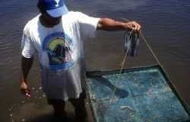
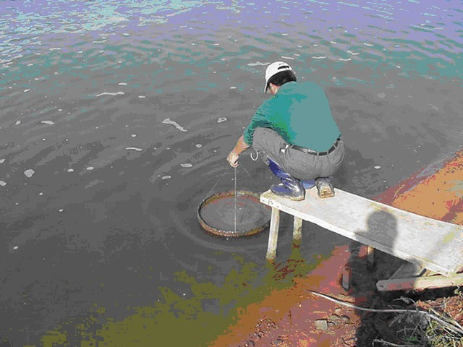

Slide 58

The quantity of the feed can be reduced whenever left-over feed is present in the trays, to avoid wastage and water pollution.
The presence of hatchlings indicates that the pond is to be manured with cow dung @ 500 kg/ha for the production of plankton, which forms the food for the hatchlings.
Small quantities of the artificial feed (250- 300 g/pond of 1000 m2) also can be broadcast in powder form during early morning.

Slide 59
Grow - out culture

Slide 60
The pearlspot is suitable for culture in confined, fresh and brackishwaters
The culture of pearlspot is more economical under polyculture system especially with milkfish and mullets than under monoculture.
The fish can attain a marketable size of 120-150 g over a period of 8-10 months.
Though growth rate is relatively slow, high stocking density with low input management can yield optimum production.

Slide 61
Being a herbivorous fish it is suitable for polyculture.
Pearlspot farming could be adopted to any scale integrating with other occupations like poultry farming. The poultry droppings form good manure for natural food production in the culture ponds.

Slide 62

Breeding occurs within 30-40 days of introduction of the brooders.
A production of upto 6 lakhs fry/ha/year can be achieved.
Harvesting is usually undertaken by draining the water from the ponds and operating a seine net, cast net or a drag net for capturing the fish.

Slide 63


