Slide 1

Industrial Automation
OPC

Slide 2
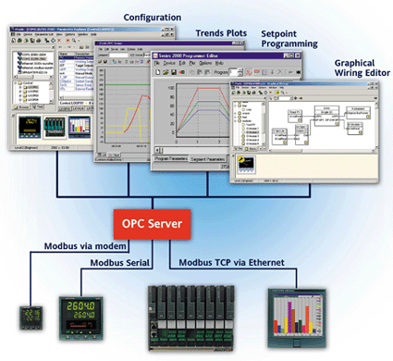
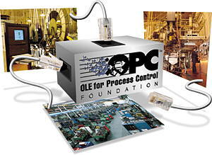
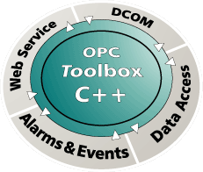
OLE for Process Control (OPC)

Slide 3
OPC Overview
OPC Common
OPC Data Access
OPC Alarms and Events Specification
OPC Historical Data Specification
Applications

Slide 4
Executive Summary
OPC is a set of standard commands collected in a software library (DLL) that can be called by client applications, written in Visual Basic, C# or other Microsoft programming languages, that allow to access automation devices (PLCs) in a uniform way, independently from their built or manufacturer.
To that effect, the particularities of the automation devices are hidden by an OPC server running either on the same machine as the client program or on another machine, by using DCOM. The OPC Servers are supplied by the manufacturer of the PLC or by 3rd parties and can manage several PLCs of the same type. Several servers can run in parallel.
The OPC library allows in particular to read and write process variables, read alarms and events and acknowledge alarms, and retrieve historical data from data bases according to several criteria.
Automation platforms such as ABB's 800XA platform act as OPC clients to collect data from PLCs or databases through third-party OPC servers. Several automation platforms act themselves as an OPC server to publish their data, events and historical data.
OPC is the preferred connectivity for 78% of MES, 75% of HMI / SCADA, 68% of DCS / PLC and 53% or ERP /Enterprise system level applications (according to Arc Advisory Group, 2004)"

Slide 5


Where is OPC in a system?
Configuration DB,
Archives,
Logfiles, etc.
Technologies
Storage
Supervision
SCADA
WAN
LAN
Process
Management
. . .
OPC
LAN
Communication
Protocols
Other systems
(LHC, Safety, ...)
Controller/
PLC
VME
FieldBus
PLC
Field
Management
Field buses
Experimental equipment
Sensors/devices
SCADA = supervisory control and data acquisition
OPC = OLE for process control
PLC = Programmable logic controller
Field buses = CAN, ProfiBus, WorldFip, ...

Slide 6
What is OPC ?
OPC (formerly: "OLE¹ for Process Control", now: "Open Process Control") is
an industry standard set up by the OPC Foundation
specifying the software interface (objects, methods) to a server that
collects data produced by field devices and programmable logic controllers.
interfaces
covered by the OPC standard
node
application
(OPC client)
servers
OPC server
X
OPC server
(simulator)
OPC server
Y
Ethernet
(not covered)
Field bus
(not covered)
PLCs Brand X
PLCs Brand Y
Sensors/Actors
1) OLE (Object Linking and Embedding) is a Microsoft technology for connecting software components.
It has since been extended by the COM / DCOM technology. It corresponds to Java Beans.

Slide 7
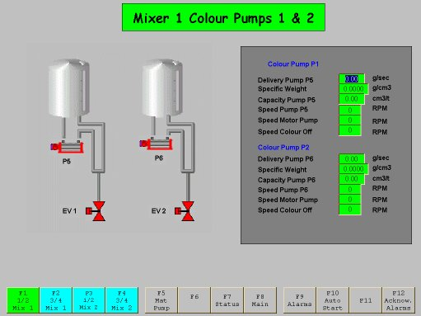
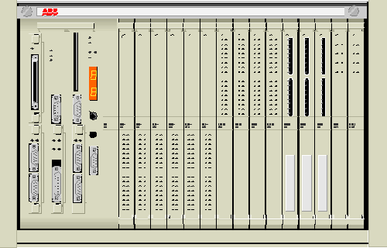

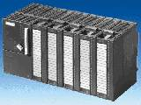
Before OPC
visualization
history
data base
MasterBus
MMS driver
Profinet
driver
XWAY
driver
ABB PLCs
Télémécanique PLCs
Siemens PLCs

Slide 8
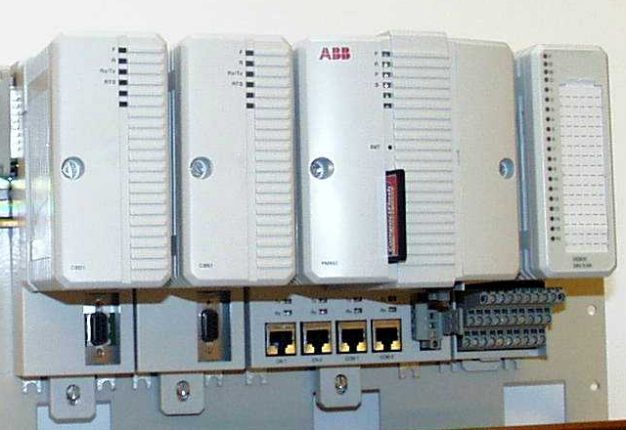
With OPC: ABB Operator Workplace Connection
Operator^{IT}
Historian
(Information Manager)
application software is written independently from the type of controller
the drivers still exist,
but the clients do not
see them anymore
AC800M
OPC server
Schneider
OPC server
Siemens
OPC server
MMS
XWAY
ProfiNet
ABB AC800M
Télémécanique TSX
Siemens S7

Slide 9
The main OPC Specifications
OPC
Batch
OPC
HDA
batch
system
history
data base
OPC
DX
OPC
Data Access
OPC
Alarms & Events
OPC
UA

Slide 10
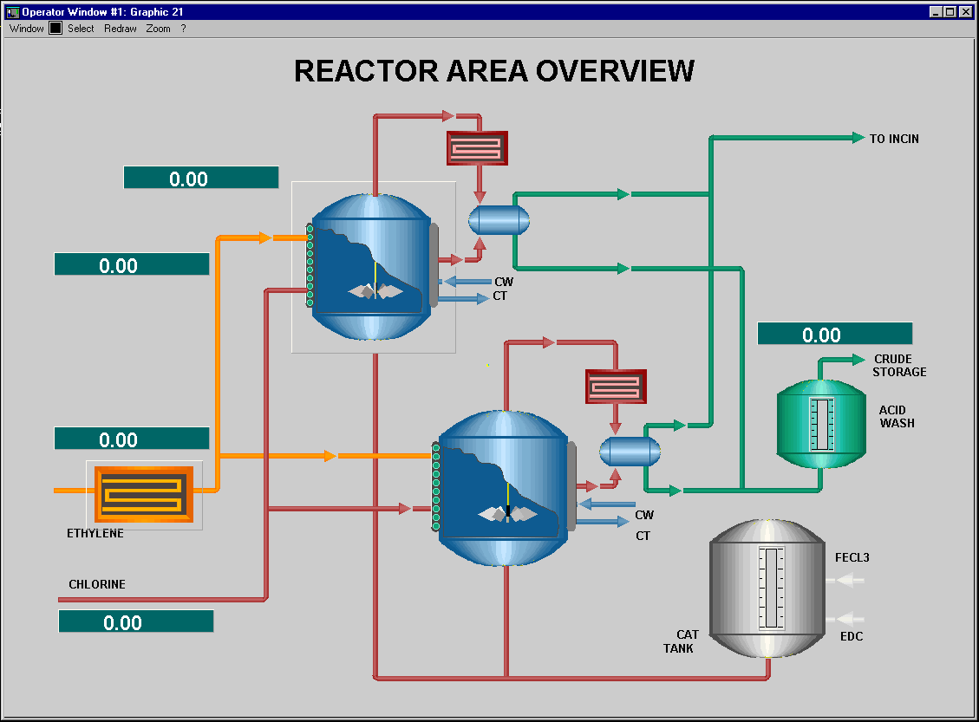
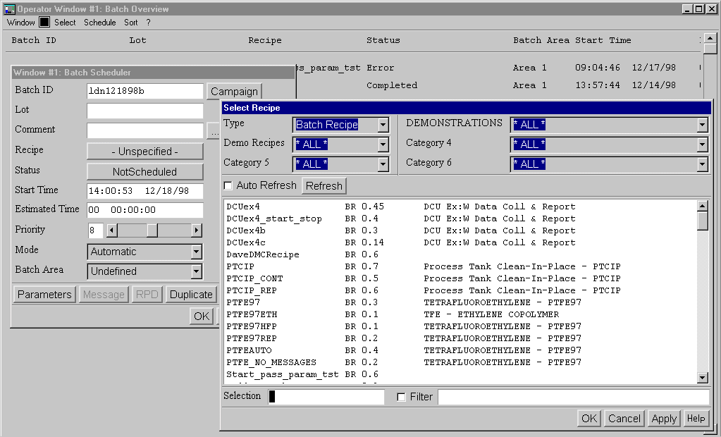
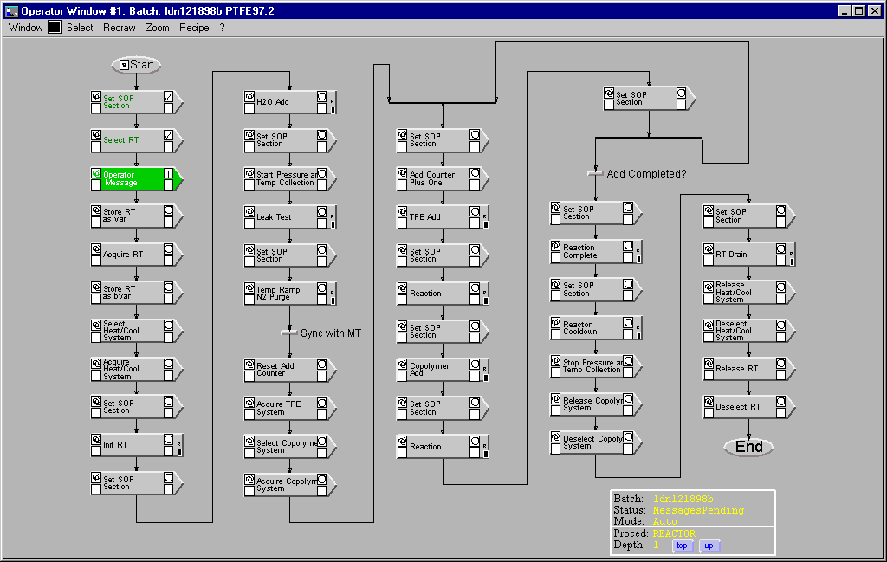
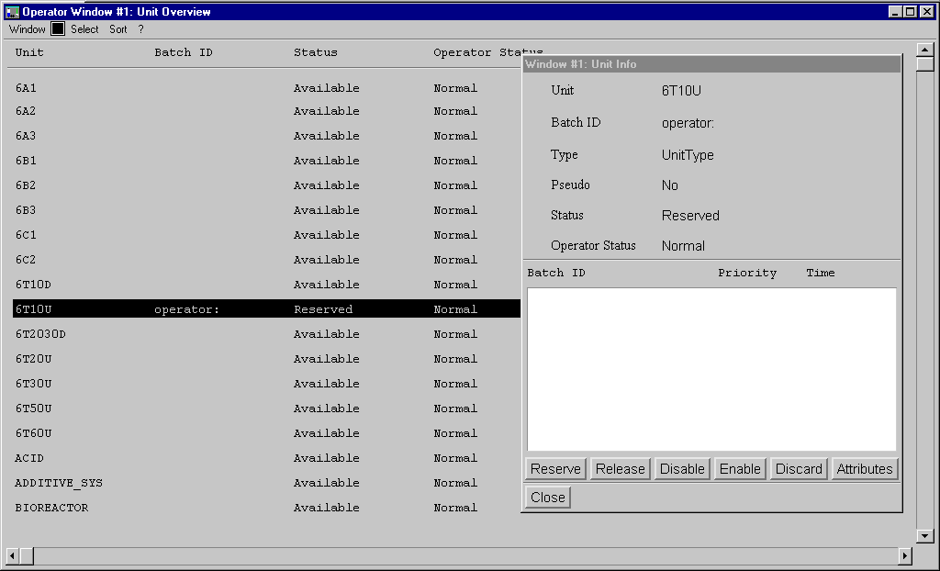
Specification 1: OPC DA for Data Access
Process variables describe the plant's state, they are generated by the sensors or calculated in the programmable logic controllers (PLCs).
Process variables can be sent upon a change, on demand or when a given time elapsed.
The OPC DA (Data Access) specification addresses collecting Process Variables.
The main clients of OPC DA are visualization and (soft-) control.

Slide 11
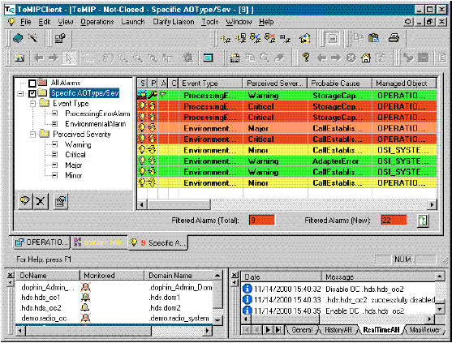
Specification 2: OPC AE for Alarms and Events
Events are changes in the process that need to be logged, such as "production start"
Alarms are abnormal states in the process that require attention, such as "low oil pressure"
OPC AE (Alarms and Events) specifies how alarms and events are subscribed, under which conditions they are filtered and sent with their associated messages.
The main clients of OPC AE are the Alarms and Event loggers.
determine the exact time of change (time stamping)
categorize by priorities
log for further use
acknowledge alarms
(events are not acknowledged)
link to clear text explanation

Slide 12
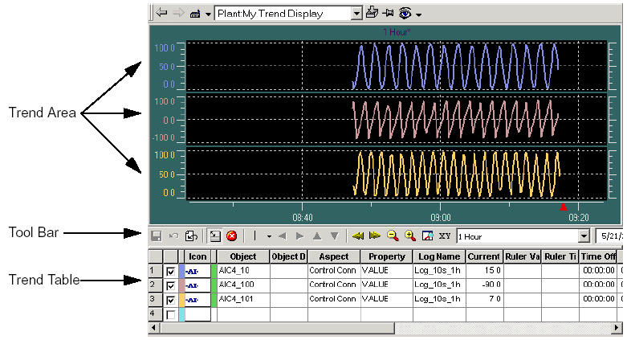
Specification 3: HDA for Historical Data Access
Historical Data are process states and events such as: process variables, operator actions, recorded alarms,... that are stored as logs in a long-term storage for later analysis.
OPC HDA (Historical Data Access) specifies how historical data are retrieved from the logs in the long-term storage, filtered and aggregated (e.g. compute averages, peaks).

Slide 13
Specification 4: OPC Batch
based on:
IEC 61512-1 Batch Control – Part 1: Models and Terminology
(ANSI/ISA S88.01 1995)
ISA-dS88.02-2000 draft 17 of May 2000
allows to access:
equipment capabilities,
current operating conditions,
historical and
recipe contents

Slide 14
Beyond Microsoft: OPC UA
In a move to get more independence from Microsoft and use web technology,
a new specification called " Unified Architecture" (formerly. OPC XML) that uses web services for all kinds of transactions: query, read, write, subscribe,...
The classical OPC DA, AE and HDA are implemented with XML / SOAP /WSDL
this allows encryption and authentication of process data.
This does not only standardize the interfaces, but also the transmitted data.

Slide 15
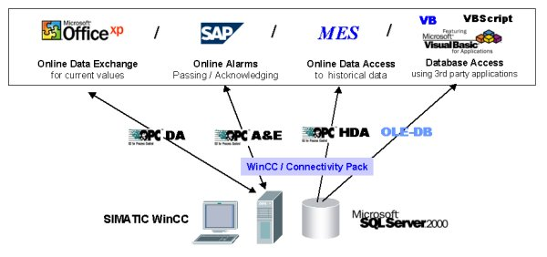

OPC as a hub
OPC variables is also a convenient way to exchange data between applications
on the same machine. OPC data can be easily read in any Microsoft Office application
source: Siemens WinCC

Slide 16
OPC connection to databases
Tools such as LifeWire’s allow to build an OPC DA interface to any ODBC - equipped database.
The database internal structure (exposed through queries) is reflected as a hierarchy of OPC items.
This allows to give a unified access to simple items.
application
(OPC client)
OPC server
ODBC
DB

Slide 17
Server(s) and Client(s) in the same node
node
client application
(OPC client)
client application
(OPC client)
OPC server
OPC server
OPC server
devices
devices
devices
devices
Clients and servers run as parallel processes
The OPC specification defines the interface between client and server in the form
of objects and methods.

Slide 18
Direct and Fieldbus access
direct connection
fieldbus connection
client application
(OPC client)
client application
(OPC client)
clients and servers run as parallel processes
(local)
OPC server
(local)
OPC server
FB Manager
fieldbus
I/O devices
proprietary protocol
can also be a point-to-point link
The OPC server is running
all the time, as soon as at
least one client is present
fieldbus
fieldbus
FB agent
FB agent
PLC
PLC

Slide 19
Full-fledged COM/DCOM across multiple nodes
connectivity node
Ethernet
app3
application 2
(OPC client)
application 1
(OPC client)
TCP/IP
TCP/IP
panel
OPC server
for BrandZ
node 1
OPC server
for BrandY
OPC server
for BrandX
OPC server
for simulation
Fieldbus Y
Fieldbus X
drivers
input / output to plant
The OPC servers supports multiple clients and servers on the same, or on remote nodes. They run as separate processes (as soon as at least one client is requesting them)

Slide 20
OPC technologies
ActiveX
Object Linking and
Embedding (OLE)
OLE for Process
Control (OPC)
(Distributed) Component Object Model
(COM / DCOM)
Transport
(TCP-IP, UDP, Queued)
only between
nodes
Ethernet
OPC bases on Microsoft's COM/DCOM technology (i.e. it only works on Windows platforms).
Effort to port it to other platforms (Linux) and web transport protocols (XML) are in progress. Advantages are the direct integration into all applications, such as Excel.

Slide 21
Structure of an OPC server
OPC/COM Interfaces
OPC Group & Item Management
Item Data Optimization and Monitoring
Device Specific Protocol Logic
Hardware Connection Management

Slide 22
OPC Overview
OPC Common
OPC Data Access
OPC Alarms and Events Specification
OPC Historical Data Specification
Applications

Slide 23
OPC DA: Scope of specification
An OPC DA Server
is configured using the information coming from the
development tools for the controllers
OPC DA Client
e.g. visualization
OPC DA Client
e.g. performance
indicator
OPC DA specified interface
OPC DA Server
Variables defined in the controllers are mirrored to the OPC DA server
e.g. Ethernet
tags
controllers
controller
controller
field bus
plant measurement points
field devices

Slide 24
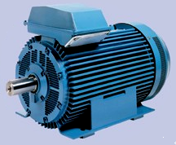
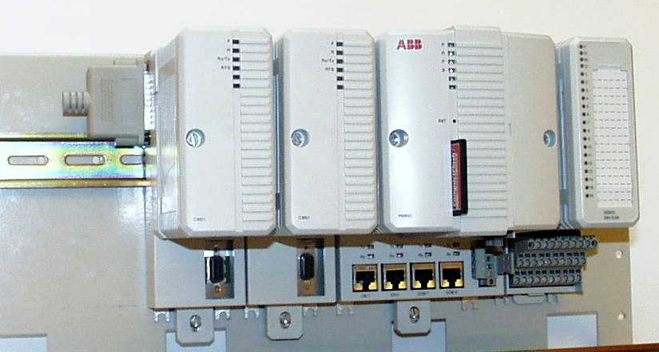
OPC DA: Example of access to a variable
OPC application
controller development
Reactor_1.Program2
ReadItem ("OPC:Reactor1: Program2.MotorSpeed")
MW%1003
MotorSpeed
Value: 112
MW%1004
Temperature
…
….
load
symbol
table
symbols
OPC
server
code
Get (192.162.0.2), MW%1003)
Return (MW%1003, 112)
Network
Program 2
Reactor_1
Marker: MW%1003
analog input to : IXD.11.2.1
Oven controller

Slide 25
OPC DA: Objects as viewed by the OPC server
An OPC server is structured as a directory with root, branches and leaves (items)
Process Line 1
Tag Name
Controller 1
Controller 2
TAG
Level_1
An item is identified by its
"fully qualified ItemID",
e.g.
"Process_Line_1.Controller_2.Level_2"
Controller_3.Prog_1
TAG
Level_2
Controller_3.Prog_2
TAG
Ramp4
Cell 1
Machine 2
the hierarchical position may differ from
the fully qualified ItemID
this will be detailed under „browsing“
Branches may contain other branches and items
The structure may also be flat instead of hierarchical
This structure is defined during engineering of the attached devices and sensor/actors.
(Intelligent servers could configure themselves by reading the attached devices)

Slide 26
OPC DA: Objects as viewed by the OPC client
Each client structures its items by groups, independently from the server.
Initially, the client browses the server structure to check if the items it is interested in exist.
A client registers its groups and items at the server. The server keeps the structure of all its clients.
clients
Client1
Client2
GroupX
GroupZ
Item1
Item2
Item3
Item1
Item2
Server root
server
Area 1
Oven_1
TAG
Temperature
TAG
Heat_On
Tank_1
TAG
Level
Area 2
TAG
Empty_Valve
Area 51
TAG
Fill_Valve

Slide 27
OPC DA: Item properties
The process data are represented by three dynamic properties of an item:
value: numerical or text
time-stamp: the time at which this data was transmitted from the PLC to the server
this time is UTC (Greenwich Winter time), not local time.
quality: validity of the reading (not readable, dubious data, o.k.)
(when writing, only the value is used)

Slide 28
OPC DA: Item types
Each item value has a type:
Boolean,
Character,
Byte, (1 byte)
Word, (2 bytes)
Double Word, (4 bytes)
Short Integer (2 bytes)
Integer (4 bytes)
Long Integer:
Long Unsigned Integer
Single Float (4 bytes)
Double Float (8 bytes)
Currency,
Date,
String,
Array of "the above"
When accessing an item, the client may request
that it is returned with a specific type, which could
be different from the server's type.
(The server's type is returned by browsing)
Type conversion is left to the server, there are no rules
whether and how a server does the conversion.
(use with caution)
Care must be taken that the data types in the
programming language or in the database match those
of the OPC Server.
Items also may have engineering units, but this option
is not often used.

Slide 29
OPC DA: Program - initialising a connection
find out existing OPC servers
myDummyServer.GetOPCServers
create an OPCServer object
myServer = new OPCServer
connect to that OPC server
myServer.Connect
create an OPCBrowser object
create an OPCGroups object
Set myBrowser = myServer.Browser
Set myGroups = myServer.Groups
create an OPCGroup object
Set myGroup1 = myGroups.Add
Set MyItems = MyGroup1.OPCItems
build array of items
checking with the browser that these items exist in this server
FQItems1[1] = "Device1.Temp1"
ClientHandle1[1] = 101
ReDim ServerHandle1(nrItems)
ReDim ServerErrors1(nrItems)
ReDim Value1(nrItems)
next
group
add item array to the group
myGroup1.AddItems
activate and subscribe group
myGroup1.IsActive
myGroup1.IsSubscribed

Slide 30
OPC DA: Libraries
The OPC DA specification is not formal, conformance can hardly be checked against this document.
To ensure that the standard is observed, the OPC foundation distributes on its website
the DLLs (opcdaauto.dll, opccomn_ps,…) that contain the type libraries to access the
OPC server.
The vendors are not compelled to implement all features. For instance, the description of the variables is seldom used. Calling unimplemented functions causes exceptions that must be caught in Visual Basic with "On Error …" statements.
There exist three versions of DA, 1.0, 2.0 and 3.0, that behave differently, however, older servers do not have a property indicating which version they support.

Slide 31
OPC DA: Custom Interface
While the Automation Interface is easy to use and quite powerful, some OPC functions are missing and special operations can only be done in Visual C++ using the custom COM interface.
This is only recommended for experienced programmers.
IOPCCommon
OPC
server
IOPCDataCallback
OPC
client
IOPCServer
IConnectionPointContainer
IOPCServerShutdown
IOPCItemProperties
[IOPCServerPublicGroups]
IConnectionPointContainer
IOPCItemMgt
OPC
group
[IOPCBrowseServerAddressSpace]
IOPCGroupStateMgt
IPersistFile
[IOPCPublicGroupSteatMgt]
IOPCSyncIO
IOPCAsyncIO2
IConnectionPointContainer
IEnumOPCItemAttributes
IOPCSyncIO
IDataObject

Slide 32
OPC Overview
OPC Common
OPC Data Access
OPC Alarms and Events Specification
OPC Historical Data Specification
Applications

Slide 33
OPC AE: Configuration
An OPC AE Server
is configured using the information coming from the
development tools for the controllers
OPC AE Client
e.g. event logger
OPC AE Client
e.g. alarm printer
OPC A&E specified interface
OPC AE Server
Events defined in the controllers are mirrored to the OPC AE server
event notification
events
e.g. Ethernet
controllers
controller
controller
field bus
plant measurement points
field devices

Slide 34
OPC AE: Purpose
The controllers (PLC) generate events in response to changes in the plant variables.
together with their precise time of occurrence, type, severity and associated message for the human operator.
An OPC Event server registers these events and makes them available to several clients
A particular class of events are the alarms, which are detailed events that may require
acknowledgement.
The OPC Alarms & Events Interface gives access to the OPC Event server, allowing to:
- browse the OPC A&E Server for predefined events.
- enable or disable alarms and events
- subscribe to alarms and events of interest
- receive the event and alarm notifications with the associated attributes
- acknowledge alarms

Slide 35
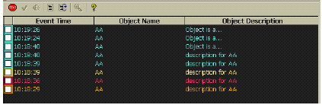
OPC AE: Displaying Alarms and Events
Alarms and events are usually displayed differently on an operator screen.
- Events are displayed in an event list that can become quite long (typically 1000 entries), entries are not cleared when the source of the event returns to normal
- Alarms are displayed in a short list (typically 50 alarms)
appearance changes when the alarm is acknowledged,
an alarm line is cleared when the alarm signal is cleared.
Ack
checkbox

Slide 36
OPC AE: Summary alarms and events
Event
Alarm
AE Client
AE Client
OPC AE
Server
OPC AE
Server
alarm notification (source, timestamp, message, condition, subcondition, severity, type)
event notification (source, timestamp, message)
message
timestamp
Condition
Event
FB
message
controller
controller

Slide 37
OPC Overview
OPC Common
OPC Data Access
OPC Alarms and Events Specification
OPC Historical Data Specification
Applications

Slide 38
OPC HDA: Historical Data Access
HDA Clients
e.g. Trend Analysis
e.g. Event Logger
independent processes
OPC HDA
Server
hidden
calculations
history
database
raw and ordered data
collector
OPC DA Server
proprietary
data acquisition
Field device
Field device

Slide 39
OPC HDA: Purpose
An OPC HDA server gives access to a historical data base (logs) in which data from the process have been collected and time-stamped, possibly through an OPC DA interface.
The OPC HDA interface clients, such as trend analysis, product tracking or data mining,
that require ordered access these data logs.
The OPC HDA interface allows to:
- browse the historical data base
- retrieve data through proper filtering, e.g. by date range, by identity, by property
- build aggregates over the retrieved data, such as average, minimum, maximum.
- enter new entries, correct entries or remove entries
- enter / delete annotations in the history data base

Slide 40
OPC HDA: Application
Parameters:
time scale (with possible offset, zoom, pan)
amplitude scale (low range, high range, scale units)
style: smoothed, stepped, filled (several ways to display the same data)
extrapolate: how to display values not received (e.g. because they did not yet change)
log: how were
data sampled

Slide 41
OPC HDA: Automation Interface summary
OPCHDAServer
An instance of an OPC HDA Server. An OPCHDAServer object must be created to can get references to other objects.
OPCHDAItems (col)
A collection containing all the OPCHDAItem objects this client has created within the scope of the OPCHDAServer object
OPCHDAItem
An object that maintains the item’s definition. Note the Custom Interface does not provide a separate Item Object.
OPCHDAItem
OPCHDABrowsers
An object that browses item names in the server’s configuration.
OPCHDAHistory
An collection containing a series of either OPCHDAValue or OPCHDAEntry objects, representing historical values of an item.
OPCHDAValue
An object that represents a discrete historical value for an item or an attribute.
OPCHDAValue
OPCHDAEntry
An object that extends the OPCHDAValue object to include additional information
OPCHDAEntry

Slide 42
OPC Overview
OPC Common
OPC Data Access
OPC Alarms and Events Specification
OPC Historical Data Specification
Applications

Slide 43
Applications: OPC & SCADA
HMI
Application
functions
ActiveX
Command
language &
procedures
ODBC/SQL
History
data base
OPC AE
Reporting &
Logging
Remote Device
Configuration
Alarm & Event
handling
Historian
OPC DA
Process data
base
Measurand
processing
FDT / DTM / XML
Communication
stream
Data Acquisition
Field protocols: 101, 61850, HTTP
standards

Slide 44
Applications: OPC & SCADA
browser
on same or other machine
(IE, Netscape,…)
web server
(IIS, TomCat)
page logic
code-behind
(servlets, .NET
web-pages
(HTM, JSP, ASP,..)
scripts & code
(Java, Perl, C#,..)
data base
Model-Viewer-Controller

