Slide 1
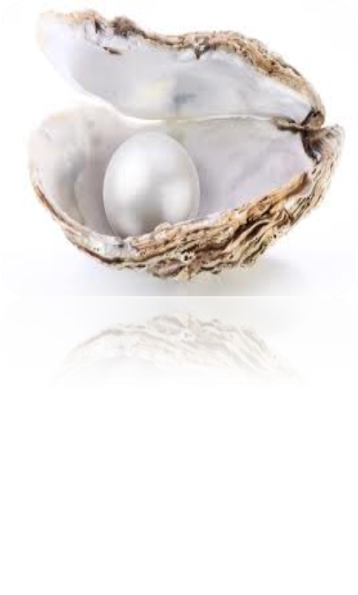
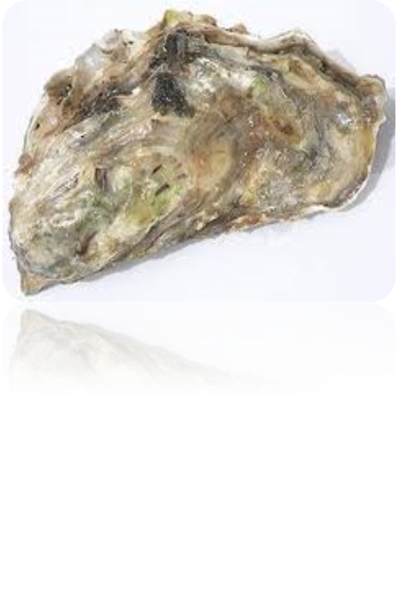
OYSTER FARMING COASTAL AQUACULTURE AND SEED PRODUCTION SYSTEM AQC 502(2+1)
PRESENTED
BY
P.NAGESWARI
AQC-MA4-04

Slide 2
INTRODUCTION
Oysters are members of the phylum Mollusca and belong to class Bivalvia.
They are distinguished by having two shells(two valves), a soft body with a small foot, a byssal gland and paired gills.
Oysters are found more or less everywhere in the world where there is sea.
They inhabit in sheltered places like basins, lagoons, intertidal areas, etc.

Slide 3
True oysters
True oysters belong to the family Ostreidae.
This family includes the edible oysters.
Belongs to the genera :
Ostrea
Crassostrea
Saccostrea

Slide 4
Cultivable edible oysters
Cultivated oyster belong two genera:-
Crassostrea (cupped)
Ostrea (flat oyster)
most of the cupped oyster grow well at temperature between 10-30⁰ c, though for spawning &larval development temperature around 20⁰c are considered optimal.
The flat oyster grows well between 10-24⁰c.
Most of oysters attach themselves to hard substrate and can tolerate wide in salinity often between 5-33ppt.

Slide 5
Species culture in the World
China – Crassostrea gigas , C.plicatula , C.rivularis
Philippines – C.gigas
Australia - C.gigas , C.commercialis
Chile – Crassostrea gigas , Ostrea chilensis
Cuba – C. rhizophora ,
Malaysia – C.belchori
Mauritius – Saccostrea cucculata

Slide 6
Species culture in India
Main species
Crassostrea madrasensis
C.gryphoides estuarine, brackish
C. rivularis water,creeks
Saccostrea cucullata Purely marine

Slide 7
Distribution and main culture areas of commercially important oyster species in India

Slide 8
SPECIES | STATE | LOCALITY | NOTES
Crassostreamadrasensis | West Bengal |  | Little information available.
 | Orissa | Bahuda estuary | Approximate area of 5 ha. Three distinct beds observed.
 | Andhra Pradesh | Sarada estuary Bhimunipatnam | Oyster beds reported. Oyster beds subjected to annual depredation due to fresh water influx.
 |  | Upputeru canal | Approximate area of 2.25 ha of rich oyster beds.
 |  | Godavari and Krishna estuaries Gokulapalli | Low density beds. Rich oyster beds regularly exploited.
 | Tamil Nadu | Pulicat Lake | Rich and extensive oyster beds regularly exploited.
 |  | Courtallayar and Adyar estuaries | Approximate area of 50 ha in each locality. Regular fishing occurs.
 |  | Mudasodai and Chinnavaykal Muthupet swamp Vaigai estuary | Small areas. Limited exploitation. Patchy settlements. Approximate area of 2 ha. No exploitation has been reported.
 |  | Tuticorin | Approximate area of 20 ha. Exploitation occurs.
 |  | Tamparaparni estuary | Approximate area of 2.5 ha. No exploitation has been reported.
 | Kerala | Ashtamudi Lake | Approximate area of 5 ha. Oysters are sparsely distributed & exploited.
 |  | Anchengo backwaters | Highly populated oyster beds.
 | Karnataka | Nethravathi, Kali & Sharavathi estuaries Venkatpur, Bhatkal, Mulky, Uppunda and Coondapoor estuaries | Oyster beds of limited extent.
 |  |  | Oyster beds of same extent. Regular exploitation occurs.

Slide 9
Crassostrea gryphoides | Maharashtra | Dahanu creek, Mahim creek, Purnagab, Malwan, Alibag, Palghar, Satpuri, Boiser, Malad, Worli, Ratnagiri, Jaytapur, Versova, Gobbunder, Cuff Parade, Marve, Madh and Bandra | Oyster beds of same extent. Regular exploitation occurs.
 |  | Utsali, Navapur and Kelwa | Oyster beds of same extent. Bottom culture is practiced.
 | Goa | Ribanden, Siolim and Curca | Oyster settlements reported.

Slide 10
Crassostrea rivularis | Gujarat | Aramra, Poshetra, Port Okha, Porbander, Sikka, Gagwa creek, Singach creek, Beet Kada, Khanara creek, Laku Point, Gomati creek, Navibander, Harsad, Balapur and Azad island | Oyster beds of same extent. Regular exploitation occurs.
 | Maharashtra | Mahim, Ratnagiri and Jaytapur areas | This species is found along with C. gryphoides.
Saccostreacucullata | Maharashtra | All along the coast | Oyster beds of same extent. Regular exploitation occurs.
 | Gujarat | All along the coast | Oyster beds of same extent. Regular exploitation occurs.

Slide 11
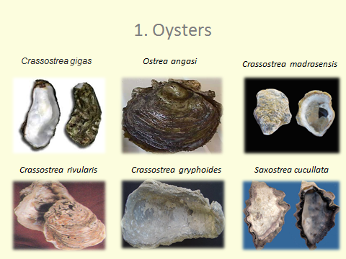

Slide 12
Internal anatomy of oyster

Slide 13
Characteristics of oysters
oyster is a sedentary bivalve.
The flesh is encased by two shell valves, the lower valve is cemented to the substratum and the upper valve acts as a lid.
The hinge mechanism connecting both valves, allows the valve to open or close.
The animal feeds by filtering the microscopic organisms in the water which pass through the gap between the two valves.
The flesh of oyster is highly nutritious containing 8-10% protein and 2% fat, in addition to minerals like calcium, phosphorus, zinc and iodine.

Slide 14
contd
Sexes are separate
Protandrous hermaphrodite was observed
Feed on wide range of living micro organisms, detritus and inorganic particles
Among the 3 species C. madrasensis grows faster and attains maximum length
It is most widely distributed and euryhaline

Slide 15
Technology of oyster farming
The technology of oyster farming consists of two important phases namely;
collection/ production of seed oysters and
growing the seed oysters to marketable size.

Slide 16
Oyster seed production
Seed collection from wild
Mass production of oyster seed through hatchery system

Slide 17
Seed collection from wild.
The collection of seed from wild depends on the spawning and provision of suitable spat collectors or cultch materials at appropriate time.

Slide 18
Spat fall prediction
The spat fall is predicted by studying the gonadal maturation stages or by appearance of oyster larvae in the plankton samples. When 70 %of female oysters are with ripe gonad spat collectors are used to collect the spats.
If the collectors are placed much earlier or after the spatfall, the collectors get silted or fouled, rendering them unsuitable for spat settlement

Slide 19
Spat collectors
The spat collectors should be rough, free from slime without any secretion of resin and strong enough to retain the oyster.
Large scale spat collection-lime coated tiles and oyster shell.
Vast potentiality of oyster seed availability along intertidal bay areas

Slide 20
Mass production of oyster seed through hatchery system
The hatchery techniques consist.of 6 phases of operation
selection and holding of broodstock, induced spawning, larval rearing, preparation of cultch materials, production of spat and culture of algal food.

Slide 21
Selection and holding of broodstock
Oysters of length ranging from 60-90 mm are ideal
oysters are selected, cleaned and placed on synthetic twine knit PVC frame in a 100 I fiberglass tank and precooled seawater (at 20°C - 22°C) is filled in the tank and aerated.
Mixed algae (2-31) with cell concentration of 1.5-2 million cells/ml is given as food daily

Slide 22
CONTD
They are held in separate flow-through tanks supplied with cultured algae supplemented seawater at 20–22 °C and salinity within the range 25–32‰.
During the winter months, when adults are sexually undeveloped, about six weeks of hatchery conditioning is required to initiate gametogenesis and mature the gametes.
Adults containing ripe gametes can be spawned by thermal shock treatment but most commonly they are opened and the gametes 'stripped' from the gonads with Pasteur pipettes, a procedure that produces good results.
Ripe females of 70–100 g live weight will yield in excess of 50–80 million eggs.

Slide 23
Induced spawning
The conditioned oysters are induced to spawn by transferring them to seawater with temperature of34-35⁰C
Once spawning is completed, the oysters are removed from the tray
two types of induced spawning
Thermal stimulation
Chemical stimulation

Slide 24
Thermal stimulation
The silica cased immersion heater and Jumothermometer are immersed in water after connecting to the thermostat controller.
The required water temperature (35°C) is set in Jumothermometer.
A group of ripe oysters (50-100 nos) are released into the tank.
Water temperature is gradually increased by heating. When the water temperature reach 35°C,the thermostat controller unit automatically stops further heating the water.

Slide 25
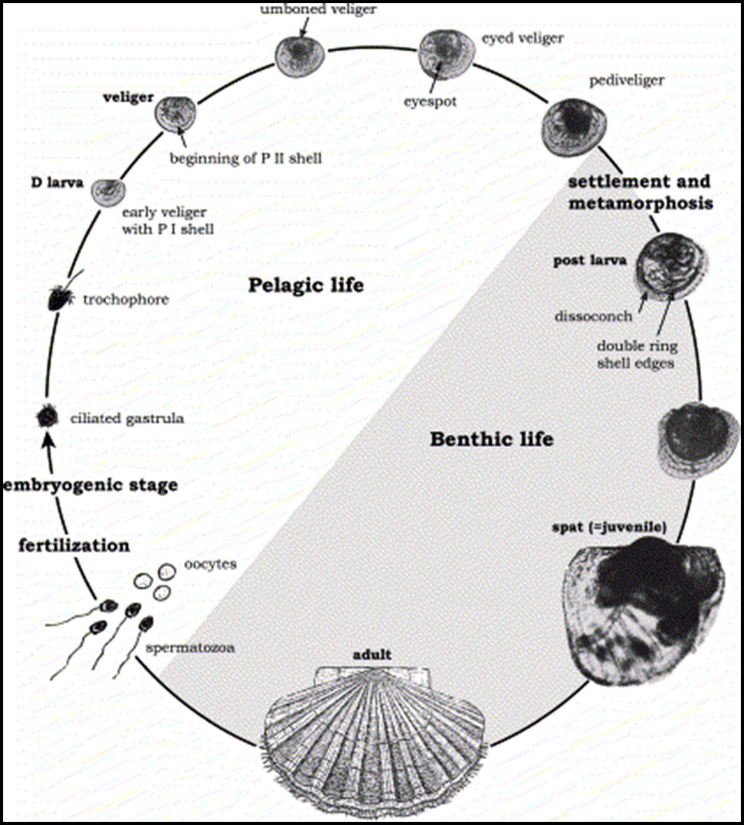
LIFE CYCLE OF OYSTER

Slide 26
Larval and post-larval culture
Development from the fertilized egg to the fully shelled prodissoconch I (D-larva) stage takes place in large volume tanks filled with finely filtered – and often UV-treated – seawater at 25–28 °C and 25–32‰.
Larvae are grown in either static water or flow-through tank systems through to the pelagic veliger stage, which lasts 14 to 18 days at 25–28 °C.
Larvae are fed cultured algae

Slide 27
LARVAL REARING
Isochrysis galbana is provided as larval food.
Stage & size of larvae | Rearing density(larvae/ml | Algal cells/day
'D' shape (60 µ) | 5 | 3000-4000
Umbo (150µ) | 3 | 4000-5000
Eyed stage (280 µ) | 2 | 5000-8000
Pediveliger (330 µ) | 2 | 10000-12000

Slide 28
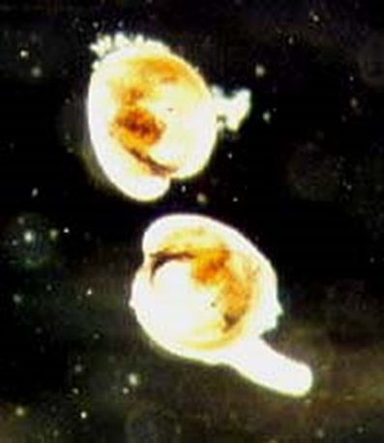
Larvae with a muscular foot looking for a site to set.

Slide 29
SETTLEMENT SUBSTRATES
At this time, settlement substrate is placed in the tanks for the larvae to explore and attach to. Materials such as slightly roughened, black PVC sheets, fluted PVC pipes, shells or shell particles are used as settlement surfaces.

Slide 30
UPWELLING CULTURE
This is a phase of production usually accomplished in large volume tank systems with partial daily water replacement, in which the juveniles are held as fluidised beds in containers in a process referred to as upwelling culture.
Rations of high nutritional value algae from hatchery culture or from algae bloomed in adjacent outdoor tanks or ponds are supplied continuously to promote rapid growth.
Once grown to the required size the spat are either transferred to the hatchery's own outdoor nursery systems or are packed and sold to oyster growers.

Slide 31
REMOTE SETTING METHOD
Remote setting is a method of oyster seed production resulting in several baby oysters (spat) attached to old oyster shell the resulting oyster seed is referred to as “spat-on-shell”.
This method is in contrast to single oyster seed production (cultchless) where the result is individual oysters grown out in bags or cages.
It consists of two phases: (1) setting, in which larvae attach to “cultch,” a setting material such as shell; and (2) a nursery period where newly set oysters (called seed) are placed in protected areas until they are ready for planting

Slide 32
Seed Production - hatchery

Slide 33
HATCHERY DESIGN CONSIDERATIONS
Government regulations
Seawater quality
Siting the hatchery
The physical plant
Algal culture facility
Broodstock holding and spawning area
Larval culture area
Juvenile culture area
Other space requirements

Slide 34
Hatchery building
The roof of the hatchery building is sufficiently high to avoid high temperature.
Part of the roof of the wet laboratory has translucent fibreglass sheets to allow sufficient light for indoor phytoplankton culture.
Glass panelled large windows and ventilators are provided for free passage of light and air.
The concrete floor has sufficient gradient facilities for easy drainage.

Slide 35
Seawater management
The seawater is usually drawn from the sea beyond the low water mark into a well through PVC pipes.
The seawater is pumped to sedimentation tanks and passed onto the biological filter which contains coarse river sand at the top, pebbles below it and charcoal at the bottom.
The filtered seawater is stored in a water sump and lifted to an overhead tank for supply to the hatchery.
Periodic cleaning of the filter bed keeps the seawater uncontaminated.
PVC, fibreglass and stainless steel materials are used in the hatchery. The seawater sterilized by ultraviolet irradiation is used only in specific cases

Slide 36
Grow out FARMING METHODS
Grow-out is almost entirely sea-based. A variety of bottom, off-bottom and suspended culture methods are used, depending on the environment (e.g. tidal range, shelter, water depth on leases, water exchange rates in bays and estuarine inlets, the nature of substrates, etc.) and tradition.

Slide 37
On bottom culture
On bottom culture practices are done in the intertidal or subtidal bottom

Slide 38
Advantages
Less labour to maintain and stage seed for stocking grow-out areas
Lower capital and maintenance expenses as no nursery or grow-out structures are required
Less labour in moving shell stock to new areas because structures are not involved
Generally, fewer permits are required for bottom culture than off-bottom culture
Usually less negative visual impact at nursery and grow-out sites

Slide 39
disadvantages
Higher percentage of mortality from predators and pests
Higher potential for siltation
Spat usually survive only on one side of the mother shell
Public resistance to many predator control methods
relatively low yields per unit culture area.

Slide 40
Off bottom culture
Fairly deeper and soft bottomed areas are used for off bottom culture practices

Slide 41
advantages
Less impacts from predators and pests
Less chance of siltation
Use of total water column by three dimensional culture techniques
Spat survival on both sides of the mother shell
Less expensive equipment required for harvesting

Slide 42
disadvantages
More public resistance to visual impact of culture structure
Potential conflicts with recreational boating
Fouling organisms severely impact some container systems
Labour intensive in initial setup
Capital coat and maintenance of nursery and growout structures

Slide 43
Methods of culture
On bottom culture | Off bottom culture
Sowing method | Raft and tray/string culture method
Pole(stick )method | Long line and tray /string culture method
Stake method | Rack and tray /string culture method

Slide 44
Rack and string method using ren
Racks are fixed at a depth of 1 – 1.25m
Rack is made of wooden poles vertically driven to the substratum over which a wooden frame made at a height of 0.5m above from the bottom
Shell rings are suspended from the racks
At the end of 12 months each string may weigh 7 – 7.5kg

Slide 46
Rack and tray method
Suitable for estuaries and shallow seas.
Bamboo or casuarina poles are driven into the bottom
Spaced I-2m apart in rows up on which a pannel frame is built.
Seeded ropes can be suspended from those frames

Slide 48
Tray culture
Tray culture of oyster is limited to detached clusters of oyster.
Bamboo or metal trays, 1.5 m × 1 m × 15 cm sidings are used.
The tray is either hanged between poles of the hanging or stake methods or suspended on four bamboo posts.

Slide 50
RAFT CULTURE

Slide 51
Long line method

Slide 52
Production cycle

Slide 53
Problems and constraints
One major constraint is that bivalves are not a popular food item and are consumed by small communities along the coast.
Availability of oyster seed is essential for large-scale production.
Other major problems are related to post-harvest handling and quality control.

Slide 54
Pearl oyster
Pearls were the first gems discovered by man thousands of years ago.
Naturl pearls-small,various colours,irregular shape
Cultured pearls-larger,more consistent size,colour
Producing cultured pearls depends on a surgical procedure called grafting.

Slide 55
Pearl oyster
Pearl oysters belong to the family Pteriidae.
They are shell bearing molluscs that can secrete pearl.
Both cultured and natural pearl can be obtained from Pearl oyster.
Examples- Pinctada fucata
P. margaratifera
P. chemnitzii.
P. sugillata.
P. maxima.

Slide 56
Distribution in Indian waters
In Indian waters, they occur in 6 regions namely the Gulf of Mannar, Palk Bay, off Trivandrum, the Andaman and Lakshadweep Islands, and the Gulf of Kutch.
Of these, the Gulf of Mannar and Gulf of Kutch are the most productive regions where pearl oysters occur in large numbers.Six species of pearl oysters occur in Indian waters.
P.fucata occurs extensively in the beds of Gulf of Mannar and to a less extent in the Gulf of Kutch.
The black-lip pearl oyster P.margaritifera, occurs in stray numbers in some pockets of Andaman and Nicobar Islands.

Slide 58
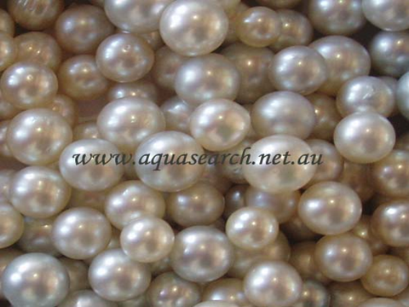

Slide 60
PEARL OYSTER
Selection of culture sites
Environmental conditions
Temperature
Salinity
Bottom
Depth
Silt load
Water current
Primary productivity
Supply of oysters

Slide 61
Overview of pearl farming

Slide 62
Problems and perspectives of the pearl oyster aquaculture
overfishing and depletion of broodstocks in some lagoons,
mass mortalities of cultured oysters,
large occupation of the lagoons by long lines and galvanised structures,

Slide 63
Carrying capacity of the ecosystem
An overload of the carrying capacity appears –
a decrease of the growth rate
an increase of chronic mortalities
a weakness of molluscs against disease

Slide 65
THE FUTURE
In this near future, it seems very important to develop the following points :
To improve the general cultivation techniques and discover the reasons of the high mortalities,
to improve the control of the farms to avoid heavy problems in and with the ecosystem,
To improve our knowledges on the relationship between cultivation grounds and evolution of the environment of the lagoons, and consequently to improve our knowledge on the general biology of this species,

Slide 66
To manage the stocks by the limitation of broodstock harvest, by the improvement of spat collectors and artificial breeding techniques in hatchery to restock exhausted lagoons,
To develop the Pearl oyster culture in other sites, other lagoons but respect the other activities like fishing and tourism,
To improve the quality of pearls instead of the quantity,
To develop the market in countries other than Japan and U.S.,
To promote the product and maintain actual prices.

Slide 67
REFERENCES
M.A.Upare and K.S Maya Devi., Pearl culture –emerging investment avenue
Management of oyster and mussel culture -
AQUACULTURE EUROPE '89 -BUSINESS JOINS SciENCE N. De Pauw and R. Billard (Eds). European Aquaculture Society. Special Publication No.12, Bredene, Bclgium (I990).
E. G. SILAS., Mussel culture in India – Constraints and prospects
K. RANGARAJAN., Mussel farming
Central Marine Fisheries Research Institute, Cochin-18
P. S. B. R. James, K. A. Narasimham and K. S. Rao., Prospects for development of oyster culture in India

Slide 68
Pilly.T.V.R, 1993, Aquaculture principles &practices.
Leonard Lovshin -Department of Fisheries and Allied Aquacultures-Auburn University, AL 36849
Zhu Jian -2005- Shellfish Culture-china
FAO

Slide 69
THANK YOU

