Slide 1
Application of conditional probability analysis

Slide 2
Conditional Probability - Conditional Probability contains a condition that may limit the sample space for an event. - You can write a conditional probability using the notation P(BA) - This reads "the probability of event B, given event A"

Slide 3
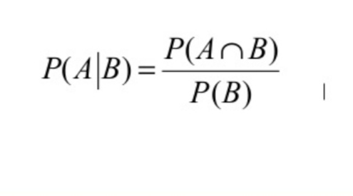
Conditional Probability Formula - The conditional probability that A occurs given that B has occurred is written as P(A|B) and is defined as:

Slide 4
Problem Solving with Venn Diagram In a class of 29 students, 20 students study French, 15 students study Malay, and 8 students study both languages. A student is chosen at random from the class. Find the probability that the students: a Studies French b.Studies neither language Studies at least one language Studies both languages e Studies Malay given that they study French Studies French given that they study Malay Studies both language given that they study at least one of the languages

Slide 6
Independence and conditional probabilities Consider the following (hypothetical) distribution of gender and major of students in an introductory statistics class: • The probability that a randomly selected student is a social science major is 60 / 100 = 0.6. • The probability that a randomly selected student is a social science major given that they are female is 30/50 = 0.6. • Since P(SS| M) also equals 0.6, major of students in this class does not depend on their gender: P(SS | F) = P(SS).

Slide 7
Get a modern PowerPoint Presentation that is beautifully designed.

Slide 8
THANK YOU
Insert the Subtitle of Your Presentation

