Slide 1
Probability and statistics

Slide 2
Confidence interval
A confidence interval, in statistics, refers to the probability that a population parameter will fall between a set of values for a certain proportion of times. Confidence intervals measure the degree of uncertainty or certainty in a sampling method

Slide 3
Confidence Interval Estimation
Provides Range of Values
Based on Observations from 1 Sample
Gives Information about Closeness to Unknown Population Parameter
Stated in terms of Probability
Never 100% Sure

Slide 4
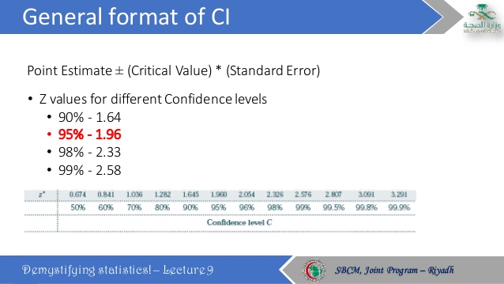

Slide 5
Elements of Confidence Interval Estimation
A Probability That the Population Parameter Falls Somewhere Within the Interval.
Sample Statistic
Confidence Interval
Confidence Limit (Lower)
Confidence Limit (Upper)

Slide 6
Level of Confidence
Probability that the unknown
population parameter falls within the
interval
Denoted (1 - α) % = level of confidence e.g. 90%, 95%, 99%
α Is Probability That the Parameter Is Not Within the Interval

Slide 7
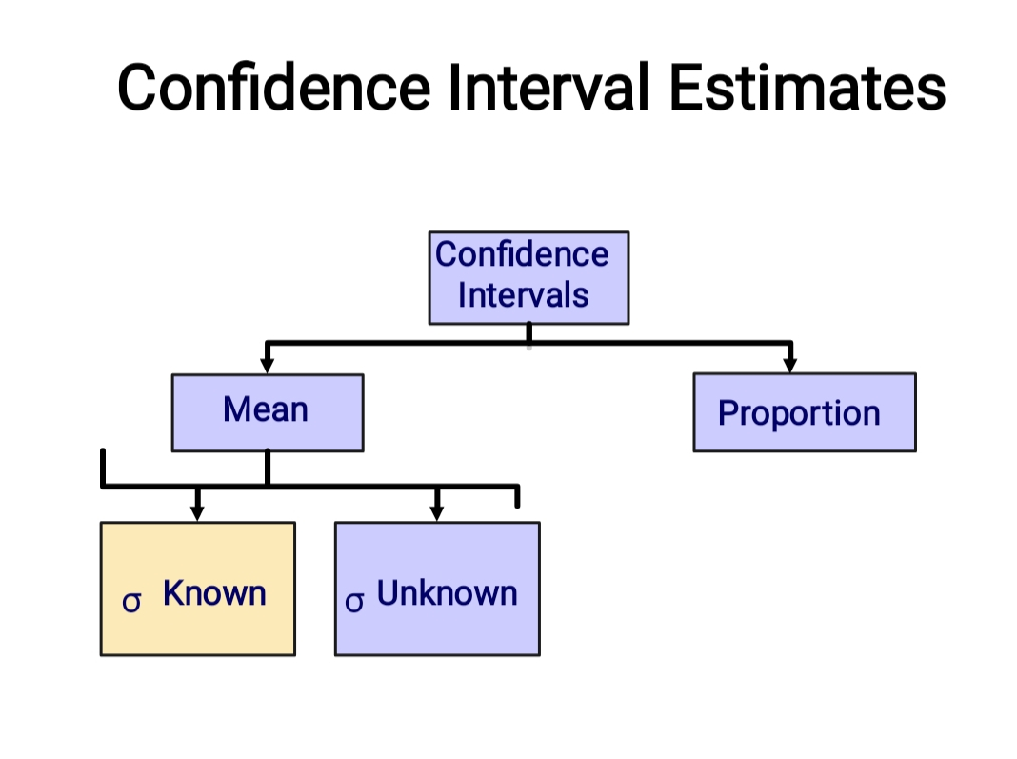
Thank you

Slide 8
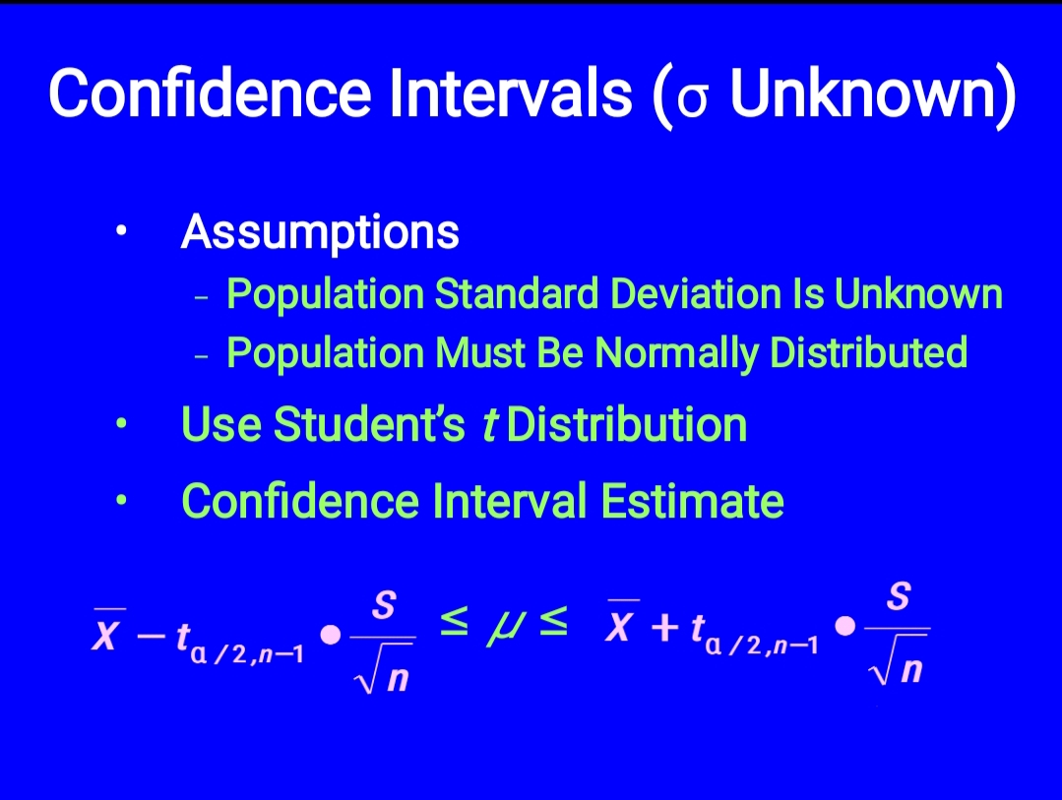
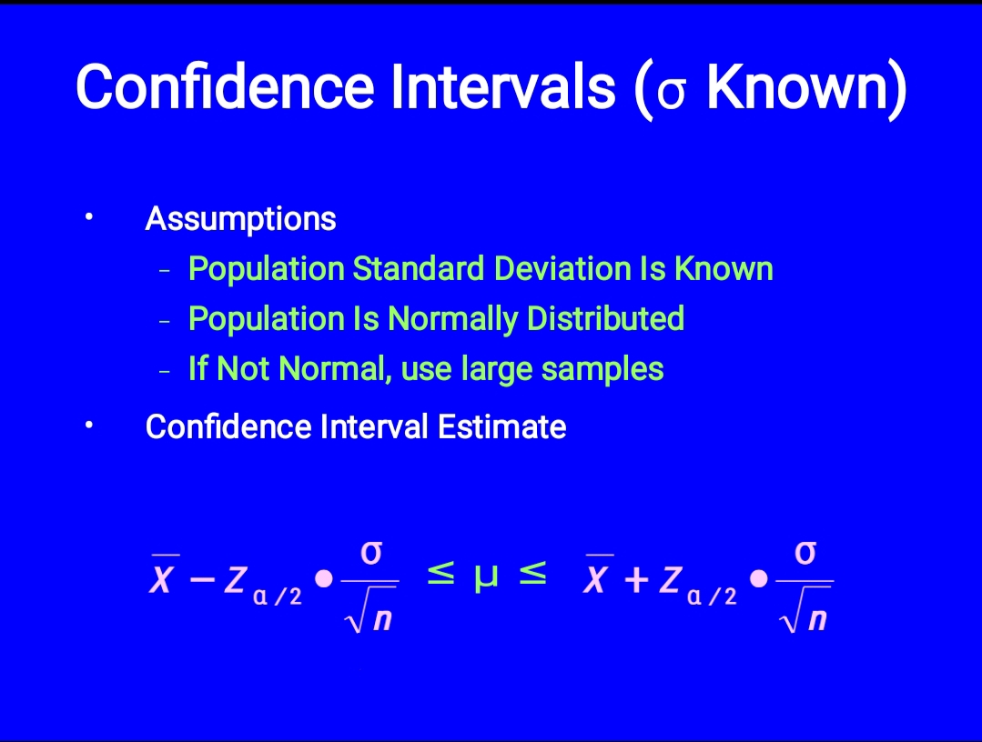
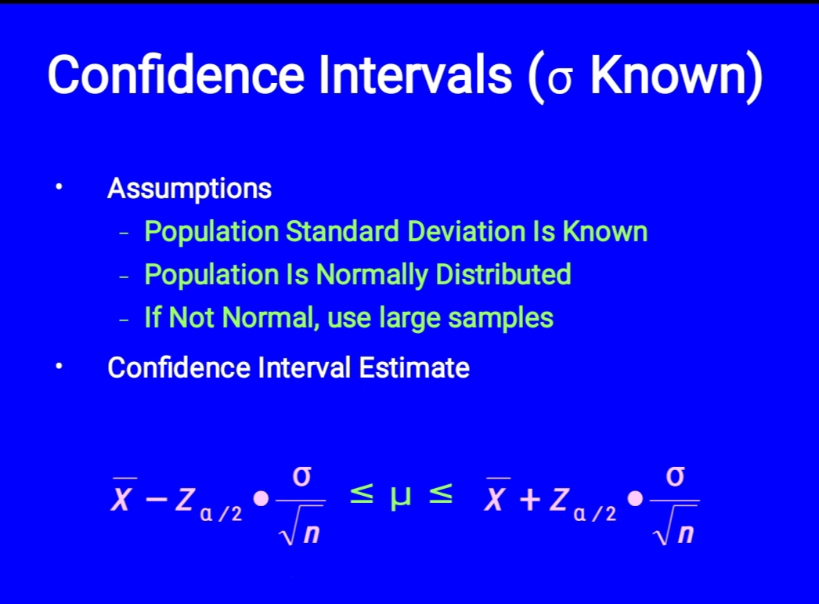
Confidence Interval Estimates
Confidence
Intervals
Mean
Proportion
σ
Known
σ
Unknown

Slide 9
Probability and statistics
Anumanchipalli Venkata Adithya
190101120033

Slide 10
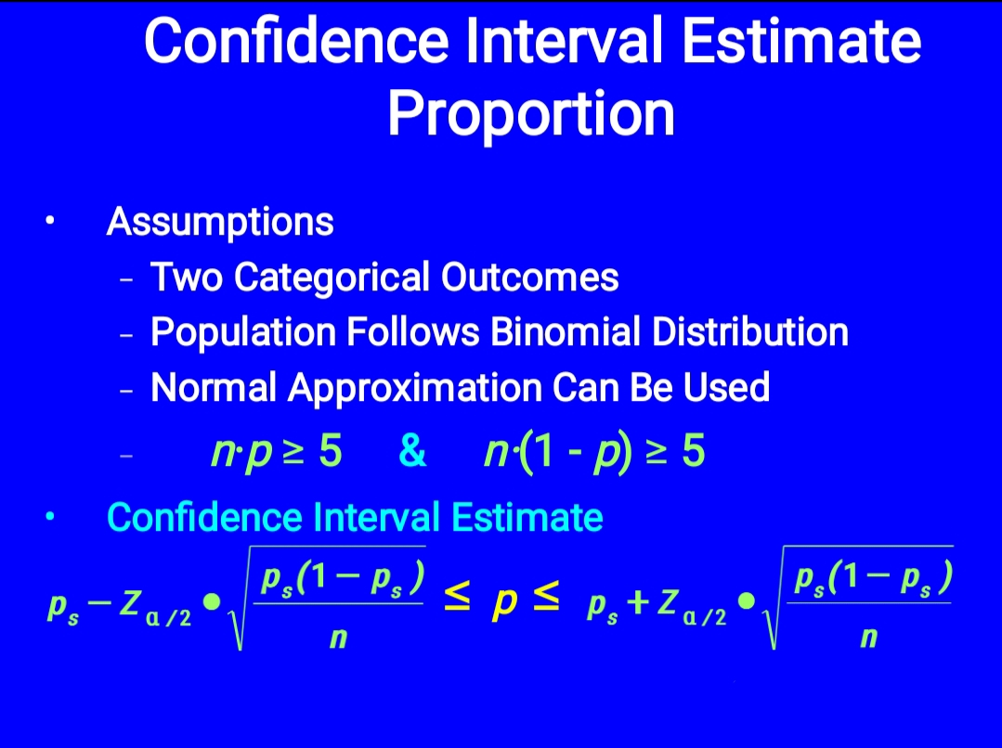
Confidence interval
What Is a Confidence Interval? A confidence interval, in statistics, refers to the probability that a population parameter will fall between a set of values for a certain proportion of times. ... They can take any number of probability limits, with the most common being a 95% or 99% confidence level.

Slide 11
THANK YOU

