Slide 1
CUTM1036 : Android App Development
(Credits 2-2-2)
By,
Dr DHAWALESWAR RAO

Slide 2
Courseware Syllabus: https://courseware.cutm.ac.in/courses/android-app-development/
Download, Install and Configure the Android App Environment
We are going to use Android Studio for developing Android apps. The prerequisites are:
JAVA JDK
- Download: https://www.oracle.com/java/technologies/downloads/#java8-windows
- Install : https://phoenixnap.com/kb/install-java-windows
- Set the path in Environment Variables→System variable→New :
Variable name: JAVA_HOME
Variable value: C:\Program Files\Java\jdk-19
(ii) ANDROID STUDIO
- Download https://developer.android.com/studio
- Install : https://developer.android.com/studio/install#windows
- Run Android Studio as a ADMINISTRATOR:

Slide 3
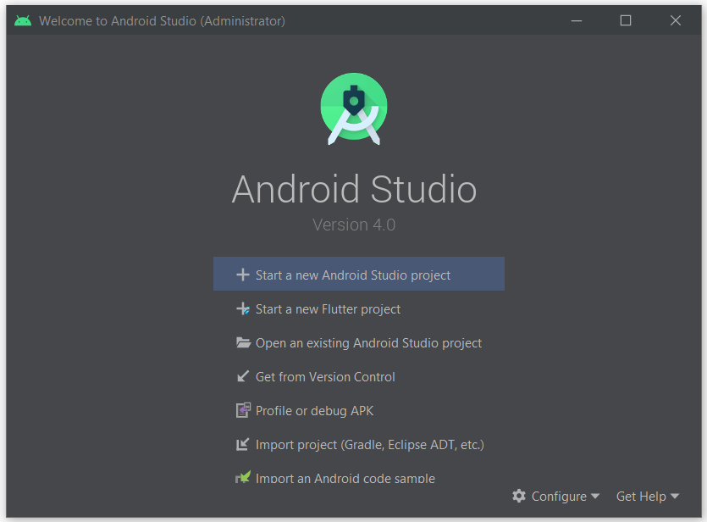
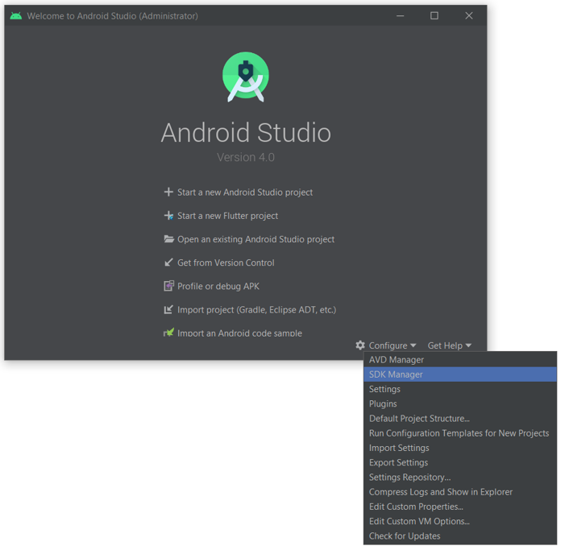

Slide 4
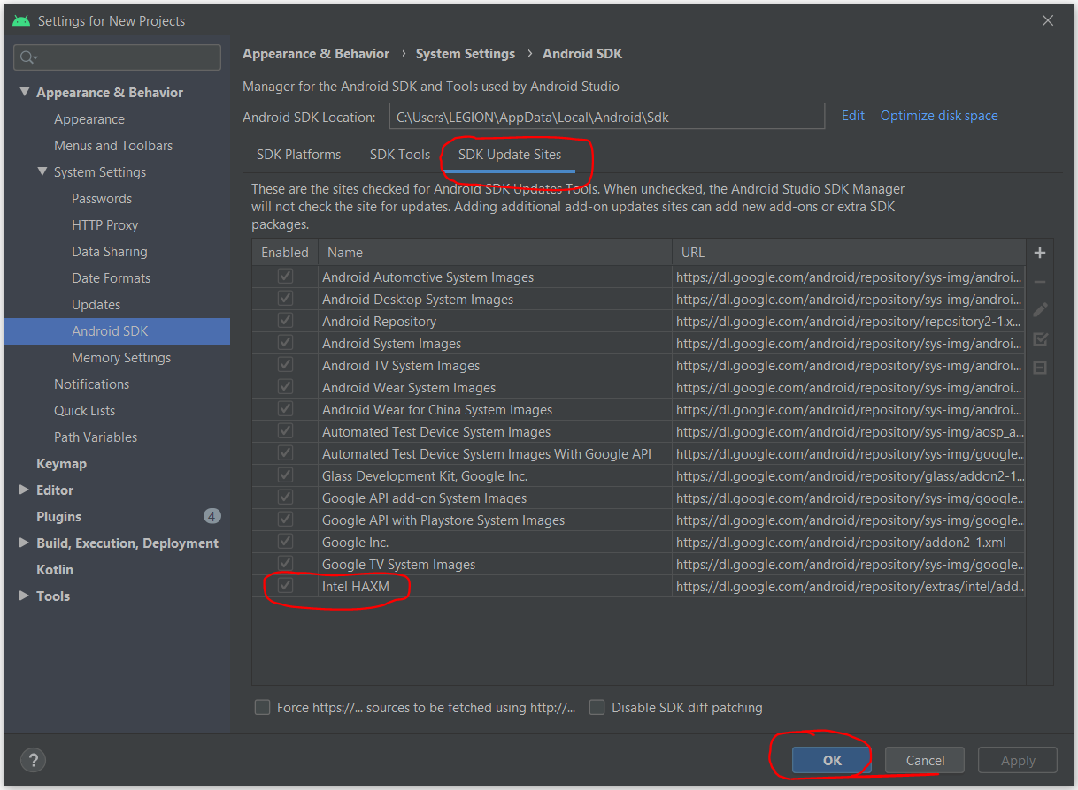

Slide 5
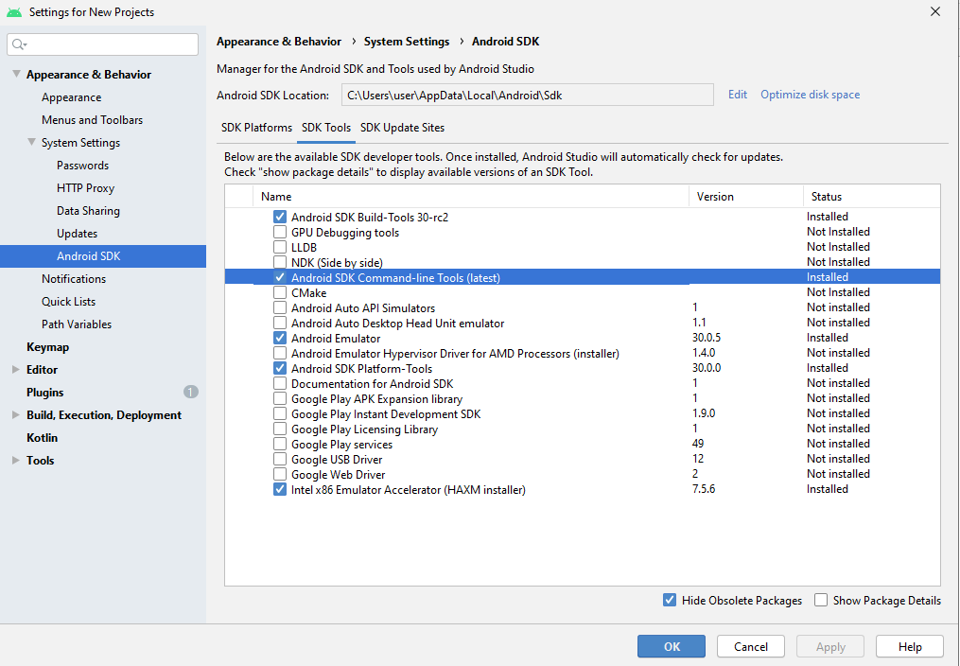

Slide 6
Does android support other languages than java?
Yes, an android app can be developed in C/C++ also using android NDK (Native Development Kit). It makes the performance faster. It should be used with Android SDK.

