Slide 1
RFID

Slide 2
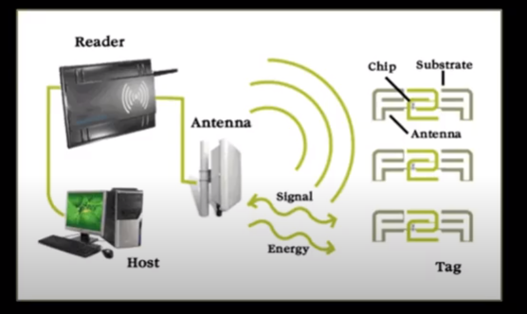
RFID(Radio frquency identification)

Slide 3
Radio-frequency identification (RFID) uses electromagnetic fields to automatically identify and track tags attached to objects.
An RFID system consists of a tiny radio transponder, a radio receiver and transmitter. When triggered by an electromagnetic interrogation pulse from a nearby RFID reader device, the tag transmits digital data, usually an identifying inventory number, back to the reader. This number can be used to track inventory goods.
There are two types of RFID tags:
Passive tags are powered by energy from the RFID reader's interrogating radio waves.
Active tags are powered by a battery and thus can be read at a greater range from the RFID reader, up to hundreds of meters.

Slide 4
Unlike a barcode, the tag does not need to be within the line of sight of the reader, so it may be embedded in the tracked object.
RFID tags are used in many industries. For example, an RFID tag attached to an automobile during production can be used to track its progress through the assembly line.

Slide 5
RFID Operation Sequence of Communication
Host Manages Reader(s) and Issues CommandsReader and tag communicate via RF signal
Carrier signal generated by the reader (upon request from the host application)Carrier signal sent out through the antennas
Carrier signal hits tag(s)Tag receives and modifies carrier signal
Antennas receive the modulated signal and send them to the Reader
Reader decodes the data
Results returned to the host application
NOTE: Bullet 5 - Tag is NOT actually generating and transmitting a signal. The Tag modifies the signal and sends it back to the reader.
Intermec tags are “passive tags” because they are NOT generating and transmitting their own signal.

