Slide 1
Radiopharmaceuticals
ISOTOPES
Nuclides having the same number of protons but different number of neutrons are termed as isotopes
The nuclides which undergo spontaneous nuclear change so as to attain stability by emitting radioactivity are termed as radionuclides or radio isotopes.

Slide 2
Half life of radioelement:
Units of radioactivityare curie,roentgen,RAD,REM.
If certain amount of radionuclide is taken and number of disintegrations per second is measured,then after certain time,half of original atoms would have got disintegrated and only half original active atoms left behind. The decay time to its half is constant irrespective of quantity present .this time is called half life of the radionuclide. Half life t1/2=0.693/⋋
⋋=
Eg. polonium 212=3X 10 ⁻⁷ sec
Half will decide the its utility in medicine

Slide 3
Properties of alpha rays
Alpha particles carry positive charge of proton which is equal to the charge of He nucleus. Mass is roughly 4 times that of hydrogen atom i.e., equal to mass of He nucleus
Alpha particles are deflected by electric and magnetic fields
The velocity of alpha particle ranges between 1.4x 10⁷m/s to 2.1x10⁷m/s depending upon source emitting it
Because of large mass the penetrating power is very low compared to other emissions
Alpha particle have large ionizing power .it produces thousands of ions before being absorbed

Slide 4
Range of alpha particles in air depends on radioactive source producing it
Alpha particles produce fluorescence in certain substances like Ba-platinocyanide and zinc sulphide
Alpha particles are scattered while passing through thin metal foils

Slide 5



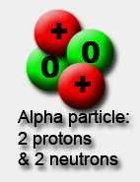

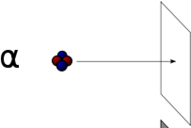
1- Alpha particle decay:
Alpha particles are made of 2 protons and 2 neutrons.
We can write them as they're the same as a he
, or , because nucleus.
lium
This means that when a nucleus emits an alpha
particle, its atomic number decreases by 2 and its
atomic mass decreases by 4.
Alpha particles are relatively slow and heavy.
They have a low penetrating power - you can stop them with just a sheet of paper.
Because they have a large charge, alpha particles ionise other atoms strongly.
Alpha-decay occurs in very heavy elements, for example, Uranium and Radium.
5

Slide 6
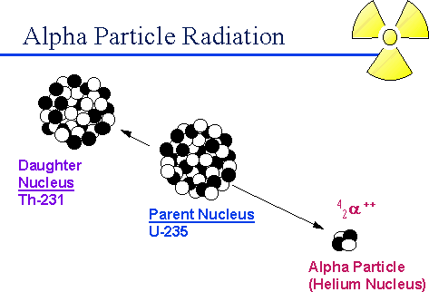
6

Slide 7
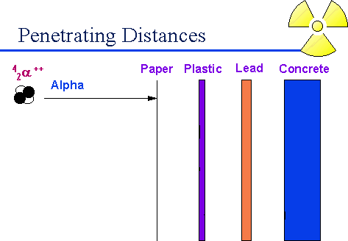
Since alpha particles cannot penetrate the dead layer of the skin, they do not present a hazard from exposure external to the body.
However, due to the very large number of ionizations they produce in a very short distance, alpha emitters can present a serious hazard when they are in close proximity to cells and tissues such as the lung. Special precautions are taken to ensure that alpha emitters are not inhaled, i₇ngested or injected.

Slide 8
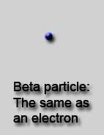

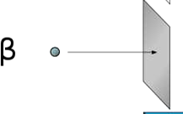

2- Beta particle decay:
Beta particles have a charge of minus 1. This means that beta particles are the same as an electron.
We can write the or , because they're the same as an electron.
This means that when a nucleus emits a - particle: the atomic mass is unchanged
the atomic number increases or decreases by 1.
They are fast, and light.
m as
Beta particles power - they aluminium.
have a medium
are stopped by
penetrating
a sheet of
Example of radiopharmaceutical emits , phosphorus-32
Beta particles ionise atoms that they pass, but not as strongly as alpha particles do.
8

Slide 9
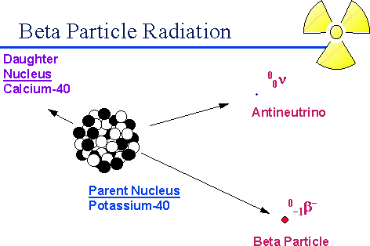
9

Slide 10
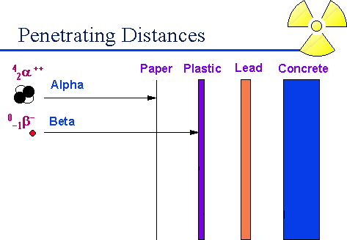
Beta particles are much less massive and less charged than alpha particles and interact less intensely with atoms in the materials they pass through, which gives them a longer range ¹⁰than alpha particles.

Slide 11
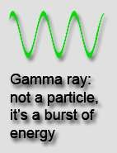
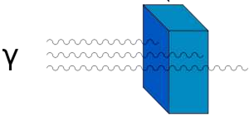
3- Gamma ray:
Gamma rays are waves, not particles. This means that they have no mass and no charge.
in Gamma decay:
atomic number unchanged
atomic mass unchanged.
Gamma rays have a high penetrating power
- it takes a thick sheet of metal such as lead to reduce them.
Gamma rays do not directly ionise other atoms, although they may cause atoms to emit other particles which will then cause ionisation.
We don't find pure gamma sources - gamma rays are emitted along side alpha or beta particles.
11

Slide 12
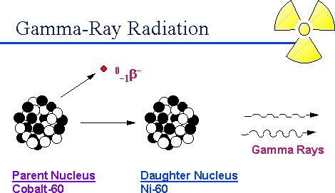

Slide 13
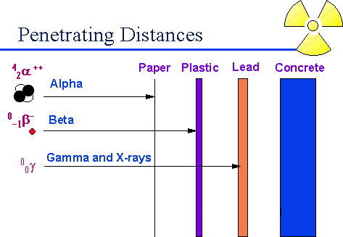

Slide 14

3- Gamma ray:
Useful gamma sources inculde Technetium-99m, which is used as a "tracer" in medicine.
This is a combined beta and gamma source, and is chosen because betas are less harmful to the patient than alphas (less ionisation) and because Technetium has a short half-life (just over 6 hours), so it decays away quickly and reduces the dose to the patient.

Slide 15
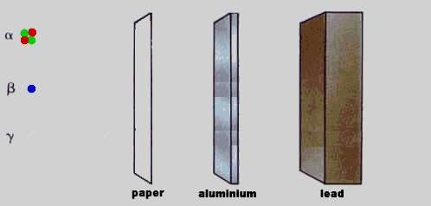
Alpha particles are easy to stop, gamma rays are hard to stop.

Slide 16



Mode of radioactive decay:
Type of Radiation | Alpha particle | Beta particle | Gamma ray
Symbol | or
Charge | +2 | -1 | 0
Speed | slow | fast | Very fast
Ionising ability | high | medium | 0
Penetrating power | low | medium | high
Stopped by: | paper | aluminium | lead

Slide 17

Production of radionisotopes
Reactor irradiation-fissionable material(uranium) taken In moderator and neutron fluxing on uranium forms isotopes.
Cyclon Irradiation-Bambarding of atoms causes generation of radioactive isotopes.

Slide 18
Measurement of radioactivity
Ionization of Chamber-Ionization chamber filled with gases and fitted with two electrodes.When radiation passes over it,causes ionization of gas molecules and forms ions.that ions moves to cathode and anode and produce electricity.According electricity ampilcity determines radioactivity
Proportional counters-in this application of potential electones causes bursting of gases and forms more electron.This electron moves to anode.Generates electric current.Showes radioactivity in terms of curie.
Geiger-Muller counter-These are most popular Radiation detectors.They can detect alpha,beta,gamma radiation.Geiger Muller contains chamber filled with gas under low atmospheric pressure.Ionization of gas molecule by radiation forms electric current.electric current showes activity in terms of curie
18

Slide 19
Handelling and storage of Radioactive isotopes
Precaution during handling and storage of radioactive substances
One should not touch radioactive emitter with hand but it should be handeled by means of foreceps
Smoking,eating and drinking activity should not be done in laboratory where the radioactive materials handeled
Sufficient protective clothing have to be used while handling
the materials
Radiactive materials have to be stored in suitable labelled containers,shielded by lead bricks
Area where radioactive materials have to been stored or
used should be monitored.
Disposal of radioactive materials should be carried out with great care
19

Slide 20
Application of Isotopes
Radiation source in therapy-it produces destructive role because radiation has ability to cause radiation.they destruct cancerous cell by ionization.e.g Sodium phosphate is(³²p) used in therapy of blood cancer
Diagnostic purposes-Labeled cyanocobalamine finds use for measuring glomerular filteration rate and sodium rose bengal used in liver function test
Research-In research isotopes are used as tracers
Sterilization-Radiation are use in sterilization of instrument in hospital and final packed container.Radiation cause ionization of bacteria,viruses,fungi,pathogenic bacteria.Hence it is used in sterilization.e.g Cesium used for sterlization of surgical instrument.
Determination of hypothyroidism and
hyperthyroidism
20

Slide 21
Radio-Opaque contrast media
Defination -are the substances having property of casting shadow on x-ray films. These substances are having ability to stops X-ray and hence appear opaque on x-
ray examination.such preparation is known as x-ray contrast media.
X-ray passes through high atomic number.The bone is very harder hence by passing x-ray gives x-ray film image.hence it is used for diagnosis
But soft tissue having less atomic number can able to pass x-ray hence we cant take x-ray of soft tissue.hence for imaging or casting the x-ray of soft tissue the radio- opaque contrast media are used
These compounds administered by systemic i.e orally and intravenously
These compounds have been successfully for examination of gastrointestinal tract,kidney,liver,gall bladder,blood vessels of heart
E.g Barium Sulphate
Classification of Radio-opaque contrast media
Water soluble contrast media
Water insoluble contrast media

Slide 22
Ideal requirement of radio-opaque contrast media
It should have high solubility
It should have high stability
It should not have any pharmacological effects
It should excrete rapidly with no toxic effects
It should stay in the body for sufficient x- ray visualisation
It should concentrate in selectively in the concerned organs
It should have adequate radio-opacity

Slide 23
Barium Sulphate
Synonym - barium meal,shadow meal
Molecular formula-BaSO₄
Molecular wt-233.4
.

Slide 24
Properties-Fine,odourless,tasteless,odourless,free from grittiness.It is iinsoluble in water
Storage-It should be stored in a well closed container
Use-Barium sulphate is a diagnostic drug which is used medicinally in x-ray examination.It is administered by enema before x-ray examination in the form of barium meal to make intestine opaque to x-ray examination

