Slide 1

Industrial Automation
SCADA-2

Slide 2
SCADA
SUPERVISORY CONTROL AND DATA ACQUISITION

Slide 3
SCRIPTS
It is the combination of logical operators which are written in a statement.
It is used to run the applications made or stimulate before final execution.
Various types of scripts make project execution simpler for programmer.

Slide 4
SECURITY
Every application has to be secured from unauthorized users by different security levels .
In SCADA this security can be given as a whole as well as individually.

Slide 5
RECIPE MANAGEMENT
One of the finest feature of any scada .
It explains that we can maintain various recipes of different process and implement it on the process.
All the recipes are stored in a single server and it can be fetched by any client server from any area to run the process.

Slide 6
NETWORKING
It explains we can share SCADA applications on LAN or Internet as well exchange of data is possible.
Lot many Networking protocols are supported by Scada software.
Can be put on networking with other peripherals and processors with various networking topologies.

Slide 7
COST ANALYSIS
Cost of SCADA is decided by two factors. Number of tags and packages.
Packages are DRN and RN
DRN stands for development ,runtime & networking.
RN stands for run and networking.

Slide 8
TAGNAMES & TAGTYPES
Every symbol used in software has to be specified name .
The logical name given to any symbol is said to be tagname.
Tagtypes defines the symbol category. It may be discrete , analog or strings.

Slide 9
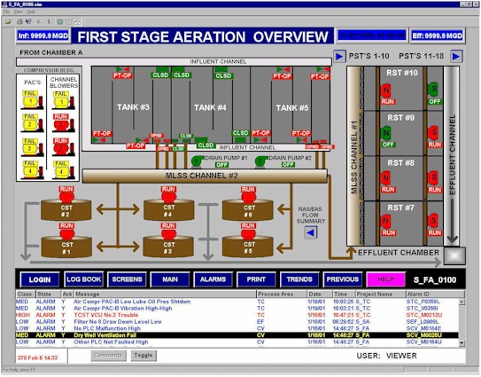
Scada Applications

Slide 10
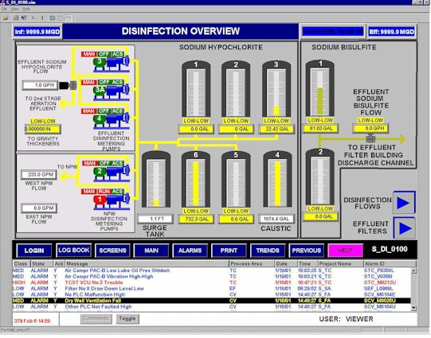
CHEMICAL PROCESS

Slide 11
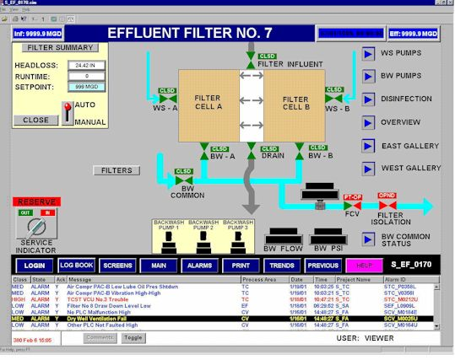

Slide 12
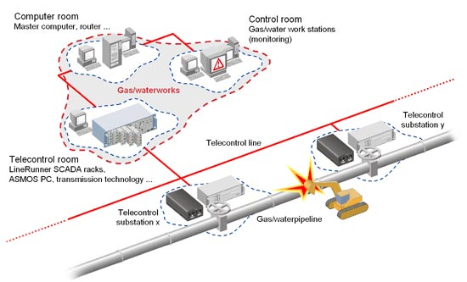
GAS & WATER PIPELINE

Slide 13
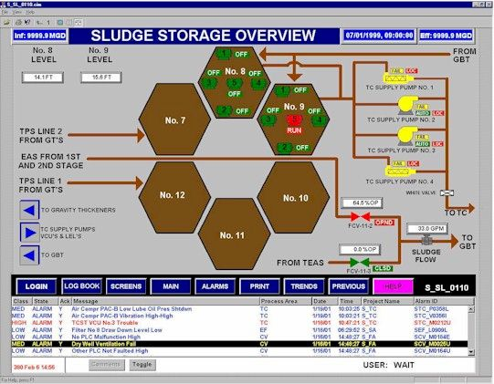
SLUDGE PROCESS

Slide 14
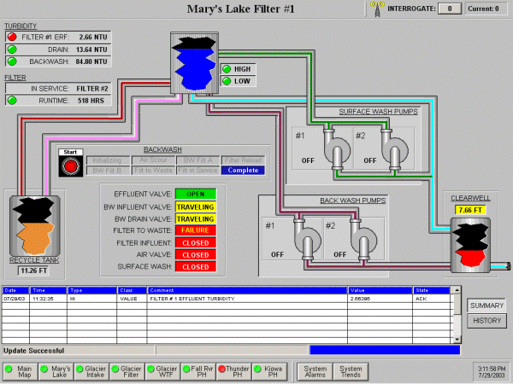
LAKE FILTER

Slide 15
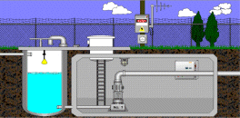
RESERVIOR MANAGEMENT

Slide 16
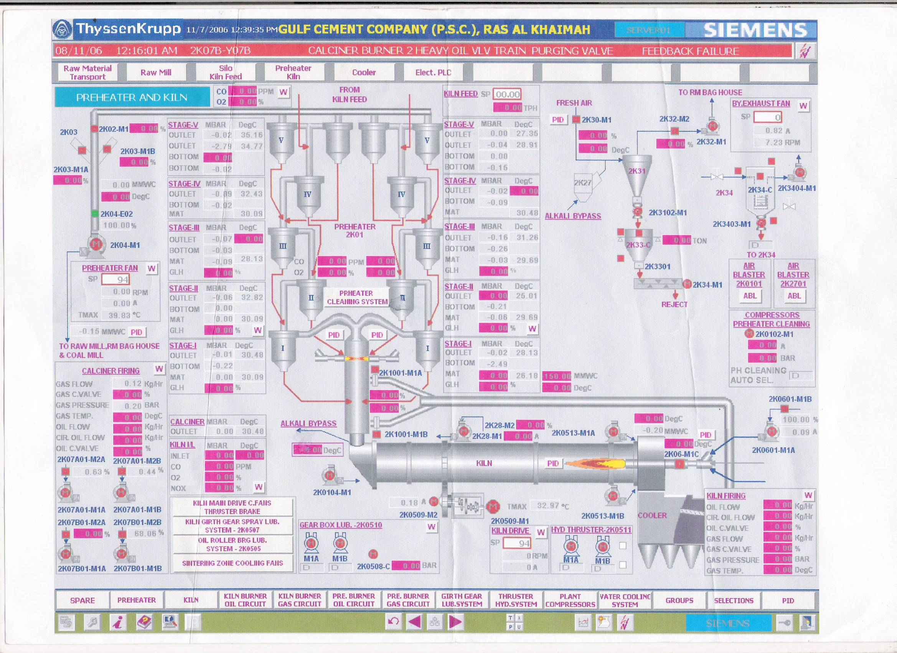
CEMENT FACTORY PROCESS

