Slide 1
DAIRY FARMING
ABC01(0-4-0)
Session: 1
Skills of identification of different breeds of Cattle and buffalo with respect to their production capability. Distinguished body features – udder, milk vein, teds, etc, their special care in the farms- handling and restraining of animals of different stray.

Slide 2
BREEDS OF CATTLE
Milch Breeds
Gir
Sahiwal 3)Red Sindhi
4) Tharparker

Slide 3
Dual Purpose Breeds
Hariana
Ongole
Kankrej
Deoni
Nimari
Dangi
Mewati
Rathi

Slide 4
Drought purpose Breeds
Hallikar
Amritmahal
Khillari
Burger
Nagori
Bachaur
Malvi
Kenkatha
Kherigarh
Kangayan
Ponwar
Siri
Gaolao
Krishna valley
Red Kandhari
Vechur

Slide 5
Gir
This breed is otherwise known as Desan, Gujarati, Kathiawari, Sorthi, and Surati.
Originated in Gir forests of South Kathiawar in Gujarat.
Basic colours of skin are white with dark red or chocolate-brown patches or sometimes black or purely red.
Horns are peculiarly curved, giving a ‘half moon’ appearance.
Milk yield ranges from 1200-1800 kgs.
Age at first calving 45-54 months and inter calving period from 515 to 600 days.

Slide 6
Sahiwal
Originated in Montgomery district in present Pakistan.
This breed otherwise known as Lola (loose skin), Lambi Bar, Montgomery, Multani, Teli.
The colour is reddish dun or pale red, sometimes flashed with white patches.
The average milk yield of this breed is between 2,725 and 3,175 kgs in lactation period of 300 days

Slide 7
Red Sindhi
This breed is otherwise called
as Red Karachi and Sindhi.
This breed mostly found in Karachi and Hyderabad district of Pakistan.
Colour is red with shades varying from dark red to light, strips of white.
Milk yield ranges from 1100- 2600 kgs.
Widely used in crossbreeding programmes.
Age at first calving 39-50 months and inter calving period from 425-540 days.

Slide 8
Tharparkar
Originated in Tharparkar district of southeast Sind in Pakistan.
Otherwise known as White Sindhi, Gray Sindhi and Thari.
Body colour is white or light grey.
The bullocks are quite suitable for ploughing and casting and the cows are good milch animals (1,800 – 2600 kgs).
Age at first calving ranges from 38-42 months and inter calving period from 430 to 460 days.

Slide 9
ANIMAL HANDLING AND RESTRAINT
Animal restraint is the process of preventing an
animal from action or motion.
An animal may require restraint for examination, treatment and milking.
Restraint can be achieved simply by moral persuasion, by physical force and by chemical means.

Slide 10
Types of Restraint:
Verbal restraint
Physical restraint
Simple restraint of cattle
• Nose Ring
• Milkman’s rope
• Bull holders
• Bull leader
• Nose String
• Udder kinch

Slide 11
Casting of cattle
• Reuffs method
• Indian method
1. Reuffs method
• A running noose is made at the end of at 30’ rope and passed round the base of the horses.
• A half hitch is next made round the neck a second round the chest immediately behind the elbows and a third round the abdomen in front of the udder or scrotum.
• The rope is pulled by two persons.
2. Indian method
• A long rope about 30’ in length is taken and a loop is made.

Slide 12
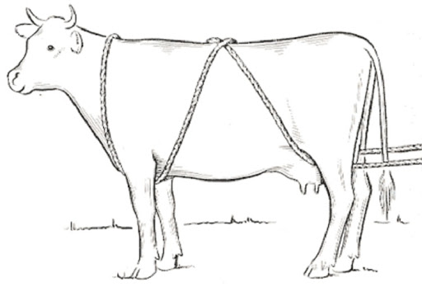
Other methods of casting

Slide 13
SAFETY DURING ANIMAL HANDLING
STEP 1:- CLOTHING
The examiner should
wear
Lose clothes.
Avoid bright color cloths. Wear proper suit.

Slide 14
STEP 2:- HEALTH CONDITION
If the examiner is unhealthy or
Suffering from any disease there is strong possibility that his illness became severe.
STEP 3:- APPROACHING
No sudden movement
while approaching.
The examiner should approach from the left or right head side of the animal.

Slide 15
RESTRAINT TECHNIQUES
Rope :-
Rope is the most cheapest and
Easy tool for restraining
large
Or small animal.
Examiner must be familiar with basic rope work.
Examiner should know some quick and easy knots.

Slide 16
Head And Tail Raising Techniqueu
This technique are applied to prevent animal from kicking or hitting the examiner with tail during the examination
Leg Raising
Tail Raising
Front Leg Tie

Slide 17
HEAD RESTRAINT TECHNIQUE:-
A halter is used to restraint the head of animal from unnecessary movement
Also the rope is lied to the nose ring so that animal
didn’t show any resistant
Halter
CASTING OR THROWING:-
If you don't have crush and you
Want to trim the hooves of animal this technique is use full

Slide 18
NOSE LEAD TECHINQUE
This technique is majorly use to restrain male cattle that kept for breading and beef purpose
In this method metal ring is fixed between the wall of two nostrils which contain sensitive tissue and restrain the animal from unnecessary movement

Slide 19
CATTLE CRUSH TECHNIQUE
A cattle crush is a strongly built cage for holding animals safely which they are examined or given veterinary treatment…
Cattle crush
Cattle crush use a current of 9
volts so that animal didn’t hit on the
wall of crush…
Stand straight

Slide 20
MILKING HOBBLES TECHNIQUE
METAL hobble
Rope hobble
The animal are tied using a rope or metal hobbles so that animal didn’t kick
This is done in female animal when milking or when going to give birth

Slide 21
RESTRAINT TECHNIQUES FOR SHEAP AND GOAT
Do not attempt to keep sheep or goat from moving by pulling on its head, horn or hide. He will quickly become excited and resist.
Restraint between legs:-
Straddling the animal
between the handler’s legs, and squeezing the sheep shoulder between the legs.

Slide 22
RESTRAINT FOR HOOF TRIMING AND EXAMINATION:-
HOOF EXAMINATION
Sheep or goat should be set up on their rump.
If they are to be vaccinated in the groin, it will be sufficient restrain to tilt him backward so that he is off balance.
HOOF TRIMING
Sheep or goats should be held the same way for hoof trimming or
for vaccination in the groin.

Slide 23
RESTRAINT FOR POULTRY:-Holding chicken in one
hand for examination
Pass middle finger between its legs and other finger slightly spread apart to support the body, other hand can be used for examination
Another method use to handle poultry is to place one hand under the chest of the bird and place it in between chest and arm

Slide 24
Thank you

Slide 25
By: Dr. Abhishek Hota

Slide 35
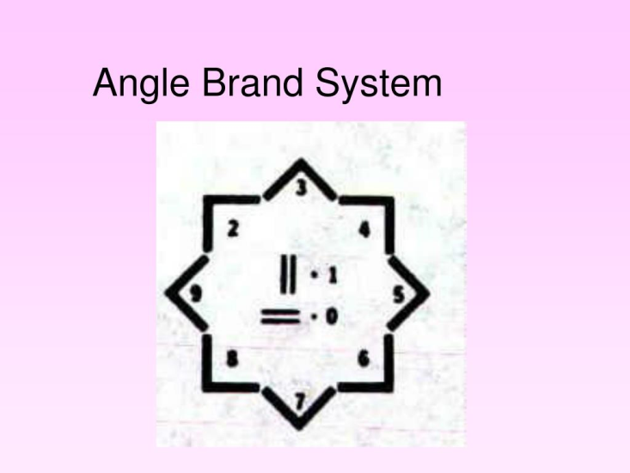

Slide 64
Thank you

