Slide 1
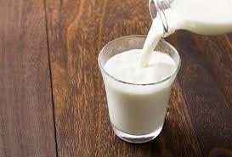
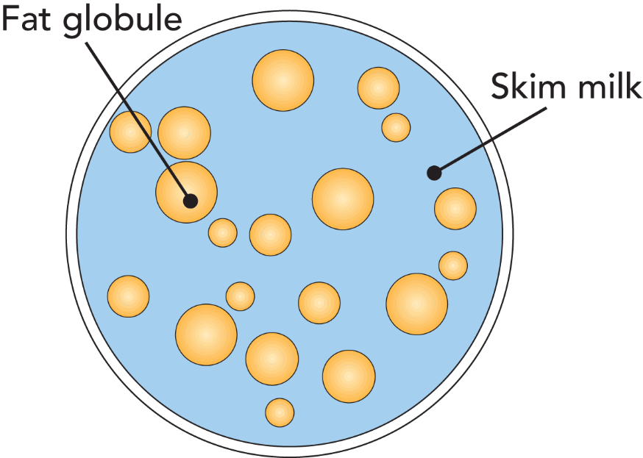
Constituents and gross composition of milk
Dr. Soma Maji

Slide 2
Definition of milk
Milk may be defined as the whole, fresh, clean, lacteal secretion obtained by the complete milking of one or more healthy milch animals, excluding that obtained within 15 days before and 5 days after calving to avoid colostrum milk and should contain minimum prescribed percentage of milk fat and milk Solid Not Fat.
(De, 1980)
Gross Composition of cow milk
Component | Average Content percentage (w/w) | Range Percentage (w/w) | Average % of Dry matter
Water | 87.3 | 85.5 -88.7
Solids not fat | 8.8 | 7.9-10.0 | 69
Fat | 3.9 | 2.4-5.5 | 31
Protein | 3.25 | 2.3-4.4 | 26
Lactose | 4.6 | 3.8-5.3 | 36
Casein | 2.6 | 1.7-3.5 | 20
Mineral substances | 0.65 | 0.53-0.80 | 5.1
Organic acids | 0.18 | -- | 1.4
Walstra and Jenness, 1984)

Slide 3
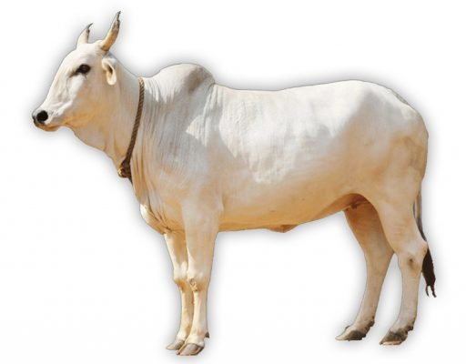
Gross composition of milk from different species of mammals
Composition (g/100g) | Human | Cow | Buffalo | Goat | Sheep | Horse | Camel
Water | 87.1 | 87.3 | 82.8 | 86.7 | 82.0 | 88.8 | 86.5
Fat | 4.5 | 3.9 | 7.4 | 4.5 | 7.2 | 1.9 | 4.0
Casein | 0.4 | 2.6 | 3.2 | 2.6 | 3.9 | 1.3 | 2.7
Whey Protein | 0.5 | 0.6 | 0.6 | 0.6 | 0.7 | 1.2 | 0.9
Lactose | 7.1 | 4.6 | 4.8 | 4.3 | 4.8 | 6.2 | 5.0
Ash | 0.2 | 0.7 | 0.8 | 0.8 | 0.9 | 0.5 | 0.8

Slide 4
Major constituents of milk
The major constituents of milk are, water, fat, proteins, lactose, minerals and
miscellaneous compounds.
1. Water
It is the medium in which all the milk constituents are dispersed. It is a universal vehicle and plays an important role in the physical properties exhibited by the milk. It also assists in maintaining the much desirable equilibrium and keeps the constituents of the milk in their native state. Water acts as a solvent in keeping the constituents in soluble, colloidal or emulsion form and influences the collegative properties of milk.
2. Fat
Fat is the costliest component of milk. It is characterized by its presence as an emulsion. The unique feature of milk fat is its fatty acid composition. Milk fat is rich in saturated fatty acids and mono unsaturated fatty acids and also acts as a carrier for the fat soluble vitamins. The unique feature of the milk fat from ruminants is that they are having short chain saturated fatty acids in substantial quantities and imparts the unique flavour to the milk and milk products. Presence of long chain unsaturated fatty acids reduce the melting point of milk fat. In order to maintain the emulsion stability several surface active substance are also associated with the milk fat and present in higher proportion in fat globule membrane.

Slide 5
3. Proteins
Milk is rich in protein content and has a unique protein namely the casein. It is present in the form of colloidal dispersion in milk and is responsible for several physical properties of milk. It also supplies all the essential amino acids, hence a complete protein and is easily digestible. In addition to casein, milk also contains (other) proteins which are known as whey proteins. Milk is a biological secretion of living cells synthesized through several (enzyme mediated) biochemical reactions (which are often mediated through enzymes). It is a well known fact that these enzymes are basically protein in nature and act as biological catalysts. Milk is a good source for several enzymes which have both desirable and also undesirable effect on preservation and processing of milk.
4. Lactose
Lactose is a major soluble component present in milk. Milk contains approximately 4.6% carbohydrate that is predominately lactose with trace amounts of monosaccharides and oligosaccharides. Lactose is a disaccharide of glucose and galactose. It is first carbon source for the microbes gaining entry into milk. It is a reducing sugar and is present in soluble state. It is a good source of energy for the young ones. In addition to lactose, milk also contain several other carbohydrates in trace levels (negligible).

Slide 6
5. Minerals
Minerals in milk are mainly inorganic salts, partly ionized and partly present as complex salts. Some inorganic matter is bound covalently such as calcium phosphate groups in casein. They are responsible for the ionic balance of milk and helps in maintaining the equilibrium between the soluble and colloidal state.
6. Vitamins
Milk contains almost all the essential vitamins which include fat soluble and water soluble vitamins. It is a very good source for the most essential fat soluble vitamin namely the Vitamin A. It is also interesting to observe that this vitamin is existing in the cow milk in its precursor form i.e. carotene a provitamin A imparts golden yellow colour to milk. Milk is not a good source of Vitamin K and Vitamin C.
7. Miscellaneous compounds
Milk contains many components which are in low concentrations (less than 100 mg/liter) which do not fall into any of the above categories. These compounds may be considered as natural if they present in freshly drawn milk and have been detected in most samples tested for that component. The compounds considered in this category are gases, alcohols, carbonyl compounds, carboxylic acids, conjugated compounds, non protein nitrogenous compounds, phosphate esters, nucleotides, nucleic acids, sulfur containing compounds, hormones etc.

