Slide 1
Skill course on Poultry Farming
ABC01(0-4-0)
Session: 2
Layout of poultry houses for meat-type breeds and egg type breeds, planning and construction of poultry houses in deep litter system and cage system of rearing floor space, requirement, bedding material preparation etc.

Slide 2
Housing of broiler
The housing of broiler is done based on deep litter system.
Housing is play a crucial role in growth and performance of birds
LITTER
material used as bedding for animals
LITTER TYPE
✴ type of flooring utilizing the most commonly
available materials such as rice hull and rice
straw and wood shavings over the cemented floor
SLOTTED TYPE
✴ type of flooring with openings to facilitate cleaning of the droppings

Slide 3
SLOT – LITTER TYPE
combination of slotted and litter type
flooring wherein slats cover 60% of
the total floor area and 40% is covered with litter.
COMMUNITY NEST
✴ Large nesting boxes for 3 - 6 layers
Location: The location shall conform to the land use plan of the area. The site shall be accessible to service roads, water supply and electric lines. The site shall be well drained and allows for free air circulation. The building shall be constructed in an east-west orientation and the structure for marketable animals shall be located near the service road. The site shall be located where the prevailing winds will not carry odors to the farmhouse.

Slide 4
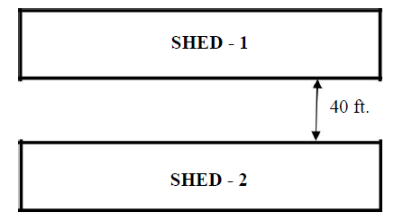
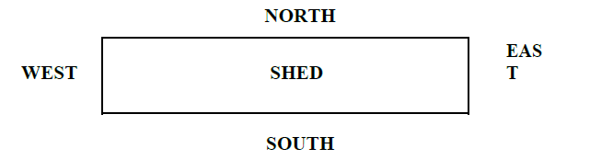
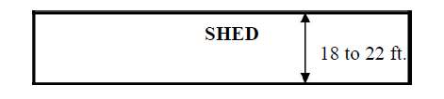
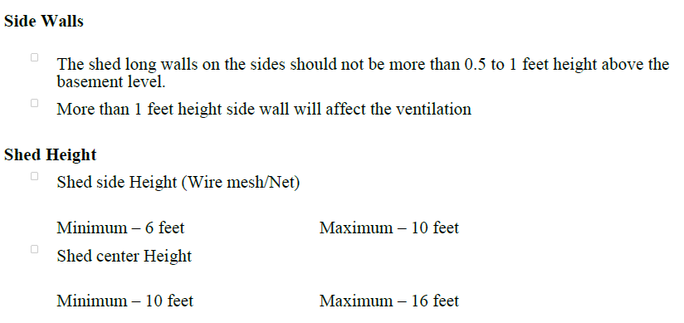

Slide 5
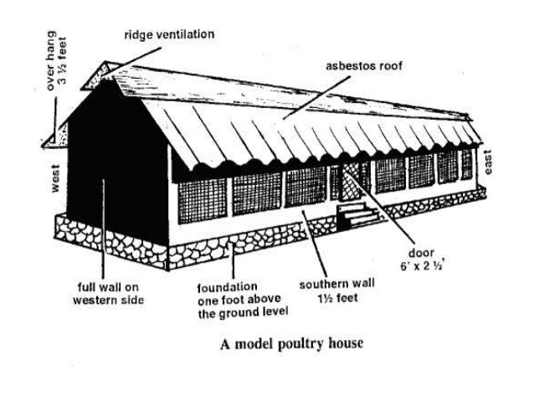

Slide 6
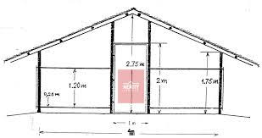
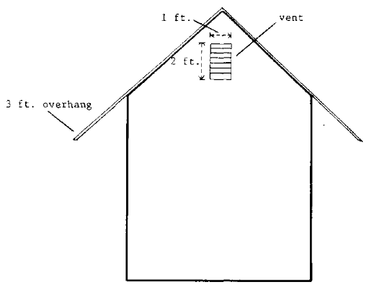

Slide 7
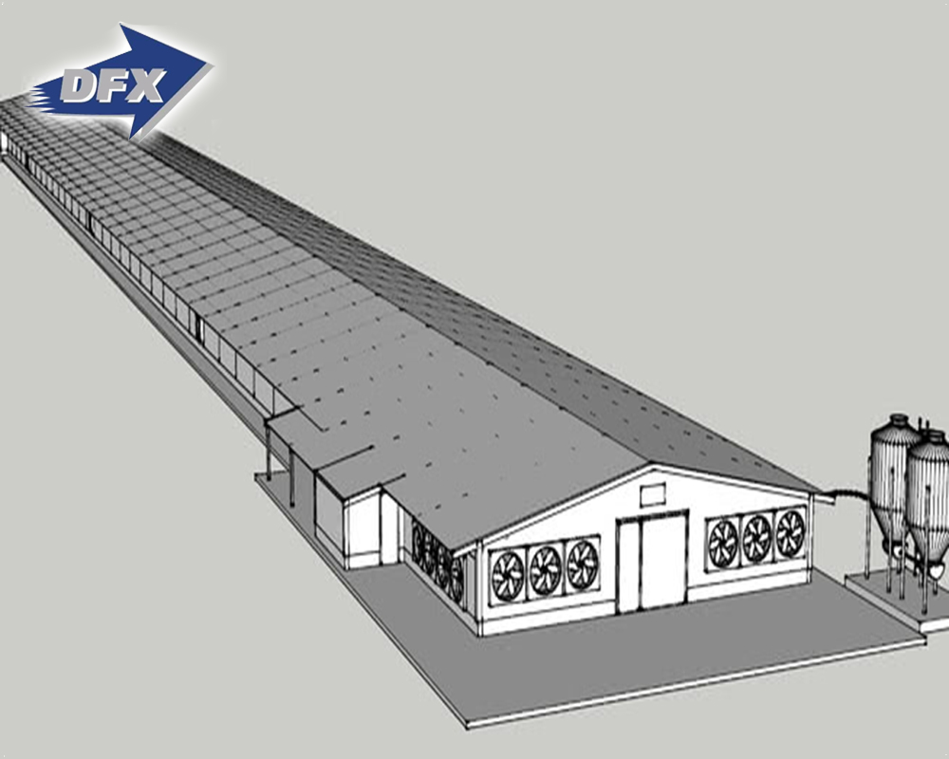
Tunnel ventilation

Slide 8
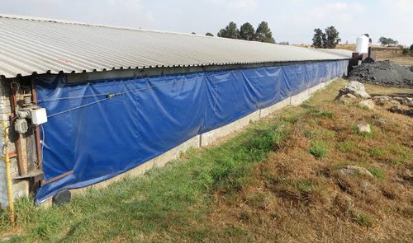

Slide 9
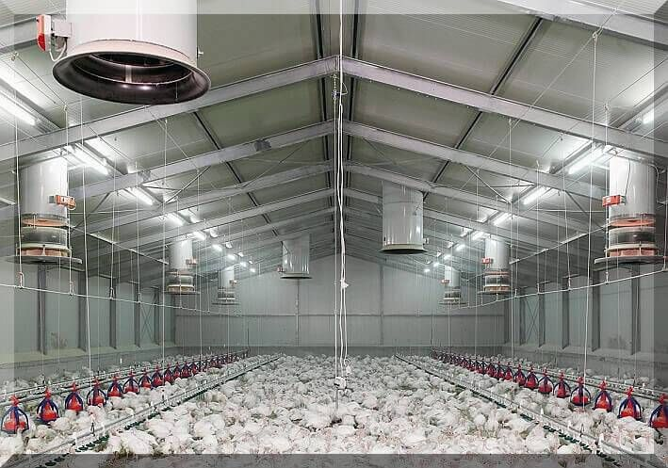
EC houses

Slide 10
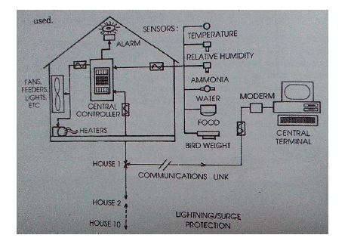

Slide 11
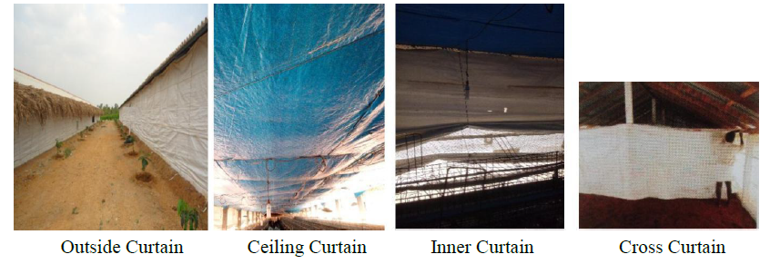
Types of curtains

Slide 12
Housing of layer
For layer birds, two system of housing can be followed
Deep litter system as broiler
Cage system

Slide 13
CLASSIFICATION
Type of confinement
✴ pen (floor production)
✴ cage (cage layer production)

Slide 14
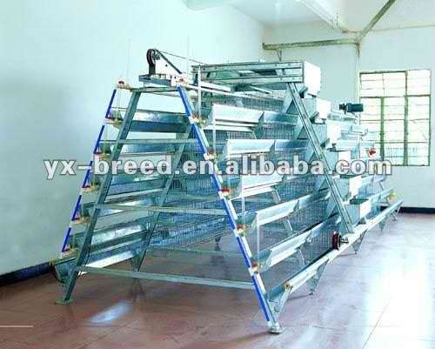
PEN

Slide 15
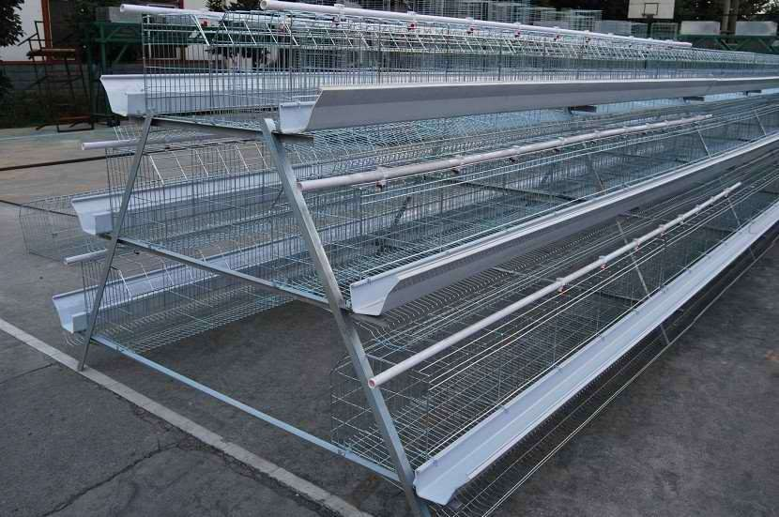
CAGE

Slide 16
CLASSIFICATION
Type of Flooring
litter type
slotted type
slot-litter type

Slide 17
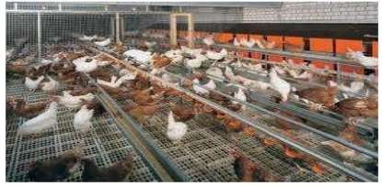
SLOTTED TYPE

Slide 18
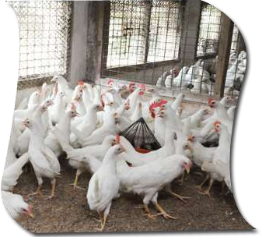
LITTER TYPE

Slide 19
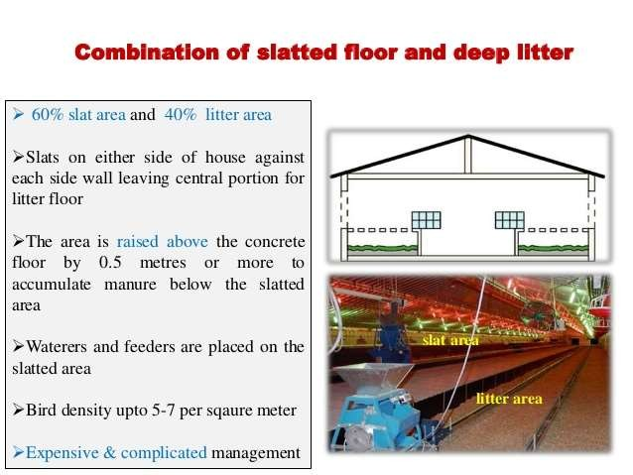
SLOT- LITTER TYPE

Slide 20
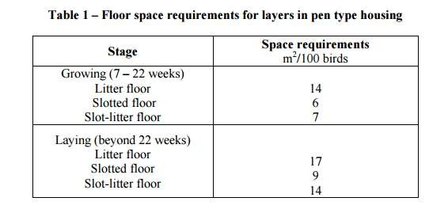

Slide 21
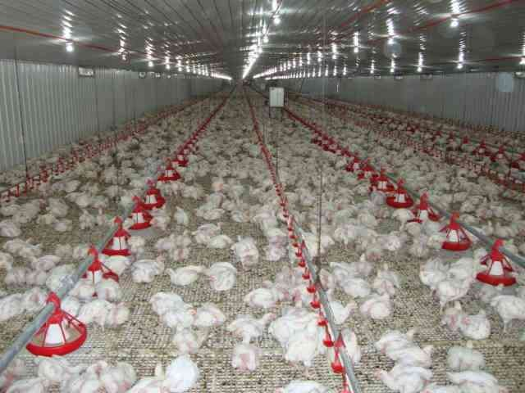
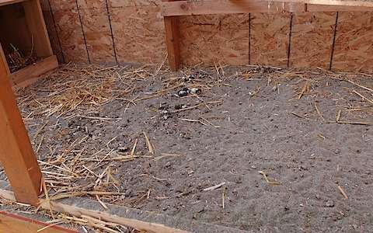

Slide 22
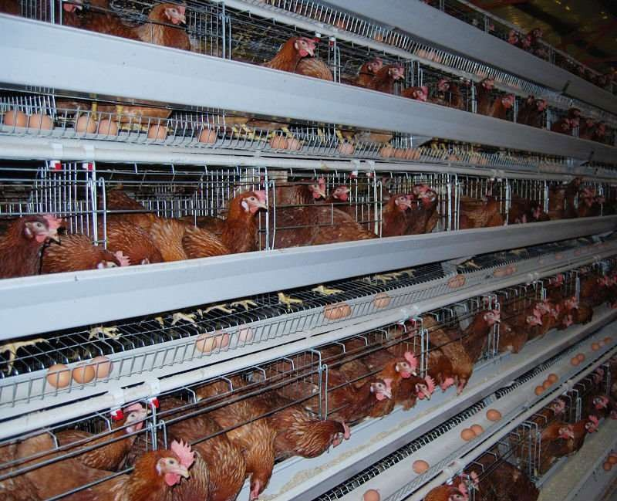
CAGE TYPE
The minimum space requirement for birds in cages shall be 5m2 /100 birds.

Slide 23
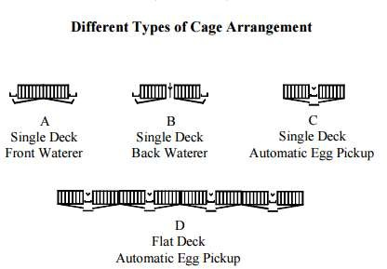

Slide 24
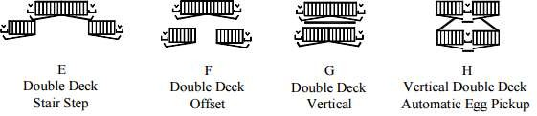

Slide 25
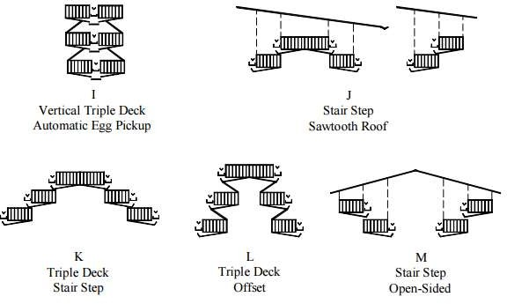

Slide 26
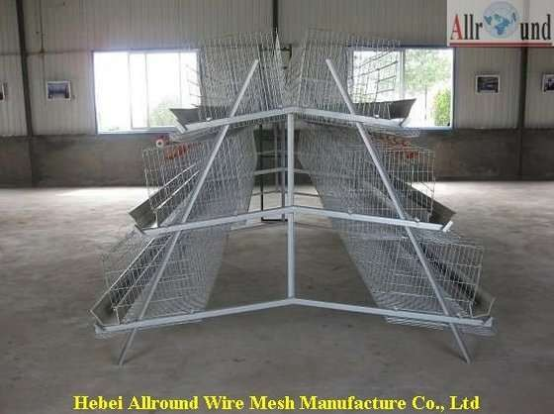
TRIPLE DECK OFFSET

Slide 27
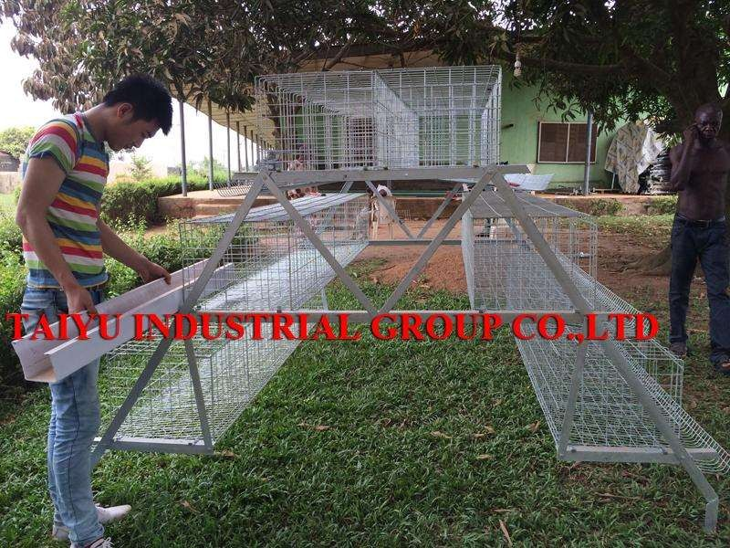
TRIPLE DECK STAIR STEP

Slide 28
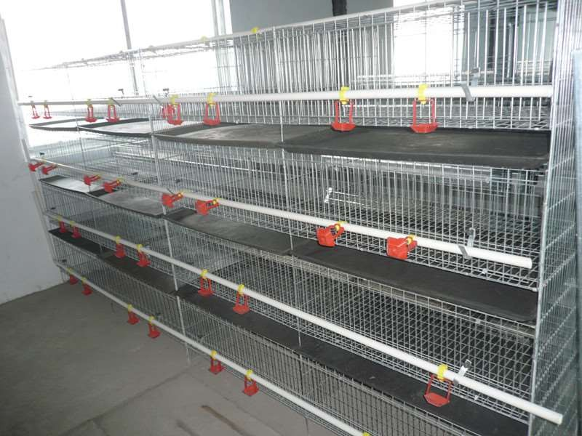
VERTICAL DESK

Slide 29
Thank you

