Slide 1
Skill course on Poultry Farming
ABC01(0-4-0)
Session: 2
Skills of cleaning of poultry layers in case of deep litter system for broiler and layers- partial replacement of litter material in case of layer birds, sterilization techniques of littering material, feeders and water fountain etc.

Slide 2

Mixture of chicken manure and bedding material.
Poultry litter is used in confinement buildings for raising broilers, turkeys and other birds.
Is a soft, fibrous plant material which absorbs moisture and is harmless to the birds.
Litter materials:
Ricehusk, sawdust, ground nut hulls, ground maize cobs,wood shavings, chopped straw, sugarcane bagasse, peanut hulls..

Slide 3
Provides media for absorbing moisture from faecal matter
Protects the feet of the birds from direct exposure to the floor ( cushion like)
Bumble foot
Foot sores

Slide 4

Must absorb moisture from dropings.
Release moisture and dries up rapidly.
Free from mould growth
Non toxic
Locally available
Biodegradable

Slide 5

a concrete floor is advised for a perfect disinfection at the end of each batch.
About 3-5” of litter should be put into the house initially and, as this breaks down, more should be added till a depth of about 8-12” is reached.
Before adding fresh litter material, remove the caked up and wet litter material.
Rack the litter thoroughly to break the clumps with the help of the litter racker and allow it to dry.

Slide 6
 Sprinkle a mixture of wood ash and fertilizer
grade superphosphate in the ratio of 4:1, at the ratio of 5 kg per 10 m2 area, before racking the litter to prevent ammonia gas release from litter.
 Addition of slaked lime may be avoided that will increase the pH of the litter which in turn release more ammonia from the litter and also favours the growth of E. coli, the most common pathogen of poultry

Slide 7
At the beginning the litter contains only 12% moisture.
If the moisture level exceeds 30% due to poor ventilation, too many birds, irregular stirring or damp floor, the litter will cease to function efficiently. Because the manure digesting bacteria can be active only within 30% moisture level of the litter.
Some time many birds will bear “balls” made of litter materials at their claw tips. Ball formation is a sign of bad litter management.

Slide 8
Built-up litter has a very important role in providing warmth to the birds in winter.
In winter the litter depth can be increased to 10-12” while in summer it may be reduced to 2.5-4”.

Slide 10

The amount of moisture in poultry bedding affects performance, health and even fuel costs.
Ideally, moisture levels should not exceed 25-30% and RH% should be managed constantly between 50-70%.

Slide 11
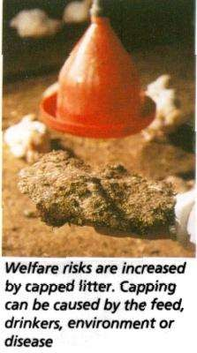
More than 30 % following problems arise
Become wet and form cakes
Generate more heat due to fermentation
More ammonia gas
Coccidiosis
Parasitic and respiratory diseases

Slide 12
More humidity – wet litter – leads to coccidiosis, warm burden
Less humidity – dusty litter - respiratory distress
Litter should be properly mixed daily
Ammonia level produced by litter should not exceed 25ppm
More ammonia level causes irritaion of eyes, stunted growth, drop in egg production and immune suppression

Slide 13
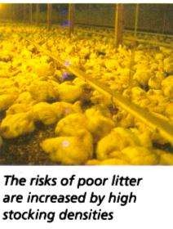
 Ventilation. Proper house ventilation is the primary and one of the most basic means available to maintain good litter quality and proper poultry litter management.

Slide 14
PH-alkaline (atleast 8)
Few bacteria and moulds can survive
Fermentation---heat-drying of litter

Slide 15

The dropping from chicken when mixed with litter synthesizes Riboflavin (Vitamin B2) and Vitamin B12 by the chemical and bacterial actions.
The built-up litter also contains niacin, phosphorus, potassium, magnesium, sodium and calcium.
Deep litter bird often pecks and eats a small quantity of litter material which contains above nutrients. This phenomenon is known as recycling.
Even if the poultry feed is slightly deficient in some of the nutrients, the deep litter birds will not show any deficiency symptoms due the recycling of nutrients

Slide 16
Poultry industry produces 2 million tonns of litter per year.
Compared with cow dung poultry mannure 10 times rich in fertilizer constituents.
 NPK – 3:2:2
Layer bird produces 16 kg dried mannure in a year in cage
18 kg in deep litter
Broiler - 1.5 kg mannure
Increases soil fertility
NPK per tonne of litter is 60-50-45
Micro nutrients like magnesium, manganese, boran, zinc and sulphur.

Slide 17
It contains fair amount of protein and energy it can be used as cattle, pig & poultry feed ingredient.
Can be safely used upto 10% in poultry rations, 20 % in cattle rations.
Dried poultry mannure contain 26 % cp and ME 800 kal/kg
Wet poultry mannure used as fish feed.
Used for production of bio-gas which may be used as generation of electricity.

Slide 18
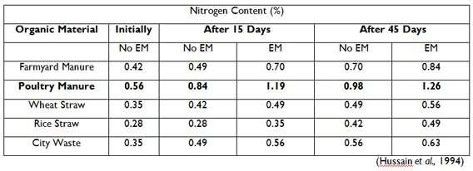

Slide 19
Oxidation ditches: aerobic fermentation of mannure occurs in open ditches.
Bacteria decompose organic matter into simpler substances like CH4/NH4, sludge and liquid mannure.
Liquid portion has NPK & can be used as fertilizer in field.
Solid sludge contain Vit. B12 and minerals, which can be used in the animal feed up to 3- 10 %.

Slide 20

Spread :
mannure is scattered on ground in thin layer which dries fast and can be applied to soil.
Dig in pits with compression: heat is generated making the material sterile to use as fertilizer.

Slide 21

Shallow covered ponds in which mannure is dumped along with liquid waste.
Here, anaerobic fermentation decomposes mannure and after 2-3 months enriched mannure can be obtained.

Slide 22

 Deep stacking of poultry waste produces considerable heat and had been shown to destroy coliforms. The maximum temperature was attained in 4-8 days and destroys the pathogenic organisms.

Slide 23
Biosecurity
Measures that should be taken to keep any diseases from a farm.
To protect from a biological threat
A Poultry Producer operates within a complex global food system.
Producers are the first line of defense in our food security system
Biosecurity is the cheapest, most effective means of disease control available

Slide 24
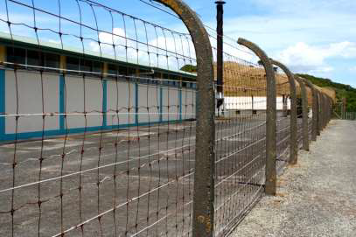
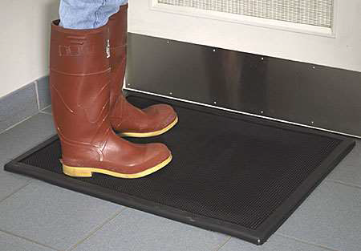
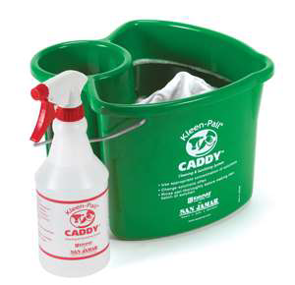
How biosecurity is achieved?
Outside Perimeter
High fences prevent intruders such as animals and people from entering the premises and possibly transmitting diseases to the flock.
Footbaths
Footbaths are placed outside the door of all facilities and contain disinfectants, reducing the risk of bringing pathogens inside the buildings.
Sanitation of Equipment and Supplies
The purpose of sanitizing equipment, surfaces, and supplies is to reduce pathogens. This is especially important in preventing the spread of diseases between neighboring flocks.

Slide 25
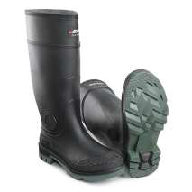
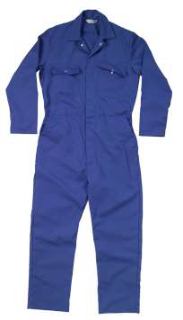
Good Hygiene
Prior to entering the facility, employees and visitors should demonstrate good hygiene by showering and wearing clean designated clothing such as boot covers, hairnets, and cover-alls.
Maintaining a flock health….
Minimize stressors to prevent increased
susceptibility to disease
◦ Fresh feed
◦ Clean water
◦ Clean, dry litter
◦ Good ventilation
◦ Provide an overall comfortable environment
Regular vaccination

Slide 26
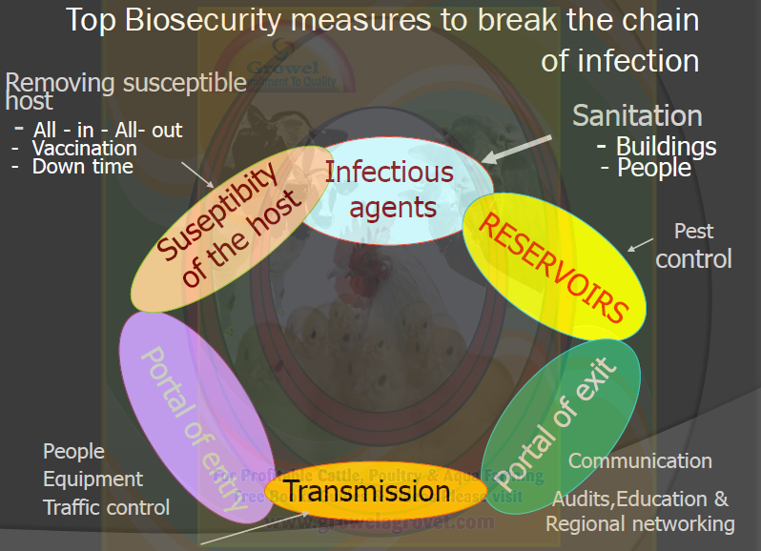

Slide 27
Cleaning and disinfection
Cleaning and Disinfection = Decontamination
Cleaning and disinfection are key components of routine biosecurity in poultry farming
Decontamination kills any disease organisms like:
virus
bacteria
parasite
mold
that might be present on a farm at the end of a production cycle or after disease outbreak
Decontamination allows for safe re-population of a farm

Slide 28
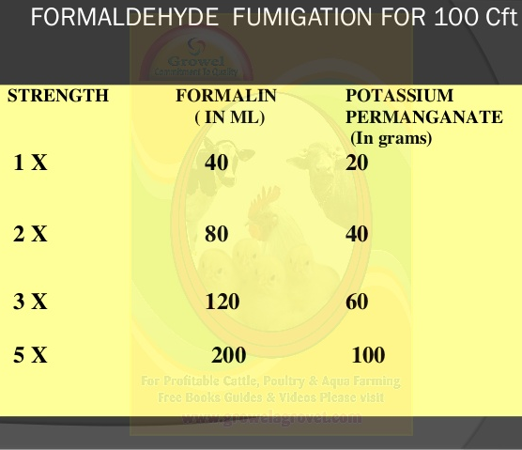
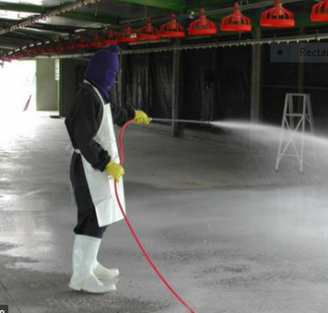
Fumigation
Fumigation is a method of disinfection or destruction of harmful disease organisms in an environment by using fumigants. Fumigants are chemicals that are released into the atmosphere in the form of gas or fume.
PPE: Personel Protective Equipement
N.B.: Leave the house locked for 1 week. After a week of locking up the house, open it and the windows and allow the residual gas to escape. Then reclose it up for the arrival of your chicks.
PPE

Slide 29
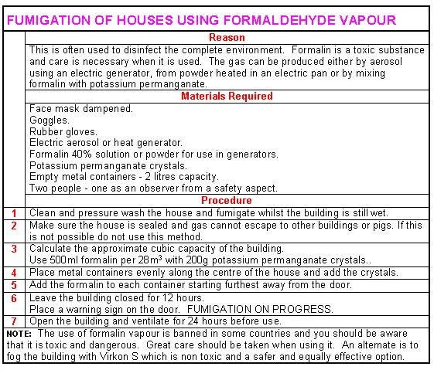

Slide 30
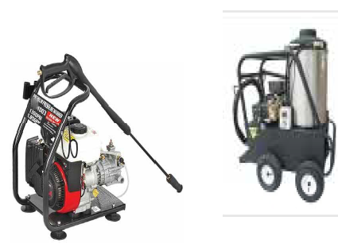
What can kill disease agents?
Detergents / soap
Disinfectants
Sunlight
Heat (direct flame or steam)
Detergents / Soaps
Warm water
Scrubbing
Brushing
Power washers
Steamers

Slide 31
Common types of disinfectants
Disinfectants are divided into several groups based on their chemical structure
Like:
• Halogens (iodophors and chlorines, halamid®, dettol®)
• Alcohols
• Oxidizing agents (hydrogen-peroxide, hyperox®, virkon®)
• Phenols (fenix®, Prophyl 75®)
• Aldehydes (glutheraldhyde – TH4®, formalin)
• Quaternary ammonium compound (Timsen® Medisep®)
N.B.: Dry cleaning and wet cleaning

Slide 32
