Slide 1
Skill course on Poultry Farming
ABC01(0-4-0)
Session: 4
Feeding & watering techniques/skills of broiler birds and layer birds, skills of controlling feed loss in poultry without affecting growth in case of broiler birds.

Slide 2
Types of food based on texture
1. Mash feed.
Mash is a form of a complete feed that is finely ground and powdered ingredients; It is well-balanced diet.
Simple manufacturing procedure is needed for mash form of feed. Mash diet gives greater unification of growth, less death loss and more economical.
There were no significant differences between birds fed on mash diet and those given pelleted diets.

Slide 3
2. Crumble feed
Crumble also is a type of feed prepared at the mill by pelleting of the mixed ingredients and then crushing the pellet to a consistency coarser than mash.
Recently this form of feed is becoming popular in broiler production due to its convenience of feeding.
In broiler and breeder growing systems was observed that best feed conversion was obtained with a feeding of high energy level with high protein profile in crumble form of feed.
Research has shown that chickens grow and lay better on crumbles (commonly used for finisher rations and some adult feeds).

Slide 4
3. Pellet feed.
Pellet feeding is really a modification of the mash system. It consists of mechanically pressing the mash into hard dry pellets or "artificial grains".
Pellet is a form of complete feed that is compacted and about 1/8 inch diameter and 1/4 inch in long.
The greatest advantage in using pellets is that there is little waste in feeding. Pellets usually used for adult birds.
Pellets are the second-best, whereas mash is the least-preferred although the most common for starter rations.

Slide 5
Types of feeding systems
1. Free choice feeding:
Feed is always available and the bird can eat at will Maximum body weight is the ultimate goal for rearing the birds
It is easy manage and no monitoring or supervision of the birds daily intake.Due to the higher cost of feed this feeding system is not very great interest.

Slide 6
2. Controlled feeding:
It is sometime attempted for a short while in first week, when birds for not learn or try to pick up their feed.
Forced feeding may be employed in other species if feed and water are denied for more than 36 hours to prevent body dehydration

Slide 7
3. Restricted feeding:
Allowing some birds an unlimited supply of feed may result in heavy body weight and leads to reduce in egg production.
Infertility and mortality may occur. Restricted feeding systems recommended for some strains of laying chicken. Restricted feeding system is essential for delaying sexual maturity.
Broiler chicks preferably after 18 days are subjected to restricted feeding up to 30-35 days to check the prolific body weight resulting metabolic diseases syndrome like ascites, gout and etc.,
Restricted feed often started in broiler breeders at 2nd week of age and continued through their laying life.

Slide 8
Nutrition
Nutrients provide poultry the energy and material needed for the development of bone, flesh, feathers, and eggs.
Feed has six major components:
1. Water: should be available 24 hr
2. Carbohydrates
3. Fats
4. Proteins
5. Minerals
6. Vitamins

Slide 9
Sources of Carbohydrates
• Rice, Wheat
• popcorn, potatoes,
• cookies, spaghetti,
• soft drinks, and corn
Sources of proteins
• Milk (Casein),
• Cereals and pulses
• Blood (haemoglobin and fibrinogen)
• Fish,
• Egg (albumin).
Amino acids are the building blocks of protein. Amino acids are of two types..
Essential amino acids
Non essential amino acids.

Slide 10
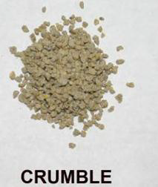
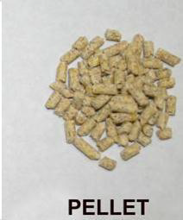
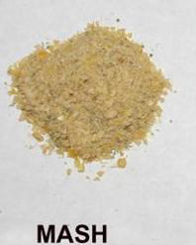
Sources of Lipids:
• Fish oil
• Bone meal
• Liver

Slide 11
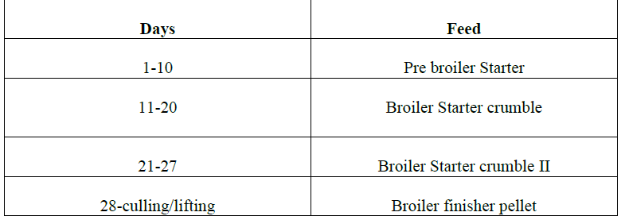
Feeding practices

Slide 12
Layer feeding management
Light: Use correct lighting schedule to ensure better performance. While light period should not be increased for growing birds, it would be advantageous to increase the light period or photoperiod for laying chicken from 22nd week of age onwards at the rate of 15 minutes per week so as to reach 16 hours of total photoperiod (natural plus artificial).
When the birds have been in lay for about 6 months, the photoperiod may be increased to 17 hours per day. The light period may be constantly maintained throughout the rest of laying period. There is no special advantage in increasing the photoperiod over 17 hours per day. The lighting programme, if started, should be followed systematically.
Feeding: A good quality layer mash should be provided to the laying birds. Ration of layer mash for chickens

Slide 13
In layer feeding management, restricted feeding is mainly practised to maintain weight or high weight will reduce the egg laying capacity.
In both broiler and layer, water should be given 24 hours.
Essential aminoacid must be included in feed ration.

Slide 14
Thank u

