Slide 1
DAIRY FARMING
ABC01(0-4-0)
Session: 2
Skills of knowing and observing of feed-in cattle and buffalo- monitoring of artificial insemination- technologies for conducting artificial insemination, insemination in farm research condition, identification of cattle and buffalo rise are in silent heat (most important in buffalo)

Slide 2
DEFINITIONS:
ESTROUS CYCLE: Reproductive cycle of
female, generally defined as period from one estrus to the next.
Two phases:
  Follicular Phase
  Luteal phase

Slide 3

DEFINITIONS :
➢
ESTRUS: Period of sexual receptivity.
Commonly referred to as “Heat”
ANESTRUS: Period when female does not
➢
experience cycles
Occurs during pregnancy, etc.

Slide 4
TYPES OF ESTROUS CYCLE
Cycle is categorized by frequency occurrence
throughout the year:
Polyestrus: Uniform distribution of estrous cycles which occur regularly throughout the year
  Example: Cattle, Swine, Rodents

Slide 5
PHASES OF ESTROUS CYCLE
FOLLICULAR PHASE:
  Short phase - only 20% of cycle
  Period from regression of corpus luteum to ovulation
  Preovulatory follicle
  Dominant hormone is estradiol

Slide 6
PHASES OF ESTROUS CYCLE
LUTEAL PHASE:
  Long phase - 80% of cycle
  Period from ovulation to corpus luteum regression
  Corpora lutea
  Dominant hormone is progesterone
  Follicle continue to grow and regress during this phase

Slide 7
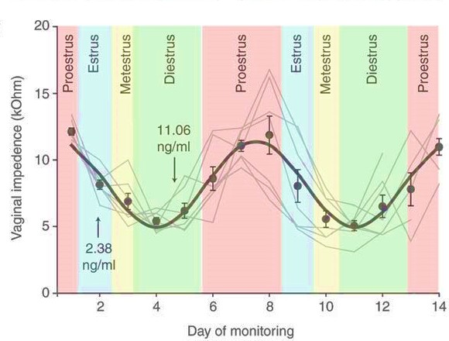
STAGES OF ESTROUS CYCLE
Four stages:
  Proestrus
  Estrus
  Metestrus
  Diestrus
    Follicular phase = Proestrus + Estrus
    Luteal phase = Metestrus + Diestrus

Slide 8
PROESTRUS
Begins when progesterone declines(luteolysis) and ends at onset of estrus
Lasts 2 to 5 days
Period of major endocrine transition
  Progesterone dominance to estrogen dominance
  FSH and LH responsible

Slide 9
Proestrus
“Building Up”
Ovarian follicle, with enclosed ovum, increase in size
Estrogens absorbed from the follicles into blood stream stimulate increased vascularity and cell growth of tubular genitalia, in preparation for estrus and pregnancy

Slide 10
Estrus
Period of sexual receptivity
Large increase in estrogen
  stimulates release of LHRH
FSH decreases due to estrogen and inhibin
  During or shortly after estrus, ovulation occurs due to major surge in LH
  LH levels increase due to LHRH
  Estrus stops once ovulation occurs.

Slide 11
Metestrus
Corpus Luteum predominant
↑Increase in progesterone, ↆ decrease in estrogen
Endometrial lining thickens and uterine muscles show increased development.

Slide 12
Diestrus
Relatively short period of time between
estrous cycles during the breeding season of polyestrous animals
– No reproductive activity

Slide 13
Prolonged Diestrus
CL is fully functional*
High levels of progesterone
End with luteolysis
10 to 14 days
*corpora lutea

Slide 14
Summary of Stages
Proestrus= Formation of ovulatory follicle + E₂ secretion
Estrus = Sexual recepitivity + peak E₂ secretion
Metestrus = CL formation + beginning of P₄ secretion
Diestrus = Sustained luteal secretion of P₄

Slide 15
Anestrus
Long period of inactivity between sexual seasons
–
No regular estrous cycles
– Ovaries relatively inactive
No follicles or CL

Slide 16
The basic pattern of the estrous cycle is the same in all domestic animals, but some specific differences are found in specific parts of the cycle. Some specifics about relevant farm species are summarized in Table
Average Reproductive Cycles
Species | Length of Estrous Cycle |  | Length of Estrus | Ovulation | Length of Pregnancy
Cow | 21 days |  | 18 hr | 11 hr after | 282 days
 | polyestrus |  |  | end estrus
Ewe | 17 days |  | 29 hr | near end | 148 days
 | seasonal (fall) |  |  | estrus
Sow | 21 days |  | 48-72 hr | 35-45 hr | 115 days
 | polyestrus |  |  | after start
 |  |  |  | estrus
Mare 21 days 4-8 days 3-6 day of 335 days seasonal (spring) estrus polyestrus (1-2 days before end of estrus)

Slide 17
Characteristics of Estrous Cycles
Cow
Estrous cycle (days) | 21
Proestrus (days) | 3-4
Estrus | 12-18 hr
Metestrus (days) | 3-4
Diestrus (days) | 10-14

Slide 18
Variation in Cycle Types
\ | Type of Cycle | Follicular Development | Ovulation & CL Formation | CL Function
Cow, Long Spontaneous Spontaneous Spontaneous

Slide 19
Estrous Cycle
New CL Forming
Fol. Size
Mature CL Present
& CL Size
Progesterone (P₄)
Estradiol (E₂)
Day of Estrous Cycle

Slide 20
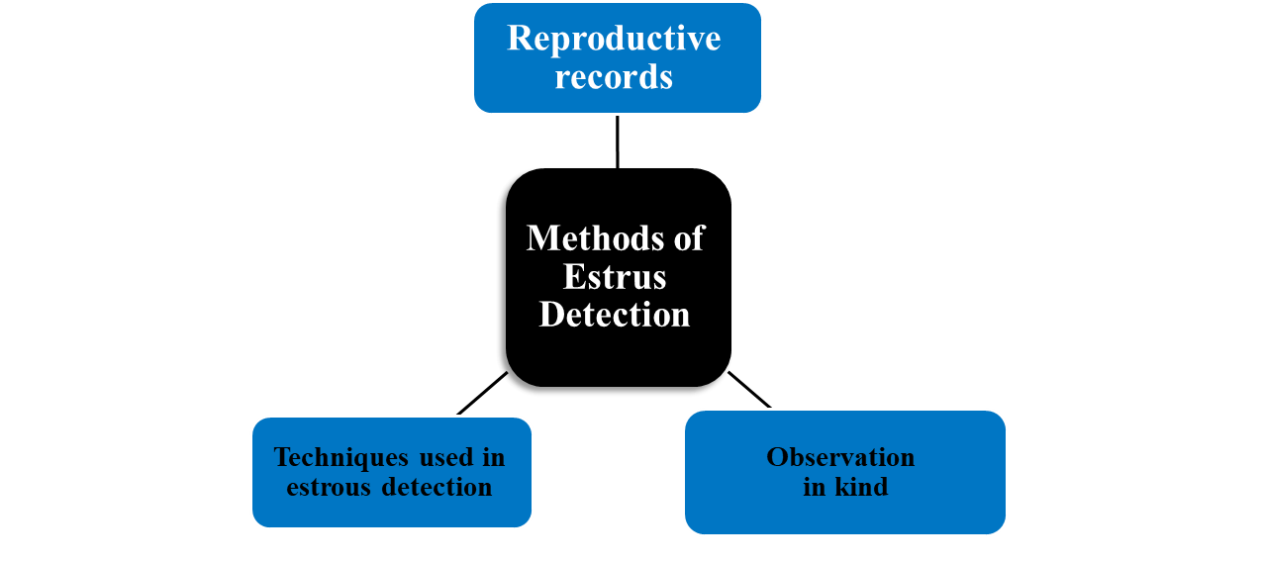
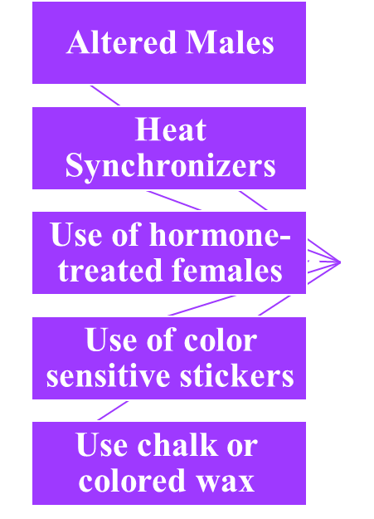
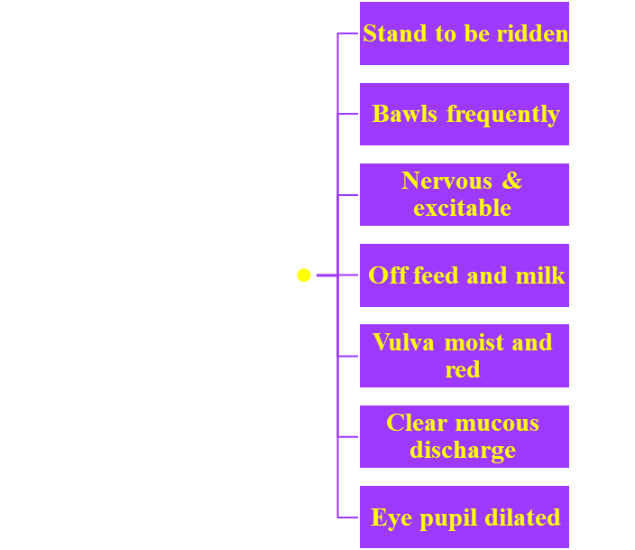
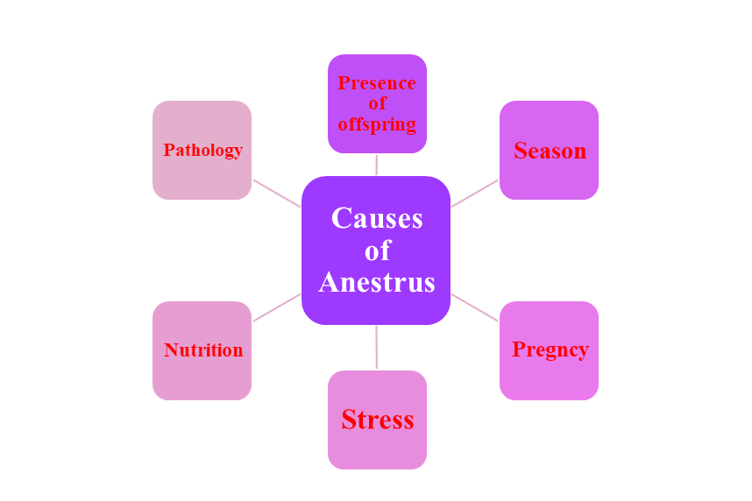
Methods of Estrus Detection
Tail-painting & use of chalk Use of closed circuit television female activity changes Progesterone tests
Vaginal probes
Use of teaser animals Chin-male devices Heat-mount detectors
Causes of Anestrus

Slide 21
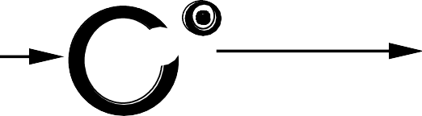
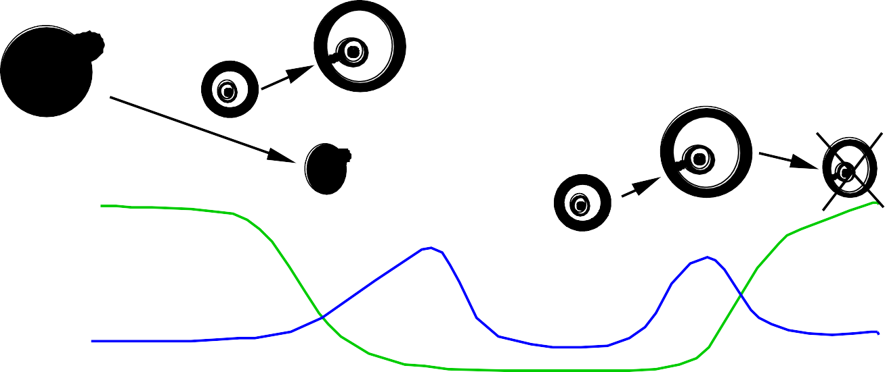
1
The estrous cycle may be divided into several phases based on behaviour changes or structural changes in internal & external genitalia.
CL CL Ovulation Atresia Progesterone CA Estradiol PGF_{2α} FSH LH -7 - 6 - 5 - 4 - 3 - 2 -1 0 1 2 3 4 5 6 7 8 Days Relative to the Gonadotropin Surge
 | Diestrus | Proestrus | Estrus | Metestrus | Diestrus

Slide 22
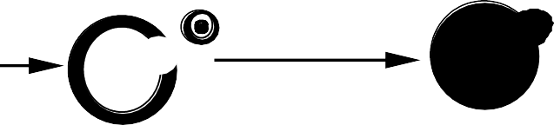

Follicular Phase
2
Proestrus
Follicle enlarges
Estrogen increases
Vascularity of the female reproductive tract increases
Endometrial glands begin to grow
Estrogen levels peak
CL
CL
Ovulation
Atresia
Progesterone
CA
Estradiol
PGF
2α
FSH
LH
-7 - 6 - 5 - 4 - 3 - 2 -1
0 1 2 3 4 5 6 7 8
Days Relative to the Gonadotropin Surge
Diestrus
Proestrus
Estrus
Metestrus
Diestrus

Slide 23
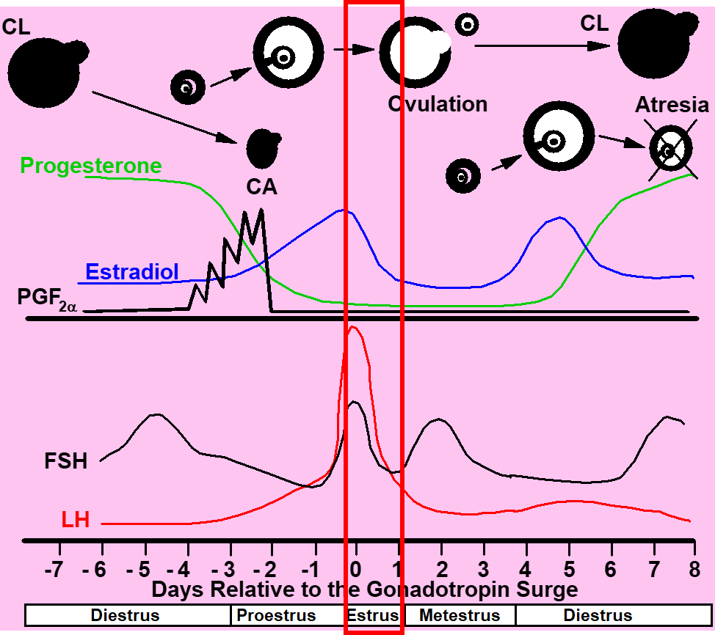
Follicular Phase
3
Estrus
•
•
•
•
Allows male to mount Estrogen decreases LH surge occurs
Ovulation 24-48 h after surge of LH
Uterine motility high with contractions moving toward oviduct
Sperm transport is optimal
Cervical mucus volume increases
•
•
•

Slide 24


Luteal Phase
4
Luteal Phase
Metestrus
Estrogen low
Ovulation in cow
Corpus hemorrhagicum present
Uterus
CL
CL
Ovulation
Atresia
Progesterone
CA
Estradiol
➢
➢
Contractions subside
Endometrial glands continue to grow and become coiled
In cattle bleeding occurs
PGF_{2α}
➢
FSH
FSH increases
LH
-7 - 6 - 5 - 4 - 3 - 2 -1 0 1 2 3
➢
Triggering growth of follicles
4 5 6 7 8
Days Relative to the Gonadotropin Surge
Diestrus
Proestrus
Estrus
Metestrus
Diestrus

Slide 25


Luteal Phase
5
Luteal Phase
Diestrus
Progesterone high
FSH
  Increases at some point to cause growth of ovulatory follicle
Uterus
  Secrets fluid but volume gradually decreases
  Contraction stop
  CL regresses at the end of this period if female is not pregnant due to PGF release
CL
CL
Ovulation
Atresia
Progesterone
CA
Estradiol
PGF_{2α}
FSH
LH
-7 - 6 - 5 - 4 - 3 - 2 -1 0 1 2 3 4 5 6 7 8
Days Relative to the Gonadotropin Surge
Diestrus
Proestrus
Estrus
Metestrus
Diestrus

Slide 26
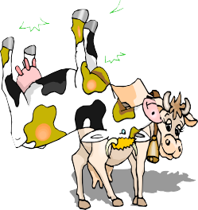
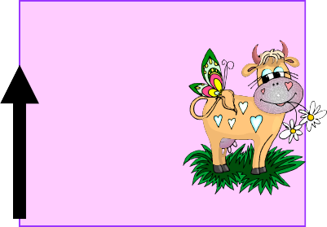
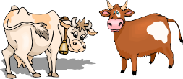
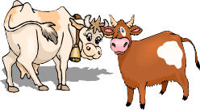
Estrus in cow and associated featured
Hours from the start of estrus
9 18 24
Hours 0
6
28
Egg re
leased
Before heat (6-10 h)
Standing heat (18 h)
After heat (10 h)
Life of egg (6-10 h)

Slide 27

Approximate Values for Selected Reproductive Events in Female Domesticated Mammals
Species
Length of cycle (days)
Duration of estrus (hours)
Approximate time of ovulation
Normal breeding season
Cow
Mean=20.5 Range 17 - 23
Mean < 10
Range 1 - 24
30 h after beginning of estrus
All year
Buffalo
Mean=21 Range 18 - 22
Mean < 15
Range 4 - 24
32 h after beginning of estrus
All year

Slide 28
Thank you

