Slide 1
Skill course on Poultry Farming
ABC01(0-4-0)
Session: 6
Skills of preparation of breeding houses for new born/day old chicks, monitoring temperature and humidity in case of better of boarders in different seasons, skills of protecting the chicks from predators. Maintaining sanitation in chick houses

Slide 2
objectives
O Brooding
O Types of brooders
O Preparation of shed to receive chicks
O Importance of environment
O Feeding and vaccination

Slide 3
O Brooding is a art and science of rearing baby chicks
O Newly hatched chicks not fully developed thermoregulatory mechanism
O Takes about 2wks to develop
O they cannot maintain the body temperature properly for the first few weeks of life
O may be subjected to chilling, if not
properly taken care of

Slide 4
O Brooding can be classified into natural and artificial brooding.
O Natural brooding
O Artificial brooding

Slide 5
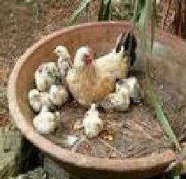
Natural brooding
O It is done with the help of broody hens after hatching, up to 3 to 4 weeks of age

Slide 6
Artificial Brooding
O In artificial brooding large number of baby chicks are reared in the absence of broody hen.
O Equipments used for brooding are called brooders. Brooder comprises of three elements:
O Heating source
O Reflectors
O Brooder guard

Slide 7
O Heating source may be electrical, gases like natural gas, LPG and methane, liquid fuel like kerosene and solid fuel like coal, wood can be used as a heating material.

Slide 8
DIFFERENT TYPES OF BROODERS
O Infra red bulbs O Heating coils O Gas brooders
O Kerosene stove
O Coal/charcoal stove
O Centralized heating system
O Battery brooders
O Biogas brooders

Slide 9
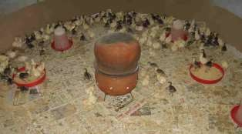
Charcoal stove / kerosene stove
O Where electricity is not available, ordinary charcoal / kerosene stoves are used to provide supplementary heat to chicks.
O These stoves are covered with plate / pans to dissipate the heat.

Slide 10
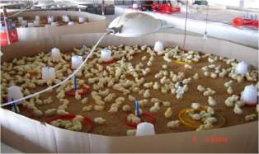
Gas brooder
O Natural gas, LPG or methane is connected to heating element which is hanged 3 to 5 feet above the chick to provide heat.

Slide 11
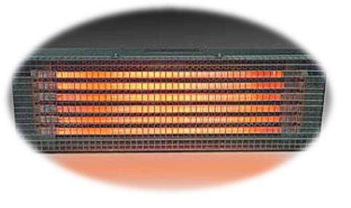
Electrical brooder
O It is also thermostatically controlled heating system that spread required amount of heat uniformly above large area, this avoid crowding of chicks under brooder directly.
O One electrical brooder can be used for 300 to 400 chicks.

Slide 12
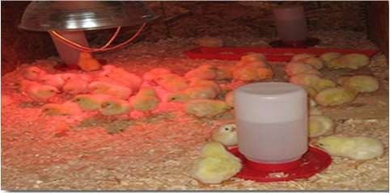
Infra-red bulbs
O It is a self reflecting bulb. One 250 watts IR bulb can provide brooding for about 150 to 250 chicks.

Slide 13
Battery brooders
O Multi tier cage brooding is practiced
O Bulbs or heaters with thermostats are used to provide warmth to chicks in battery brooders

Slide 14
Reflectors
O These reflectors are called Hovers.
O Flat type hover – These hovers are provided with heating element, heating mechanism and pilot lamp and in some cases thermometer is also there in order to record the temperature.
O Canopy type hover – These reflectors are in concave shape

Slide 15
Brooder guard / chick guard
O They are used to prevent chicks from straying too far away from heat supply until they learn the source of heat.
O We have to provide brooder guard with a diameter of 5 feet, height of the brooder should not exceed 1.5 feet.
O For this purpose, we can use materials like cardboard sheet, GI sheet, wire mesh, and mat etc. depending upon the season of brooding

Slide 16
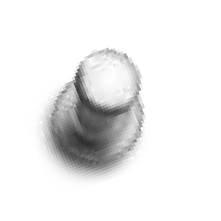


HOVER
CHICK GUARD

Slide 17
RECEIVING OF CHICKS
O After taking out the previous adult birds, clean and disinfect the poultry house.
O 3 to 4 weeks interval may be provided between 2 batches as down time.
O Form a circle of about 5 feet diameter with brooder guard.
O The 5 feet diameter brooder can hold about 200 to 250 chicks.

Slide 18
O A minimum brooder space of 150 and 125 cm² has to be provided per chick in DL and battery cages respectively, up to two wks of age
O On floor , first 4 wks ------ 0.4 sft floor space later extended to 0.8 sft floor space up to 8wks of age

Slide 19
O At the centre of brooder guard, provide any one of heat source like IR bulb, ordinary incandescent bulb or gas brooders.
O Spread litter material about 2” height in a circle and then spread old newspaper over the litter material.
O Arrange feeders and waterers alternatively like
cart-wheel fashion.
O Check the brooder for proper temperature 24 hours prior to arrival of chicks.
O Switch on the brooder heating source several hours before the arrival of the chicks in order to maintain required brooding temperature

Slide 20
Spread ground maize or rava or fine mash / crumble feed on the old newspaper for 1 or 2 days. Afterwards, they will learn to consume feed from the feeder.
Provide electrolyte, glucose and vitamins in the drinking water for first 2 to 3 days to overcome stress.
After arrival of chicks, moist the beak and leave the chicks under heating source.
Maintain a brooder temperature of 90 to 95⁰F for the first week and then reduce 5⁰F every week until it reaches the room temperature.
Watch the behaviour of chicks in order to find out whether temperature provided is correct or less or more.

Slide 21
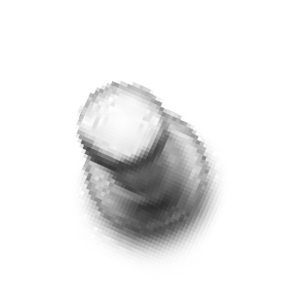
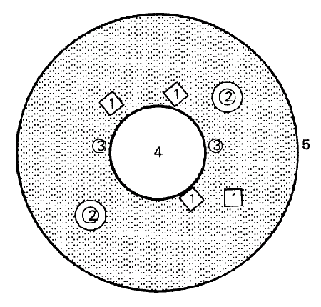






Just right
Too hot
Too cold
Too
drafty

Slide 22

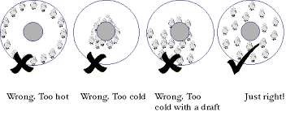

Slide 23

When Temp is less – chicks will try to hurdle near the source of heat under brooder without movements.
O If temp is too high - chicks will go away from source of heat, near to the guard and remain there with dull movements. Even may show panting also.
O If birds congregate themselves in masses in brooder space it indicates draftiness of weather.
O If temp is favourable: evenly spread under and around
brooder with alert and pleasant movements.
O Based on chicks position and movement, adjust temperature.

Slide 24

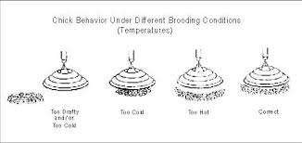

Slide 25
In case of too much temperature, we can reduce the heat by reducing the power of the bulb or we can raise the heating element.
In case of too low temperature, we have to supplement more heating source or we can further down the heating element.
In case of chill weather or chill breeze, we can
provide curtains towards the wind direction.

Slide 26
Ventilation
O Required to provide fresh air removing abnoxious gases like and carbon di oxide and Ammonia for healthy respiration
O Opening and covering of curtains need to be done correctly depending on weather condition

Slide 27
Relative Humidity
O 50-60% RH has to be maintained

Slide 28
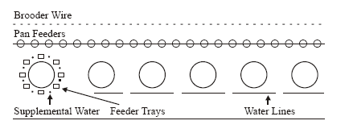
The following illustration is given as a guide for
the placement of equipments around the brooder during the early brooding stages.

Slide 29
Remove the old newspaper after 3 days and destroy it by burning. If necessary, spread another set of newspaper.
Remove brooder guard after 7 to 10 days depending upon the season.
While removing the brooder guard, see that the corners of the sheds are rounded in order to avoid mortality due to huddling.
.

Slide 30
Change the feeders and waterers according to age and requirement.
24 hours lighting programme may be adopted during 0-8 days of age.
One hour darkness may be provided to train the chicks in case of any power failure

Slide 31
Medication programme:
First and Second day – Electrolytes and vitamins.
3rd to 7th day – Antibiotics. (Other medications as and when required)

Slide 32
Cage Brooding
Before the birds arrive, prepare the house as follows:
Put nonskid paper on the bottom of the cage. This paper may disintegrate and fall through the cage bottom or it should be removed at beak trimming time (10 days).
Start the heating system 24 hours before the birds arrive.
Adjust the temperature to 33-34ºC (91.4-93.2ºF.).
Keep the relative humidity at 50% minimum. In cage brooding, adequate humidity is very important.

Slide 33
Temperature Management
In a cage or warm room brooding system, reduce the temperature 3ºC (5ºF.) per week from 34ºC (93.2ºF.) until 21ºC (70ºF.) isreached.
Look for signs of overheating (panting and drowsiness) or chilling (huddling) and make appropriate adjustments.
Heat control is more critical in cage brooding because the chicks cannot move to find their comfort zone.
Maintain adequate humidity if you brood in cages. Relative humidity for cage brooding must be maintained at 40-60%.

Slide 34
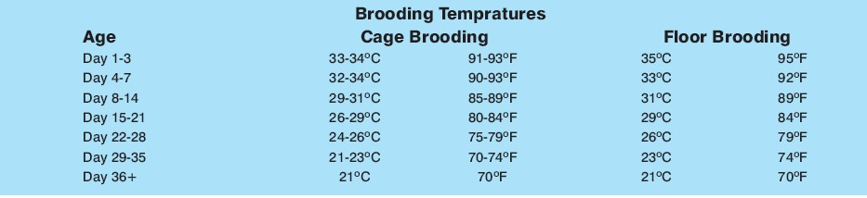


Slide 35
Feeding and watering
O Chicks (0-8 WKS) must provided with adlib feeding
O CP 20%, ME 2800Kcal
O The height of the feeder--- back of the bird
O Feeder space-3cm/ chick
O Feeder must always be 2/3 rd full and feed wastage must be avoided
O Drinking space- 1.5 linear cm

Slide 36
Thank you

