Slide 1
Introduction to VLSI Design
Session 1.1

Slide 2
Overview of Digital Design Using Verilog
Evolution of Computer-Aided Digital Design
Emergence of HDLs
Typical Design Flow
Design Methodologies
Importance of HDLs
Popularity of Verilog HDL

Slide 3
Evolution of Computer-Aided Digital Design
SSI: Small scale integration
A few gates on a chip
MSI: Medium scale integration
Hundreds of gates on a chip
LSI: Large scale integration
Thousands of gates on a chip
CAD: Computer-Aided Design
Logic and circuit simulators
Prototyping on bread board
Layout by hand (on paper or a computer terminal)

Slide 4
Evolution of Computer-Aided Digital Design (cont’d)
VLSI: Very Large Scale Integration
Hundred thousands of gates
Not feasible anymore:
Bread boarding
Manual layout design
Simulator programs
Automatic place-and-route
Bottom-Up design
Design small building blocks
Combine them to develop bigger ones
More and more emphasis on logic simulation

Slide 5
Emergence of HDLs
The need to a standardized language for hardware description
Verilog and VHDL (VHSIC HDL)
Simulators emerged
Usage: functional verification
Path to implementation: manual translation into gates
Logic synthesis technology
Dramatic change in digital design
Design at Register-Transfer Level (RTL) using an HDL

Slide 6
VLSI IC Design Flow
Design specification
Behavioral description
RTL description
Functional verification and testing
Logic synthesis
Gate-level netlist
Logical verification and testing
Floor planning, automatic place & route
Physical layout
Layout verification
Implementation

Slide 7
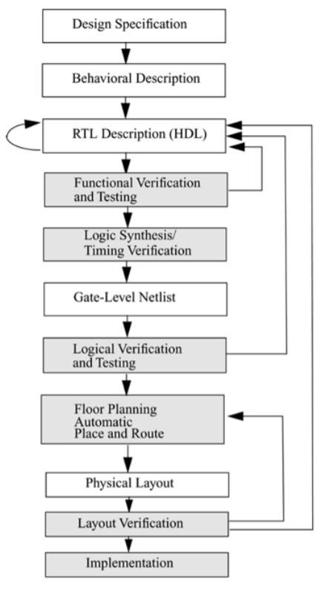
VLSI IC Design Flow

Slide 8
VLSI IC Design Flow
Design specification
In any design, specifications are written first.
Specifications describe abstractly the functionality, interface, and overall architecture of the digital circuit to be designed.
At this point, the architects do not need to think about how they will implement this circuit.
Behavioral description
A behavioral description is then created to analyze the design in terms of functionality, performance, compliance to standards, and other high-level issues.
Behavioral descriptions are often written with HDL

Slide 9
VLSI IC Design Flow
RTL description
The behavioral description is manually converted to an RTL description in an HDL.
The designer has to describe the data flow that will implement the desired digital circuit.
From this point onward, the design process is done with the assistance of EDA tools
Functional verification and testing
Simulation is the process of verifying the functional characteristics of models at any level of abstraction.
We use simulators to simulate the Hardware models.
To test if the RTL code meets the functional requirements of the specification, we must see if all the RTL blocks are functionally correct.
To achieve this we need to write a testbench

Slide 10
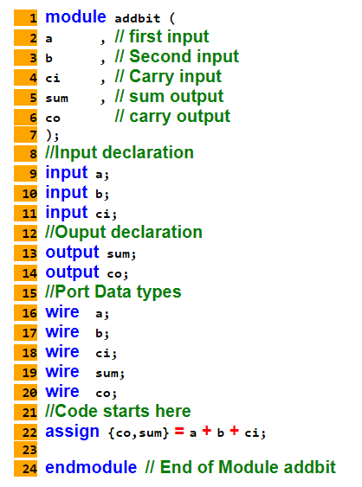
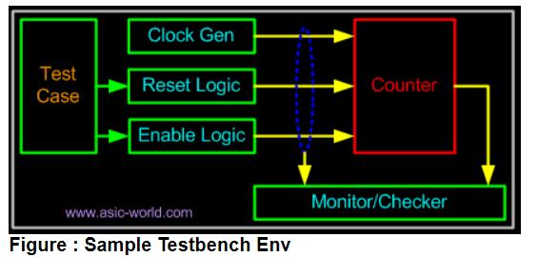
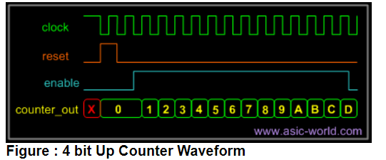
RTL Description
Functional Verification and Testing

Slide 11
VLSI IC Design Flow
Logic Synthesis and Gate level Netlist
The Logic synthesis tools convert the RTL description to a gate-level netlist.
A gate-level netlist is a description of the circuit in terms of gates and connections between them.
Logic synthesis tools ensure that the gate-level netlist meets timing, area, and power specifications.
Logical verification and testing
After the synthesis there are a couple of things that are normally done before passing the netlist to backend (Place and Route)
Formal Verification : Check if the RTL to gate mapping is correct.
Scan insertion : Insert the scan chain in the case of ASIC.

Slide 12
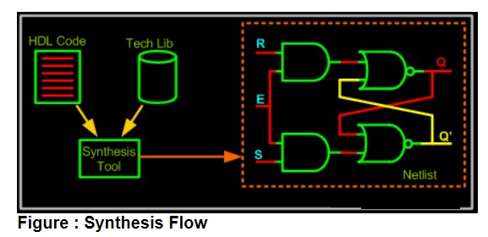
Synthesis Flow

Slide 13
VLSI IC Design Flow
Floor planning, automatic place & route
The gate level netlist from the synthesis tool is taken and imported into place and route tool in Verilog netlist format.
All the gates and flip-flops are placed; clock tree synthesis and reset is routed.
After this each block is routed.
The P&R tool output is a GDS file, used by foundry for fabricating the ASIC
Physical layout
The gate-level netlist is input to an Automatic Place and Route tool, which creates a layout.
Layout verification and implementation
The layout is verified and then fabricated on a chip

Slide 14
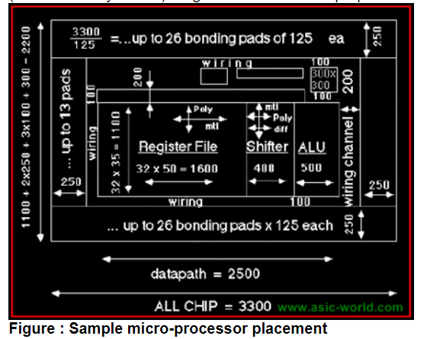
Placement

Slide 15
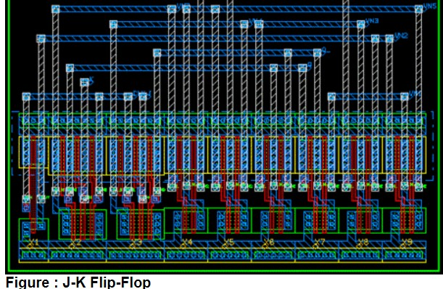
Final Layout

Slide 16
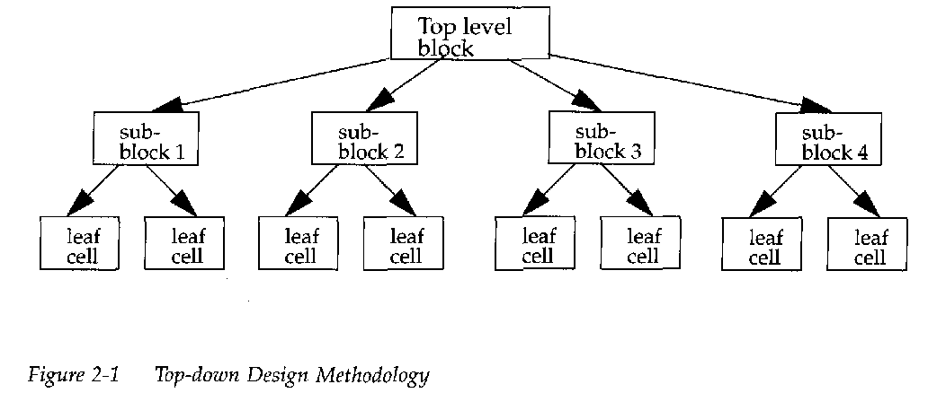
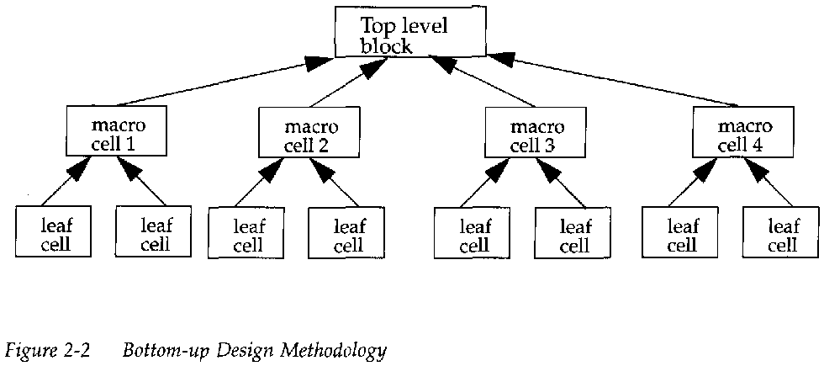
Design Methodologies
There are two basic types of digital design methodologies: a top-down design methodology and a bottom-up design methodology
In a top-down design methodology, we define the top-level block and identify the sub-blocks necessary to build the top-level block. We further subdivide the sub-blocks until we come to leaf cells, which are the cells that cannot further be divided.
In a bottom-up design methodology, we first identify the building blocks that are available to us. We build bigger cells, using these building blocks. These cells are then used for higher-level blocks until we build the top-level block in the design

Slide 17
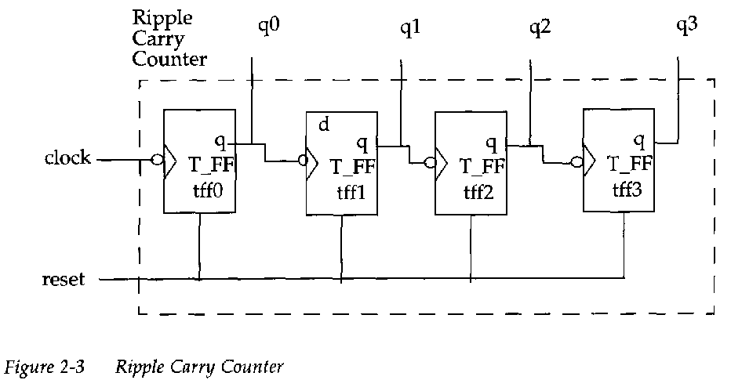
4-bit Ripple Carry Counter
Design Methodologies

Slide 18
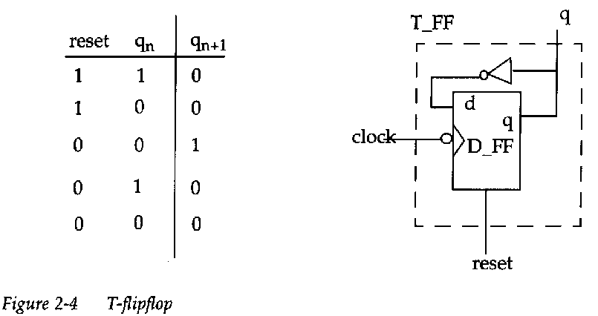
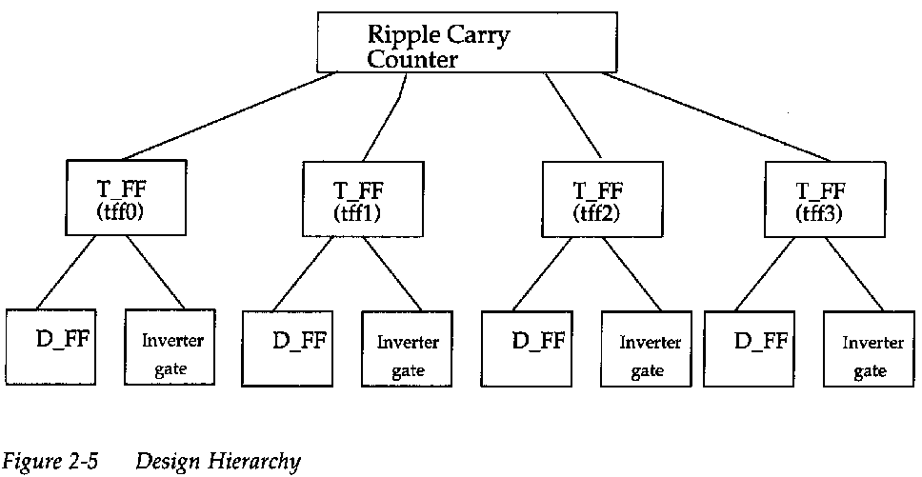
T-flipflop and the Hierarchy

Slide 19
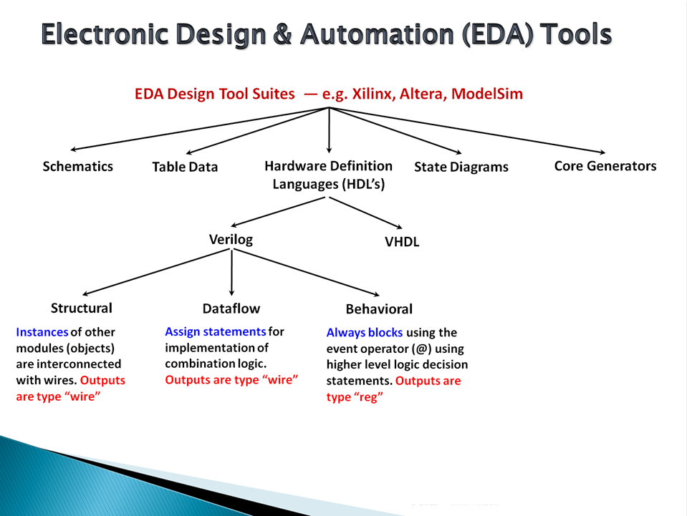

Slide 20
Importance of HDLs
Retargeting to a new fabrication technology
Functional verification earlier in the design cycle
Textual concise representation of the design
Similar to computer programs
Easier to understand

Slide 21
Popularity of Verilog HDL
Verilog HDL
General-purpose
Easy to learn, easy to use
Similar in syntax to C
Allows different levels of abstraction and mixing them
Supported by most popular logic synthesis tools
Post-logic-synthesis simulation libraries by all fabrication vendors
PLI to customize Verilog simulators to designers’ needs

