Slide 1
Livestock & Poultry Management
ASAP2101(2-1-0)
Session: 10
Role of livestock in the national economy

Slide 2
Ruminants
Objective: Describe the function and major parts of the digestive system of ruminants.

Slide 3
Ruminant Animals
Animals with complex digestive systems
Capable of digesting material with a high fiber concentration
Uses microbial fermentation
  Cattle
  Sheep
  Goats
  Deer

Slide 4
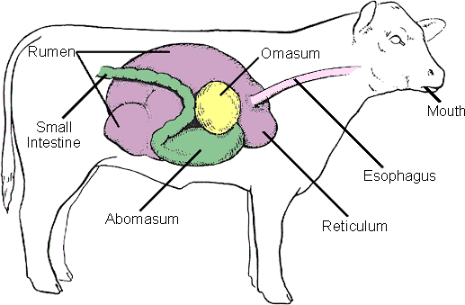
Ruminants
Ruminant Digestive System

Slide 5
Parts and Functions
Mouth
  Bites and chews
Esophagus
  Connection
Four Compartment Stomach
  Rumen
  Reticulum
  Omasum
  Abomasum
 | 85% of the capacity

Slide 6
Parts and Functions
Ruman
  Largest of the four parts “room-in-it”
  Filled with bacteria
  Converts large amounts of roughage to amino acids
Fact!!!!
    The average cow rumen can hold over 160 liters (40 gallons)

Slide 7
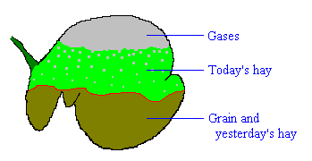
Ruman

Slide 8
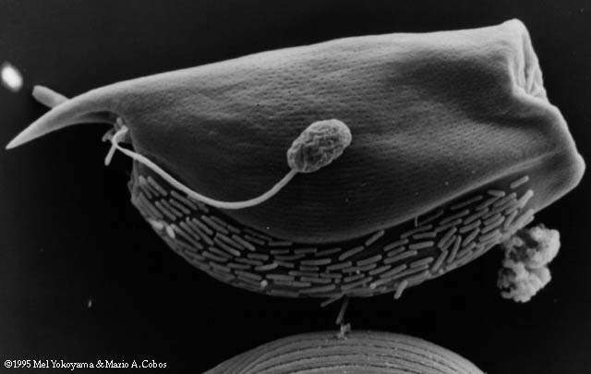
Ruman Microbe

Slide 9
Ruman Microbe
The large microbe is a type of protist
The creature that looks like a tadpole attached to the side of the protist is a fungal spore
The smaller, rod-shaped organism lining the underside of the protist are bacteria.

Slide 10
Parts and Functions
Reticulum
  Compartment where liquid goes
  Honeycomb in structure
Omasum
  Grinds and squeezes
  Removes some liquid
Abomasum
  True stomach
  Enzymes and acids

Slide 11
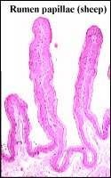
Parts and Functions
Small Intestine
  Partially digested feed is mixed
    Bile
    Pancreatic juice
    Intestinal juice
  Most of the food nutrient is absorbed
    Villi or Papillae

Slide 12
Parts and Functions
Large intestine
  Main function is to absorbed water
  Add mucus to undigested feed
    Feces

Slide 13
Non-Ruminant
Objective: Describe the function and major parts of the digestive system of non- ruminants.

Slide 14
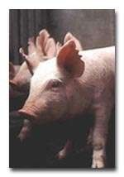
Non-Ruminant
Simple digestive system
  (Monogastric)
  Feed must be highly quality concentrates
  Cannot digest large amounts of fiber
    Human
    Dogs
    Cats
    Rabbits
    Pigs
    Horses????

Slide 15
Non-Ruminant Parts & Functions
Mouth
Esophagus
Stomach
  Enzymes acts on feed
  Churns and mixes
Small intestine
Large intestine

Slide 16
Non-Ruminant Parts & Functions
Accessory system
  Liver
    Produces bile that acts on fat
  Pancreas
    Produces insulin
Anus
  End of the digestive tract

Slide 17
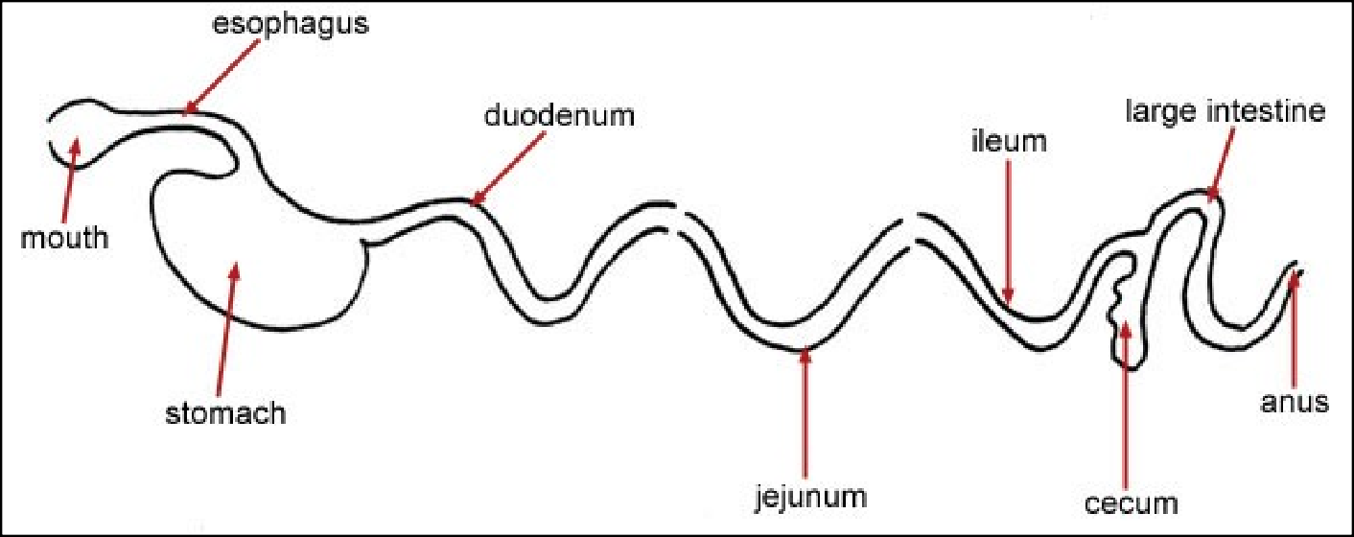
Monogastric
Simple Digestive System

Slide 18
Poultry Digestive Systems
Objective: Describe the function and major parts of the digestive system of non- ruminants.

Slide 19
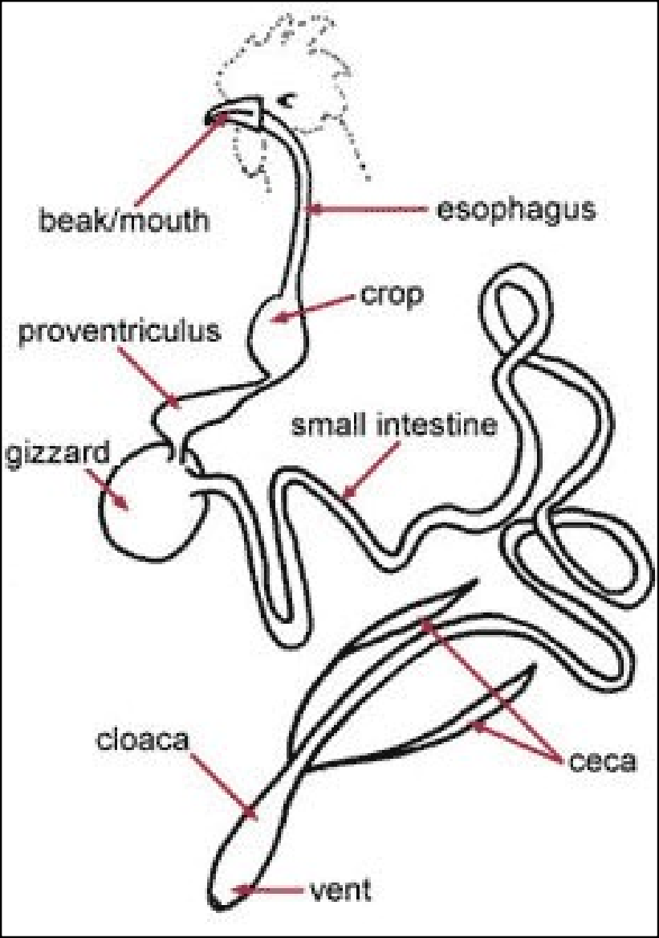
Poultry
Chickens
Turkeys
Ducks
Geese

Slide 20
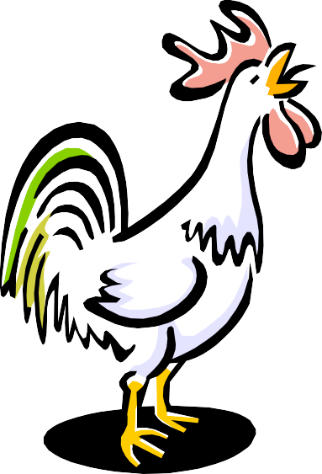
Poultry Digestive Systems
Mouth or beak
  Can not chew food
Esophagus
  Connects mouth to crop
Crop
  Stores feed

Slide 21
Poultry Digestive Systems
Gizzard
  Crushes feed
    Contains grit and gravel
  Mixes feed with digestive juices
Liver
Small and Large Intestine
Vent
  Removes solid and liquid waste

Slide 22
Inspecting Animal Digestive Systems
Esophagus
  Tube like structure
Stomach
  Pouch with undigested feed
Liver
  Large brown organ beneath the stomach or crop

Slide 23
Inspecting Animal Digestive Systems
Small intestine
  Long tube
  Gray colored partially digested feed
Large intestine
  Large relatively short compartment
  Contains fecal material

Slide 24
Nutrients
Competency: Distinguish the functions and sources of feed nutrients for farm animals

Slide 25
Groups of Nutrients
Objective: Identify the six major groups of nutrients

Slide 26

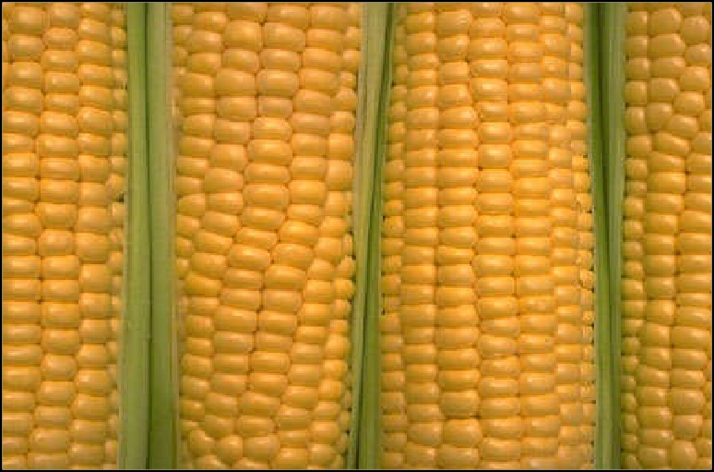
Carbohydrates
Composed of sugar, starches, cellulose and lignin
Provide energy and heat
Make up the largest quantity of livestock feed
  Carbon
  Hydrogen
  Oxygen

Slide 27
Fats and Oils
2.25 times the energy value of carbohydrates
At body temperature fat are solids and oils are liquid
  Example: cooking lard
Extra carbohydrates are stored as fats
  Carbon, hydrogen, oxygen
Carriers fat-soluble vitamins

Slide 28



Proteins
Major component of muscles and tissues
Made up of amino acids
Continuously needed to replace dying body cells
Young animals need large amounts for growth

Slide 29


Vitamins
Needed in small quantities
Helps regulate body functions
Designated by letters
  A,B,C,D,E,K
Sources:
  Naturally found in feed
  Feed additives made from animal by- products
  Made by the body itself

Slide 30
Minerals
Needed in small amounts
  Calcium, phosphorus, sodium, etc.
Regulates body functions
Provide growth for:
  Bone
  Teeth
  Tissue
    Example: calcium is needed in poultry for eggshell development

Slide 31
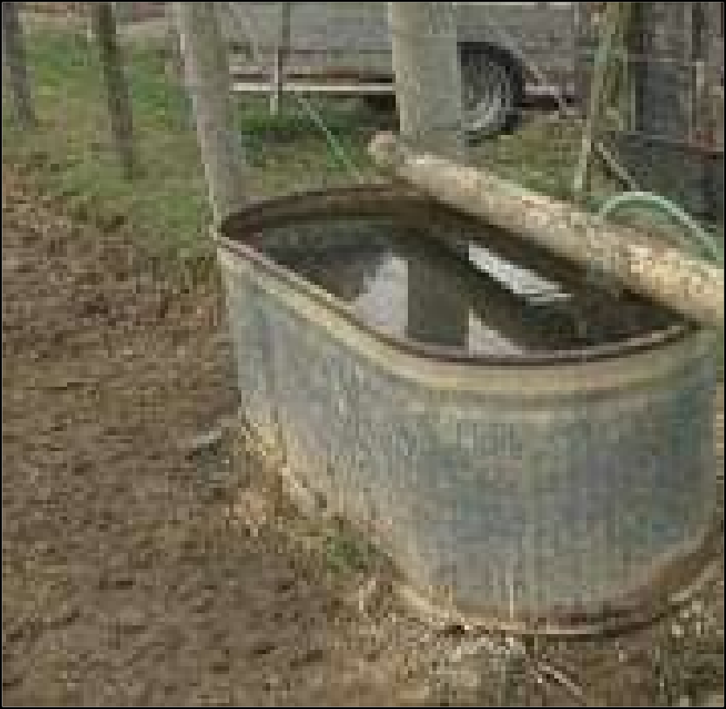
Water
Makes up 40% to 60% of the animals body
Dissolves other nutrients and helps carry them to parts of the body

Slide 32
Sources of Nutrients
Carbohydrates
  Cereal grains
    corn
    wheat
    oats
    rye
    barley
    sorghum

Slide 33
Sources of Nutrients
Proteins
  Plant sources
    Soybean meal
    Cottonseed meal
    Alfalfa meal
  Animal sources
    Meat meal
    Fishmeal
    Dried milk
    Synthetic nitrogen source called urea

Slide 34
Sources of Nutrients
Fats and Oils
  Grains and protein concentrates
Vitamins and Minerals
  Most feed ingredients
  Supplements
    Pre-mixes
    Mineral blocks

Slide 35
Sources of Nutrients
Other sources and exceptions:
  Alfalfa (roughage) can be used to provide energy and fiber
  Molasses
    Improve taste (palatability)
    Reduce feed dust

Slide 36
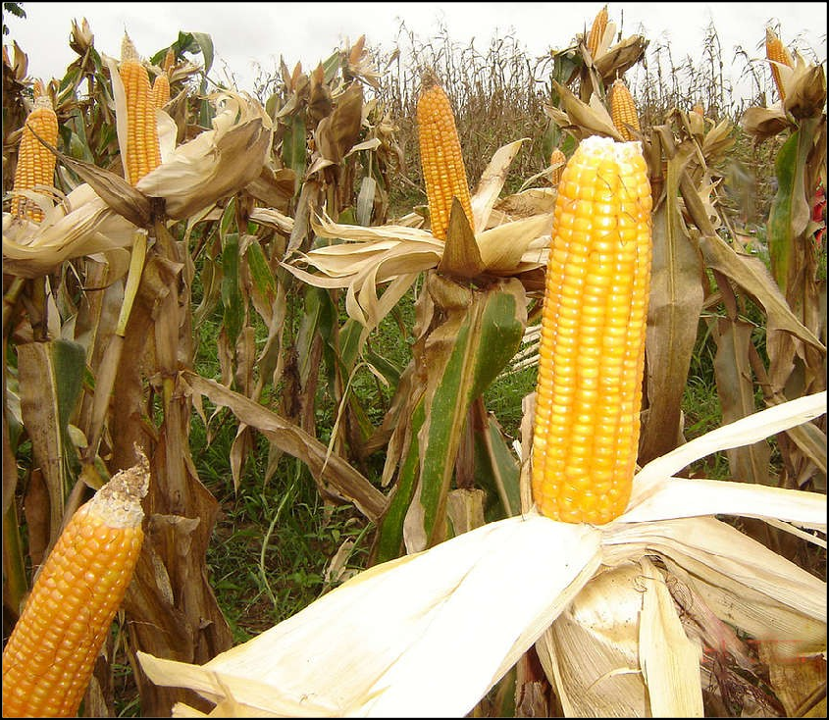
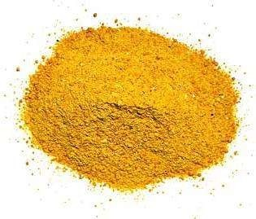
Concentrates
High in Nutrient Value
Grains
  Corn
  Barley
  Wheat

Slide 37
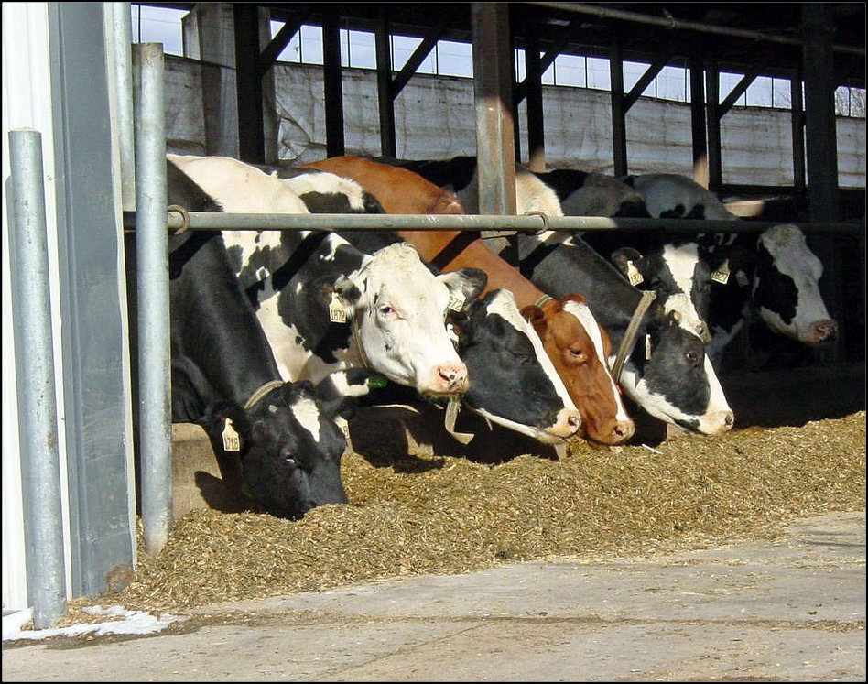
Roughages
High in Fiber
Forage Crops
  Silage
  Hay
  Pasture Grass

Slide 38
Nutritional Value
Total Digestible Nutrients
Concentrates are high in TDN
Roughages are low in TDN

Slide 39
Thank you

