Slide 1
Livestock & Poultry Management
ASAP2101(2-1-0)
Session: 20
Proximate principles of feed

Slide 2
Overview
Introduction
Proximate Principles
Demerits of Proximate analysis
Merits of Proximate analysis
Conclusion

Slide 3
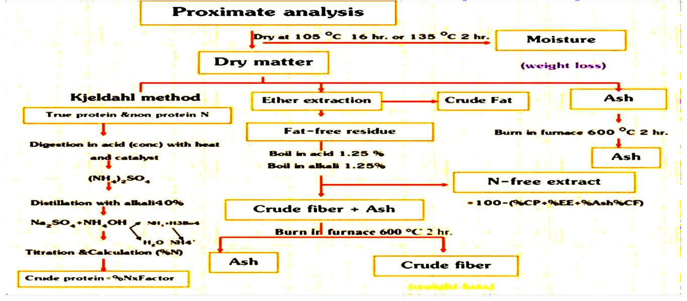
Introduction

Slide 4
Proximate principle
1.Water (moisture) 2.Crude protein
3.Crude fat (ether extract) 4.Crude fiber
5.NFE (Nitrogen free extract) 6.Ash

Slide 5




Water (Moisture)
Principle
It is determined by drying feed sample in hot air oven at 100 ⁰C for a specified length of time
DM,% = wt after drying/wt before drying x 100%
% Moisture = 100 – DM,%

Slide 6

Significance of moisture
Moisture determines the keeping quality of hay
Moisture content determines the losses in silage making
Usefull in classification of feed in to succulent and non-succulent
Moisture content is significant in storage of feed
Moisture content is important while purchasing of feed
Moisture content is directly related to nutritive value of feed

Slide 7

Demerits
Drying above 60 ºC can create artifacts that hinder lignin, fiber & ADF analysis
Most likely underestimate dry matter
Loss of volatile fatty acids (VFA's)

Slide 8

Crude protein
Estimated indirectly by determining the nitrogen content of feed and multiplying it with 6.25.
Estimated by a process developed by a Danish chemist
Johan Kjeldahl.
100/16 = 6.25, therefore: NITROGEN x 6.25 = CRUDE PROTEIN
Principle and Scope
In the presence of sulfuric acid, sodium sulphate and a catalyst, the amino nitrogen of many organic materials is converted to ammonium sulphate. The ammonia is distilled from an alkaline medium and absorbed in standardized mineral acid.

Slide 9
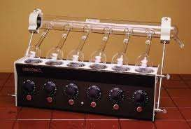
Assumptions of Kjeldahl analysis 1.All proteins contain 16% N. Hence constant‘6.25’ to convert N to protein.
uses
2.All N in the food comes from true protein.

Slide 10

Problems with assumption 1
All amino acids are not created equal
Therefore, all proteins are not created equal
Amino Acid | % Nitrogen
Alanine | 15.72
Arginine | 32.16
Aspartate | 10.52
Cystine | 11.66
Glutamate | 9.52
Protein | % Nitrogen
Casein | 15.9
Glycinin | 17.5
Hemoglobin | 16.8
Ovalbumin | 15.5
Serum globulin | 16.2
(Kaiser et al., 1995)
(Kaiser et al., 1995)

Slide 11

Problems with assumption 2
True protein in the plant is overestimated by the Crude Protein value (Maynard and Loosli, 1979).
The use of concentrated sulfuric acid at high temperatures poses a considerable hazard
The technique is time consuming to carry-out

Slide 12

Crude Fiber
Principle
Two boiling processes simulate the pH conditions of the digestive tract
Crude fiber composed of cellulose, hemicelluloses, and lignin
Lignin is not a true carbohydrate
The method has been widely used to determine the fiber content of feed but it has some serious shortcomings

Slide 13

Demerits
C.F. - Indigestible and non nutritive residue
Acid and base solubilize some of hemicelluloses, pectin and lignin
NFE of a feed therefore tends to be overestimated
Hence crude fiber underestimates true fiber

Slide 14

Crude fat
Principle and Scope
A dried, ground sample is extracted with diethyl ether which dissolves fats, oils, pigments and other fat soluble substances.
Demerit
This process assumes all substances soluble in ether are fats. Plant pigments, wax which are also soluble in ether, but do not have the same nutritional values of fats

Slide 15

Nitrogen free extract (NFE)
Principle
NFE represents the soluble carbohydrate of the feed, such as starch and sugar.
% NFE = % DM - (% EE + % CP + % ash + % CF)
Demerit
NFE not determined analytically but is calculated by difference.
Therefore, NFE accumulates all of the errors that exists in other proximate analysis components.

Slide 16

Total Ash
Principle
When a sample is burnt in muffle furnace at 600ºC for 2 hours, only mineral matter is left behind. This is the total ash or mineral content of feed.
% Ash = wt. after ashing/sample wt. x 100%
Demerits
No indication of amounts of individual minerals.
Long time required(12-24 hours).
Muffle Furnaces are quite costly to run
Loss of volatile minerals e.g., Cu, Fe, Pb, Hg, Ni, Zn.

Slide 17

Advantages of Proximate Analysis
Comparison of feeds on a specific basis
It is a common basis for the feed purchasing and for ration formulation
No substitute till today except for fiber component
It forms Starting point for specific analysis
Used for analysis of feeds, faeces, urine, body tissues, body fluids

Slide 18

Conclusion
Proximate analysis is a system for approximating the nutritive value of feedstuff without actually using it in feeding trial
It is simple and yet descriptive method for evaluating the nutritive value of feeds
Main demerits of this system are it underestimates dry matter, assumes that all proteins contain 16% N, crude fiber is considered as in indigestible non nutritive residue, this process assumes all substances soluble in ether are fats, it does not includes vitamins and gives no indication about kind of minerals present in Ash

Slide 19
Thank you

