Slide 1
Livestock & Poultry Management
ASAP2101(2-1-0)
Session: 13
Nutrients and their functions

Slide 2
What is Nutrition!
Nutrition is the science of dealing with the utilization of food by the body processes which transforms food into body tissues and energy.

Slide 3
Utilizations
Nutrients are utilized by the animals for:
Maintenance
Growth
Production
Reproduction
Health control

Slide 4
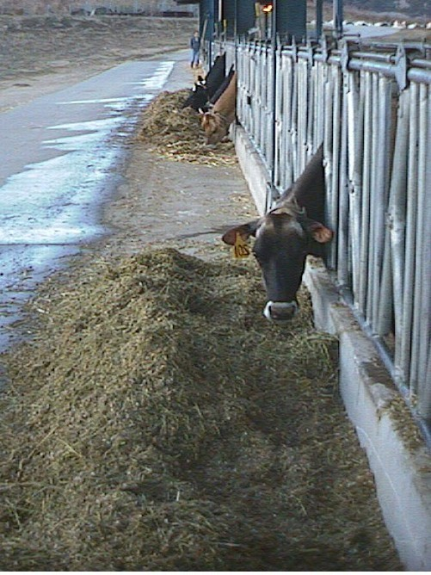
Importance
To obtain and utilize surplus or unusable feed stuffs
And convert them to desirable products such as
meat, milk, eggs, fiber and work.

Slide 5
What is a Nutrient?
A single class of food or group of like foods that aids in the support of life and makes it possible for animals to grow or provide energy for physiological processes.

Slide 6
Digestible Nutrient
The portion of the nutrient which may be broken down (digested) and absorbed and used by the body.

Slide 7
The Six Nutrients Needed
Protein
Carbohydrates
Fats
Minerals
Vitamins
Water

Slide 8
Protein
Needed for growth and repair
Helps form muscles, internal organs, skin, hair,wool, feathers, hoofs and horns
Contain carbon, hydrogen, oxygen and nitrogen

Slide 9
Examples of Proteins
Meat and Bone Meal
Fish Meal
Soybean Meal
Cottonseed Meal
Dried Skim Milk
6. Amino Acids

Slide 10
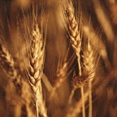
Carbohydrates
Furnish energy for body functions, growth and reproduction
The largest part of the animals food supply and usually the fibrous part of the diet
Include sugars, starch and cellulose
Are made of carbon, oxygen and hydrogen

Slide 11
Fats
Furnish a concentrated source of energy, up to
2.25 times as much energy as carbohydrates do
Form cholesterol, steroids and other body compounds
Found in every cell in the body
Affect the condition of skin and hair
Are made of carbon, oxygen and hydrogen, but contain much larger proportions of carbon and
hydrogen than carbohydrates do
They also provide energy reserves, protection for vital organs, and they insulate the body

Slide 12
Minerals
Primarily found in bones and teeth
Important in blood for the carrying of oxygen
Regulates heartbeat with potassium, sodium and calcium

Slide 13
Major Minerals
The major minerals are
calcium, phosphorus, sodium, chlorine, magnesium, and potassium.
They are required at comparatively high levels described as per cent of diet or grams per day.

Slide 14
Minor Minerals
They are required only in very small amounts.
Some minerals fed in excess amounts may cause a deficiency in others
Iron, Zinc, Copper, Manganese, Cobalt, Iodine, Molybdenum, Selenium, Fluorine

Slide 15
Vitamins
Are only needed in small amounts
Are essential for life and health
Provide a defense against disease, promote growth and reproduction
Contribute to the general health of
the animal
Vit. A, B, C, D, K, E etc

Slide 16
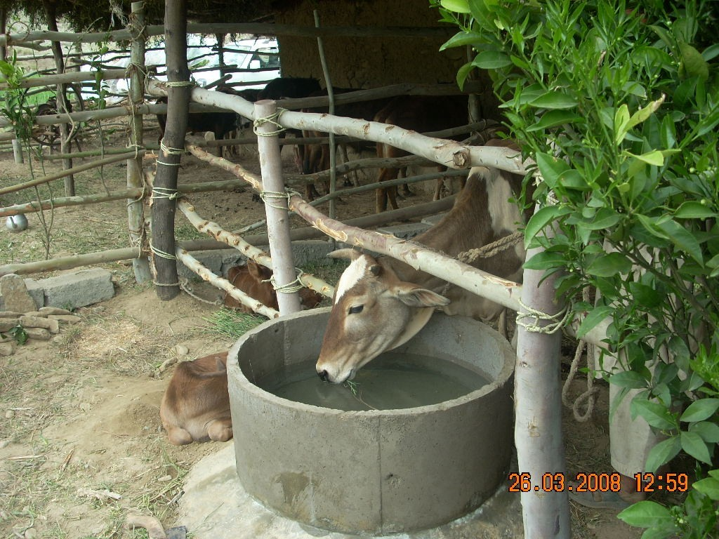
WATER
Accounts for 70% or more of the composition of most plants and animals

Slide 17
How much do animals drink per day?
Beef cattle: 7-12 gallons per head
Dairy cattle: 10-16 gallons per head
Horses: 8-12 gallons
Swine: 3-5 gallons
Sheep and goats: 1-4 gallons
Chickens: 8-10 gallons per 100 birds
Turkeys: 10-15 gallons per 100 birds

Slide 18
Factors for Control
Water Quality
  Salinity, acidity, pollution, and algae growth
Environmental Factors
  Air temperature and feed quality
Animal Factors
  Breed differences, age, and condition of stock

Slide 19
Feed Resources
Fodders
Crop Residues
Grains/ Oilseeds
LIVESTOCK FEED
By- Products
Feed Additives
Grazing Areas

Slide 20
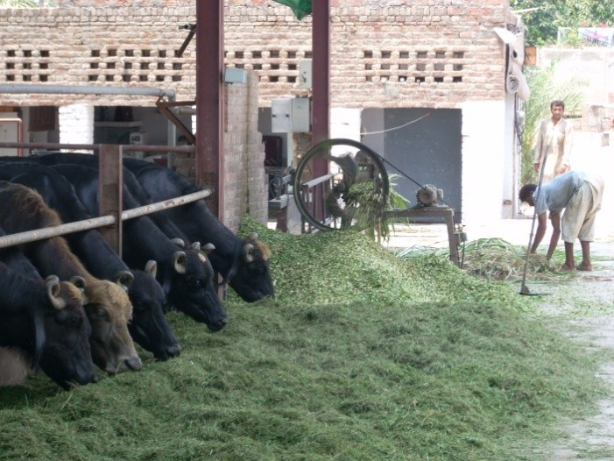
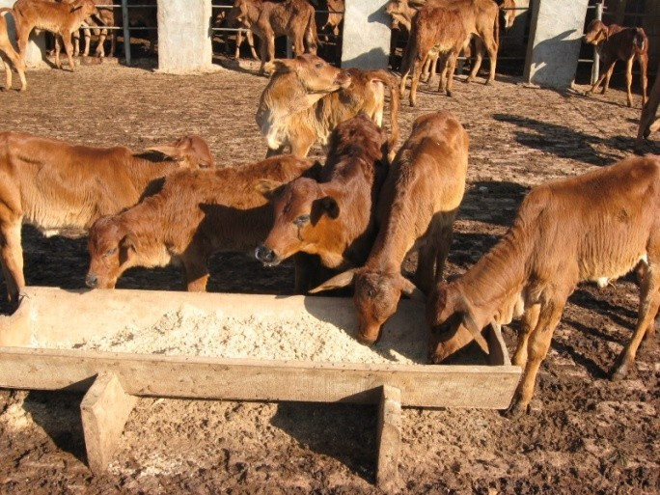
FEED CLASSIFICATIONS
Roughages
Concentrates
Supplements

Slide 21
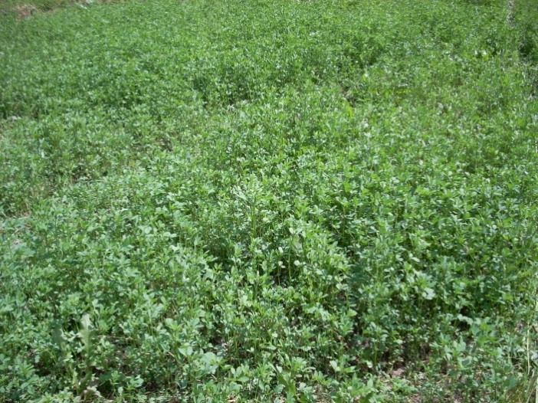
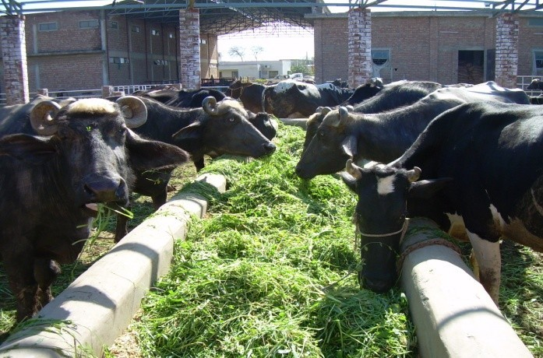
ROUGHAGES
High in Fiber and relatively low in digestible nutrients
Examples of roughages:
Alfalfa
Clover
Soybean
Oat hay
Corn Silage

Slide 22
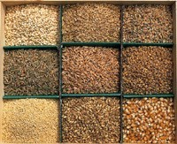
Concentrates
Are low in fiber and high in digestible nutrients
Examples of concentrates:
Corn
Cottonseed
Barley
Oats
Sorghum

Slide 23
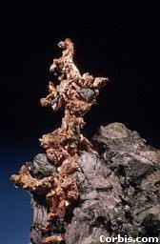
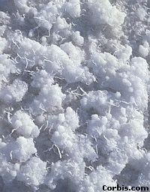
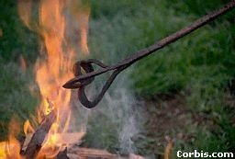
Supplements
Supplements are extras that supply the body with additional nutrients.
Some of the supplements are minerals salt, copper, iodine and iron
Vitamin A and D are also very important to ruminant animals
Salt
Copper
Iron

Slide 24
Mineral Mixture
Ingredients | Percent
DCP | 63.25
Sodium Chloride | 35.00
Copper sulphate | 00.25
Ferrous sulphate | 00.75
Magnese sulphate | 0.10
Zinc sulphate | 0.50
Cobalt sulphate | 0.10
Potassium iodide | 0.05
Total | 100

Slide 25
Feeding Management
An Art that need to know;
■
Requirements of the animal according to milk yield & lactation stages
Nutrient composition of available feeds &
How to combine different feeds to match the animal requirements
■
■
Should be
Balanced approach Cost effective Sustainable
■
■
■

Slide 26
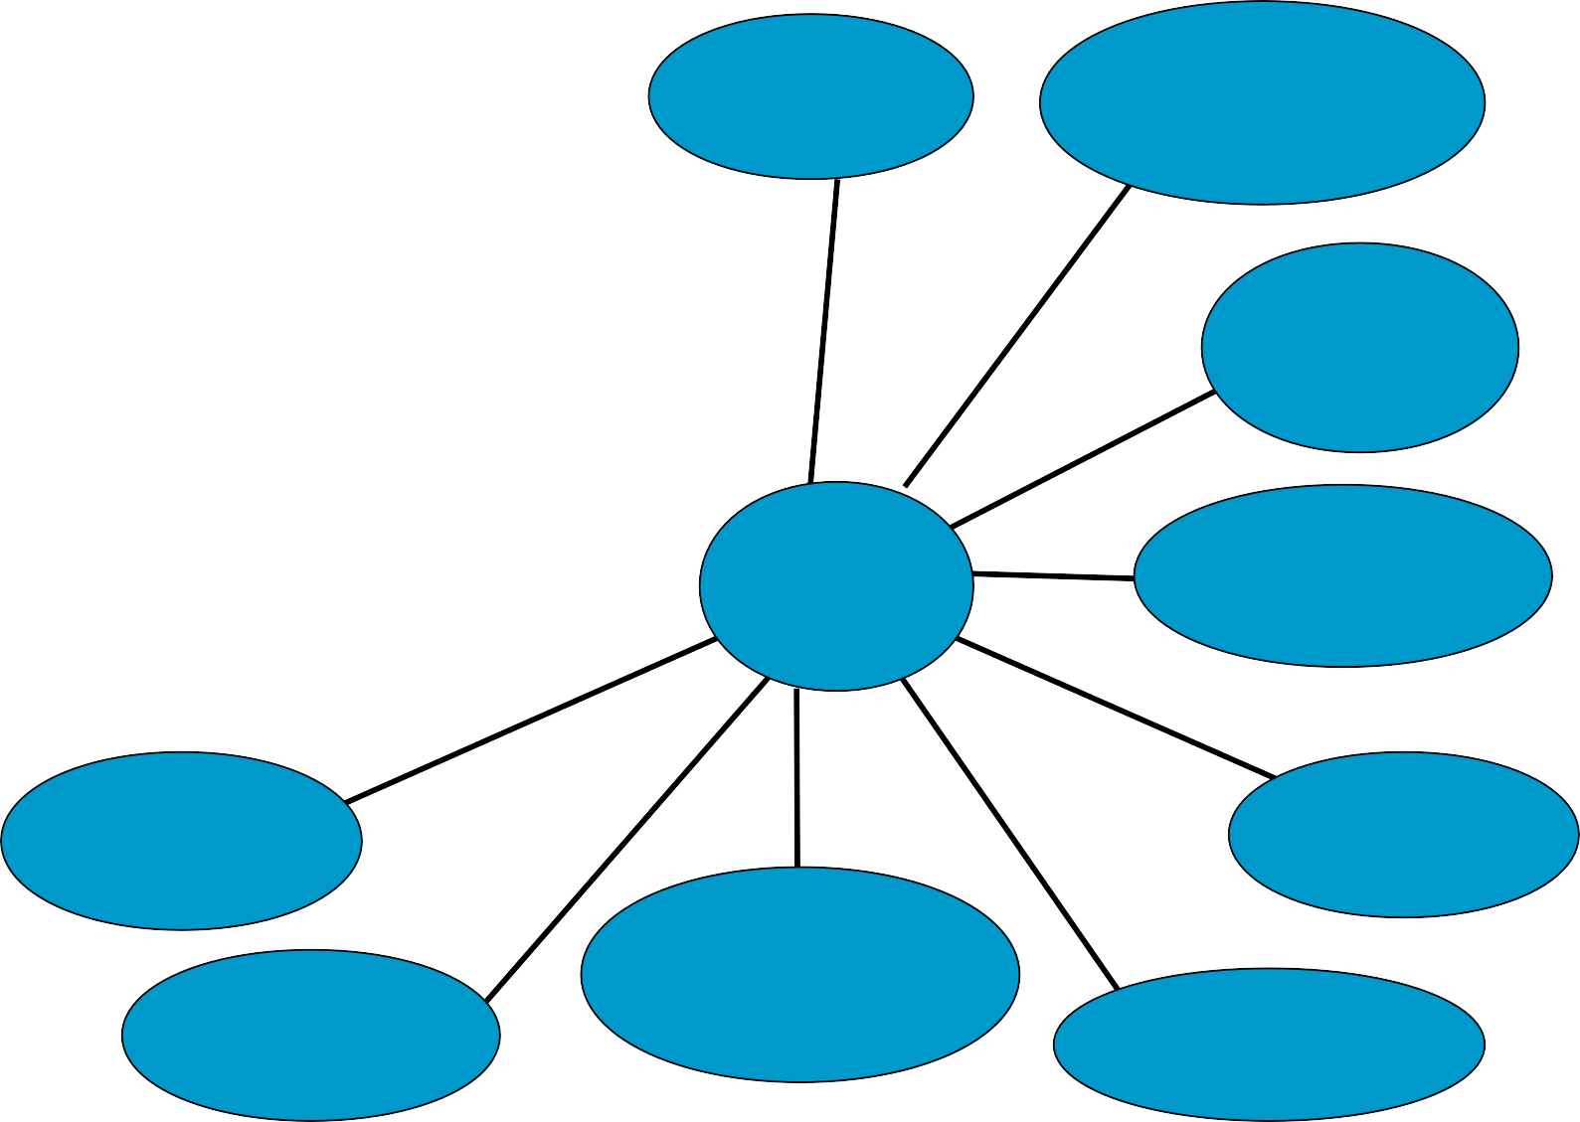
Improvement in Utilization of Feed Resources
Fodder Management
Animal Factors
Feed Contamination & Poisoning
Diagnosis of Feed Problems
Feeding Management
Feed Improvement Techniques
Nutrients
↑ Feed Utilization
Requirements
Feed Composition
Feed Supplements
Feed Testing & Results Interpretation
Feed Formulation
Hay or silage Making

Slide 27
How to over come the dry period feed scarcity problem
Conserve green fodder as silage ( maize fodder, sugar cane tops, oats, mott grass etc)
Hay making ( Berseem/ lucern)
Adopt urea treatment of straw for improved feed value
■
■ Offer multinutrient feed blocks when poor quality forages are fed.

Slide 28
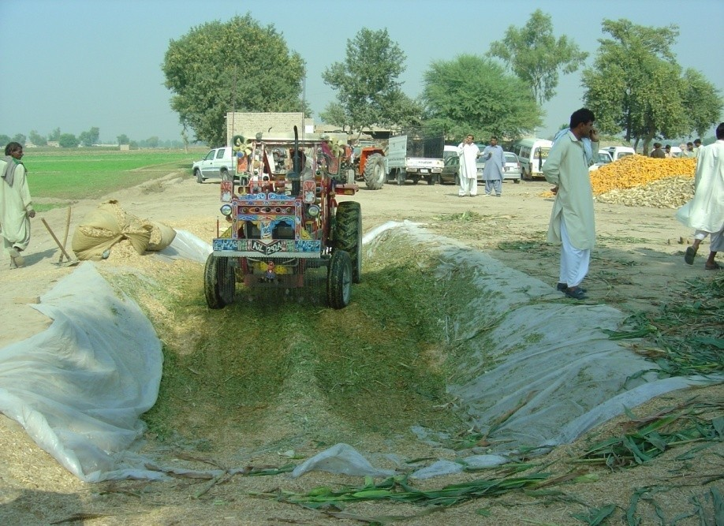
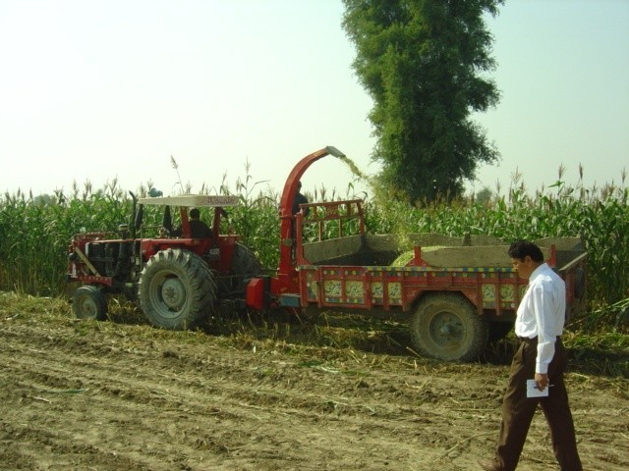
Silage Making

Slide 29
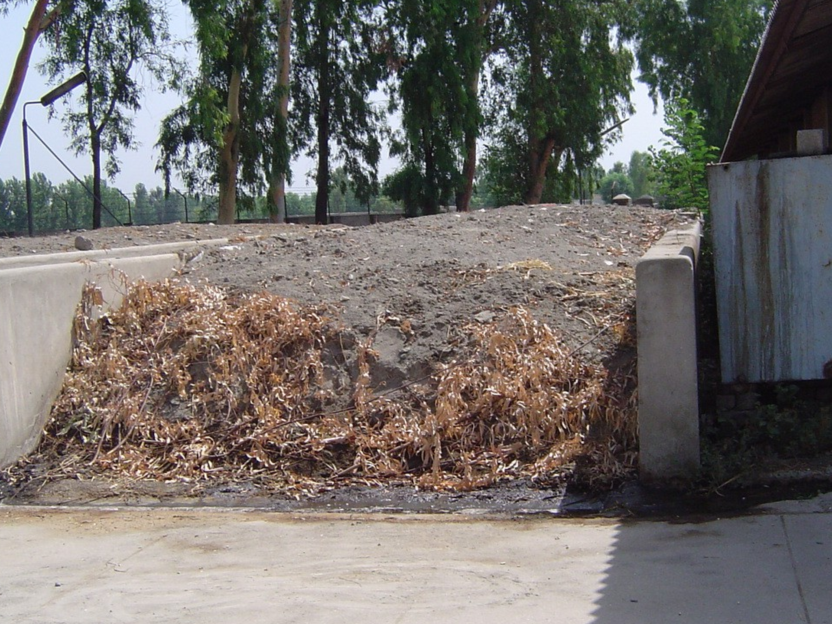

Slide 30
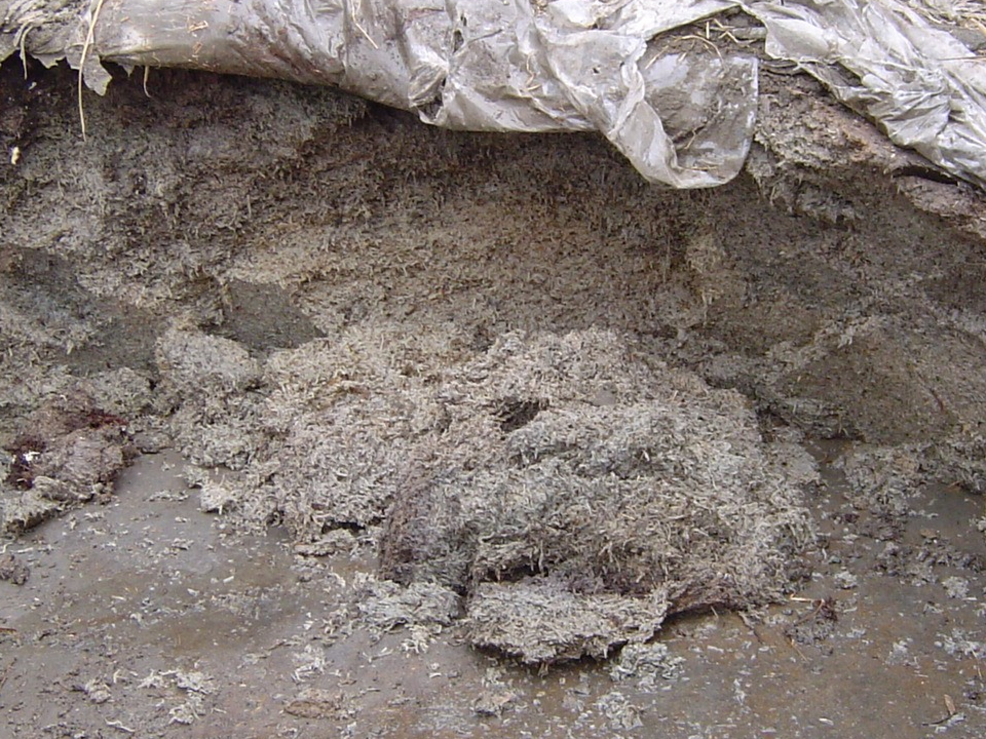

Slide 31
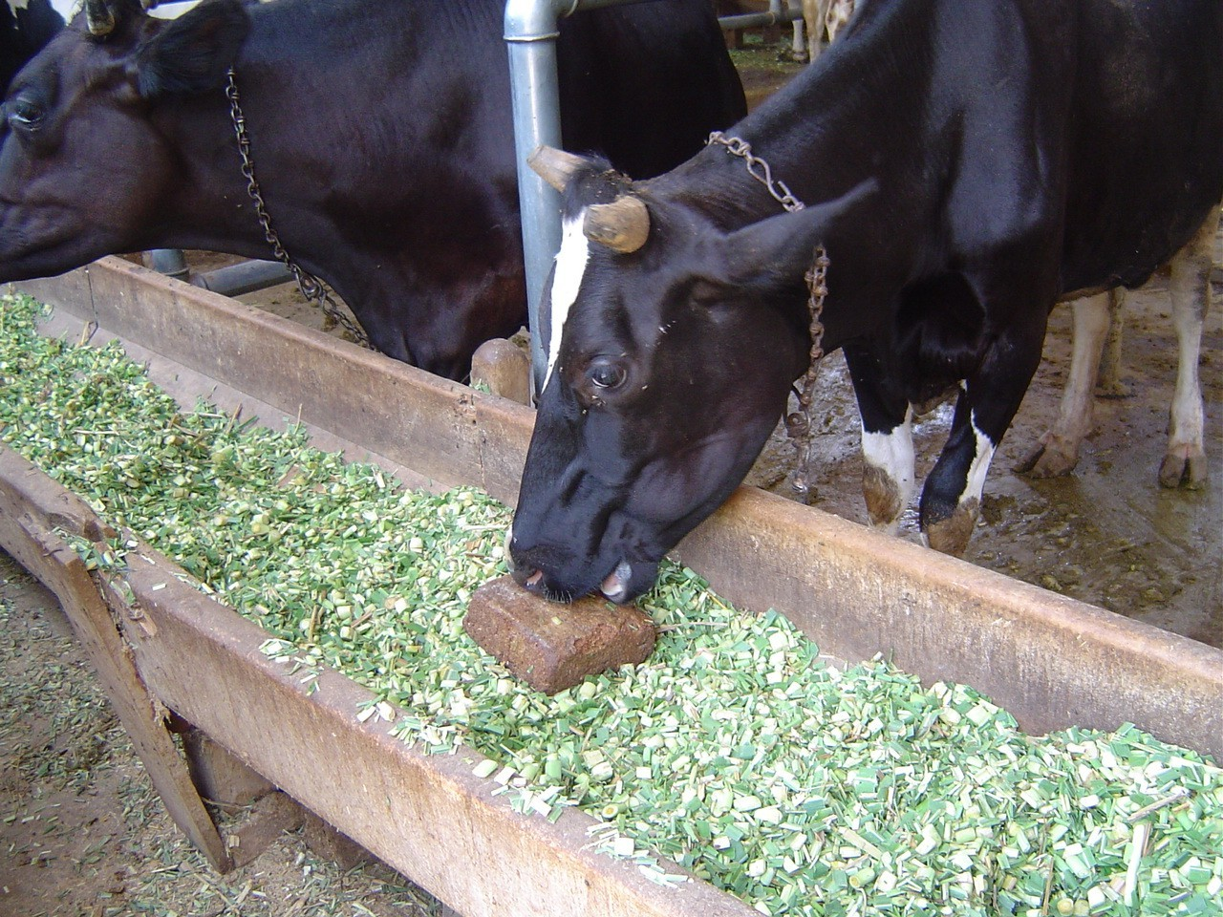
Molasses-urea Blocks are suitable with
poor quality forages during dry period

Slide 32
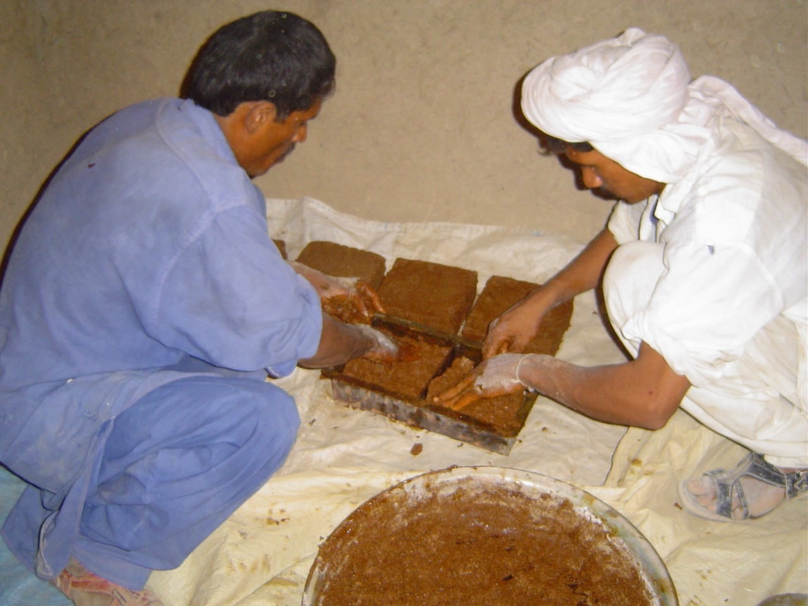
Molasses- Urea Blocks can be prepared on farm

Slide 33
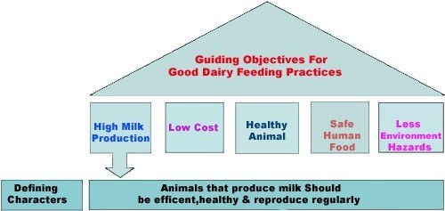

Slide 34
Feeding ruminant animals at different life stages
Start from Pregnancy to End of Lactation Period
(Peak, mid, late lactation)

Slide 35
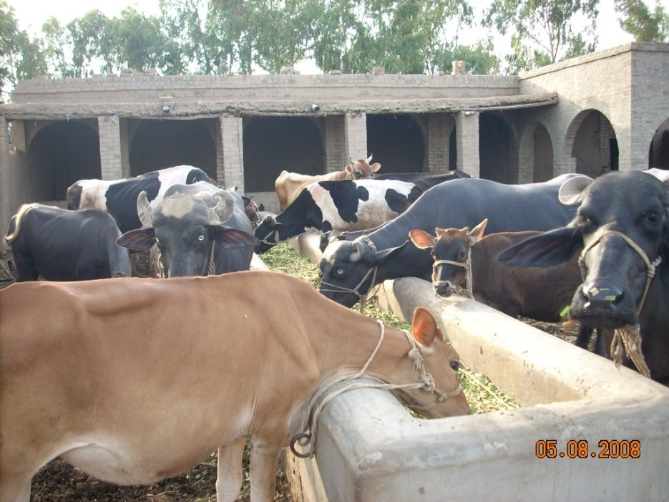
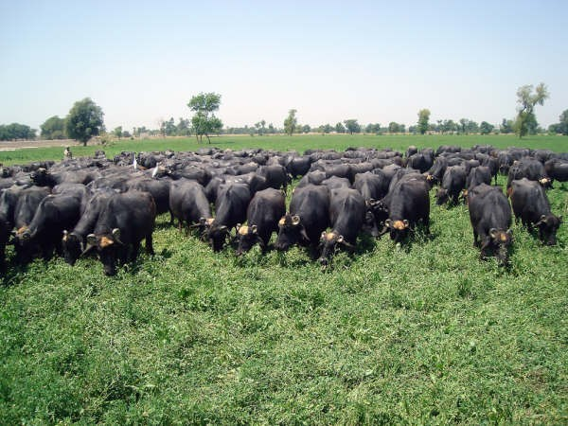
Dairy Nutrition
■ Nutrition is important in order to be profitable in the dairy industry from growth of the calves through milk production in lactating cows.

Slide 36
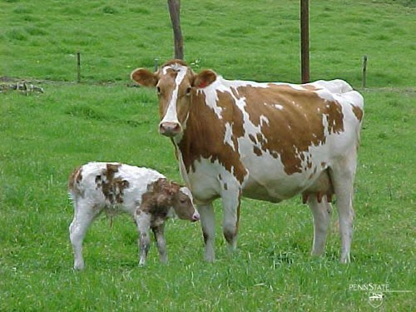
Stages of A Dairy Cow
Calf
Heifer
Dry Cow
Close-up Cow
Lactating Cow

Slide 37
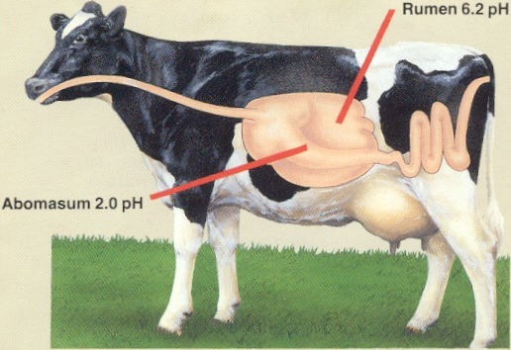
Digestive system

Slide 38
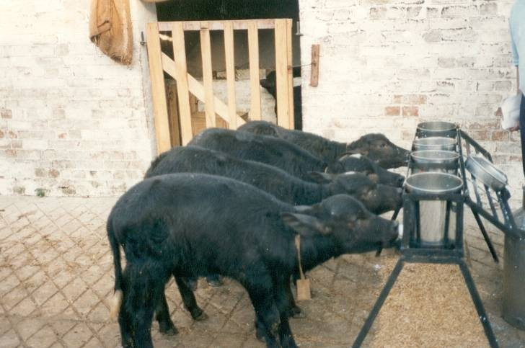
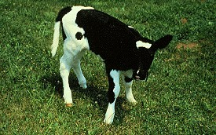
Calf Nutrition
Calves are born as monogastric animals (simple stomach)
So offer feed that must be easy to digest (high quality digestable proteins, energy, vitamines and minerals)

Slide 39
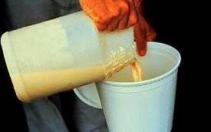
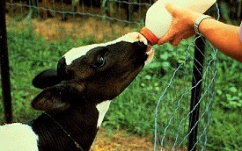
Calf Nutrition
Energy is important first two weeks because can not digest starch, sugar or unsaturated fats.
Colostrum feed at first feeding to get higher amounts of protein, minerals, immunoglobulins, and antibodies. Lines to walls of digestive tract to protect against diseases

Slide 40
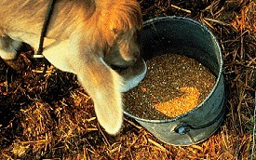
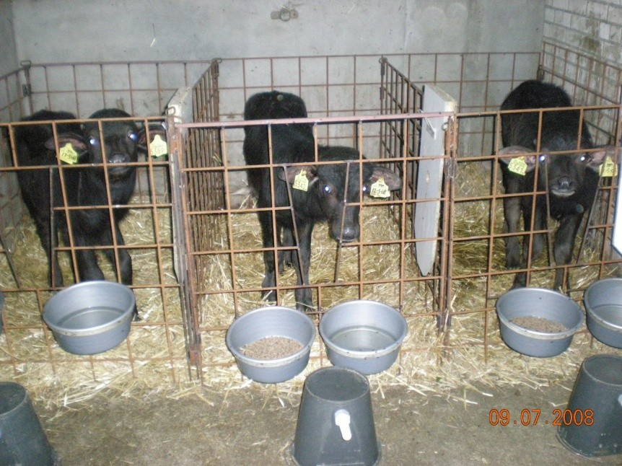
Calf Nutrition
Grains (Dry Matter) stimulate production of VFAs in rumen (acetic, propionic, butyric)
Digestive system develops from 2
weeks until 4-6 months and calf evolves into ruminant

Slide 41
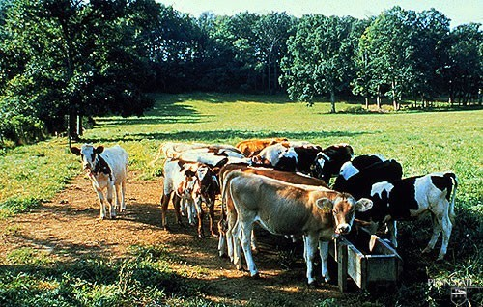
Heifer Nutrition
■
Nutrition is important at this time because reproduction depends on sound, healthy animals.
If underfed, diseased or have parasites then puberty is delayed. Low energy will lead to ovarian inactivity. Low protein will cause irregular or silent heats.
30-40% of adult weight at breeding age (13-15 months)
■
■

Slide 42
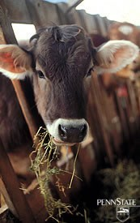
Heifer Nutrition
Pasture is a good choice of forage (high energy and less expensive)
3 lbs concentrate/ day
12% crude protein, 15% crude
fiber and .41% Calcium at 6
months, .29% Calcium at 12 months
Final 3 months of pregnancy heifer will need extra nutrients for developing calf

Slide 43
Dry Cow Nutrition
Low energy diet (less expensive)
Pasture often used
Important for successful lactation to follow
Restore body energy and nutrient reserves
Want to maintain 3+ to 4- body condition score

Slide 44
Feeding in Pregnancy (Last 2 months)
For;
Rapid growing foetus
Develop body reserves for use in subsequent lactation
How;
Give rest if in milk (forced drying) Feed concentrate 2 kg/day + good quality fodder, restrict straw
■
■

Slide 45
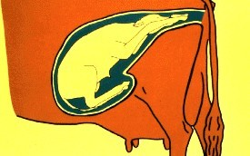
Close-up cows
Move cows and heifers to close-up pen at 2 weeks before calving
High dry matter intake to gain nutrients for cow and calf to reduce metabolic problems

Slide 46
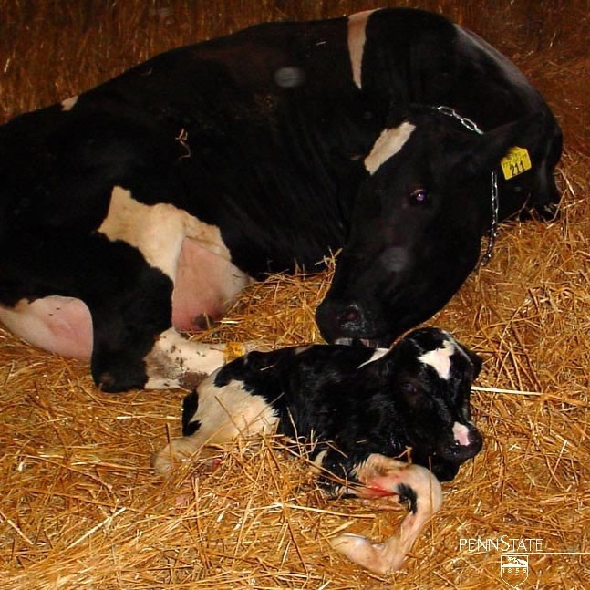
Close-up Cows
Start grain feeding Increase CP to 15% Limit added fat 100 gm/d
■
■
■
Low energy with adequate levels of minerals vitamines and protein and watch forage levels (<50% DM)
Decrease metabolic problems and maintain condition while not lactating
■
■
Decrease Calcium to begin to use stored Ca to prepare for lactation changes

Slide 47
Early lactation (First 60 days)
Most critical period
Period of peak milk yield
Higher the peak yield more will be the milk yield throughout lactation until drying off.
Good quality forage
Maintain healthy level of fiber
Avoid high starch level
Undegradeable protein & digestible fiber

Slide 48
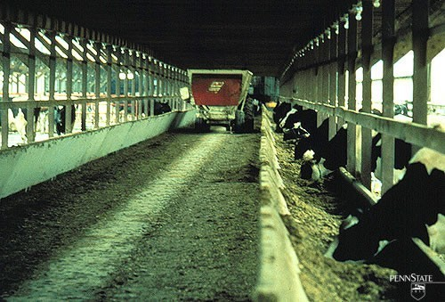
Lactating Cows
Highest energy diet (most expensive)
Supports not only growth, reproduction and maintenance but also production
Free feed at all times to increase and support production

Slide 49
Consequences of Feed Restriction in early lactation as a traditional practice
Low peak milk production & total lactation yield
Drastic body weight losses in high potential cows leading to;
Metabolic diseases ( milk fever, acetonaemia, red water disease etc)
■
Delayed estrus resumption
■ Long dry period

Slide 50
Thank you

