Slide 1
Livestock & Poultry Management
ASAP2101(2-1-0)
Session: 18
Prevention (including vaccination schedule) of important diseases of livestock

Slide 2
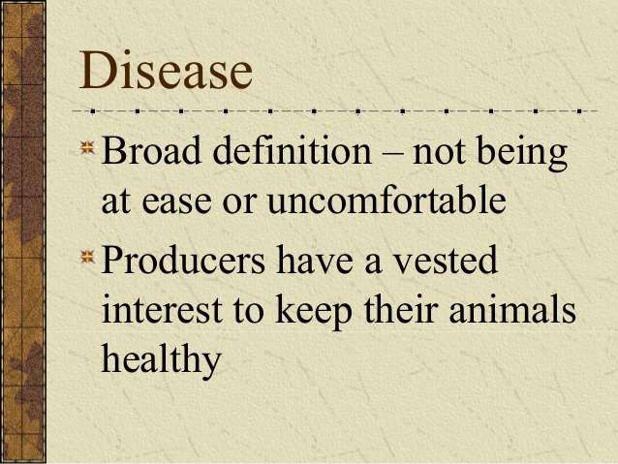

Slide 3
A. Signs of good health include:
Contented animals look free from all anxiety.
Some animals have specific signs to look for and others will take a trained eye to recognize. Sheep will stay quiet and cattle will chew their cud.
3. Body temperature, respiration, and pulse rate should be monitored because unusual highs and lows can be symptoms.
Alertness can be judged by checking if an animal perks its ears when you draw near.
The skin and coat of most animals should be oily and elastic like.
One of the easiest things to notice is when an animal goes off feed. All healthy animals should eat aggressively when fed and ruminants should be seen chewing their cud.

Slide 4
General symptoms specific to disease:
Animal losing fetus
Shaking
Coughing
Poor growth or decrease in production
Rough coat
Loss of appetite

Slide 5
NORMAL CLINICAL VALUES IN ANIMAL
Table: Normal clinical values in animals:
Species | Temp ture1 | Pulse rate, per minute | Respiration rate per minute
Cattle& buffalo Sheep | 101.6 | 42 – 60 | 16 – 24
& Goat . Poultry | 102.6 | 70 – 80 | 18 – 30
 | 107.0 | 130 – 160 | 15 – 30

Slide 6
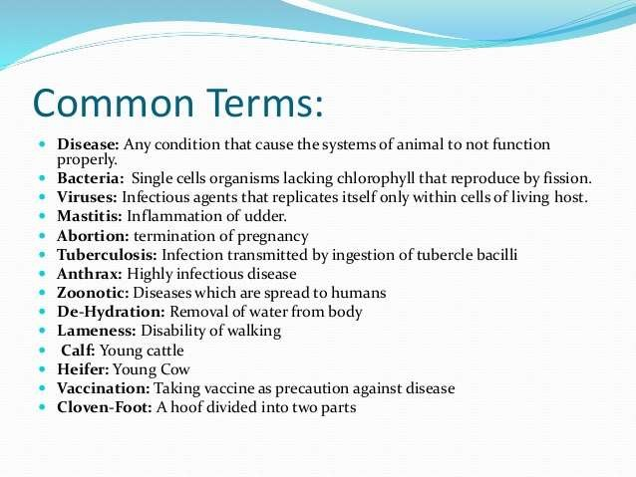

Slide 7








TYPE OF DISEASE :
INFECTIONOUS DISEASE
NON INFECTIONOUS DISEASE
DISEASE OF LIVESTOCKS
INFECTIONOUS
NON INFECTIONOUS
VIRAL DISEASE
Metabolic disorder
Trauma
BACTERIAL DISEASE
Faulty nutrition

Slide 8
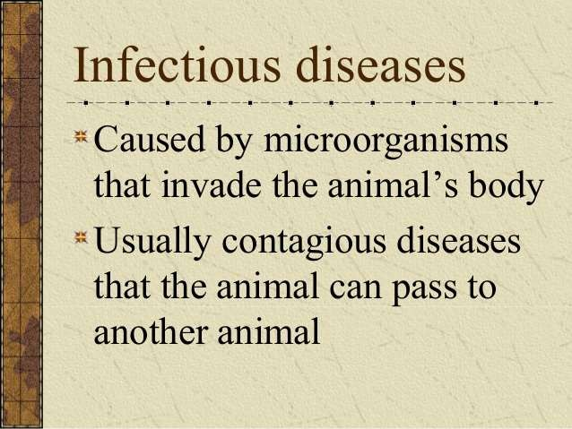

Slide 9
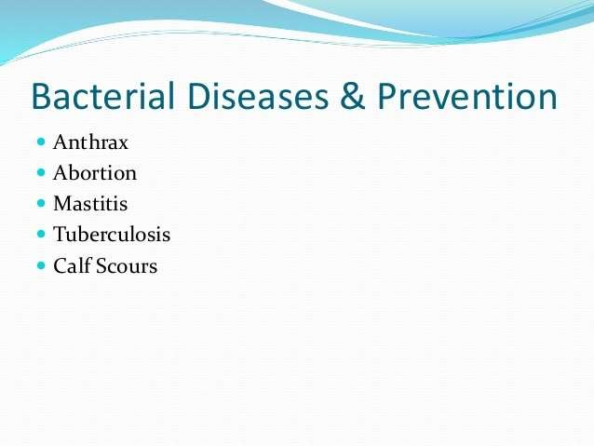

Slide 10
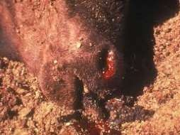
Anthrax
Causative agent: Bacillus anthracis
Mode of Transmission: By ingestion, from soil when
grazing or in contaminated food/wound infection
Host: All Species (Cattle, sheep and goats are most susceptible)
Symptoms:
In peracute sepeticemia death occurs within 2 hours after animal collapsing with
convulsions, sudden death in animals that appeared normal is common.
In acute septicemia death occurs within 48 to 96 hours clinical signs include fever, anorexia, ruminal stasis, hematuria and blood tinged diarrhea.
Pregnant animals may abort and milk production often abruptly decreases.
Terminal signs include severe depression, respiratory distress and convulsions.
Oozing of tarry coloured unclotted blood from all the orifices of the animals body
Prevention and Control:
By active immunization. The organism is susceptible to penicillin-G, tetracyclines,
erythromycin and chloramphenicol.

Slide 11
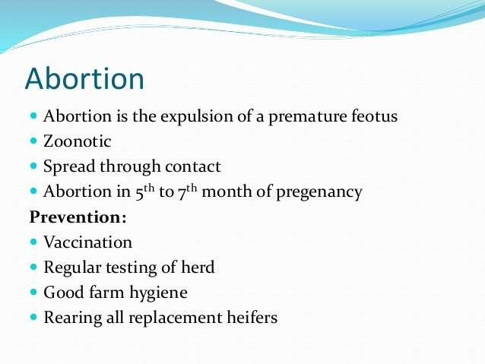

Slide 12
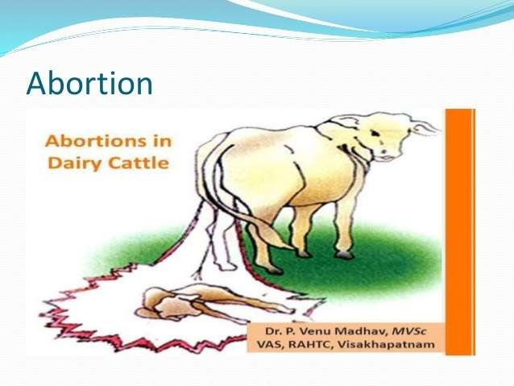

Slide 13
Mastitis
Introduction: Mastitis is an inflammation of the mammary gland. In which the milk undergo physical, chemical and microbiological changes where as mammary glandular tissue under go physical and pathological changes. In which infected milk colour, consistency change and contains more amount of leucocytes.
Clinical Signs:
Per acute form: Pyrexia, anorexia, respiratory distress, swollen, hot and painful udder. Cessation of milk production. Exudate are often blood stained.
Acute form: Swollen udder, changes in quality of milk. Milk become curd like, yellow, brown fluid
with flakes and clots.
Subacute form: No changes in the udder tissue.
Chronic form: Udder is haemorrhagic, and fibrotic. Swollen and palpable supra mammary lymphnode,. Udder is thick, firm, nodular and atrophic, yellowish or white fluid with clots and flakes.
 Treatment: Stripping out the milk from the infected quarters. Cleaning of infected quarters with normal saline and distilled water. Infusion of antibiotic therapies immediately after the infection. Continuous use antibiotics as per the antibiogram.
 Control:
Hygenic measures are important.
Animals diagnosed positive should be milked at last.
Milkers should wash their hands before milking and should use well washed white overalls.
A separate clean cloth for each cow is used for washing the udder with a disinfectant.
The first stream of milk from each quarter should not be allowed to drop on floor but collected in a separate container. Milkers should not wet their hands with first stream of milk.

Slide 14
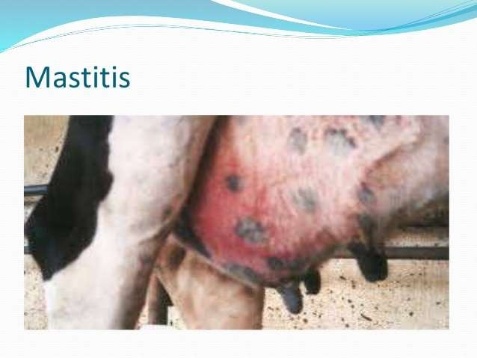

Slide 15
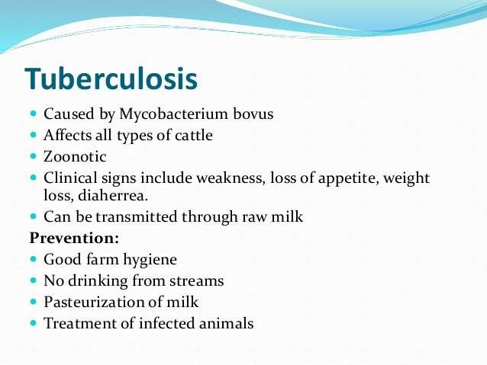

Slide 16
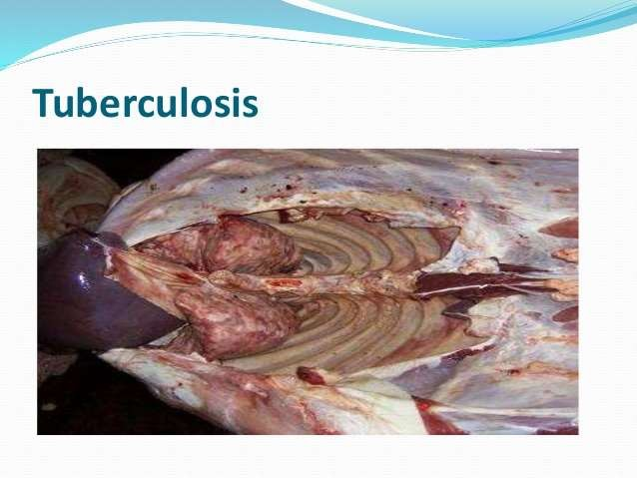

Slide 17
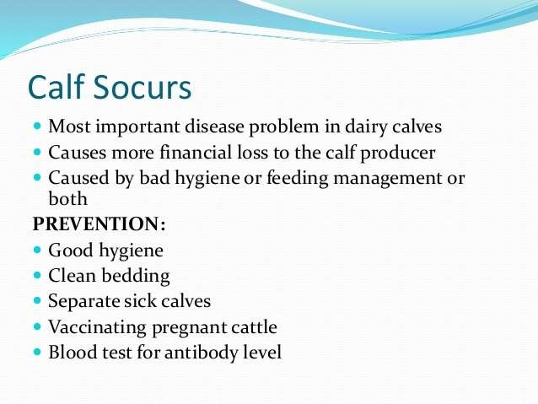

Slide 18
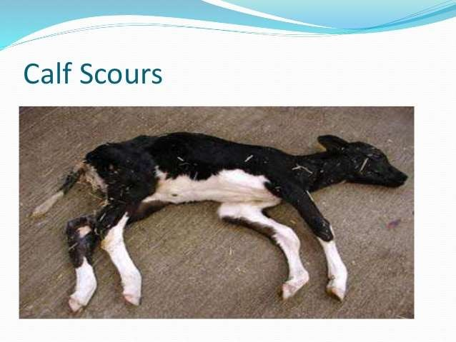

Slide 19
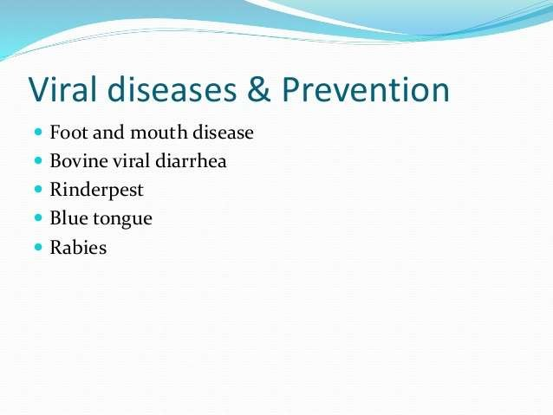

Slide 20
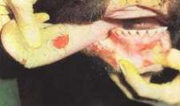
Foot and Mouth Disease (FMD)
Causative agent: Picorna Virus
Mode of Transmission: By direct contact i.e. Through water, manure, pastureBy direct contact i.e. Through
water, manure, pasture and cattle attendant
Host: In cloven-hoofed animals (cattle, pigs, sheep, goats, and water buffalo)
Symptoms:
The formation of vesicles (fluid-filled blisters) and erosions in the mouth, nose, teats and feet. Initial signs are pyrexia (39.4-40.6ºC), dullness, anorexia, and fall in milk production. These signs are followed by excessive salivation; drooling, serous nasal discharge; shaking, kicking of the feet or lameness; and vesicle (blister) formation in the tongue, dental pad, gums, soft palate, nostrils, muzzle, interdigital space, coronary band, and teats. Pregnant cows may abort, and young calves may die without developing any vesicle
The course of an FMD infection is 2 to 3 weeks. Secondary infection may delay recovery.
Presence of ropy saliva
Prevention & Control:
Thorough disinfection of shed, utensils, clothes of attendants.Vaccination – polyvalent – once – 4 months or varies with type of vaccine

Slide 21
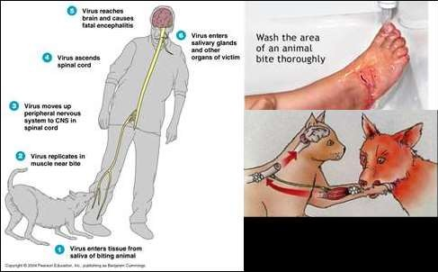
Rabies
Causative agent:- Rhabdovirus
Initial Signs:-
pain at the bite site, a general feeling of illness
fever, headache, muscle aches
poor appetite, nausea, and vomitin, sore throat
depression
Later Symptoms:-
anxiety, confusion, excessive saliva production
hallucinations, high level of excitement
insomnia, restlessness
paralysis of lower legs, problems swallowing due to painful throat and voice box spasms
hydrophobia (fear at the sight of water despite an intense thirst)
 Prevention & Treatment:
By vaccination (Pre or Post bite)

Slide 22
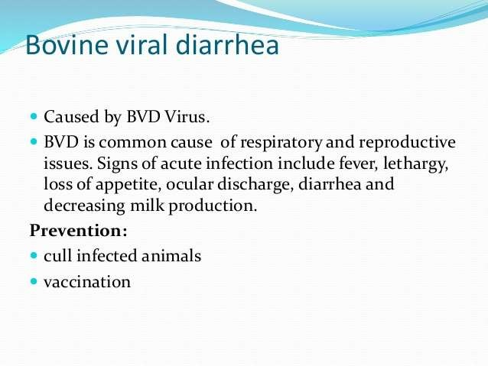

Slide 23
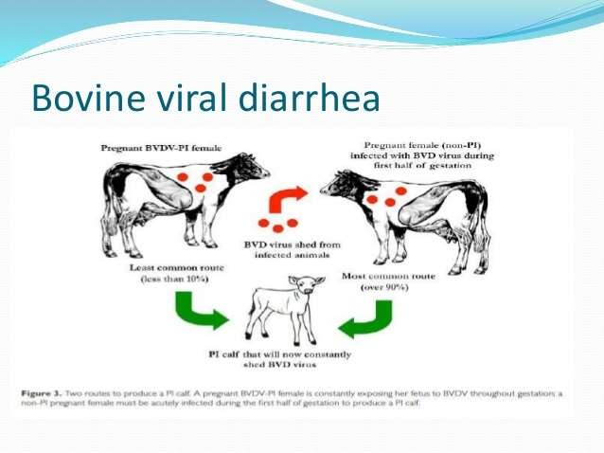

Slide 24
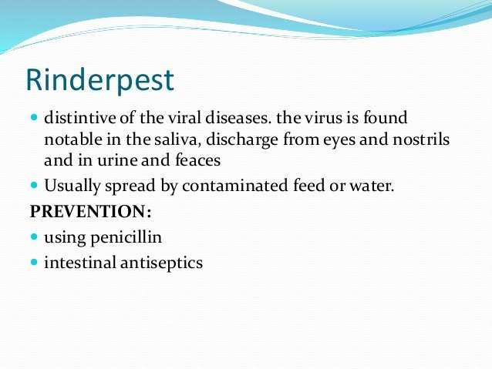
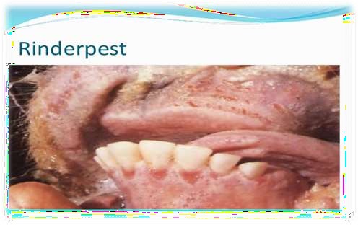

Slide 25
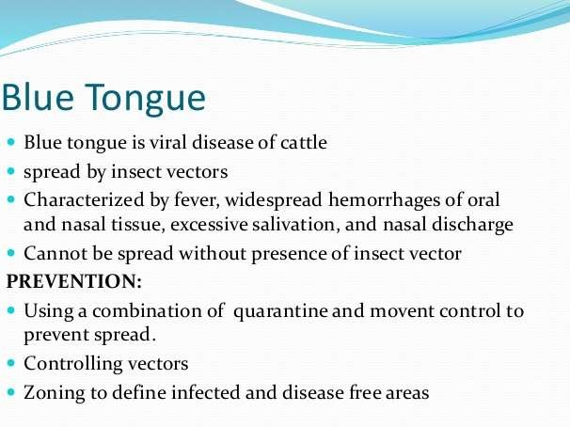
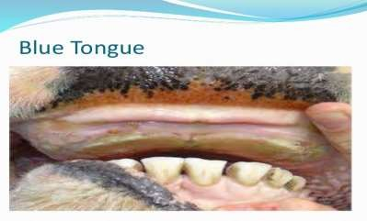

Slide 26
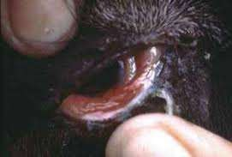
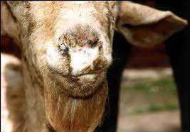
PPR in Goats
Causative agent: Morbilli virus of family Paramyxovirus
Transmission: By direct contact i.e. Through water, manure, pasture
Symptoms:
Fever
Occular and nasal mucous discharge,
Mouth lesion
Respiratory distress
 Prevention:
Yearly vaccination.
Separation of infected one from healthy animals

Slide 27
NON INFECTION DISEASE
Faulty nutrition .
>Ration is not balanced
Metabolic disorder.
>Not adequate digested.
Trauma
>Wound and injuries

Slide 28
FAULTY NUTRITION :EXAMPLE
Bloat
Rapid fermentation (breakdown of carbohydrate by enzyme to
much gas ).
Bovine pulmonary emphysema :
Feedlot problem ,panting,coughing,difficult breathing .
Fescue foot
Pasture problem,cattle grazing in a fescue pasture ,the animal shifting from one hind to other,sometime with one in the air.
Enterotoxemia (overeating disease)
Affect cattle /sheep on high concentration rations.animal may die in
1 or 24 hours .
Founder:
Footlot problem :swelling of tissue thar=ts attaches to hoof of the feet

Slide 29
METABOLIC DISORDER ;EXAMPLE
Grass tetany
most often affects cows that are lactating ,it is caused by a lack of magnesium .
Hardware disease:
Animal swallows metal objects that ruminant stomach.
Nitrate poisoning :
Caused by the animal eating or drinking a product that has too much nitrogen in it .
Poisonous plant
animal eating poisonous plant in a graze land setting ..

Slide 30
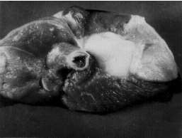
METABOLIC DISORDER :
Rumentitis (liver abcess complex)
Cattle on a high conc rations .the soil and manure content levels play a factor in the prevalence of thus disease.
white muscle (selenium difficiency)
Common where the soil is lacking in selection in selenum .
The muscle turns a white colour.
Pic: white muscle

Slide 31
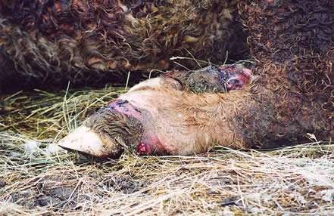
EXAMPLE :
::fescue legs

Slide 32
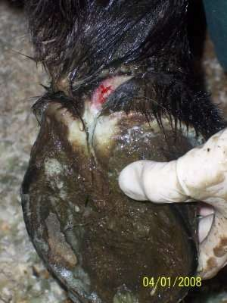
Example::
trauma

Slide 33
PREVENTION MEASURES
General Measures for Prevention of Contagious Diseases
Identification of isolation of infected,-rd in contact animal.
Treatment of' affected animals
Slaughter of animals suffering from incurable diseases.
Disposal of Deal animals either burning or deep burial.
Destroy contaminant folder by burning.
Proper disposal of contaminated water.
Regular cleaning and disinfection of cattle shed and its premises.
Don’t allow animals from affected to clean area.
Restrict the movement of animals from effected to clean area.
Don’t allow animals to drink water from ponds, rivers etc. during
out break of disease.

Slide 34
Close animal markets, cattle shows etc. during outbreak
of disease.
Regular spraying of insecticide to control external parasites.
Regular de-worming to control internal parasites.
Avoid stress associated with along distance
transportation, inclement weather and under nutrition
Provide adequate ventilation and sufficient space.

Slide 35
VACCINATION SCHEDULE
Vaccination schedule
Disease | Age | Interval | Month
FMD | 3rd month | Every six month | Jan-Feb, June-July
BG | 6th Month | Every year | Aug-Sep
HS | 6th Month | Every Year | Sep-Oct
Every Year
( Affected area only)
Anthrax
6th Month
April - May
4-8th month of Heifer
Brucellosis
--
Mar - April

Slide 36
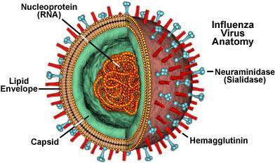
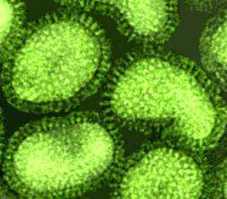
Avian influenza
Avian Influenza (AI) is a viral infection affecting wild and domestic birds.
Many species of birds are susceptible to AI including chickens, turkeys, guinea fowl, and other domestic birds, as well as a some wild avian species.
AI is caused by viruses that are members of the family Orthomyxoviridae, and the genus Influenza virus, Type A.

Slide 37
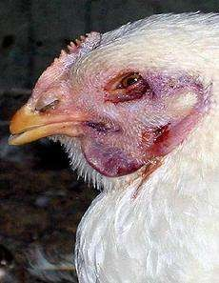
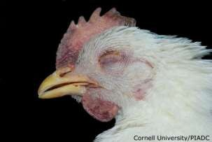
Clinical Signs
The severity of clinical signs depends on factors such as:
•age
•species
•concurrent infections
•environment
•the pathogenicity of the virus
Symptoms:
In domestic poultry, clinical signs reflect abnormalities in the respiratory, digestive, urinary, and reproductive organs.
Generalized signs include decreased activity, ruffled feathers, decreased feed and
water consumed occasionally greenish diarrhea.
Respiratory manifestations include mild to severe coughing, sneezing, excessive lacrimation, accumulation of liquids in eyelids, and nasal discharge.
decrease in egg production are observed in laying hens and breeders.

Slide 38
Prevention and Control
The recommended strategy for controlling AI is eradication.
•This requires different components including:
biosecurity practices
•controlling human traffic, quarantining birds before introduction, proper cleaning and disinfection of facilities, keeping healthy birds away from contact with sick birds and wild birds, and incubating eggs only from clean flocks
increasing host resistance through vaccination
•Inactivated vaccines have been shown to be effective but are fairly expensive

Slide 39
Infectious bronchitis(IB)
•Cause
•Corona-virus is the causal agent. Several different genotypes of IB virus are known to exist.
•Transmission
•The virus is transmitted from bird to bird through the airborne route. The virus can also be transmitted via the air between chicken houses and even from farm to farm.
•Species affected
•Only chickens are susceptible to IB virus.
•Clinical signs
•In young chicks IB virus infection causes a cheesy exudate in the bifurcation of the bronchi
•In older birds IB does not cause mortality.
•Egg productionwill decrease dramatically, deformed eggs with wrinkled shells will often be laid

Slide 40
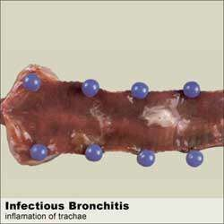
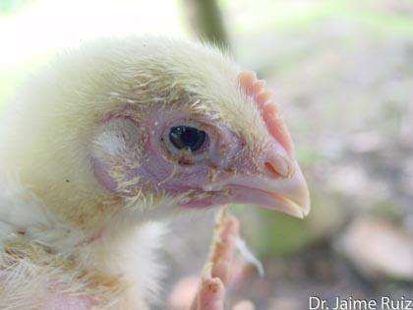
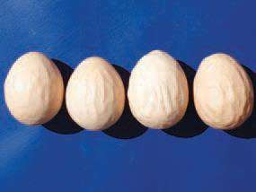
•Treatment and control
•There is no treatment for infectious bronchitis.
•Secondary bacterial infections may be prevented by, or treated with antibiotics.
•Prevention by vaccinationis the best method to control IB

Slide 41
Chronic respiratory Disease(CRD)
•Cause
•The underlying cause of CRD is Mycoplasma gallisepticum (Mg).
•TheconditionisfrequentlytriggeredbyrespiratoryvirusessuchasNDandI
Bandsubsequentlycomplicatedbybacterialinvasion.
•The main agents involved in the infection are Mycoplasma gallisepticum and E. coli.
•Stresscausedbymovingthebirds,bydebeakingorotheroperationsorothe runfavorableconditionse.g.coldorbadventilation,makethebirdsmoresus ceptible.
•Transmission
•ThemainproblemisthatparentbirdsinfectedwithMycoplasmagalliseptic
umcantransmittheorganismthroughtheeggtotheiroffspring.
Inaddition,infectioncanoccurbycontactorbyairbornedustordroplets

Slide 42
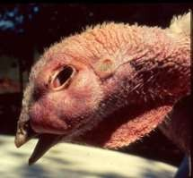
Clinical signs
•Young chickens (broiler chicks or layer pullets) will show respiratory distress
•The birds frequently show a lack of appetite, decreased weight gain and
increased feed conversion ratios.
•In adult birds the most common symptoms are sneezing, coughingand general signs of respiratory congestion.
•In laying birds a drop of egg productionbetween 20-30 % can occur.
•CRD does not normally cause an alarming number of deaths..
•Treatment
•Treatment of Mg-infected chickens or turkeys with suitable antibiotics or chemotherapeutics has been found to be of economic value.
•control by medicationor vaccinationand eradication of Mg infections
•Fertile eggs from infected birds can be treated with antibiotics such as tylosin to eliminate the Mycoplasma gallisepticum organisms.
•Methods used are the injection of fertile eggs or egg dipping. Blood serum testing of breeder chickens for Mg antibodies has become a routine to test flocks for a Mg infection

Slide 43
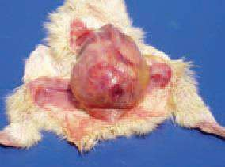
ESCHERICHIA COLI INFECTIONS
Escherichia coli infections are widely distributed among poultry of
all ages and categories.
They are primarily related to poor hygienic conditions neglected technological requirements or to respiratory and immuno suppressive diseases.
A common sequel of navel infections is local or diffuse peritonitis .
Omphalitis (navel infection)
•It is characterized with reddening and tissue oedema in the
umbilical region .
The delayed absorption of the yolk sac is a prerequisite for E. coli infections and peritonitis

Slide 44
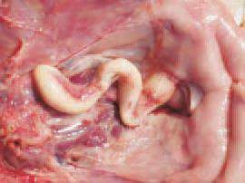
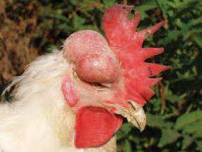
Salpingitis (inflammation of the oviduct). Salpingites due to E. coli
infections could be also observed in growing birds.
•The oviduct is dilated, with thinned wall and filled with caseous exudate all along its length .
Salpingites are among the commonest causes for death in layer
hens. E. coli penetrates from the cloa via an ascendant route.
•Egg yolk peritonitis in a layer hen consequently to E. coli salpingitis. The chickens could be hatched with a latent infection, when E. coli is present in ovaries and the oviduct. In these instances, the infection could turn into an overt infection under the influence of some stress factors or lesions
Panophthalmitis (inflammation of all tissues of the eyeball). Generally, it develops secondary to E. coli septicaemia and is usually unilateral

Slide 45
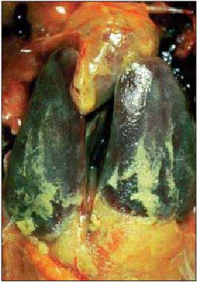
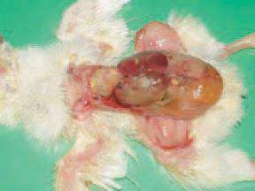
•E. coli septicaemia of a respiratory origin. In such cases, the respiratory mucosa damaged by infectious and non-infections agents (ND viruses including vaccinal strains, IB, mycoplasmae, high ammonia levels) is the entrance door of the E. coli infection. The lesions are principally observed in the respiratory tract (trachea, lungs and air sacs), but some adjacent serous coats (pericardium, peritoneum) are also affected and thus, the picture of a typical serofibrinous polyserositis is produced

Slide 46
Thank you

