Slide 1
Livestock & Poultry Management
ASAP2101(2-1-0)
Session: 3
Housing principles, space requirements for different species of livestock and poultry

Slide 2
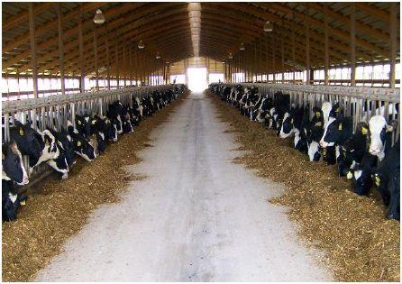
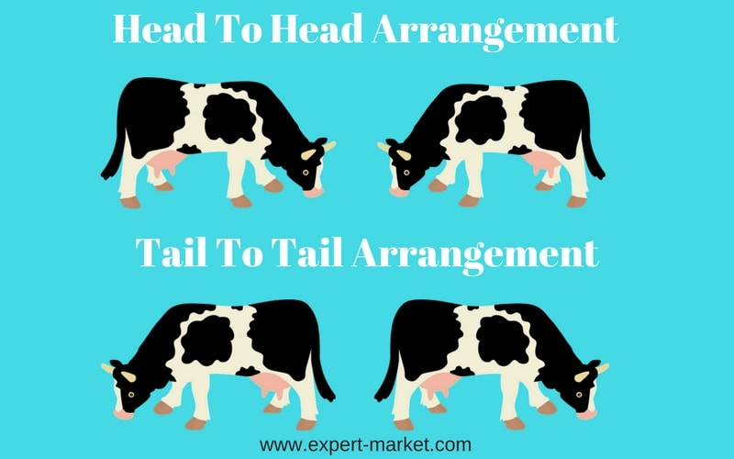
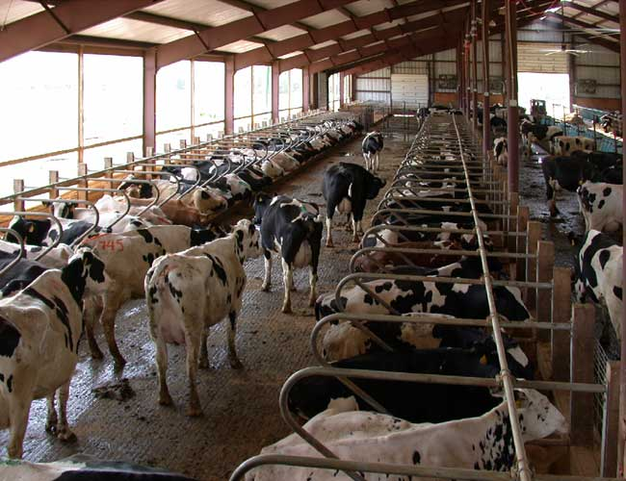
Arrangement of cow in an organised farm

Slide 3
Cattle Shed
The entire shed should be surrounded by a boundary wall of. 5" height from three side and manger etc., on one side. The feeding area should be provided with 2 to 2 ½ feet of manger space per cow. All along the manger, there shall be 10" wide water trough to provide clean, even, available drinking water.
The water trough thus constructed will also minimize the loss of fodders during feeding. Near the manger, under the roofed house 5' wide floor should be paved with bricks having a little slope (Standing space).
Beyond that, there should be open unpaved area (40'X35') surrounded by 5' wall with one gate. It is preferable that animals face north when they are eating fodder under the shade. During cold wind in winter the animals will automatically lie down to have the protection from the walls.

Slide 4
Loose housing
Conventional barns or Stanchion barns

Slide 5
Direction of houses

Slide 6
Floor
The inside floor of the barn should be of some impervious material which can be easily kept clean and dry and is not slippery. Paving with bricks can also serve ones purpose. Grooved cement concrete floor is still better.
The surface of the cowshed should be laid with a gradient of 1" to 1 14" from manger to excreta channel. An overall floor space of 65 to 70 sq.ft. Per adult cow should be satisfactory.
Walls
The inside of the walls should have a smooth hard· finish of cement, which will not allow any lodgment of dust and moisture. Comers should be round. For plains, dwarf walls about 4 to 5 feet in height and roofs supported by masonry work or iron pillars will be best or more suitable. The open space in between supporting pillars will serve for light and air circulation.

Slide 7
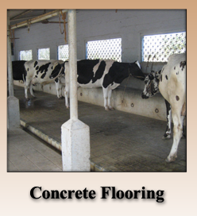
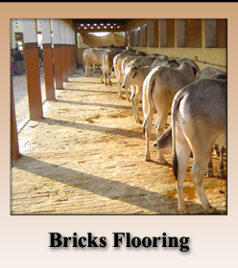
Flooring

Slide 9
Roof
Roof of the barn may be of asbestos sheet or tiles. Corrugated iron sheets have the disadvantage of making extreme fluctuations in the inside temperature of the barn in different seasons. However, iron sheets with aluminum painted tops to reflect sunrays and bottoms provided with wooden insulated ceilings can also achieve the objective. A height of 8 feet at the sides and 15 feet at the ridge will be sufficient to give the necessary air space to the cows. An adult cow requires at least about 800 cubic feet of air space under tropical conditions. To make ventilation more effective a continuous ridge ventilation is considered most desirable.
Manger
Cement concrete continuous manger with removable partitions is the best from the point of view of durability and cleanliness. A height of 1 '-4" for a high front manger and 6" to 9" for a low front manger is considered sufficient. Low front mangers are more comfortable for cattle but high front. mangers prevent feed wastage. The height at the back of the manger should be kept at 2'-6" to 3". An overall width of 2' to 2 1/2' is sufficient for a good manger.

Slide 11
Types of Roofs
Tile roofing

Slide 12
Roof design
Gable roof
Hip roof

Slide 13
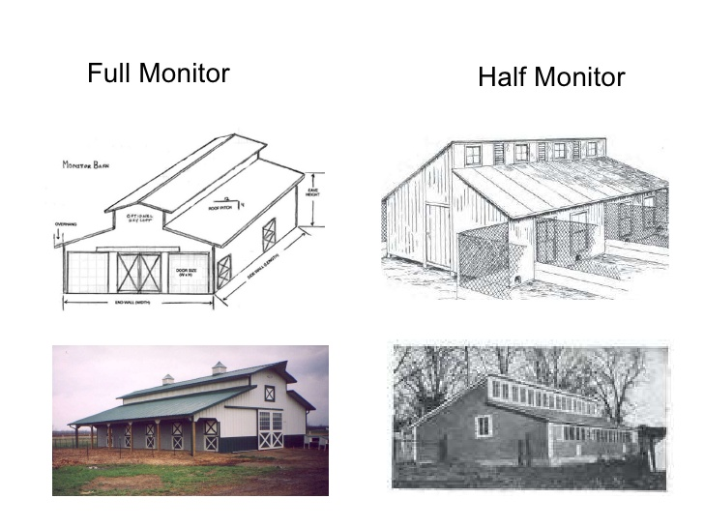

Slide 14
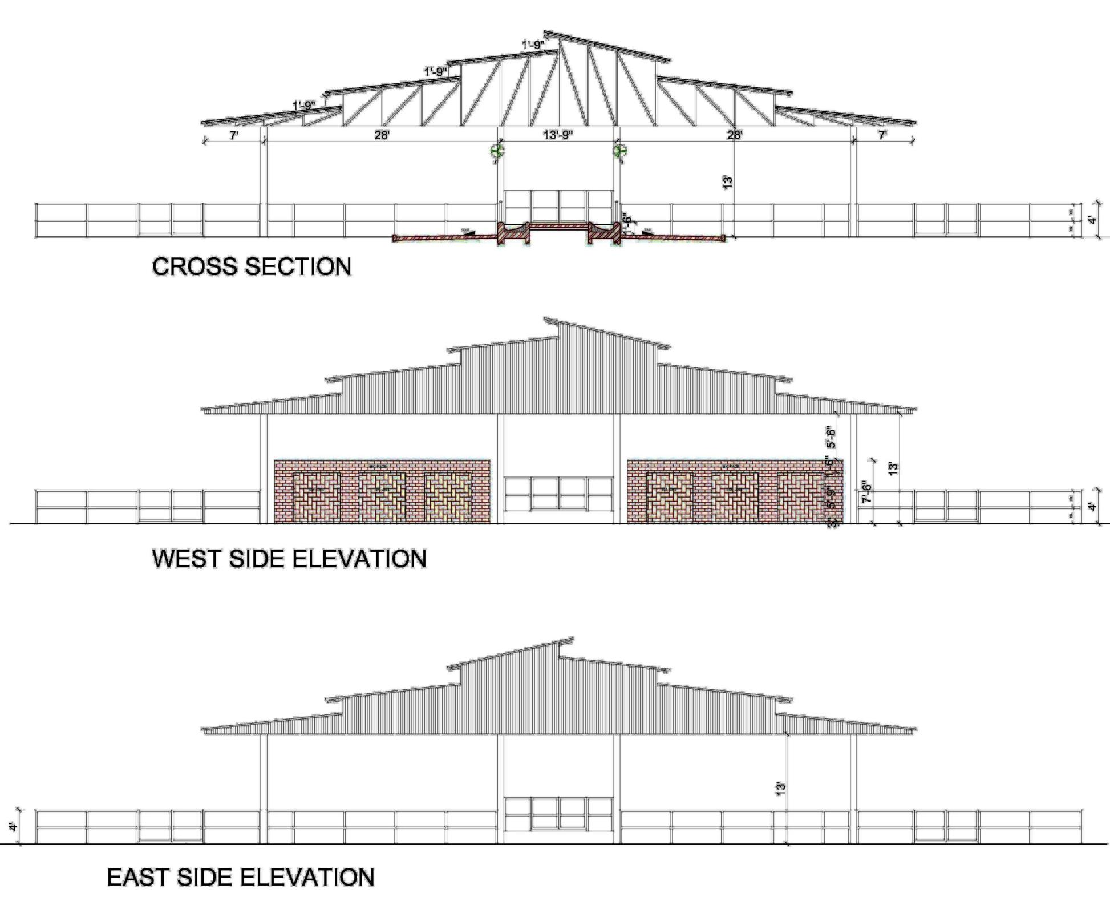

Slide 15
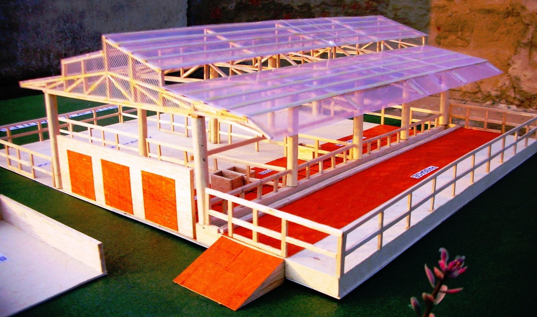

Slide 16
Alleys
The central walk should have a width of 5'-6' exclusive of gutters when cows face out, and 4'-5' when they face in. The feed alley, in case of a face out system should be 4' wide, and the central walk should show a slope of 1" from the centre towards the two gutters running parallel to each other, thus forming a crown at the center.
Manure gutter
The manure gutter should be wide enough to hold all dung without getting blocked, and be easy to clean/ Suitable dimensions are 2" width with a cross-fall of 1" away from standing. The gutter should have a gradient of 1" for every 10” length. This will permit a free flow of liquid excreta
Doors
The doors of a single range cowshed should be 5" wide with a height of 7', and for double row shed the width should not be less than 8" to 9'. All doors of the barn should lie flat against the external wall when fully open.

Slide 17
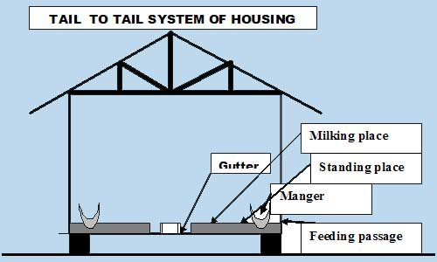

Slide 18
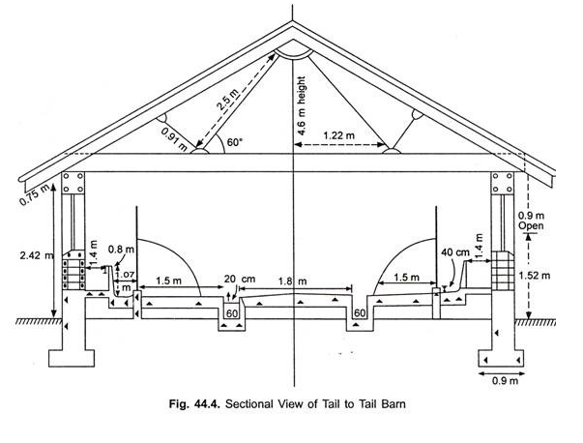

Slide 19
Calving Boxes
Allowing cows to calve in the milking cowshed is highly undesirable and objectionable. It leads to in-sanitary in milk production and spread of disease like contagious abortion in the herd. Special accommodation in the form of loose-boxes enclosed from all sides with a door should be furnished to all parturient cows. It should have an area of about 100 to 150 sq.ft. With ample soft bedding, it should be provided with sufficient ventilation through windows and ridge vent.
Isolation Boxes
Animals suffering from infectious disease must be segregated soon from the rest of the herd. Loose boxes of about 150 sq.ft are very suitable for this purpose. They should be situated at some distance from the other barns. Every isolation box should be self contained and should have separate connection to the drainage disposal system.

Slide 20
Sheds for Young Stocks
Calves should never be accommodated with adults in the cow shed. The calf house must have provision for daylight ventilation and proper drainage. Damp and ill-drained floors cause respiratory trouble in calves to which they are susceptible. For an efficient management and housing, the young stock should be divided into three groups, viz., young calves aged tip to one year bull calves, female calves. Each group should be sheltered in a separate calf house or calf shed. As far as possible the shed for the young calves should be quite close to the cow shed.
Each calf shed should have an open paddock or exercise yard. An area of 100 square feet per head for a stock of 10 calves and an increase of 50 square feet for every additional calf will make a good paddock. It is useful to classify the calves below one year into three age groups, viz., and calves below the age of 3 months, 3-6 months old calves and those over 6 months for a better allocation of the resting area.

Slide 21
An overall covered space of:
20-25 square feet per calf below the age of 3 months,
25 -30 square feet per calf from the age of 3-6 months,
30-40 square feet per calf from the age of 6-12 months and over, and
40-45 square feet for every calf above one year, should be made available for the sheltering such climatic conditions. A suitable· interior lay-out of a calf shed will be to arrange the standing space along each side of a 4 feet wide central passage having a shallow gutter along its length on both sides. Provision of water troughs inside each calf shed and exercise yard should never be neglected.

Slide 23
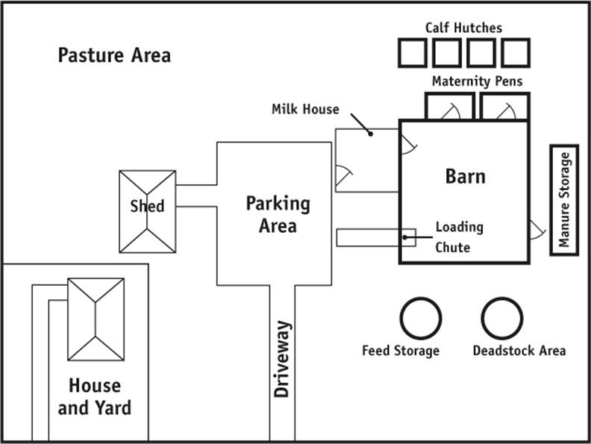

Slide 24
Poultry Housing

Slide 25
Housing

Slide 26
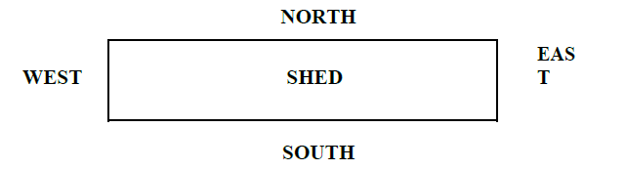
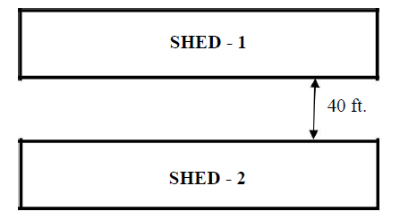
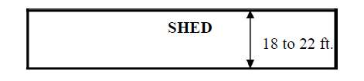
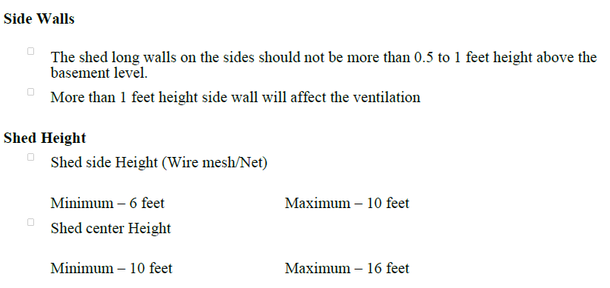

Slide 27
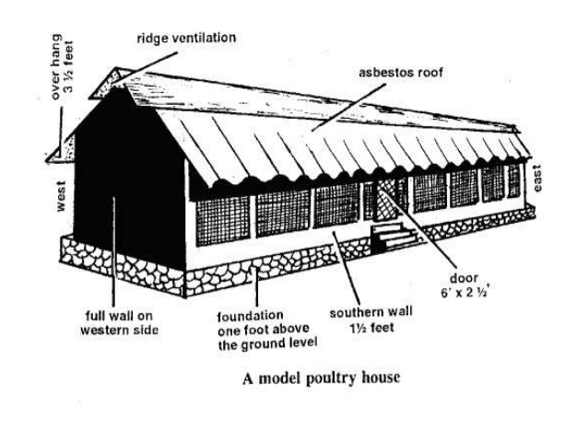

Slide 28
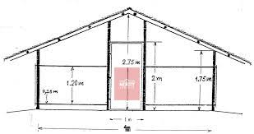
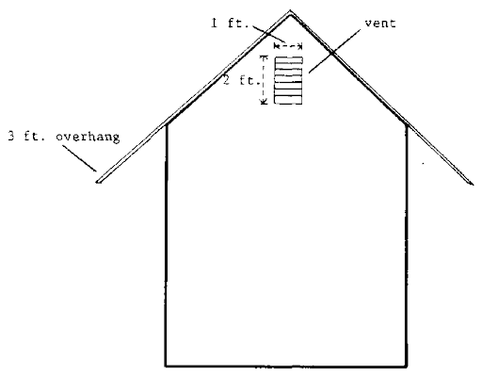

Slide 29
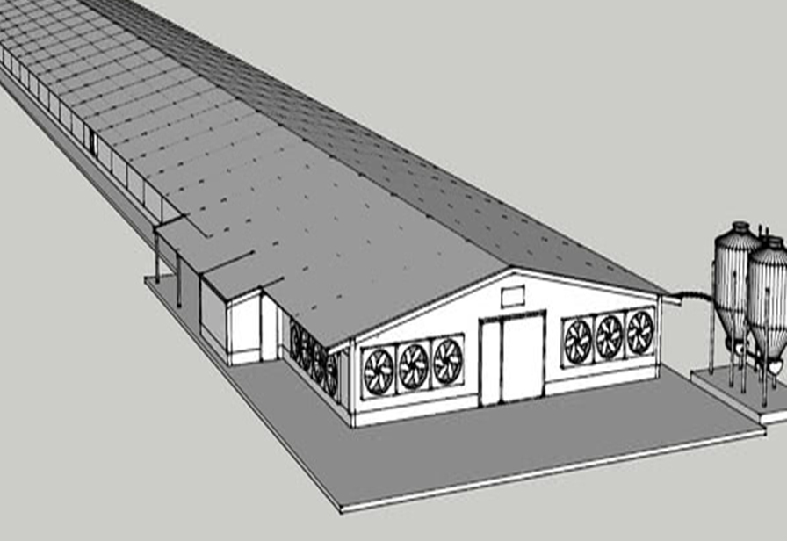
Tunnel ventilation

Slide 30
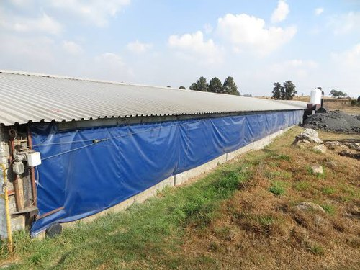

Slide 31
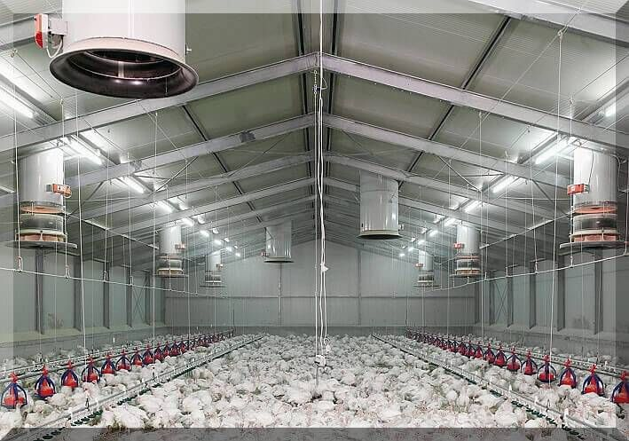
EC houses

Slide 32
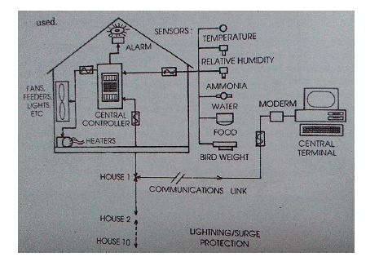

Slide 33
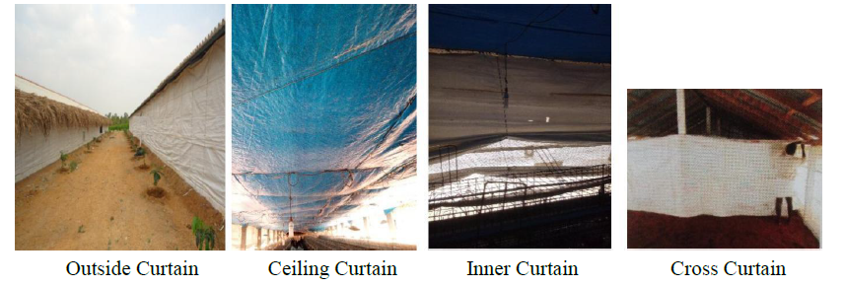
Types of curtains

Slide 34
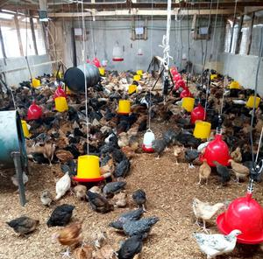
Arrangement of feeder and drinker

Slide 35
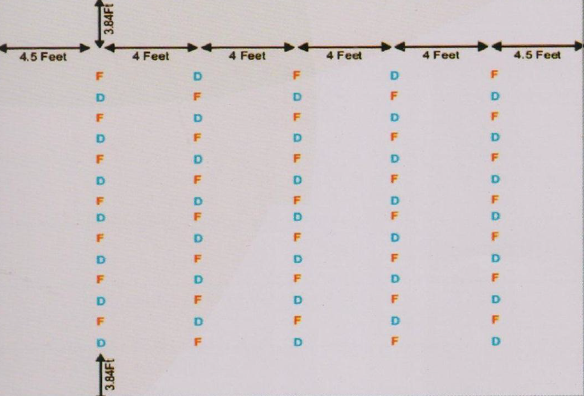

Slide 36
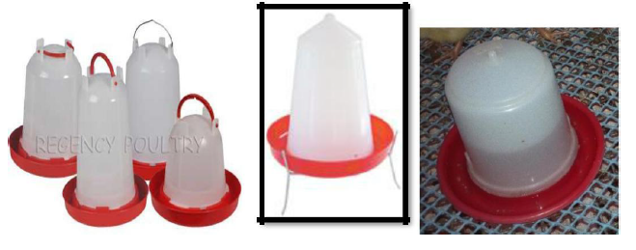
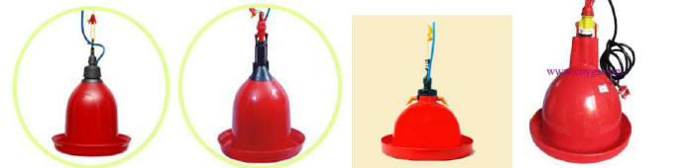
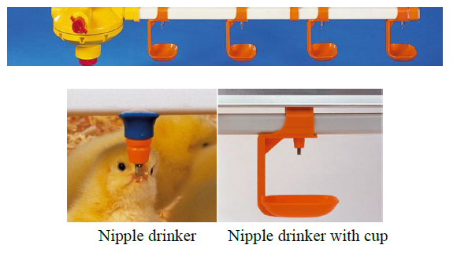
Drinker

Slide 37
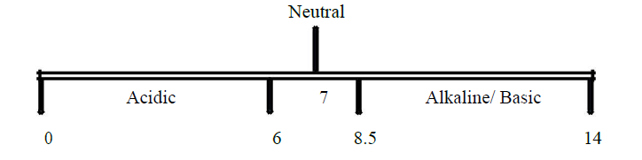
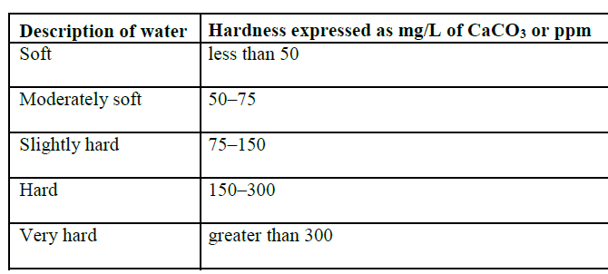

Slide 38
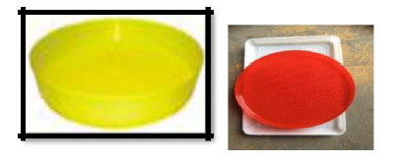
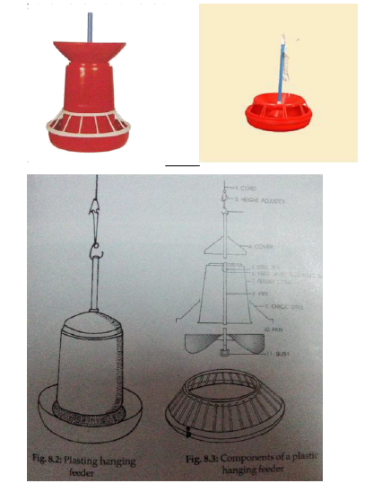
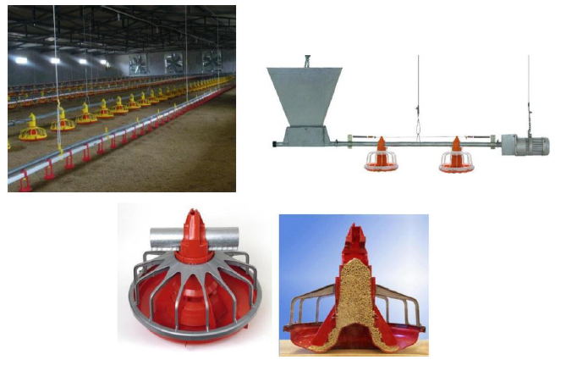
Feeder

Slide 39
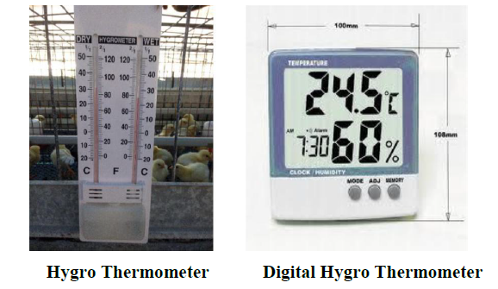
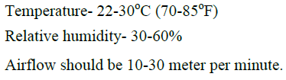
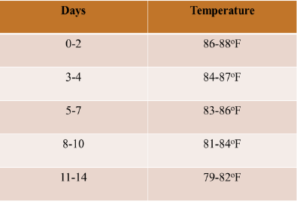

Slide 40
Gas production in poultry house
Ammonia
H2S
Co2
So2
Dust
    Gas to be removed by ventilation

Slide 41
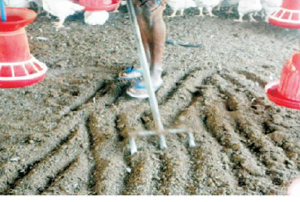
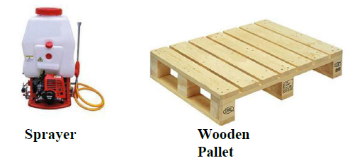
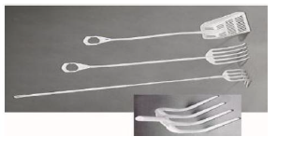
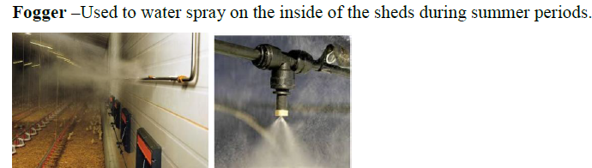
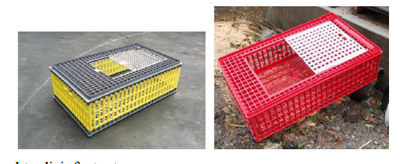
Other equipment

Slide 42
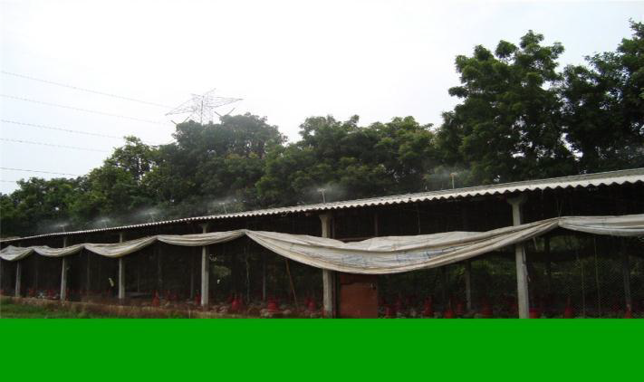
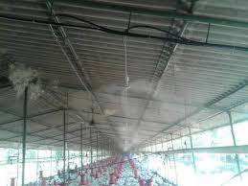
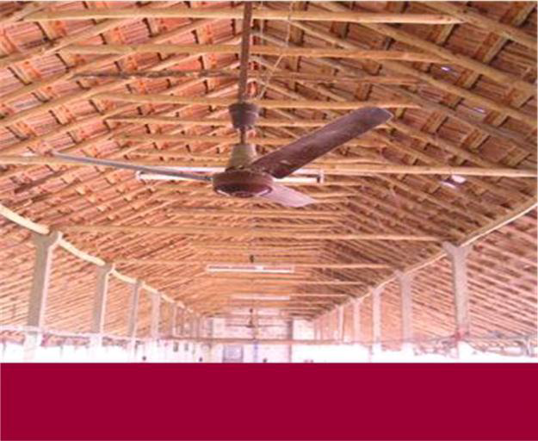
Sprinkler
Fogger
Every 600 sq ft- one fan. Height – 6 feet from the floor

Slide 43
Thank you

