Slide 1
Livestock & Poultry Management
ASAP2101(2-1-0)
Session: 6
Incubation, Hatching and Brooding of Poultry eggs and chicks

Slide 2
Temperature
Birds are comfortable with the environmental temperature with the range of 65ºF to 70ºF(18-24ºC).This is known as the ―comfort zone.
In this zone weight gain, FCR, mortality and egg production are normal. Birds maintain their normal body temperature (104-106ºF).

Slide 3
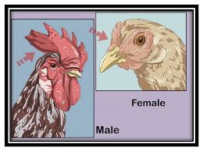
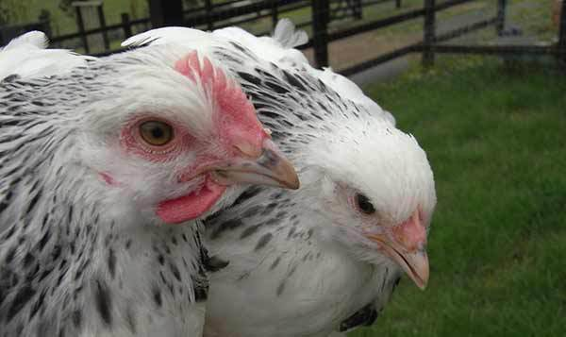
Sexing of birds
Males grow faster than females, males need more floor space and nutrients than the females.
Due to these reasons male and female broiler are reared separately from day old to disposal. Day old broiler chicks are sexed by ―Feather sexing method rather than by ‘vent sexing‖ as in case of egg type chicks
The sexed broiler chicks are brood and reared separately. Separate diets are provided for males and females.

Slide 4
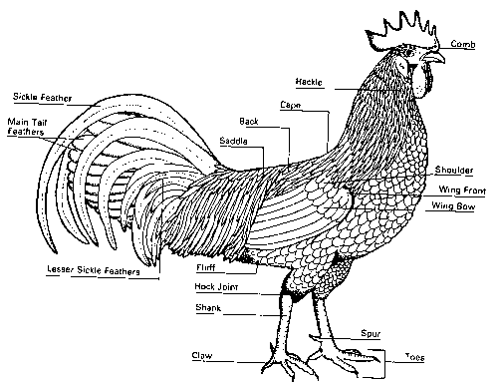
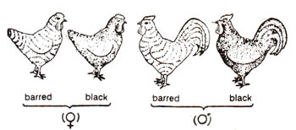

Slide 5
Disinfection and cleaning
Dry cleaning Physically removes the organic material
Wet cleaning involves the use of water
Steps to be followed in shed cleaning
Switch off the power supply
Removal of equipment‘s from the farm
Litter removal
Shed repair work
Cleaning with water
Cleaning with Disinfectants
Fumigation
Shed ready

Slide 6
Fumigation
3 days before chick‘s arrival fumigation should be carried out inside the sheds
Mudpots with small holes
1:2 ratio
1kg KMnO4+ 2 litre formalin for 1000 sq.feet.
To be effective, formaldehyde must react with cell protein of the microbes. There are 5 factors which influence its effectiveness:
1) Concentration (1X, 2X, 3X)
2) Temperature of the room (60 80°F)
3) Duration of treatment
4) Relative humidity (50 70%)
5) Microbes load
1X Concentration is 20 gm of KMno4/ bleaching powder and 40 ml of formalin for 100 cubic feet. Cubic feet means shed length x width x height.
Fumigation Lock the shed
After completing all the procedures, keep the sheds under lock to avoid unnecessary personnel movement

Slide 7
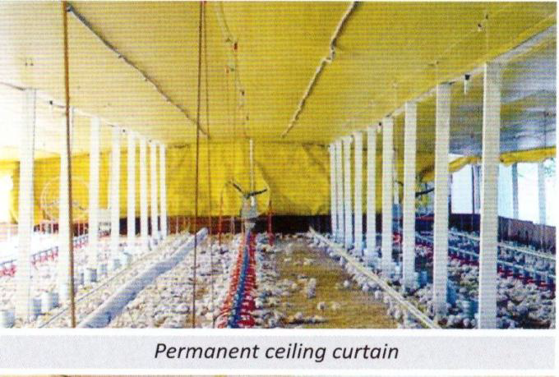
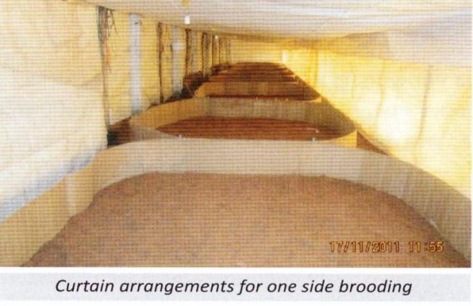
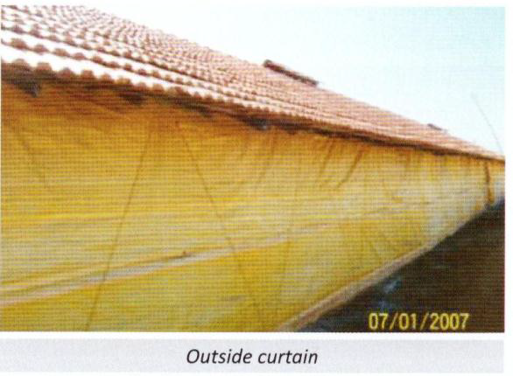
Day old chick receipt
OBJECTIVES:
The brooding arrangements, required consumables and equipments to be kept ready before the arrival of chicks.
CEILING CURTAIN: height of about 6 feet from the floor
Inner curtain and cross curtain. Outside curtain

Slide 8
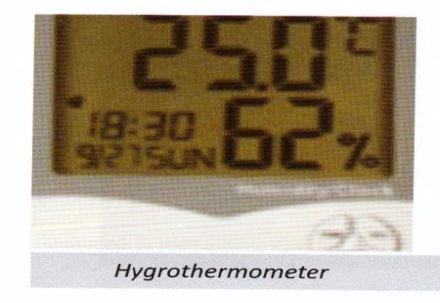
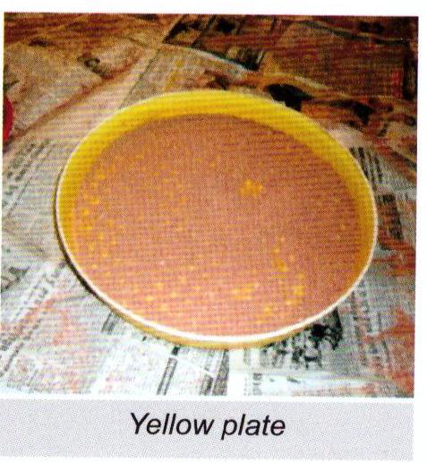
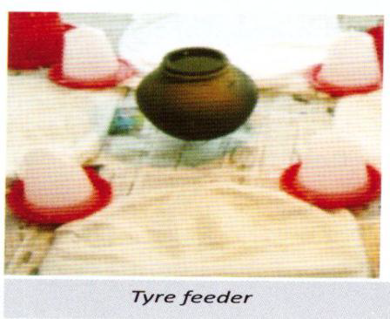
Materials needed during brooding
1. Husk / coir waste: 400kg /1000 sq.ft.
2. Round brooding sheet (corrugated paper) : 40ft/350 chicks.
3. News paper : 4kg / 1000 sq.ft.
4. Char coal 80kg / 1000 chicks.
5. Hygrothermometer (1 no) for each shed.
6. 50 chicks / Yellow Plate
7. 100 chicks / Tyre feeder

Slide 9
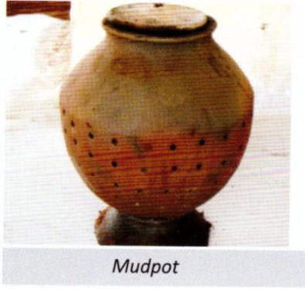
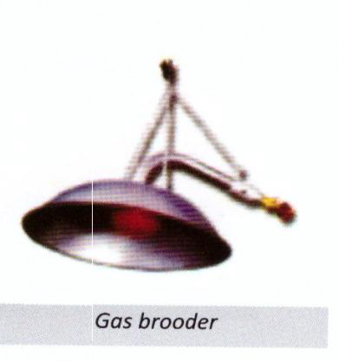
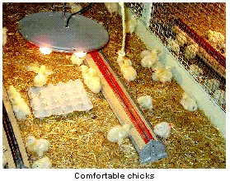
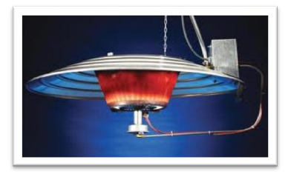
Heat source
Mud pot with lid and hole – 1 no for 350 chicks / Gas brooder hover )1 no ) & 30 kg LPG gas / 1000 chicks and Alternate heating source.
-100 watt bulb for 100 chicks.
-One infrared bulb per 250 chick

Slide 10
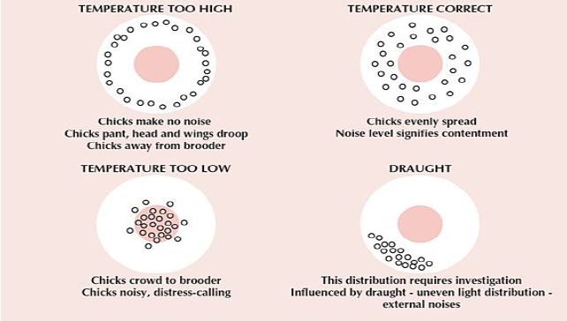

Slide 11
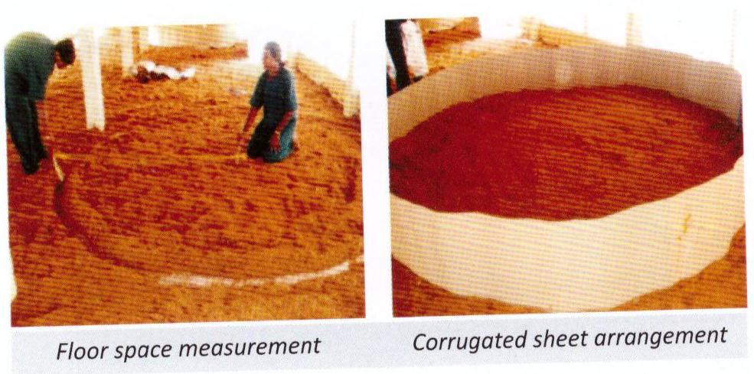
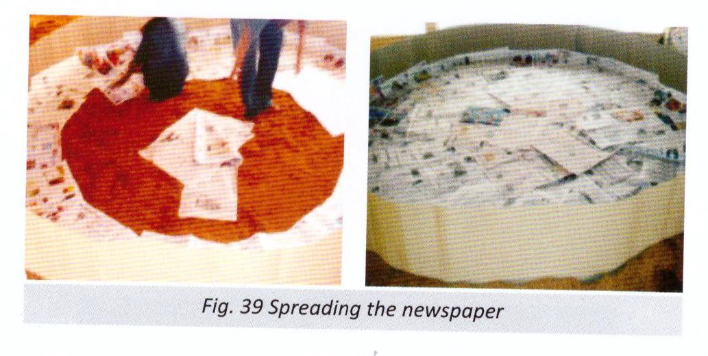
SPECIFICATION OF THE BROODING SHEET:
1. Height – 1.5 feet.
2. Length – 40 feet.
3. (Diameter – 12 feet for equipment and chicks)
4. Formula used for round brooding floor space calculation πг² = 3.14x6x6 sq.ft / chick = Total sq.ft / No of chicks = 0.25 / chick

Slide 12
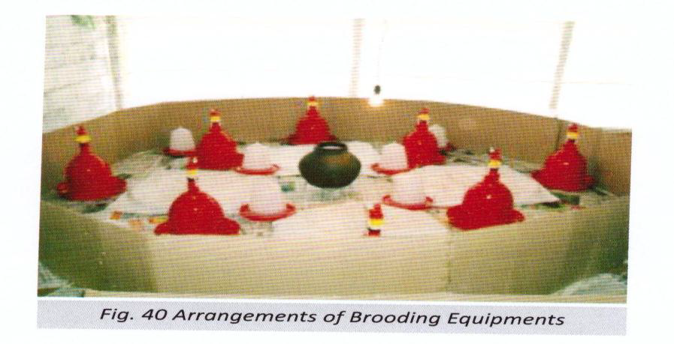
REQUIREMENTS FOR 350 CHICKS / BROODER
1. Auto drinker: 7 Nos (feeding)
2. Chick drinker : 7 Nos.
3. Tyre : 4 No or Chick feeder : 7 Nos.
4. Incandescent (Round) bulb : 1 Nos : 100 watts.
5. Hygrothermometer : 1 Nos.

Slide 13
Floor space requirement

Slide 14
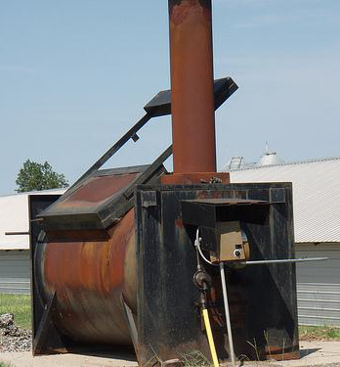
Dead Bird Disposal
1. Burial
2. Constructed Disposal Pit
3. Composting
4. Incineration
5. Daily Pickup
6. Freeze and Pickup
7. Landfilling

Slide 15
Thank you

