Slide 1
Livestock & Poultry Management
ASAP2101(2-1-0)
Session: 7
Management of growers and layers

Slide 2
Introduction
Period after brooding till sexual maturity is referred as growing period (9-18 weeks)
and
from onset of sexual maturity (when hen housed production is 5%) till the end of laying cycle is referred as Laying period. (18-72 weeks)

Slide 3
GROWER MANAGEMENT
Commercially 9-18/20 weeks are called growers.
This period is more critical.
Obtaining desired body weight ensures maximum production during subsequent laying period.
Faulty management may lead to under or over weights, lack of uniform growth, delayed maturity, prolapse, cannibalism and high grower house mortality

Slide 4
Proper cleaning and disinfection of grower house is needed
before introduction of grower birds.
Growers may be reared in separate grower houses or continue to be reared in brooder cum grower house
Spread litter material to a height of 4” in case of deep-litter
system.
Arrange feeder and waterers in the grower house.
Change the feeder and waterer according to the need.
Provide sufficient floor space, feeding space and water space.
Floor Space: 1260 cm² (1.4ft²), In case of cages 54 sq.inches
Feeder space: 6-8 cm/bird
One linear feeder of 120 cm Length & 8cm depth--------40 grower
birds

Slide 5
Water space : 2cm/bird
Circular waterer 36 cm H and 8cm D of 6ltr capacity- 50 growers
100 birds-15-20 liters water/day

Slide 6
Grower mash/feed
CP-16%
ME-2500Kcals/Kg
Ca-1%
Approximately 60-80 g of feed/bird/day
Adopt restricted feeding programme during growing period to prevent fattening of pullets and early sexual maturity and thus to improve egg production.

Slide 7
Uniformity
Aim for the uniformity of the flock.
Sample weights are taken once in a week to find out the average body weight as per the breeder suggestions.
At a given age, growing pullets should have average body weight very close
to breeder recommendations and at least 70% of the birds’ weight within 10% of flock average.

Slide 8
RESTRICTED FEEDING
It is adopted during growing period of layers or breeders.
There are two types of restricted feeding
1 Quantitative feed restriction 2 Qualitative feed restriction

Slide 9
Quantitative feed restriction
In which the amount of feed is reduced below the normal requirement of birds.
This can be done on day-to-day basis or skip-a- day programme or skip-two days in a week programme.
But this restriction depends on the matching of the flock average body weight with standard body weight provided by the breeder.
Quantitative feed restriction is usually followed in commercial breeders.

Slide 10
Qualitative feed restriction
In which the quality of the feed is reduced below the standard requirement of the bird.
This can be done by including unconventional feeds or lesser nutrient feed ingredients in place of high protein or high energy diet.
Here the quantity of allotment to the bird is not restricted.
During restricted feeding programme, provide more number of feeders and see that all the birds are taking feed simultaneously or otherwise dominant birds will take more amount of feed and the weaker will be subjected to feed deprivation and hence the uniformity will be affected

Slide 11
Advantages of feed restriction during growing period
A considerable saving on feed cost because, only 80 % of the calculated feed requirement will be offered.
They are likely to consume less feed per dozen eggs even during laying period when they are offered ad libitum feed.
The pullets accumulate less fat and therefore produce more eggs.
It is easier to identify weaker birds at an early age during feed restriction.

Slide 12
Culling of such birds helps not only saving feed but also promoting layer house survivability because, healthier birds will be moving to laying house.
Layers feed-restricted during growing period have been found to produce eggs in longer clutches than those fed ad libitum.

Slide 13
Lighting management
Only 12 hours lighting programme is sufficient in case of open-sided houses.
No artificial light is needed.

Slide 14
Follow strictly the recommended vaccination, medication and other management programs like deworming, debeaking etc for the growers.
It would be better to repeat debeaking at 12-14th wks of age.
Deworming mostly done through the water
First deworming- 8wks of age
Followed by 16-18 wks of age

Slide 15
Deworming drugs
Piperazine
Robendol
Thiabendazole
Levamisole
Zodex
Pancure
Taenil
Helmonil
Dicestal
Round worms
Tapeworms
The most common medicine used is Piperazine 45%(0.5- 1ml/b) or 65% 370 ml/2000 growers
Levamisole. It is also immuno stimulant
Levamisole HCL 30% w/w-20-25mg/kg bwt

Slide 16
Albendazole 10-15% is effective against all. 100g/1000 birds
Vaccination

Slide 17
Layer Management
System of housing
1+3 system
1 brooder cum grower house
3 layerhouses
New brood of chicks obtained once in 20 wks
Growers shifted at 18-19wks
The batch interval is 20wks
Commercial large operations don’t go for this system

Slide 18
1+1+5 system
1 Brooder house
1 grower house
5 Layer houses
New brood chicks purchased every 12 wks
Growers can be shifted earlier

Slide 19
1+1+6 0r 8 system
For every 9 weeks new batch of chicks will arrive
The layers can be maintained in layer house for a longer period of time
This system is more useful in very large operations

Slide 20
Floor rearing
Proper cleaning and disinfection of layer house.
In deep-litter system, floor space of 2 sq.ft. per bird and feeding space of 5” per bird are provided
6 feet linear feeder can be used for every 30
layers or 18” diameter circular feeder of 4-5 no for every 100 birds.
Watering space is just half that of the feeder space

Slide 21
Provide 18” diameter plastic waterer of 2 numbers for every 100 birds.
Spread litter material, in case of deep-litter system up to 6” thickness.
Arrange feeder and waterer in the poultry house to the height of birds’
Provide nest box for every 5 layers about a week before the first egg is laid.
Nest should be placed in the darker part of the house and clean regularly

Slide 22
There are three types of nest:
Individual nest – One nest box is sufficient for 4-5 birds.
Community nest – This will accommodate 50- 60 birds.
Trap nest – This will accommodate 1 bird at a time and is used for academic and breeding studies.
The nest should be provided with litter material. The litter material has to be replaced at least once in a week to prevent contamination of the eggs.
During night hours the nest should be closed to prevent sitting of birds in the nest.

Slide 23
Cage rearing
Layer cages
Two types of stair-step layer cages are commonly used in open-sided poultry houses
Conventional cages
Reverse cages

Slide 24
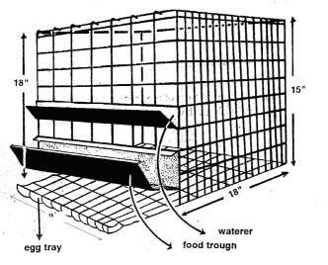
Conventional cages
Specifications for each box Front feeding length : 15 inch Front height : 18 inch
Back height : 15 inch Depth : 18 inch

Slide 25
Reverse cages
Specifications for each box
Front feeding length : 18 inch
Front height : 18 inch
Back height : 15 inch
Depth : 15 inch
These cages can hold 3 to 4 birds. They are arranged either in 2-tier or 3-tier.
A slope of 1/6 is provided in conventional cages, where as in reverse cages the slope is 1/5.

Slide 26
Advantages of reverse cages over conventional cages
More feeding space is available in reverse cages. So, all 4 birds can take feed at a time, where as in conventional cages, 3 birds can take feed and the other one is waiting at the back.
Number of cracked eggs is less due to lesser rolling distance.
Better ventilation in reverse cages than conventional cages.

Slide 27
In cage system 3 birds/box of 18” x 15” cage floor space is
provided (0.63 sq. ft per bird)

Slide 28
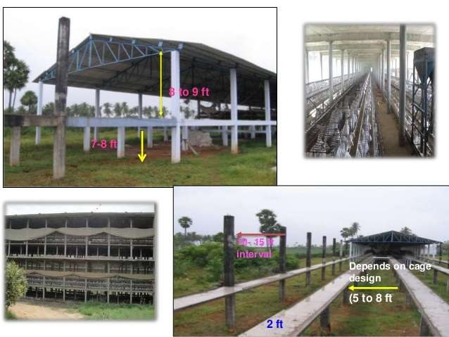

Slide 29
Arrangement of cages
Cages are arranged in 2 0r 3 rows one above the other on either side, termed as californian cages
The known type arrangements in house is
2 L and and M type
or
2 L type and 2M type
or
3 M type cages with L type cage normally fixed to the sides of poultry house

Slide 30
Lighting Management
Provide light stimulation at 18 wks of age starting with a minimum of 13 hr of day length
Increase light by 15-30 min /wk until 16 hrs of light is reached.
Light intensity- 0.9 -1.2 foot candle
Never decrease day length and light intensity during laying period

Slide 31
Timing for lighting stimulation
Lighting stimulation should not be provided until the flocks reach the optimum body weight of 1270-1360g or the weight described by the sp. breed
Flocks that receive light stimulation at sub- optimal body weight may lead to prolapse

Slide 32
Egg production
Egg laying starts at 20th week and the percentage of production increases every week to reach a level of 90% and above after 28 wks of age. Which is maintained up to 36 wks of age even up to 40-42 wks.
28-36 wks peak egg production
Afterwards it slumps down slowly to reach 70% or belowby 72 wks.

Slide 33
Feeding
Provide well-balanced layer mash. Phase feeding may be followed for layers according to age, level of production and climatic factors.
The average feed consumption during laying period ranges from 100-110 gram.
Feed consumption during winter increases and during summer, feed consumption decreases.

Slide 34
Nutrient | Layer phase -I 21-45 wks | Layer phase-II 46-72wks
ME Kcal/kg | 2600 | 2400
CP % | 18 | 16
Ca % | 3 | 3.5
Avail.P % | 0.65 | 0.65
Lys % | 0.7 | 0.65
Methionine | 0.35 | 0.30

Slide 35
Egg handling
The layer type chicken lay their eggs mostly during forenoon
Eggs may be collected twice in the morning and once in the afternoon
The frequency of egg collection has to be increased 4 to 5 times during peak summer
Air cooled rooms for storage of eggs
Specially designed card board trays have to be used

Slide 36
Deworming should be done regularly at an interval of 6-8 weeks depending on the worm load, especially when reared under deep-litter system.
Vaccination
Cull the unproductive layers regularly

Slide 37
LAYER PRODUCTION INDICES
Egg production
The egg industry has two principal methods of measuring daily, weekly, and total egg production i.e. the hen-day and hen- housed systems.
Hen-Day Egg Production (HDEP)
For a particular day

Slide 38
For a long period
This may be calculated by first computing the number of hen- days in the period by totaling the number of hens alive on each day of the period.
Then calculate the number of eggs laid during the same
period.

Slide 39
HDEP is usually expressed in percentage. It is mostly used for the scientific studies and truly reflects the production capacity of the available birds in the house.
A farm average of 85% or more per year is desirable.

Slide 40
Hen-Housed Egg Production (HHEP)
For a particular day

Slide 41
For a long period

Slide 42
It is usually expressed in numbers. HHEP values of 80% or 295 or higher are desirable.
It a fails to account for past mortality, Egg size or quality. However, it is the best egg production index available and is universally used by the industry.
From a cost of egg production standpoint, HHEP is good as it measures the effects of both egg production and mortality.
If there is no mortality during a period, the HDEP and HHEP are equal.

Slide 43
Feed efficiency
Feed efficiency/kg.egg of mass=Kg. feed consumed
one Kg. of eggs produced
A value of 2.5or less is advantages to farm
Feed efficiency/ Dozen eggs= Kilograms of feed consumed
12eggs produced
The value should be 1.65 or less

Slide 44
Thank you

