Slide 1
SIZE REDUCTION
PREPARED BY: Gurudutta Pattnaik PROFESSOR
SoPLS, CUTM.

Slide 2
DEFINITION:
Size reduction is the operation carried out for reducing the size of bigger particles into smaller one of desired size and shape with the help of external forces.
COMMINUTION is another term used for size reduction.
2

Slide 3
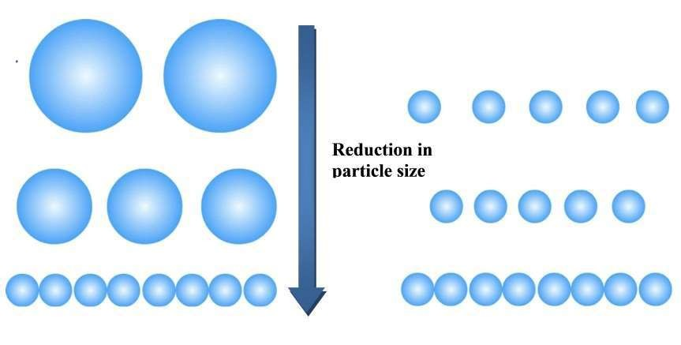
3

Slide 4
OBJECTIVES OF SIZE REDUCTION:
Increase the surface area because, in most reactions involving solid particles, the rate of reactions is directly proportional to the area of contact with a second phase.
Break a material into very small particles in order to separate the valuable amongst the two constituents.
Achieve intimate mixing.
To dispose solid wastes easily .
To improve the handling characteristics.
To mix solid particle more intimately.
4

Slide 5
ADVANTAGES:
Content uniformity
Uniform flow
Effective drying
Increases surface area or viscosity
Uniform mixing and drying
Improve rate of absorption. particles greater is absorption.
Improve dissolution rate.
Smaller the
5

Slide 6
DISADVANTAGES:
Drug degradation
Contamination
6

Slide 7
MECHANISM OF SIZE REDUCTION:
Impact- particle size reduced by a single rigid force (hammer).
Compression- in this mode material is crushed between rollers by the application of pressure.
Attrition- arising from particles scraping
against one another or against a rigid surface by rubbing action.
Cutting- the material is cut by means of sharp blades.
7

Slide 8
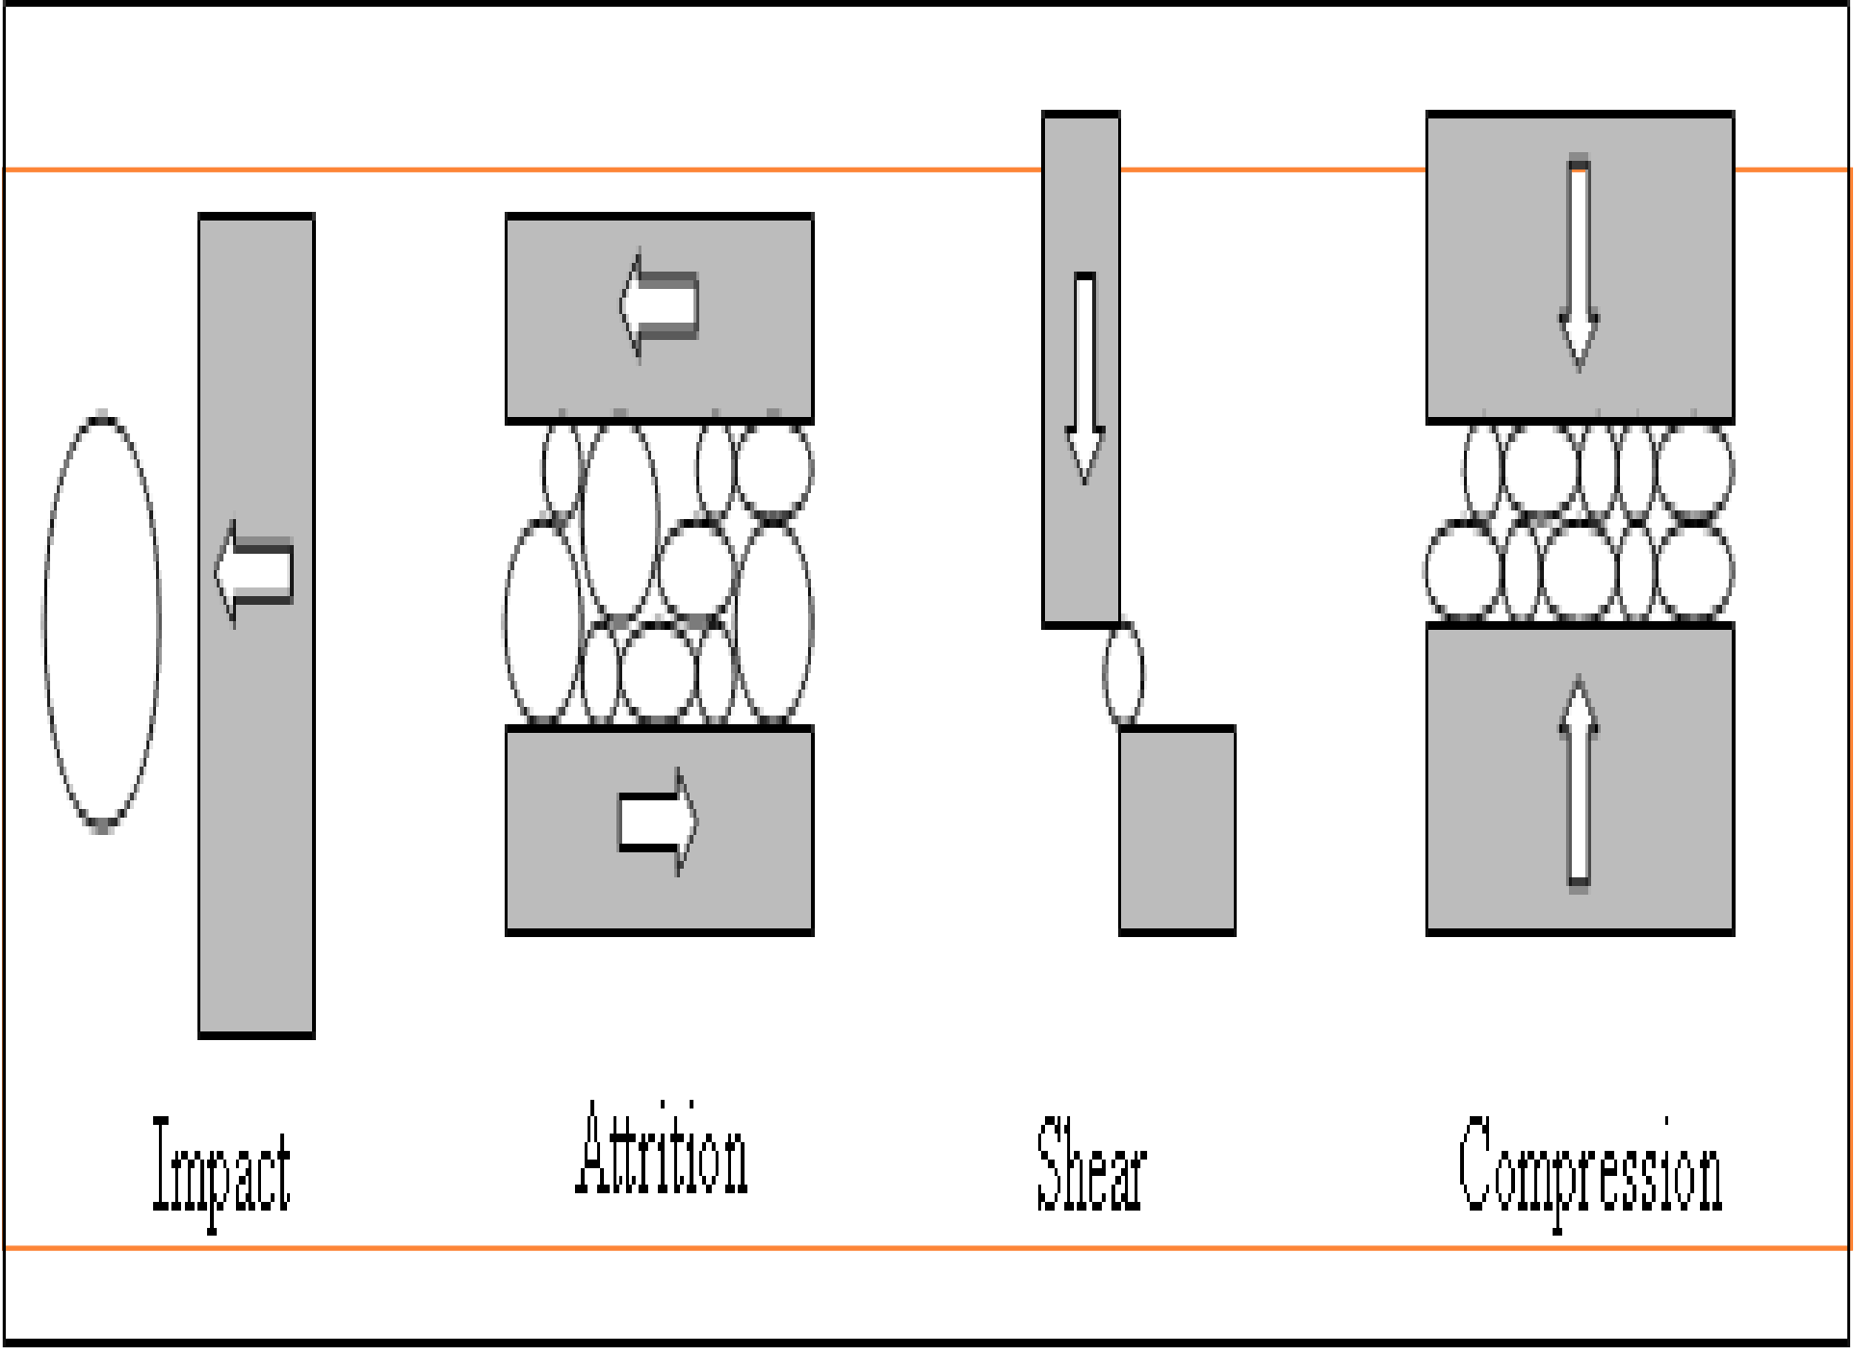

Slide 9
FACTORS AFFECTING SIZE REDUCTION:

Slide 10
MECHANISMS AND LAWS
The energy requirement for particle size reduction is a function of input and output of particle size, hardness, strength and other properties of solids.
Various theories are:-
Rittinger’s theory
Kick’s theory
Bond’s theory
for energy requirement

Slide 11
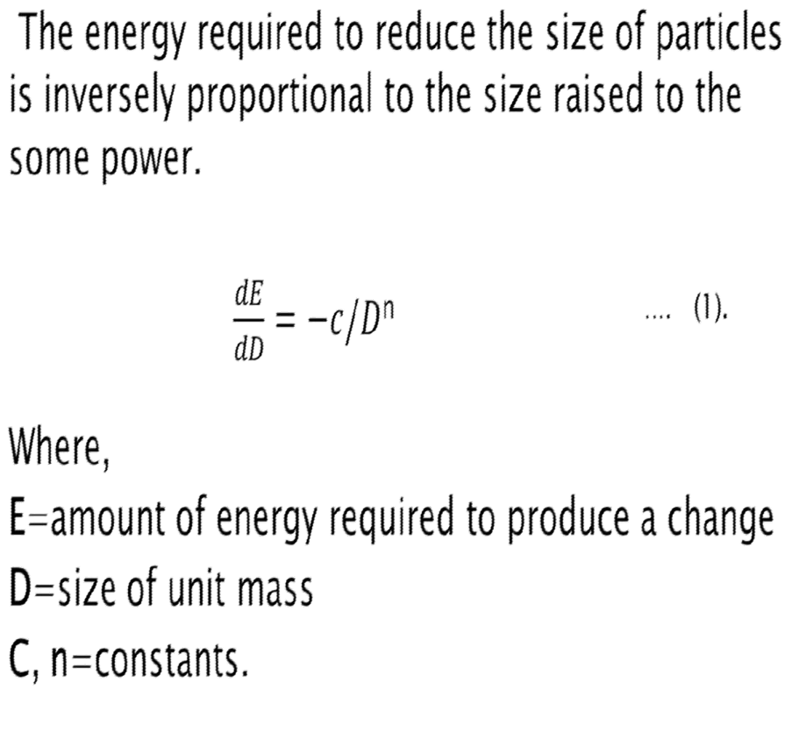

Slide 12
Integrating equation (1),
E=C ln(d_{i}/d_{n}) . . . . (2)
(d_{i}/d_{n}) =reduction ratio.
If n=1.0equation (2)becomes Kick’s theory. If n=1.5 equation (2) becomes Bond’s theory.
If n=2.0 equation (2) becomes Rittinger’s theory.

Slide 13
RITTINGER’S THEORY
According to this theory energy E required for size reduction of unit mass is directly
proportional to the new surface produced.
E=K_{R} (Sn – Si) …. (3)
area
Where
S_{i} = initial surface area
S_{n} = new specific surface area
K_{R} = Rittinger’s constant.
• E= amount of energy
13

Slide 14
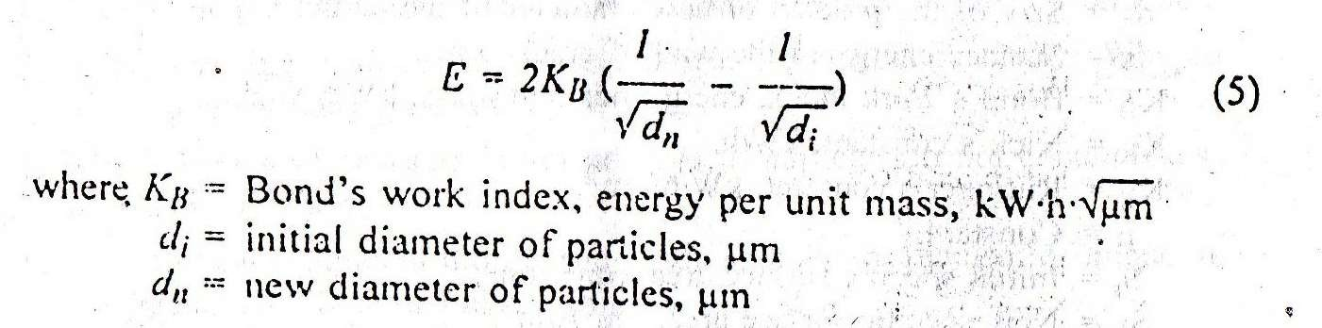
BOND’S THEORY
According to bond theory the energy used in crack propagation is proportional to the new crack length produced.
It states that energy required for deforming a set of particle of equivalent shape is proportional to the change in particle dimensions.
14

Slide 15
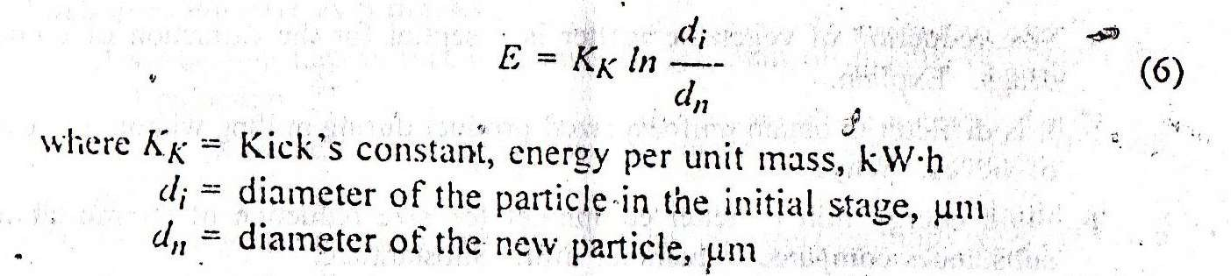
KICK’S THEORY:
It states that energy required for deforming a set of particle of equivalent shape is proportional to the ratio of the change in particle size.

Slide 16
Rittinger’s theory:(n=2.0)
Energy α new surface area formed.
Bond’s theory:(n=1.5)
Energy used in crack propagation α Crack length produced.
Energy α Ratio of change in particle dimensions.
Kick’s theory:(n=1.0)
Energy α Ratio of change in size.
16

Slide 17
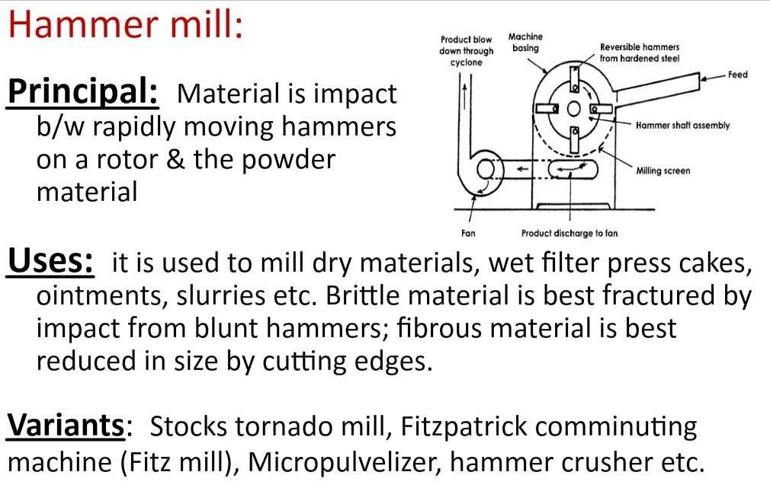

Slide 18
CONSTRUCTION & WORKING
A hammer mil is essential y a steel drum containing a vertical or horizontal rotating shaft or drum on which hammers are mounted.
The hammers swings on the ends or fixed to the central rotor.
The rotor is rotates at a high speed inside the drum while material is fed into a feed hopper.
The material is put into the hopper which is connected with the drum.
The material is powdered to the desired size due to fast rotation of hammers and is col ected under the screen.

Slide 19
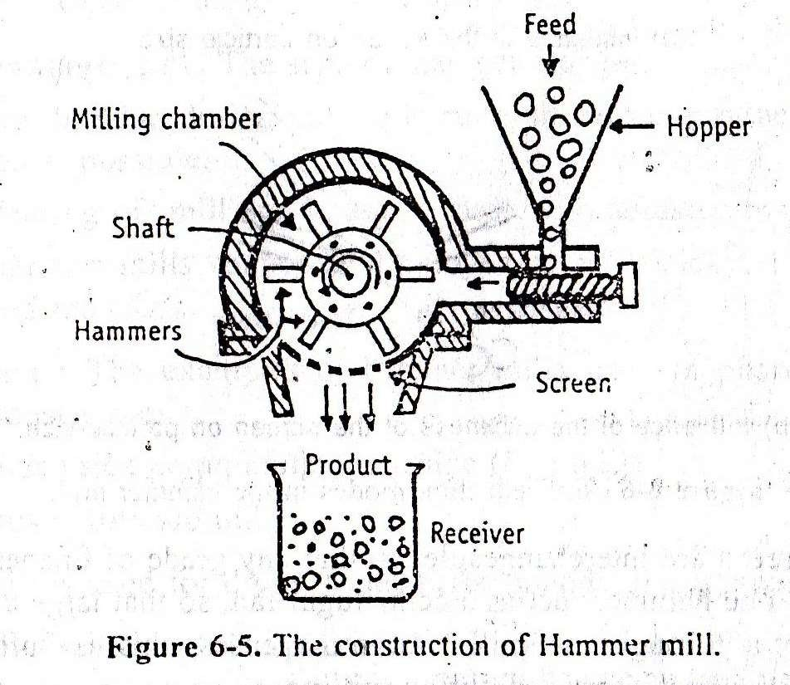
This are mainly
operated
at 2500 rpm or
1000 to 2500
rpm for the
reduction of the
large particles. speed
sized High rotor
uses 10000 rpm speed.

Slide 20
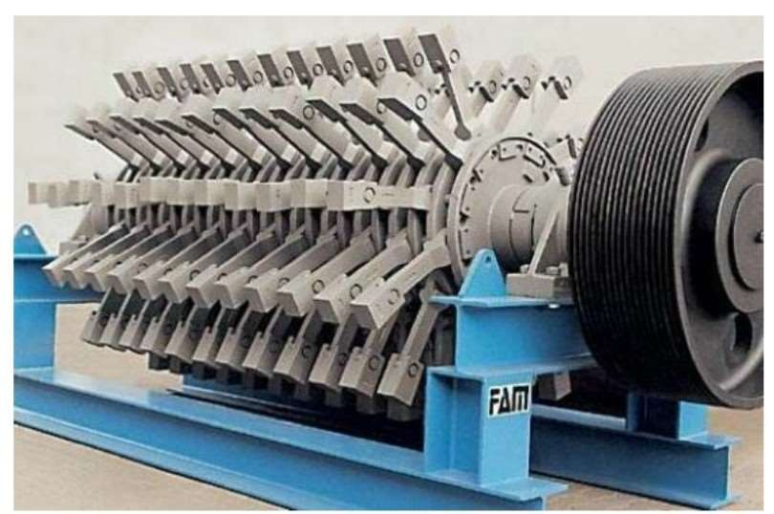

Slide 21
ADVANTAGES:
It is rapid in action, and is capable of grinding many different types of materials.
They are easy to instal and operate, the operation is continuous.
There is little contamination of the product with metal abraded from the mil as no surface move against each other.
The particle size of the material to be reduced can be easily control ed by changing the speed of the rotor, hammer type, shape and size of the screen.
21

Slide 22
DISADVANTAGES:
Heat buildup during milling is more, product degradation is possible.
therefore,
Hammer mills cannot be employed to mill sticky, fibrous and hard materials.
The screensmay get clogged.
22

Slide 23
BALL MILL:
These are also knows as tumbling mills or pebble mills.
Principle: The ball mill works on the principle of impact between the rapidly moving balls and the powder material, both enclosed in a hollow cylinder.
At low speed the balls roll over each other attrition will be mode of action thus in the ball mill attrition and impact both mechanisms takes place.
23

Slide 24
Construction:
It consists of a hollow cylinder which is mounted on a metallic frame in such a way that it can be rotated on its longitudinal axis.
The length of the cylinder is slightly higher than its diameter.
The cylinder contains balls that occupy 30 to 50% of the mill volume.
The ball size depends on the size of the feed and the diameter of the mill. Balls are made up of
steel, iron or stoneware medium.
and act as grinding
24

Slide 25
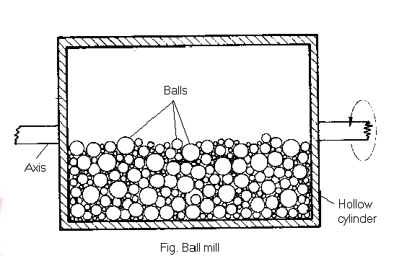

Slide 26
Working:
The drug to be ground is put into the cylinder of the mill in such a quantity that it is filled to about 60% of the volume.
A fixed number of balls are introduced and the cylinder is closed. The mill is allowed to rotate on its longitudinal axis.
The speed of rotation is very important
26

Slide 27
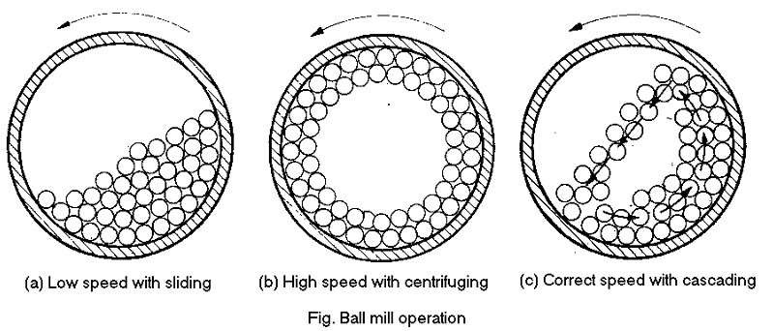
Uses:
For fine grinding with a particle size of 100 to 5 mm or less.
For production of ophthalmic and parenteral products.
For milling dyes, pigments and insecticides at low speed.
27

Slide 28
ADVANTAGES:
It can produce very fine powder.
Ball mill is used for both wet and dry grinding processes.
Toxic substances can be ground, as the cylinder is closed system.
Rod or bars can also be used as grinding media.
Sticky material are size reduced in ball mill,
Installation, operation and labor costs are low.
Since the mill is closed system used for sterile products and oxygen sensitive products.

Slide 29
DISADVANTAGES:
The ball mill is a very noisy machine.
Ball mill is a slow process.
Soft, fibrous material cannot be milled by ball mill.

Slide 30
FLUID ENERGY MILL/ JET MILL/ MICRONIZERS/ ULTRAFINE GRINDERS
Principle:
Fluid energy mill operates on the principle of impact and attrition. Milling takes place because of high velocity collisions between the suspended particles.
Construction:
It consist of an elliptical pipe which has a height of about 2 meters and diameter may be ranging from 20 to 200 mm.

Slide 31
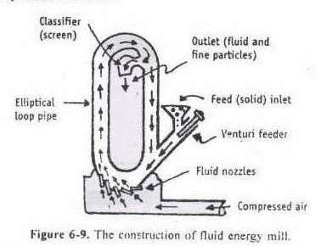

Slide 32
The mill surface may be made up of either soft stainless steel or tough ceramics.
Grinding nozzles are placed tangential and opposed to the initial flow path of a powder.
Compressed air is used at 600 kilopascals to 1 megapascals.
Venturi feeder is provided in the path of the airflow. An outlet with a classifier is fitted to allow the escape of air.

Slide 33
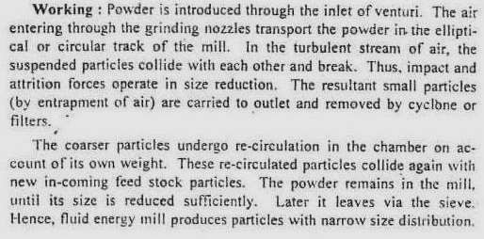

Slide 34
Uses:
To reduce the particle size of most of drugs such as antibiotics and vitamins.
Advantages:
It has no moving parts heat is not produced during milling.
It is rapid and efficient method for reducing powder to 30 mm or less.
No contamination is possible.
Disadvantages:
Not suitable for milling of soft, tacky and fibrous
material.
Equipment is expensive.
34

Slide 35
EDGE RUNNER MILL:
Principle:
The size reduction is done by crushing due to heavy weight of stones.
Construction:
It consist of two heavy rollers and may weigh several tons.
The roller move on a bed which is made up of granite or stone.
Each roller has a central shaft and revolve on its axis.
The rollers are mounted on horizontal shaft and move around the bed.
35

Slide 36
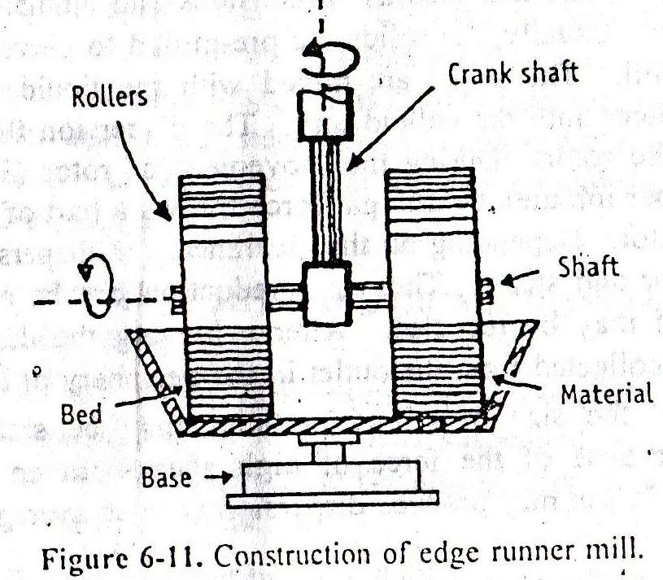

Slide 37
WORKING:
The material to be ground is placed on the bed with the help of the scrapper in such a way that it comes in the path of the stone wheel.
These stones revolve on its own axis and at the same time travel around the shallow stone bed.
The material is ground for definite period.
The powder is collected and passed through a sieve to get powder of required size.

Slide 38
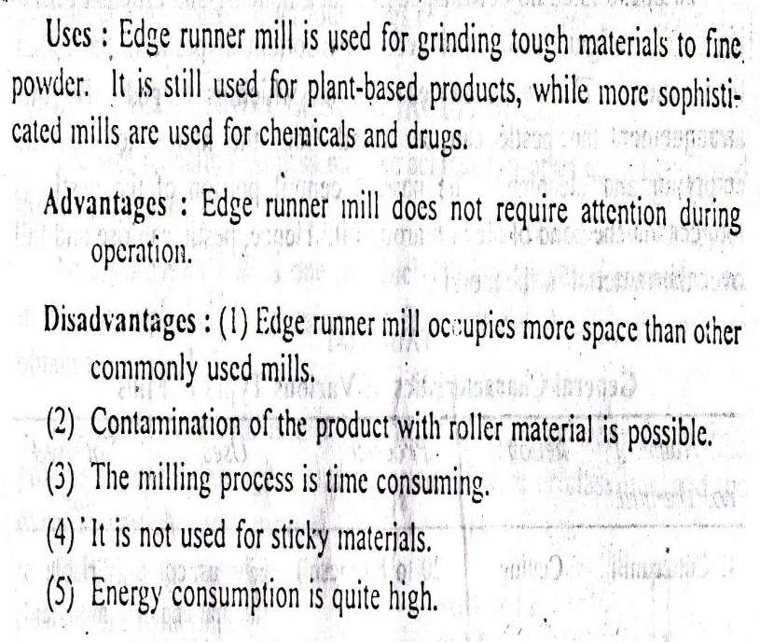

Slide 39
END RUNNER MILL:
Principle:
Size reduction is done by crushing due to presence of heavy weight steel pestle.
Construction:
It is considered as mechanical mortar pestle.
It consist of a steel mortar which is fixed to a plate.
The construction of mortar is connected to horizontal shaft bearing a pulley so the plate with mortar can be rotated at high speed.
The pestle is dumb-bell shaped and bottom of pestle is flat.
39

Slide 40
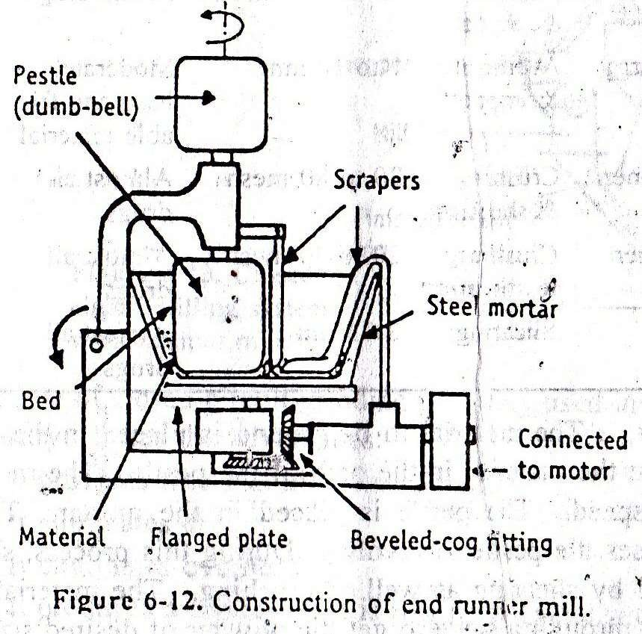
40

Slide 41
Construction of pestle is done in such a way that it can be raised from mortar for cleaning and emptying.
Working:
The material to be ground is placed in the mortar. The scraper puts the material in the path of the pestle.
The mortar revolves at high speed and the pestle is placed in the mortar.
The revolving mortar causes pestle to revolve.
The material is collected and passed through a sieve to get the powder of desired size.
41

Slide 42
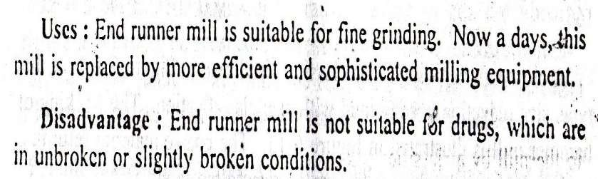
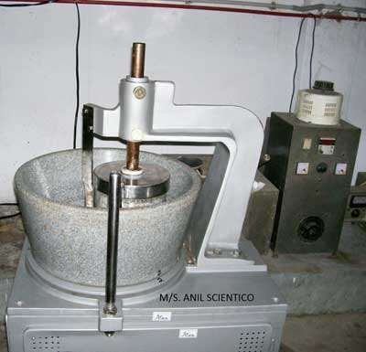
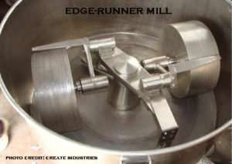

Slide 43


