Slide 1
Signaling pathway through TLR4
Signal Transduction
A process of transmission for molecular signals from cell’s exterior to interior to make an appropriate response.
General Steps
1. Receptor activation by extracellular/ intracellular signal.
2. Binding of adapter proteins to receptor domains
3. Recruitment of other proteins
4. Phosphorylation, Ubiquitination, Acetylation etc.
5. Activation.
6. Repeat of step 3,4,5 (If required).
7. Activation of transcription factor
8. Synthesis of desired proteins.
ADAPTER PROTEINS: Adaptor proteins are types of connecting molecules that regulates signal transduction by engaging the surface receptors.

Slide 2
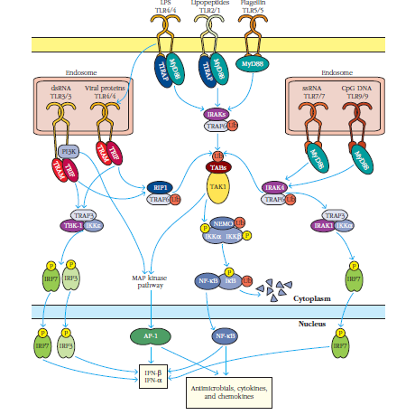
Signaling pathway through TLR4
Plasma membrane
MyD88 DEPENDENT PATHWAY
Activation of cell membrane bound TLR4 occurs through ligands.
TRIF DEPENDENT SIGNALING
Activation of endosomal TLR4
through ligands.
Nuclear membrane
MyD88 – Myeloid Differentiation
TRIF- TIR domain containing adapter inducing interferon-β

Slide 3
Signaling pathway through TLR4
Signaling through cell membrane bound TLR4
LPS activation causes binding of
MyD88/TRAP.
IRAK ubiquitinates and activates TRAF6.
TRAF6 ubiquitinates TAB and NEMO.
TAK1 activation occurs.
Further signaling can be
directed in two ways)
1a. TAK1 phosphorylates IKK complex.
1b. IKK complex ubiquitinates and phosphorylates Ikb of NFkB
causing entry of NFkB into nucleus that
causes transcription of innate response
genes. The detached Ikb is degraded.

Slide 4
Signaling pathway through TLR4
2a. TAK1 also activates MAP kinase pathway alternatively.
2b. AP-1 dimer gets activated which causes transcription of IFNά and β genes (Type 1 Interferons).

Slide 5
Signaling pathway through TLR4
Signaling through endosomal TLR4
Viral protein activation causes binding of TRIF/TRAM.
Further signaling can be directed in two ways.
1a. RIP1 ubiqutinates and activates TRAF6.
1b. Steps for signaling through membrane bound TLR4 should be followed.
2a. TRIFF/TRAM binding causes activation of TRAF3/TBK-1/IKK complex
2b. The complex phosphorylates IRF3/7 which enter nucleus to transcribe cytokine genes

