Slide 1
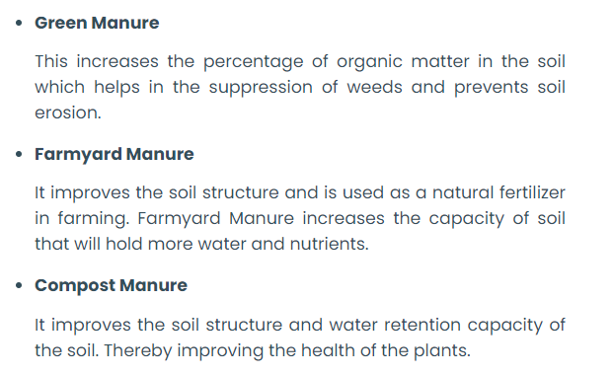
Types of manure
Decomposed matter from plants
Decomposed matter of dung and urine from
Farm animals.
After decay and decomposition of plant
and animal matter

Slide 3
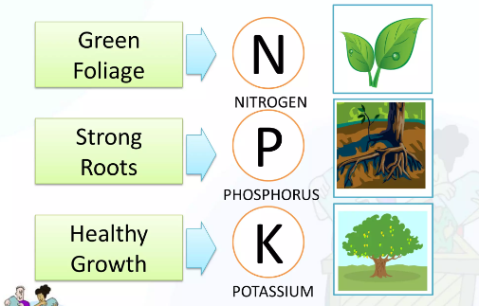

Slide 4
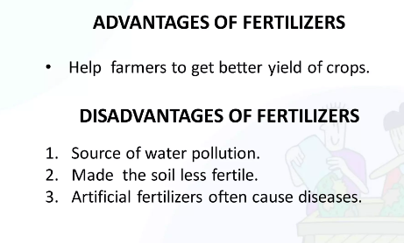
Make

Slide 5
Nutrients in fertilizers
Natural nutrients: C, H and O.
Primary nutrients: Urea, Nitrogen, Phosphorous, Potassium (NPK).
Secondary nutrients: Ca, Na, S, Mg.
Micronutrients: Co, Mo, B, Fe, Mn, Co, Zn.
Types of Inorganic fertilizers (Based numbers of primary nutrients)
Single fertilizer – Fertilizer containing one nourishing element. - NH4Cl, KCl.
Compound fertilizer – Contains 2 or more nourishing elements. – KNO3, Diammonium phosphate.

Slide 6
Types of organic fertilizer (Based on source)
Animal based: By products from meat and diary industries.
Powdered blood, Powered bones, fish by-products.
Plant based: alfa-alfa meal, corn gluten meal, cotton seed meal.
Mined fertilizers: The organic fertilizers mixed with minerals soft rock phosphates and lime stones.
Manure versus organic fertilizers
Manure is formed due to decomposition of plants
and animals naturally.
Organic fertilizer is artificially made from plant and
animal products in factories.

Slide 7
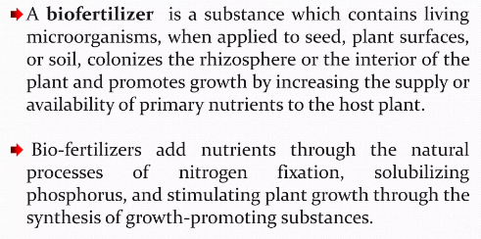
Biofertilizers

Slide 8
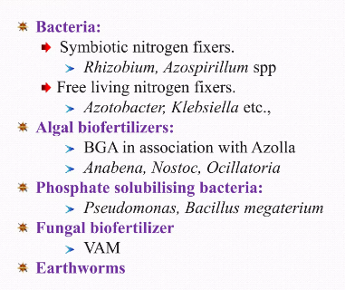
Biofertilizer types
Vesicular Arbuscular Mycorrhiza

Slide 9
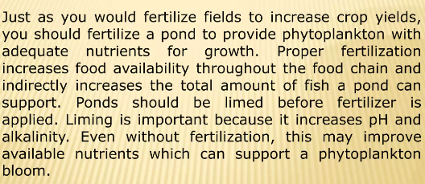
Pond fertilization: A management for soil and water quality aquaculture
LIMING – An important process of pond preparation. Pond soil has an
acidic property. So It has to be made alkaline by adding neutralizing
compounds like Ca, and Mg.

Slide 10
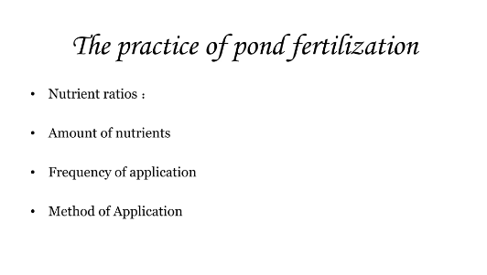
A proper pond fertilization depends on following factors.

Slide 11
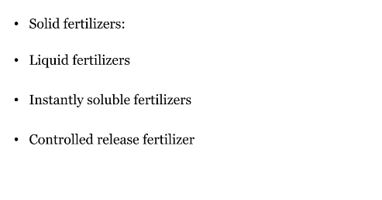
Types of fertilizers used for pond fertilization

Slide 12
Solid fertilizers used for pond fertilization
Example – Granular form of fertilizers containing N. P and K.
Phosphorous is vital for growth of aquatic species.

Slide 13
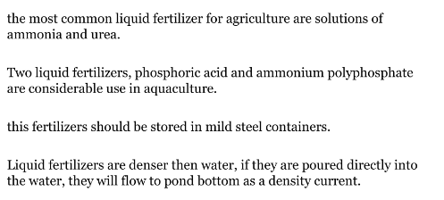
Liquid fertilizers used for pond fertilization

Slide 14
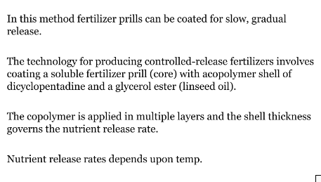
Instantly soluble fertilizers used for pond fertilization
Controlled release fertilizers

Slide 15
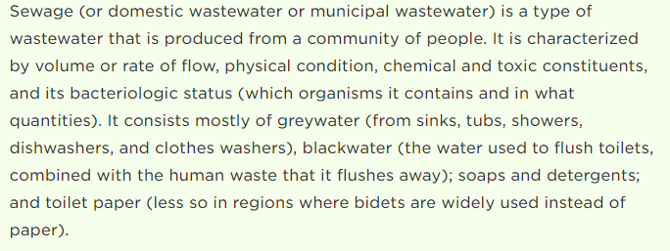
Sewage and its treatment

Slide 16
YES….Sewage contains large amount of organic matter
(Fat, Carbohydrates, Urea and Minerals) and can be used as fertilizer.
It is not that easy….like spreading dry leaves on a lawn.
It contains heavy metals, oils, chemicals and micro-organisms too.
Therefore, the need of hour is to ‘treat’ the sewage followed by using it as fertilizer.

