Slide 1
QUESTIONS
What is active immunity?
Serum of animals immunized with attenuated Tetanus virus could cure fresh animals injected with these pathogens – Active/Passive immunity?
Vaccine induced immunity – Active/Passive?
Anti venom therapy – Humoral or cell mediated immunity?
Which pathogen can induce better immune response – Non-attenuated
or attenuated?
Humoral immunity is active or passive?

Slide 2
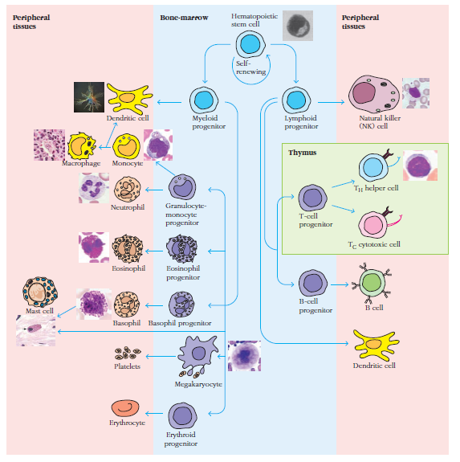
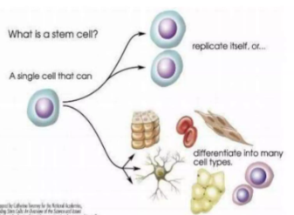
HAEMATOPOESIS
Process of blood cell formation
From HSC.
Self renewal

Slide 3
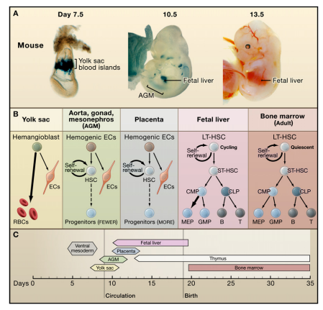
HAEMATOPOESIS DURING EMBRYONIC DEVELOPMENT

