Slide 1
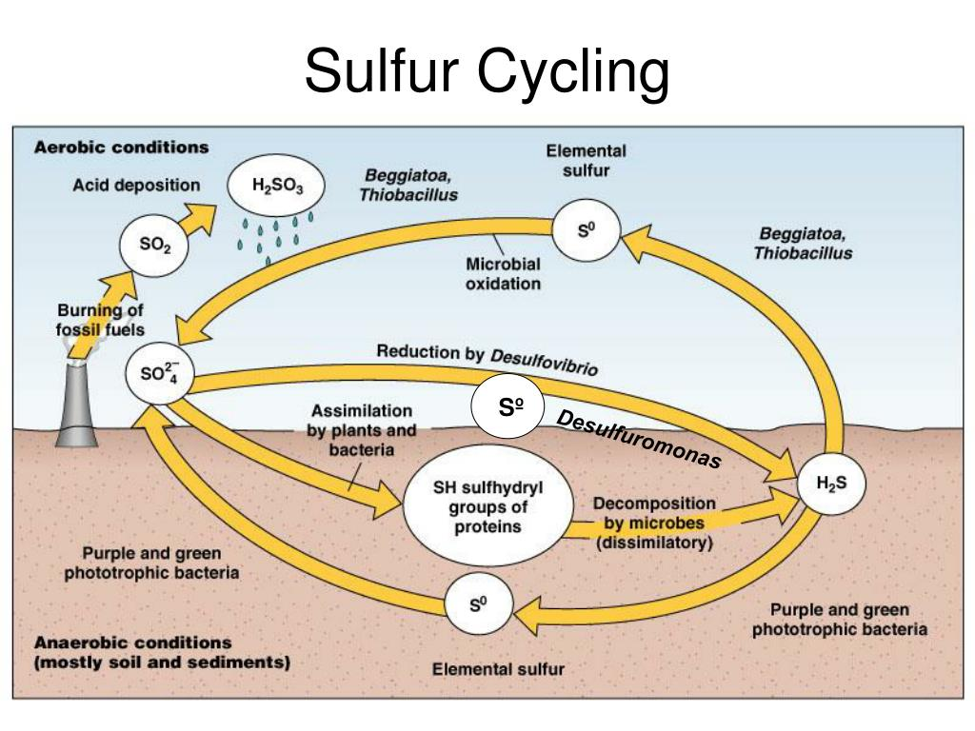
Role of aquatic microorganisms in Sulfur cycle
2
1
3
4
2
1
Notes:
Beggiatoa and Thiobacillus are two genera, both are autotrophs, purple

Slide 2
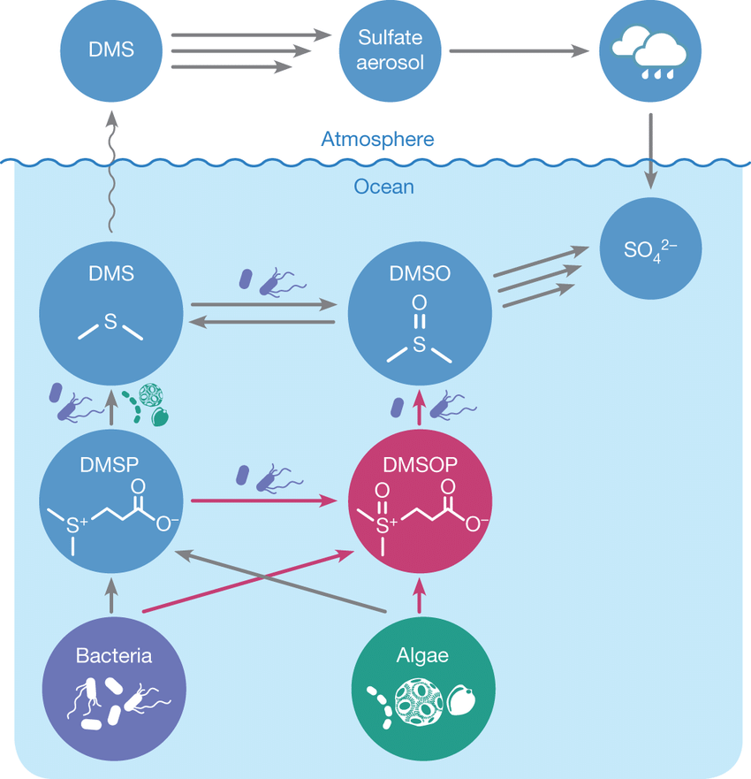
H2SO3
H2SO3 – Sulfurous
Acid.
DMS – Dimethyl sulphide
DMSP – Dimethyl
Sulfoniopropionate
DMSOP – – Dimethyl
Sulfoxoniumpropionate
DMSO - Dimethylsulfoxide

Slide 3
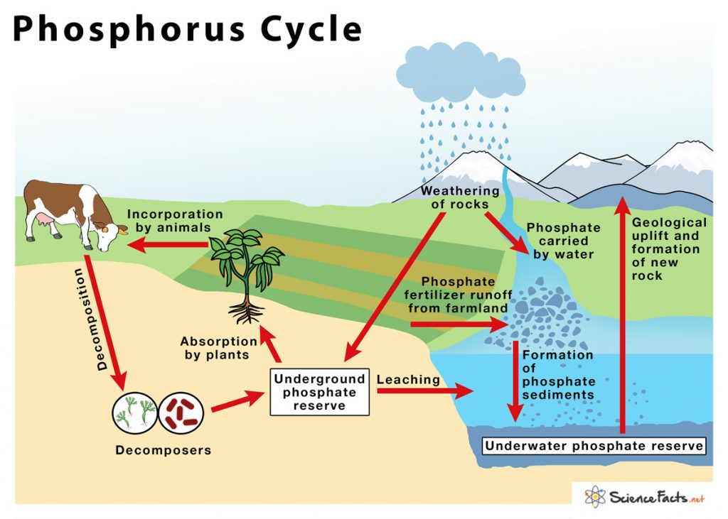

Slide 4
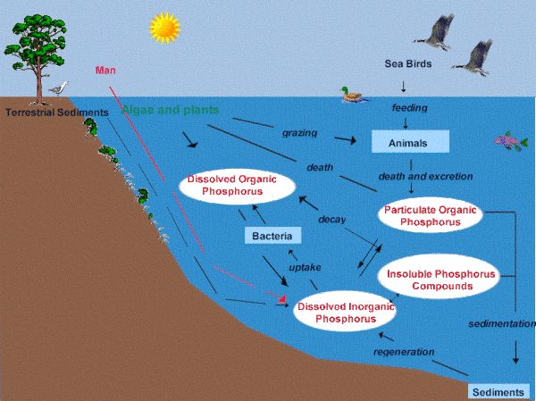
Role of aquatic microorganisms in Phosphorous cycle
Organic phosphates
Inorganic phosphates
Mineralization by Bacillus, Arthrobacter due to
Phosphatase enzyme

Slide 5
Manures and Fertilizers

Slide 6
