Slide 1
Sources of Agricultural -Finance

Slide 2
Agricultural finance is the provision of multiple types of services dedicated to supporting both on- and off-farm agricultural activities and businesses including input provision, production, and distribution, wholesale, processing and marketing.

Slide 3
Agricultural credit in India is available to farmers and other people working in the farming sector in India from various sources.
Sources of agricultural credit can be broadly classified into institutional and non-institutional sources.
Non-Institutional sources include moneylenders, traders and commission agents, relatives and landlords,
Institutional sources include co-operatives, commercial banks including the SBI Group, RBI and NABARD

Slide 4
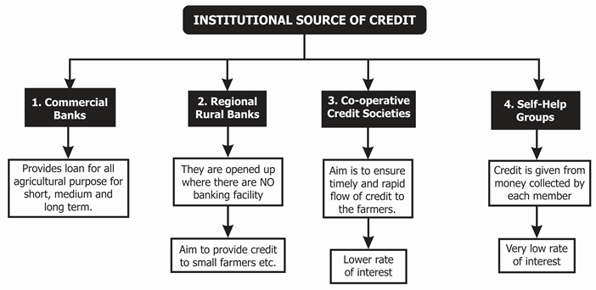

Slide 5
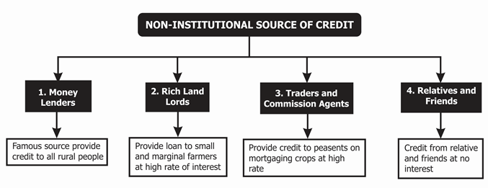

Slide 6
