Slide 1
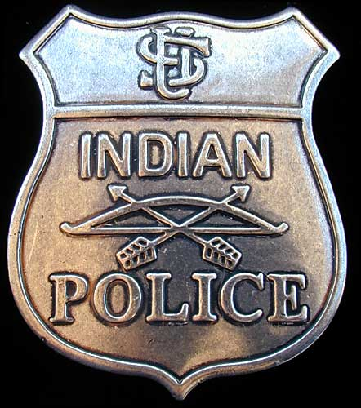
POLICE OFFICERS

Slide 2
Police Ranking System
Sl No Rank
Director General of Police
Addl. Director General of Police
Inspector General of Police
Deputy Inspector General of Police
Senior Superintendent of Police
Superintendent of Police
Deputy Superintendent of Police
Police Inspector
Police Sub-Inspector
Assistant Sub-Inspect
Head Constable
Constable

Slide 3
1. Director General Of Police(DGP)- The highest authority of a state in police is DGP (Director General Of Police). In India, the Director General Of Police(DGP) is a three star rank and the highest ranking police officer in the states of India. The DGP usually the head of the state Police force. All DGPs are IPS officers.
2. Addl. Director General Of Police(ADGP)- In India ADGP is a three star rank who assist the DGP in law and order. All ADGPs are IPS officer. The rank insignia of a ADGP or Commissioner of Police (state) is the national emblem over crossed sword and baton.
3.Inspector General Of Police(IGP)- An IGP is a senior officer in the police force or Police service of several nations. The rank usually refers to the head of a large regional command within a Police service and in many countries refers to the most senior officer of the entire national Police.

Slide 4
4.Deputy Inspector General Of Police (DIGP)- Deputy Inspector General Of Police is a one star rank in the IPS. This rank in the Indian Police , just below IGP. A state can have and most states have several DIGs.
5.Senior Superintendent Of Police (SSP)- Senior Superintendent is the district head. They are entrusted with the power and responsibility of maintaining law and order and related issues of a metropolitan district of a state or a union territory of India. They are assisted by their junior officers.
6.Superintendent Of Police (SP)- SP is the head of a large urban or rural area within a district. They also served as assisting officers to the additional/special director general of police in various bureaus.

Slide 5
In Twin city commissionerate policy is applied where they are given additional responsibilities to maintain law and order in twin cities. Head of the commissioner system is called Commissioner of police and it is equivalent to SP ranking. Commissioner of Police is empowered with the powers of an executive magistrate and function as such. They are the special post Required to support the police system.
7.Deputy Superintendent Of Police(DSP)- They are the state police officers recruited by state police services. They can be elevated to IPS rank and become SP by serving 12 years of service.
Assistant commissioner of police (ACP) is the equivalent post to DSP and basically exist in metropolitan or twin cities. This post is created along with DSP post in commissionerate system in 1876.

Slide 6
8. Police Inspector- Inspector are given responsibility of a police station. In other words Inspector of police is the in-charge of a police station and the area coming under the police station.
9. Sub-Inspector- Sub inspector works under the supervision of Inspector and assist in the work of Police inspector.
10. Assistant Sub-Inspector(ASI)- ASI is a non-gazetted police officer ranking above a police head constable and below a sub-inspector. The rank insignia for an ASI is one star.
11. Head Constable- Head Constable in the Indian police is equivalent to sergeant in police forces in other countries. Head constables wear three bars on their epaulettes.
12.Constable- Constable assist the Head constable in their work related to lodge a complain and look after the work of police station.

Slide 7
