Slide 1
Chemicals of therapeutic value and Low priority aquaculture drugs

Slide 2
Chemical
Chemical is a distinct compound or substance, especially one which has been artificially prepared or purified or extracted from natural sources.
Compound: Thing consisting of several parts or elements.
Elements are chemically the simplest pure substances (made up of one types of atom) which cannot be broken down into another substances.

Slide 3
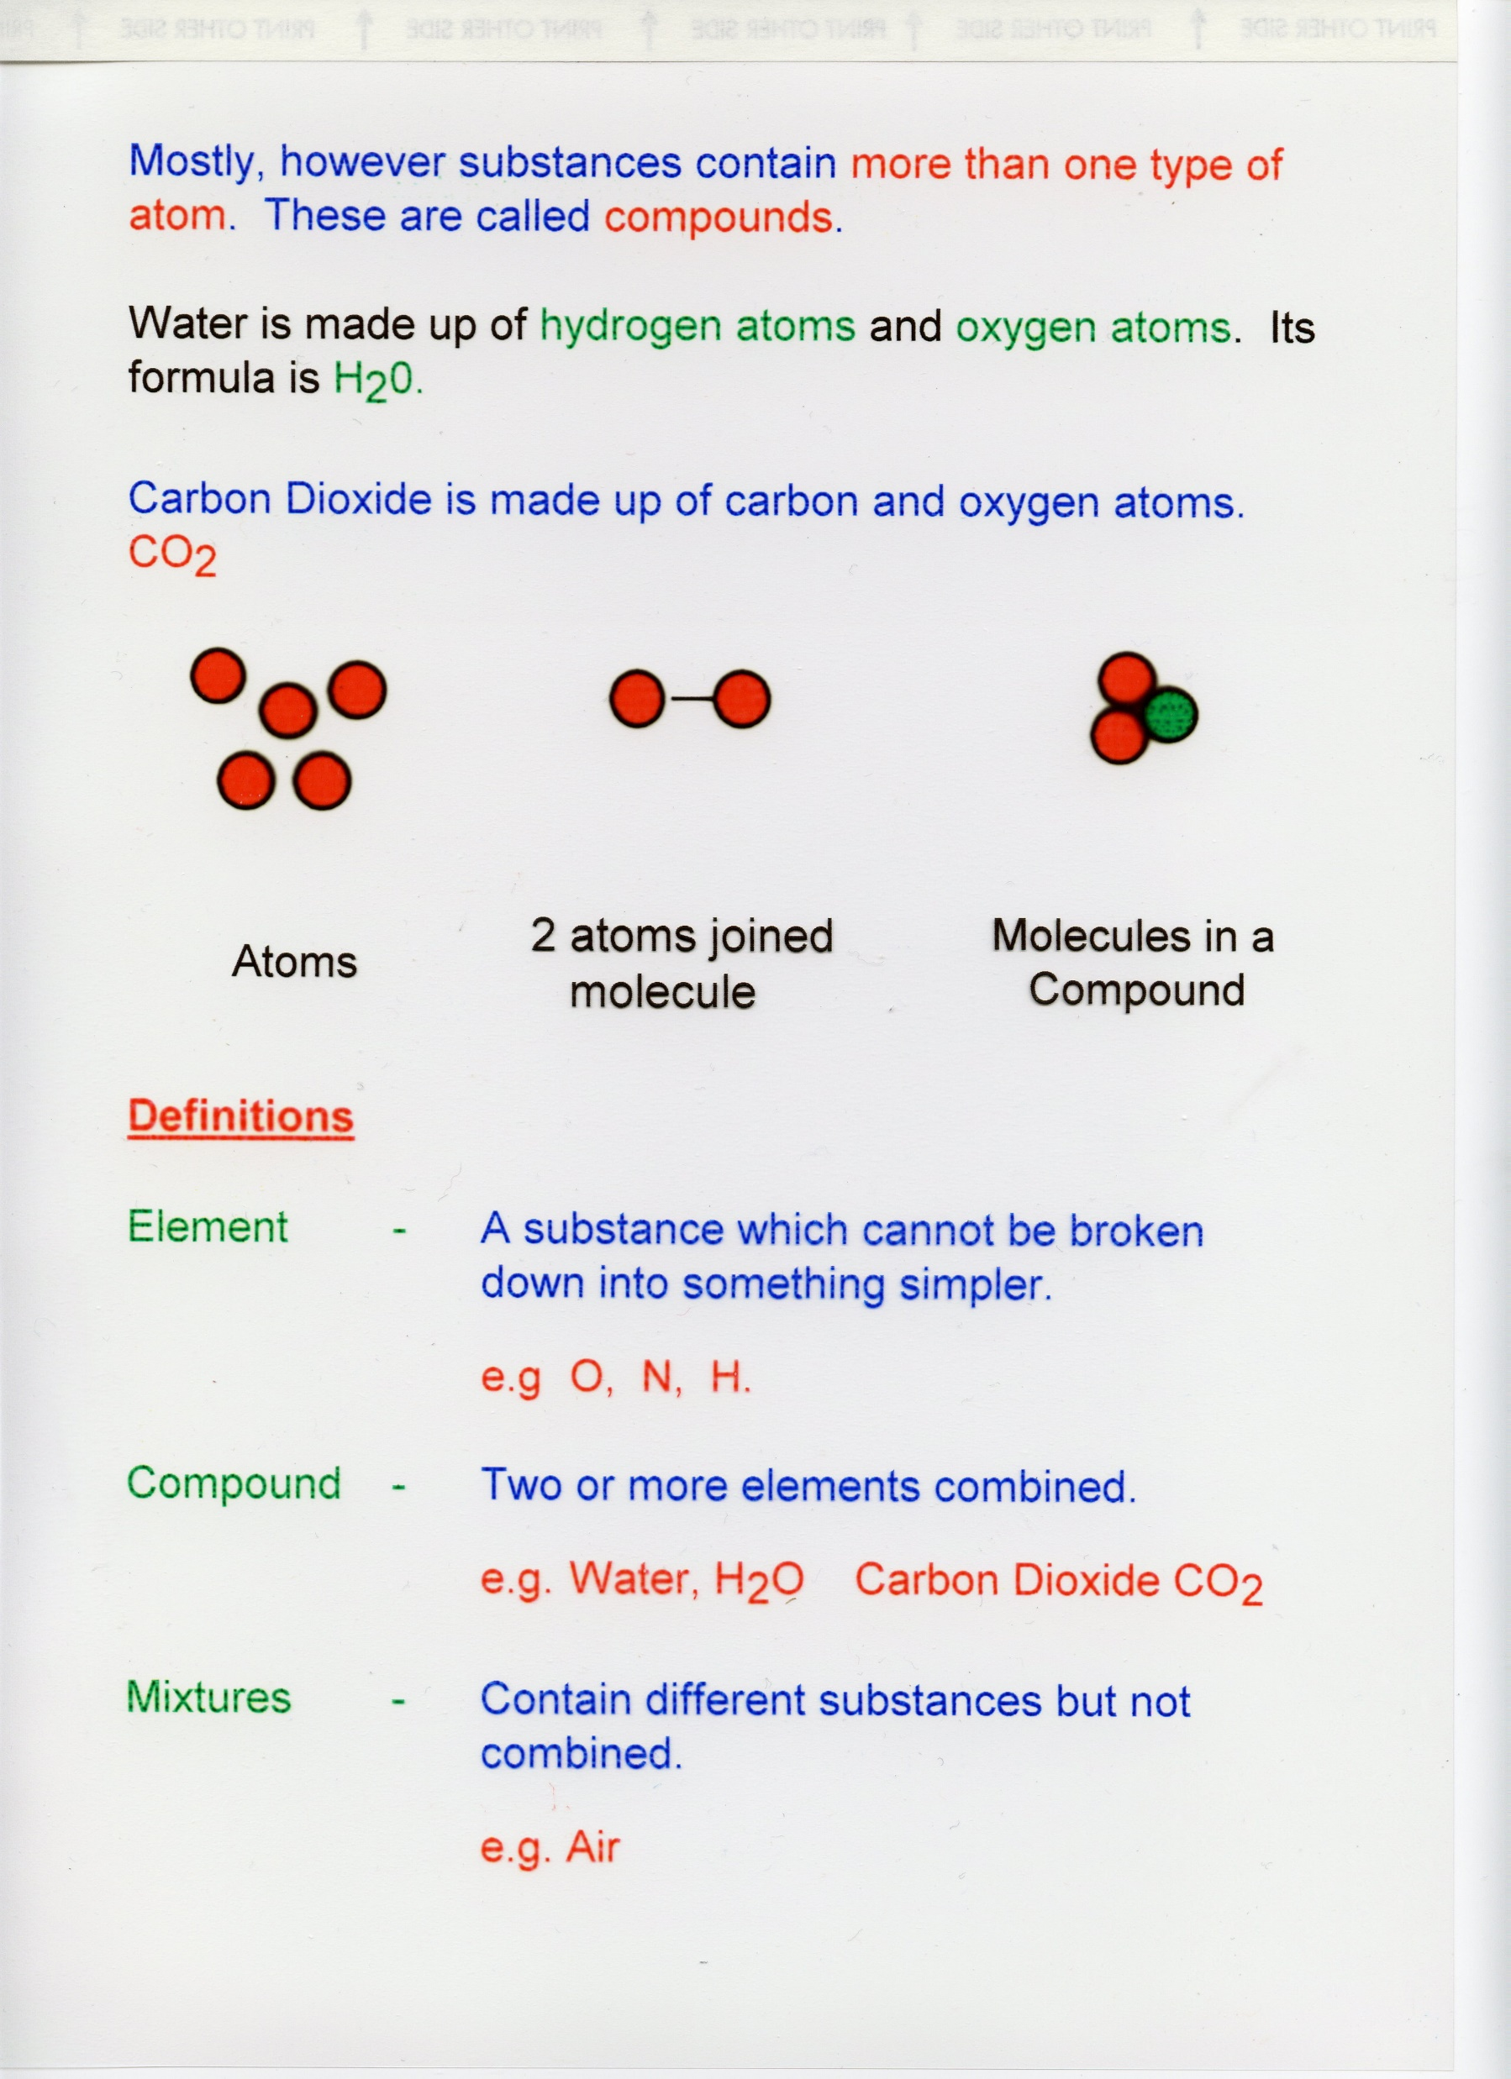

Slide 4
Therapeutic
Therapeutic is a branch of medicine that is concerned specifically with the treatment of disease.
Sources of Therapeutic chemical compound
Therapeutic agents are obtained from 6 major sources-
Plants sources
Animals sources
Minerals or Earth sources
Microbiological sources
Synthetic sources
Recombinant DNA technology

Slide 5
Plant sources
All most all parts of the plant are used- stem, leaves, bark, fruit and root.
Leaves:
The leaves of Digitalis purpurea are the source of Digitoxin and Digoxin, which are cardiac glycosides.
Leaves of Eucalyptus gives oil of Eucalyptus, which is important component of cough syrup.
Tobacco leaves give nicotine.

Slide 6
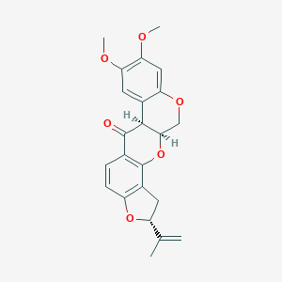
Rotenone
Insecticide, piscicide, and pesticide.
It occurs naturally in the seeds and stems of several plants, such as the jicama vine plant, and the roots of several members of Fabaceae plant.
Rotenone is produced by extraction from the roots and stem
Rotenone works by interfering with the electron transport chain in mitochondria.
Rotenone also inhibits microtubule assembly.

Slide 7
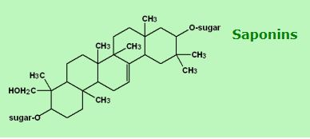
Saponin
Saponins are glucosides with foaming characteristics.
Saponins consist of a polycyclic aglycones attached to one or more sugar side chains.
The foaming ability of saponins is caused by the combination of a hydrophobic (fat-soluble) sapogenin and a hydrophilic (water-soluble) sugar part.
Saponins have a bitter taste.
Saponins toxin are known as sapotoxin.

Slide 8
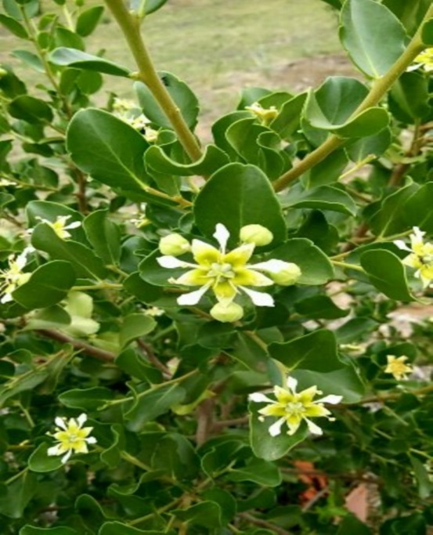
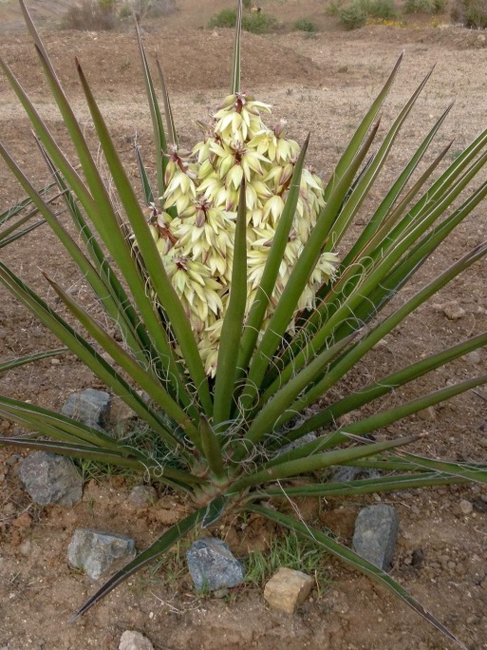
The best known sources of saponins are peas, soybeans, and some herbs with names indicating foaming properties such as soapwort, saoproot, soapbark and soapberry.
Commercial saponins are extracted mainly from Yucca schidigera and Quillaja saponaria.
Quillaja saponaria
Yucca schidigera

Slide 9
Animal sources
Pancreas is a source of Insulin, used in treatment of Diabetes.
Urine of pregnant women gives human chorionic gonadotropin (hCG) used for treatment of infertility.
Sheep thyroid is a source of thyroxin, used in hypertension.
Cod liver oil is used as a source of Vitamin A and D.
Blood is used in preparation of vaccine.

Slide 10
Mineral sources
Iron is used in treatment of iron deficiency anaemia.
Zinc is used as zinc supplement. Zinc oxide paste is used in wounds.
Iodine is antiseptic. Iodine supplement are also used in diet.
Fluorine has a antiseptic properties.
Selenium sulphide is used in anti dandruff shampoos.

Slide 11
Synthetic sources
Synthetic drugs are manufactured to pharmacologically resemble naturally occurring drugs.
Example- Emetine bismuth Iodide, Apomorphine, Ampicillin, Methyl testosterone etc.
Microbial sources
Penicillium notatum is a fungus which release penicillin.
Actinobacteria give Streptomycin.
Aminoglycosides such as gentamicin obtained from Streptomyces.

Slide 12
Antimycin A
Antimycin A is a secondary metabolites produced by Streptomyces bacteria.
Antimycin A is the active ingredient in Fintrol, a chemical piscicide (fish poison) used in Aquaculture.
Antimycin A is an inhibitor of cellular respiration, specifically oxidative phosphorylation.

Slide 13
Recombinant DNA technology
Recombinant DNA technology involves cleavage of DNA by enzyme restriction endonucleases.
The desired gene is coupled to rapidly replicating DNA (Viral, Bacterial or Plasmid).
The new genetic combination is inserted into the bacterial cultures which allow production of vast amount of genetic material.
Advantage:
Huge amount of drugs can be produced.
Drug can be obtained in pure form.

Slide 14
Low Regulatory Priority (LRP) Drugs
LRP drugs are harmless compounds that have historically been used in aquaculture but will likely never be approved by FDA.
List of LRP are:
SL NO | Drug name | Application / Action
1 | Acetic acid | Parasiticide
2 | Calcium Chloride | Egg hardening
3 | Calcium Oxide | Protozoacide
4 | Carbon dioxide gas | Anaesthetic
5 | Fuller’s earth | Reduce egg adhesion
6 | Garlic | Parasiticide
7 | Ice | Reduce metabolic rate

Slide 15
SL NO | Drugs Name | Application / Action
1 | Magnesium Sulfate | Parasiticide
2 | Onion | Parasiticide
3 | Papain | Remove egg mass gelatinous material
4 | Potassium Chloride | Osmoregulation
5 | Povidone iodine | Egg surface disinfectant
6 | Sodium bicarbonate | anaesthetic
7 | Thiamine hydrochloride | Thiamine deficiency in Salmonids
8 | Sodium Chloride | Osmoregulation
9 | Sodium Sulfite | Improve egg hatchability
10 11 | Urea and Tannic acid Clove Oil | Denature egg adhesion Anaesthetic

Slide 16
Assignment for Group-1(FSP)
Dated….
Case study report
Topic: Case study of village fish farmer
Point to be write:
1. Name of Farmer, Information about pond/farm/ area etc.
2. Mannuring/fertilizer/liming schedule
3. Feeding
4. Treatment of weed fish and aquatic weeds
Submitted by: your name, registration number
Send it to me, Email: tasok.leya@cutm.ac.in

Slide 17
Assignment for Group-2 (FSP)
Dated….
Case study report
Topic: Case study report on fish epidemiology
Point to be write:
1. Farmer name, pond detail
2. Details of Fish seed source
3. Prophylaxis schedule
4. Details of Epidemiology
Submitted by: your name, registration number
Send it to me, Email: tasok.leya@cutm.ac.in

