Slide 1
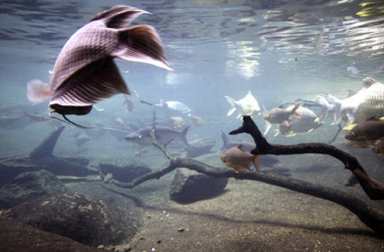
TRAITS OF IMPORTANT CULTIVABLE SPECIES

Slide 2
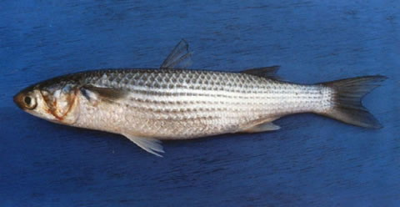
GREY MULLETS
Important cultivable fishes in brackish water ponds
Suitable for farming as they are herbivores and detritivores, feeding low in the tropic level
Require less supplementary feed
Tolerant to higher temperatures and salinities, hence can be grown in tropical and sub-tropical areas
Poly-cultured with other fish and shrimps

Slide 3
Distinctive characteristics
Belong to the family Mugilidae
Have a broad and flattened head; a small and terminal mouth; two short dorsal fins; devoid of a lateral line
Have blue, green or olive colorations on the back
The sides and belly are silvery and body has 3-9 longitudinal streaks
Mugil cephalus -fastest growing larger sized mullet which is very widely distributed in the tropics and the subtropics
Other important cultivable species - Liza macrolepis and Liza tade.
Mugil cephalus

Slide 4
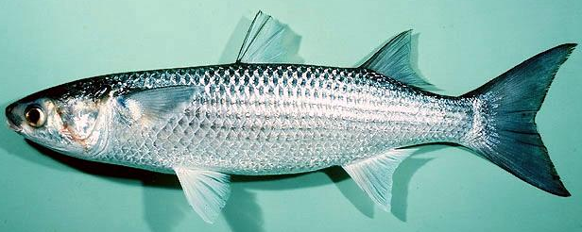
Mugil cephalus
Robust body and fatty tissue covering most of the eye
The lips are thin, the lower one having a high knob on the symphysis
There are 6-7 indistinct brown bands down the flanks and a dark purple blotch at the base of the pectoral fin
Grows to a maximum size of 90 cm, but the common sizes range from 35 – 45 cm

Slide 5
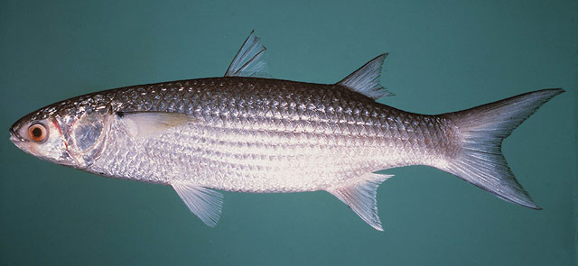
Liza macrolepis
moderately robust body and the fatty tissue is only in the from of a rim around the eye
The body does not have nay bands or stripes
Grows to a maximum size of 60 cm, with common sizes ranging from 25-30 cm.
Liza tade
the body is slender and elongate
The head is depressed and elongated
In adults 5-7 indistinct longitudinal marks
are present on the upper half of the body.

Slide 6
Biology
Majority of grey mullets are marine, inhabiting shallow areas of the sea. Since they are highly euryhaline and eurythermal, they ascend brackish waters, bays, creeks, swamps and estuaries
Adults feed on algae, diatoms, crustaceans, decaying organic matter and detritus found at the bottom. The post larvae, fry and juveniles feed on plankton
Most species spawn in the sea, but fry form shoals along the coasts and enter estuaries, lagoons and creeks from where they can be easily collected
Cultivable mullets grow quickly in ponds attaining up to 45 cm in length and 750 g in weight at the end of one year
Life span is 2-3 years with maximum growth in the first year of their life

Slide 7
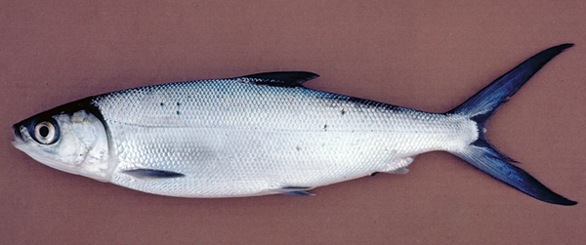
MILKFISH
The milkfish, Chanos chanos - the most ideal fish for coastal aquaculture
They have fast growth rate, in the first year of its life, wide range of tolerance to temperature, salinity and dissolved oxygen; feeds on algal mats at the bottom, resistance to most diseases and parasites
Cultured on a large scale in Indonesia, the Philippines and Taiwan for centuries

Slide 8
Distinctive characters
Milkfish –
moderately compressed, spindle shaped elongated body covered with small scales
Mouth is small, without teeth, snout is longer than the lower jaw, which has a small tubercle at its tip
The dorsal fin is located at about the middle point of the body; anal fin short and situated far behind the dorsal fin base
Lateral line is present and tail fin is large and forked. The dorsal, anal and caudal fins have dark margins

Slide 9
Grows up to 180 cm in length and 20 kg in weight, but the fish caught in the sea normally range from 70-110 mm
The fry and fingerlings feed on microscopic algae. The fish grows to about 50 cm in length weighing 500 – 800 g in brackish water ponds
In ponds milkfish feed mainly on filamentous algae at the bottom along with associated microorganisms and detritus
The fish can be fed supplementary feed such as rice bran, oil cakes and other feed stuffs.

Slide 10
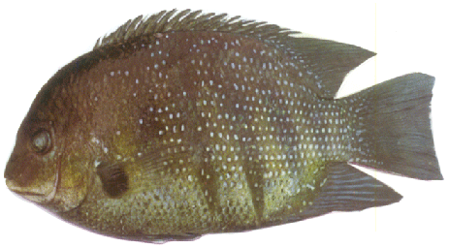
PEARL SPOT
The pearl spot Etroplus suratensis - cichlid fish distributed in India, Sri Lanka and Pakistan
Available in estuaries, tidal creeks, lagoons, backwaters and swamps
Attains a length of more than 30 cm and weight of about 1.5 kg.

Slide 11
Distinctive characters
Body is oblong, compressed and elevated
Small teeth on jaws, none on the palate
The dorsal fin is single, with spinous portion greater in extent than the soft portion
Lateral line present in the upper fourth of the body
Colour light green, with eight oblique bands on the body. Most of the scales have central white pearly spots
The dorsal, caudal, ventral and anal fins are dark coloured, pectoral yellowish with a black base
Strong spines on dorsal and anal fins present.

Slide 12
Biology
Matures within one year of its life and breeds in confined waters such as ponds, almost throughout the year
A female releases up to 6,000 eggs at a time. The eggs are attached to submerged objects like stones, twigs, tiles, bamboo poles etc. by the female after cleaning them
The male fertilizes the eggs and the female guards over them during development and hatching
The early fry feed on zooplankton, the advanced fry on aquatic insect larvae. Juveniles and adults feed on filamentous algae and other weeds

Slide 13
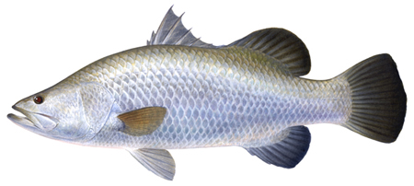
ASIAN SEABASS
Asian sea bass Lates calcarifer - prime value fish grown for luxury markets
Commonly distributed in Australia, Myanmar, India, Indonesia, Malaysia, the Philippines, Singapore and Thailand
In India - a by catch in the traditional shrimp filtration fields

Slide 14
Distinctive characters
Lates calcarifer - family Centropomidae
Elongated and compressed body, with a deep caudal peduncle
Head is pointed with a concave dorsal profile, becoming convex in front of the dorsal fin
Mouth is large, slightly oblique and the lower edge of the opercle is serrated, with a strong spine

Slide 15
The spinuous and the soft parts of the dorsal fin are separated by a deep notch
The lateral line extends on to the tail
In juveniles the colour is olive brown above with silvery sides and belly, while in adults it is greenish or bluish above and silvery below
No spots or bars are present on the body
The eyes are bright pink, glowing at night

Slide 16
Biology
The fish has wide range of tolerance to temperature and salinity
Grows to a maximum size of upto 200 cm
It is a highly carnivorous fish, feeds on fishes and crustaceans
Fry feed on zooplankton and fingerlings on crustacean, worms, molluscs etc
Growth is faster in the first three months of the first year
Fish migrate to the estuaries for breeding
In culture ponds the Asian sea bass attains 1.5 to 3.0 kg in the first year and 5 kg in the second year
The fish is highly cannibalistic- suitable for grow out in floating cages with periodic size grading.

Slide 17
GROUPERS
Groupers -important group of fishes for coastal aquaculture
Epinephelus tauvina and E. malabaricus of the family Serranidae have a robust, somewhat compressed, oval-oblong and elongated body
There are 11 spines and 14-16 soft rays in the dorsal fin and 18-20 rays in the pectoral fin
A large blackish blotch is present at the base of the last four dorsal spines extending onto the lower part of the fin in E. tauvina but absent in E. malabaricus, which possesses about five, more or less distinct and slightly oblique, irregular bars on the body
Epinephelus tauvina

Slide 18
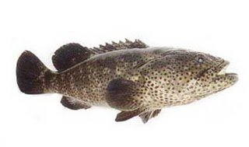
Also, three dark blotches are present on the inter-opercle in E. Malabaricus
The head and body are greyish, covered with small, dull, orange-red to dark brown spots
They grow to 50-65 cm and to 100 cm respectively
Hong Kong, Thailand, Singapore and Malaysia are the major producer of groupers in sea cages
Groupers are suitable for culture in net cages, as well as in ponds
Wild seed collection is the major source of seed for culture of groupers.
E. malabaricus

Slide 19
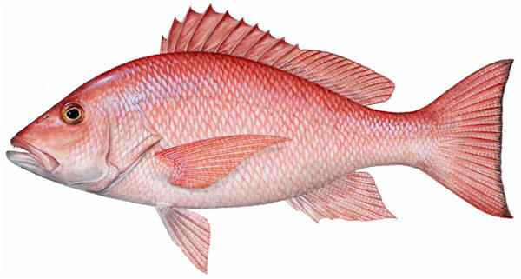
SNAPPERS
The snappers -high value in the domestic and international markets
Golden snapper or red snapper are the preferred species
Lutjanus johni is culture in Malaysia and Singapore
It has a moderately deep body with a straight or slightly convex head profile
The dorsal has10 spines and 13 to 14 soft rays. Longitudinal scales above the lateral line are parallel to it and those below the lateral line are horizontal

Slide 20
The body has a reddish or bronze – silvery colour with a dark spot on each scale, forming a series of dark streaks in the body
A large black blotch may be present above the lateral line in the junction between spinuous and soft part of the dorsal
The fish grows t a maximum length of about 70 cm; but the common sizes are 40 – 60 cm in length
Red snapper feeds on invertebrates and fishes; and inhabits shallow waters and mangrove areas besides the sea up to a depth of about 80 m.

