Slide 1
OPERATING SYSTEM
TYPES OF OPERATING SYSTEM

Slide 2
Operating Systems
Operating Systems
The operating system is the most important program
that runs on a computer.
Operating system is an interface between computer and user.
It is responsible for the management and coordination of activities and the sharing of the resources of the computer.

Slide 3
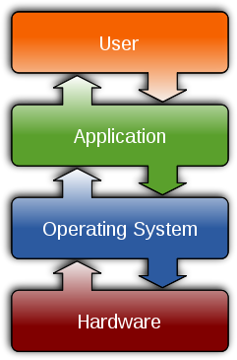
Operating Systems
Operating Systems

Slide 4
Operating Systems
Types of Operating System
Real-time
Multi-user vs. Single-user
Multi-tasking vs. Single-tasking
Distributed
Embedded

Slide 5
Operating Systems
Types of Operating System
Real-Time
A real-time operating system is a multitasking operating system that aims at executing real-time applications.
Responds to input instantly.

Slide 6
Operating Systems
Types of Operating System
Multi-user vs. Single user
A multi-user operating system allows multiple users to access a computer system concurrently.
Time-sharing system can be classified as multi-user systems as they enable a multiple user access to a computer through the sharing of time.
Single-user operating systems, as opposed to a multi-user operating system, are usable by a single user at a time.

Slide 7
Operating Systems
Types of Operating System
Multi-tasking vs. Single-tasking
When a single program is allowed to run at a time, the system is grouped under a single-tasking system
While in case the operating system execution of multiple tasks at one
allows the time, it is
classified as a multi-tasking operating system.

Slide 8
Operating Systems
Types of Operating System
Distributed
A distributed operating system manages a group of independent computers and makes them appear to be a single computer.
The development of networked computers that could be linked and communicate with each other, gave rise to distributed computing.

Slide 9
Operating Systems
Types of Operating System
Embedded
Embedded operating systems are designed to be used in embedded computer systems.
They are designed to operate on small machines like PDAs with less autonomy.
They are able to operate with a limited number of resources.

Slide 10
Operating Systems
Major Functions of Operating System
Resource management
Data management
Job management
Standard means of communication between User
and Computer

Slide 11
THANK YOU

