Slide 1
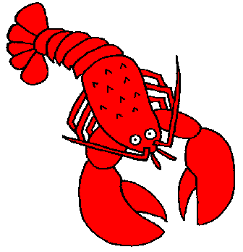
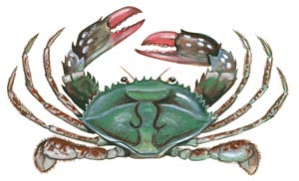
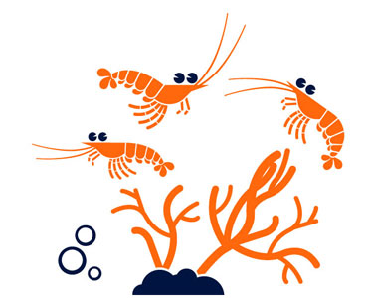
TRAITS OF IMPORTANT CULTIVABLE SHELLFISH

Slide 2
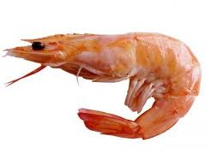
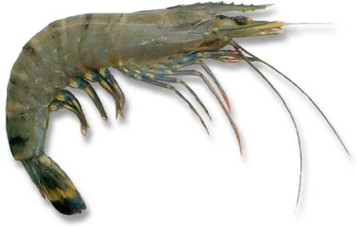
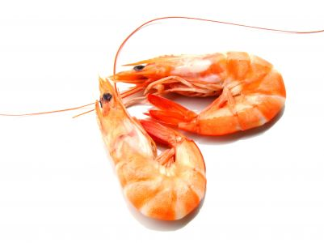
SHRIMPS
Shrimps are the most widely cultivated species in India
Among edible crustaceans, shrimp are considered as highly valuable commodity
At present India is 5th aquaculture production of shrimps in the World
Due to its large size and faster growth rate, Penaeus monodon is the most widely grown shrimp in India and south east Asia
Other suitable species - P. indicus, P. merguiensis and P. semisulcatus. P.japonicus is grown in Japan while P. vennamei is the most widely cultivated species in the south and central America

Slide 3
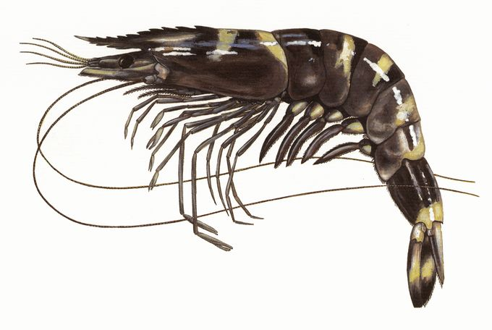
Penaeus monodon
Called as tiger shrimp- largest of the marine shrimps
Attains a maximum length of 365 mm and 440 g in weight
Juveniles and sub-adults are found in estuaries, backwaters and mangrove areas while mature adults are caught from the sea
Can tolerate very low salinities; fastest-growing; hardy and suitable for aquaculture
Attains maturity at about 200 mm size
Spawning takes place at depths between
30 and 60 m
Fecundity is 2- 19 lakh eggs at a size range of
200 to 260 mm

Slide 4
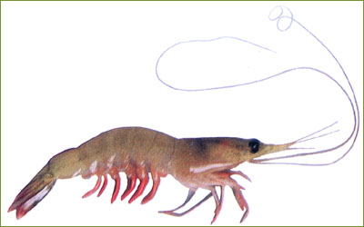
Penaeus indicus
Commonly known as Indian white shrimp
Distributed from Goa to Kanyakumari on the west coast and throughout the east coast
Maximum size -230 mm
Juveniles are caught extensively in estuaries, adults are found in the sea
Attains maturity at about 130 mm size
Spawning takes place in deeper waters
Fecundity is 68000 to 73000 eggs per individual

Slide 5
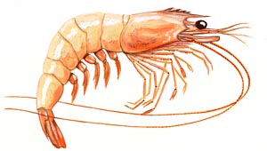
Penaeus merguiensis
The banana prawn P. merguiensis - has discontinuous and restricted distribution
Found South of Maharastra to Goa and North Karnataka along the west and in Andhra Pradesh and Orissa on the west coast
Maximum size - 240 mm and attains maturity at a size of about 140 mm
On an average it produces about 4.5 lakh eggs per spawning
The juveniles are found in the estuary but adults migrate to sea for maturity and spawning

Slide 6
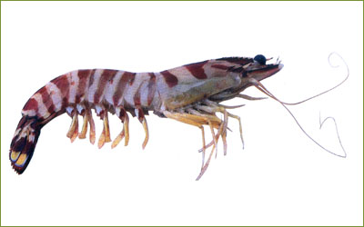
Penaeus semisulcates
Commonly called green tiger shrimp
Found in large quantities in the Gulf of Mannar and Palk Bay. Minor fishery exists in Gujrat, Kerala and Andhra Pradesh
Juveniles of this species are not found in estuaries unlike the other cultivable shrimps of India
The shrimps prefer shallow areas of the sea where luxuriant growth of sea grass is found
Matures at a size of about 130 mm and breed almost throughout the year

Slide 7
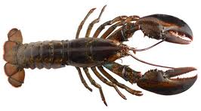
LOBSTERS
Lobsters are the most highly prices commodity
Supply of lobsters - intensive fishing in different parts of the world
Traditional lobster stocks are heavily overfished
Aquaculture-very slow growth rate - difficulty in producing seed in hatcheries due to very poor survival
Presently undersized lobsters caught by fishermen are collected by the growers and cultured in suitable enclosures to marketable size through appropriate feeding schedule and water quality management – FATTENING
In India - no commercial lobster fattening or culture is being undertaken

Slide 8
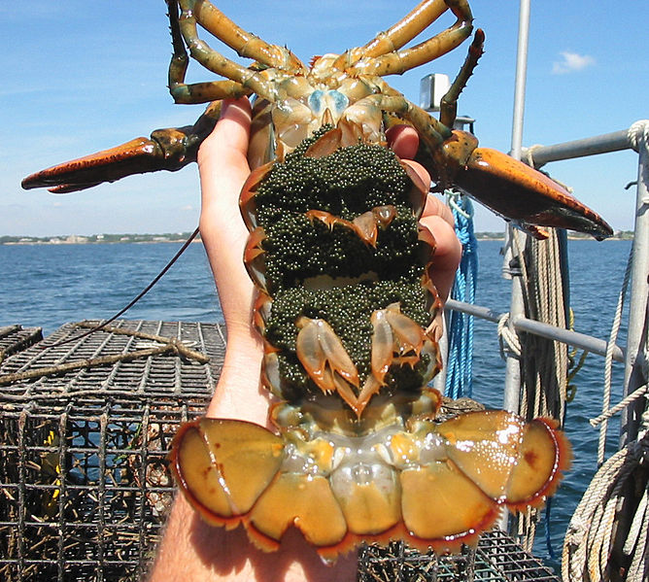
Spiny lobsters - heterosexual and strictly marine throughout their life
Attain maturity at the age of 2-2.5 yrs and reproduce in inshore waters
Breeding is continuous, each species having peaks at different times in different areas
The life cycle involves a prolonged metamorphic phase extending for several months
Fertilized eggs attach to the abdomen of the mother which is called berried female
berried female

Slide 9
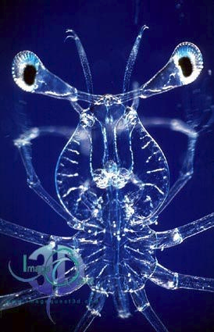
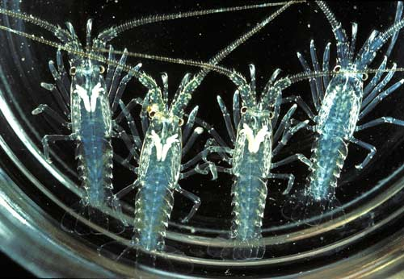
They hatch into a flat transparent phyllosoma larvae
The pelagic larvae after a series of stages during the next 10-12 months transform in to characteristic post larvae called puerulus
The puerulus is tiny and transparent but resembles adults and settles to the bottom. It soon develops in a juvenile

Slide 10
The lobsters are carnivorous and nocturnal
Feed-bottom dwelling organisms and decaying animal matter
The most preferred food is bivalve mollusks, polychates and fish
Growth -faster in the early stages and they attain 20 – 25 cm in the first two years. Afterwards the growth rate is very slow being 2-3 cm per year
They have a life span of 7-8 years

Slide 11
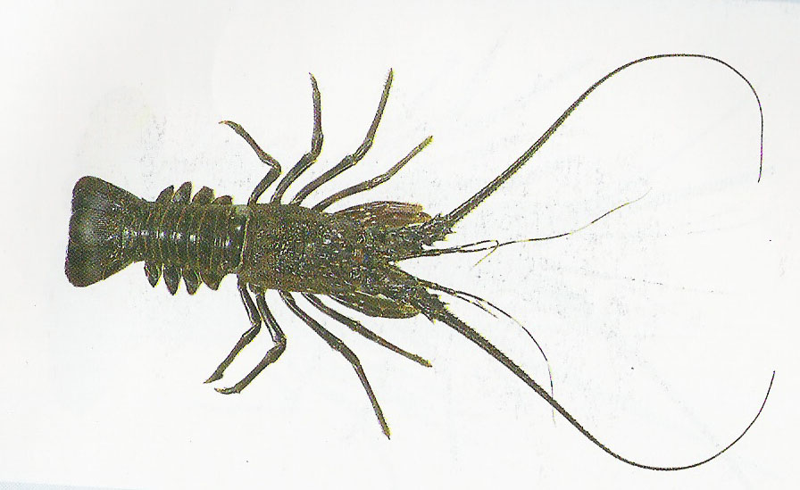
Panulirus polyphagus
Maximum body length 37 cm
Carapace rounded and moderately curved with spines and tubercles
Antennular plate with a single pair of anterior spines. Abdomen without groves
Body colour dull greenish. Each abdominal segment with a distinct transverse band of white colour along the posterior margin
Legs with indistinct blotches and short stripes
It is generally associated with muddy sea bottom and found in maximum abundance along Maharashtra and Gujarath coast

Slide 12
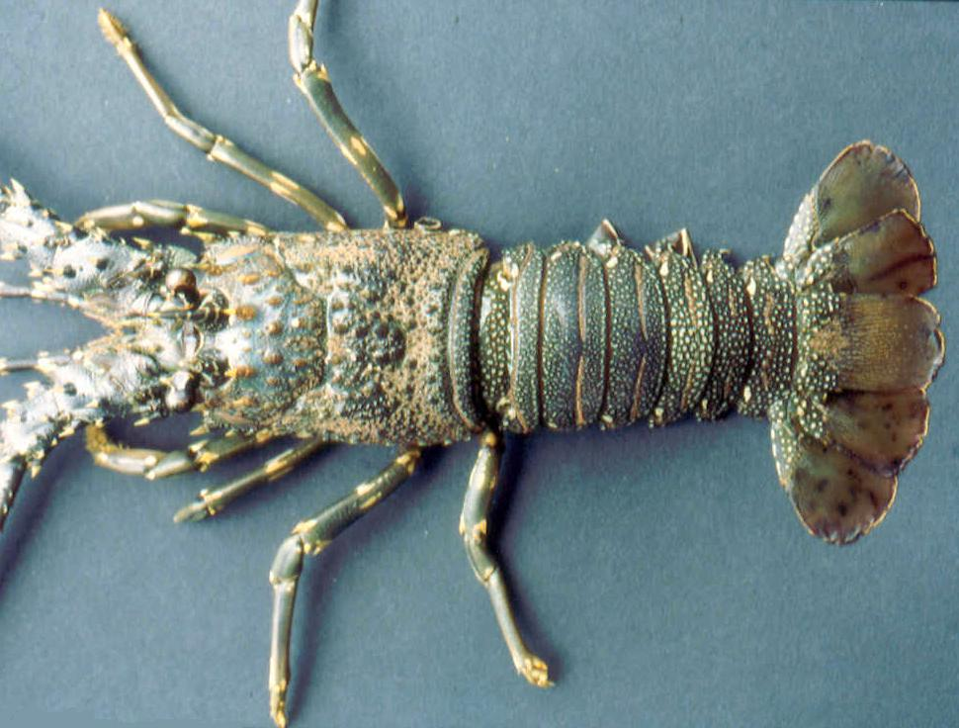
Panulirus homarus
Medium sized lobster growing to about 30 cm in length
Carapace rounded with numerous spines
Antennular plate bearing two equal pairs of spines and many scattered smaller spines in between
Abdominal segments grooved transversely, grooves sometimes interrupted medially
Colour of body dark greenish to blackish
Lateral border of each abdominal segment with a white circular spot
This species coexists with P. ornatus in the rocky coastal areas from Trivandrum to Cape Comorin, Gulf of Mannar and Madras. P. homarus is dominant in southern areas, while P. ornatus is dominant in Mandapam area

Slide 13
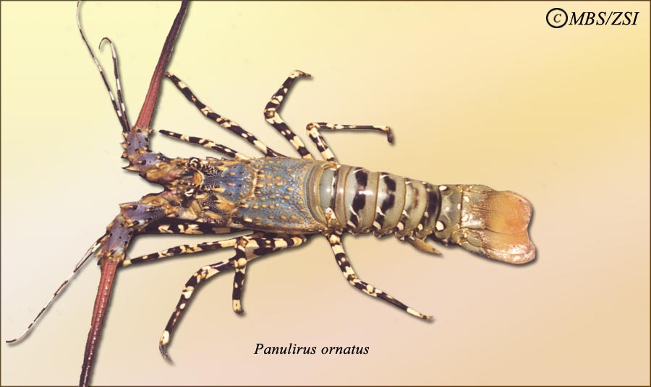
Panulirus ornatus
The largest species under this genus
Grows to about 50 cm
Carapace rounded and covered with numerous spines and tubercles
Antennular plate bearing two pairs of spines, the anterior pair being much larger than the posterior
Abdominal segment smooth, without transverse grooves. Body colour grayish brown
Each abdominal segment with a broad dark transverse band and two large white spots on either side
Legs with black and light yellow stripes

Slide 14
CRABS
Crabs rank third in their importance as gourmet food and the value of fishery they support after shrimps and lobsters
Scylla tranquibarica and Scylla serrata are the larger ones attaining sizes of 0.5 to 2.0 kg and suitable for culture
They are known as mud crabs, green crabs or mangrove crabs
They prefer muddy and sandy bottoms
They breed in the sea and megalopa onwards migrate to the estuaries
Males are bigger than females of the same age
They are omnivores feeding on shrimps, bivalves and fish among other food items
They are continuous breeders with peaks at different times in different places.

Slide 15
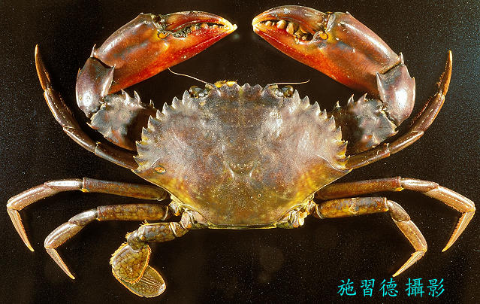
Scylla tranquibarica
This is the larger of the two species growing to a maximum size of 2.0 kg
Free living unlike S. serrata which burrows into the substratum.
Outer margin of carpus of chelipeds with 2 sharp spines. Colour of upper surface of body light to dark green
Polygonal marking on all walking and swimming legs

Slide 16
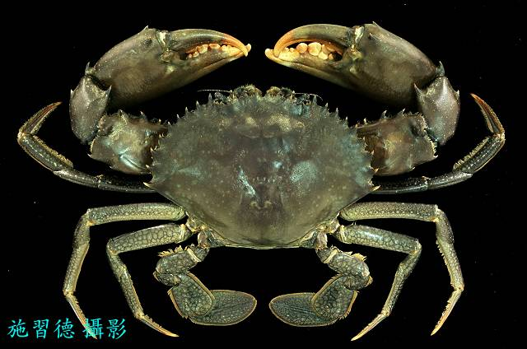
Scylla serrata
Outer margin of the carpus of cheliped with one blunt spine
Colour of the carpapace greenish brown to ferruginous brown
No polygonal markings on legs
Lower surface of the fixed finger of cheliped dark to pinkish red in colour

