Slide 1
Use of allegation method in calculations
Ms. Shubhashree Das
Assistant Professor
School of Pharmacy
Centurion University of Technology and Management
Balasore
shubhashree.das@cutm.ac.in

Slide 2
Alligation method
This is a mathematical method used for solving problems in which the ingredients possessing different percentage strength are mixed.
Two alligation methods are available:
1.Alligation medial: This method involves calculating the weight average percentage strength of a mixture of two or more substances of known quantity and concentration.

Slide 3
2.Alligation alternate: This rapid method involves determining the proportions in which substances of different strengths are mixed to yield a desired strength or concentration.
1.The required percentage or concentration is placed in the centre.
2.The percentage of the substance with the lower strength is placed on the lower left hand side.
3.The percentage of the substance with higher strength is placed on the upper left-hand side.
4.The required percentage is subtracted from the lower percentage ,and the obtained difference is placed on the upper right hand side.
5.The higher percentage is subtracted from the desired percentage, and the obtained difference is placed on the lower right hand side .

Slide 4
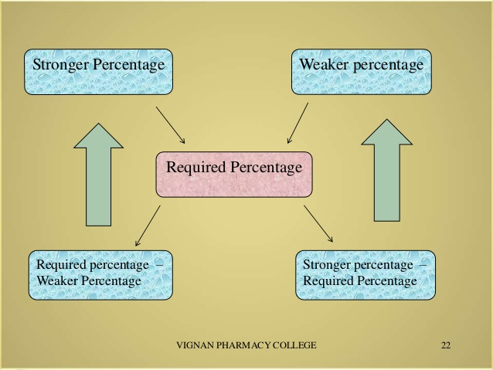

Slide 5
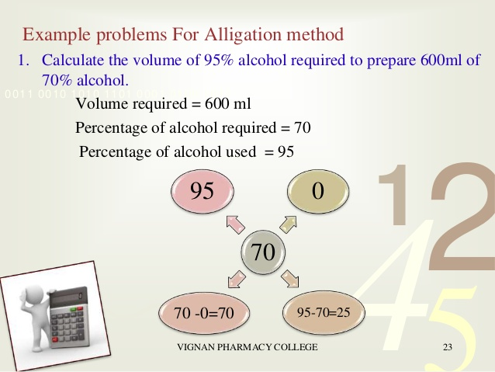

Slide 6
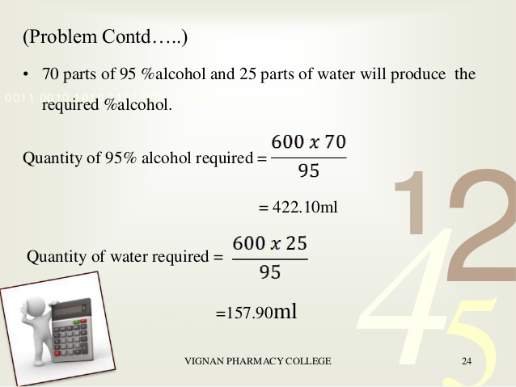

Slide 7
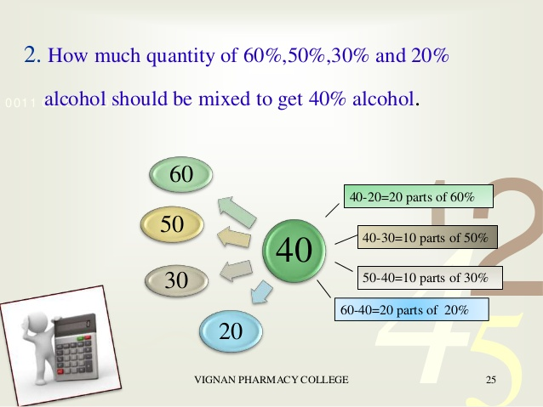

Slide 8
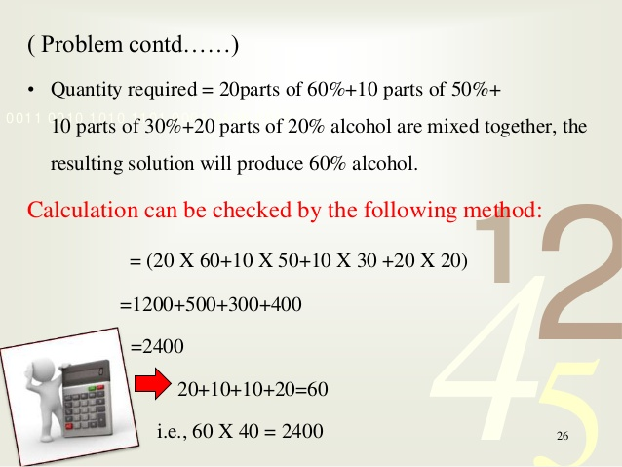

Slide 9
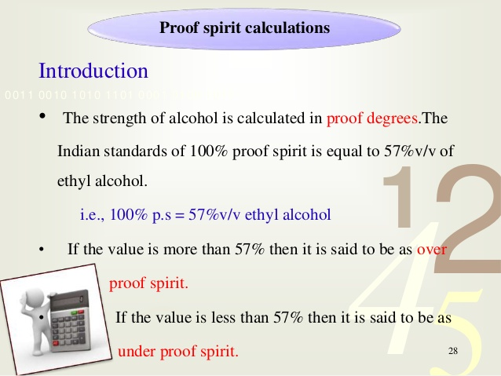

Slide 10
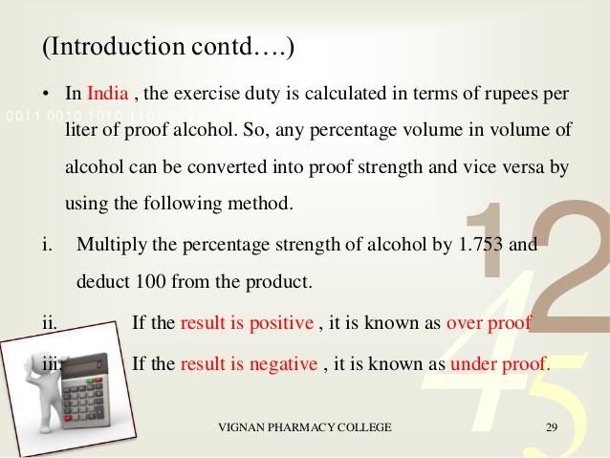

Slide 11
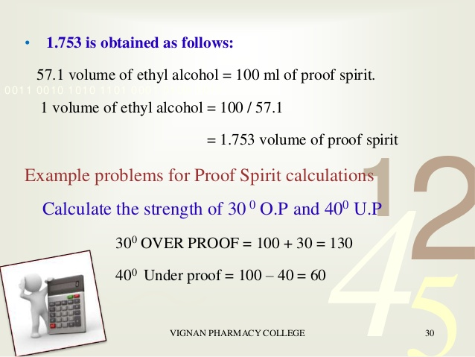

Slide 12
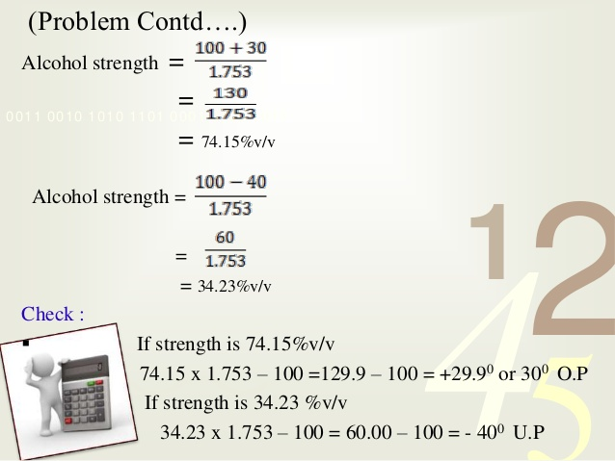

Slide 13
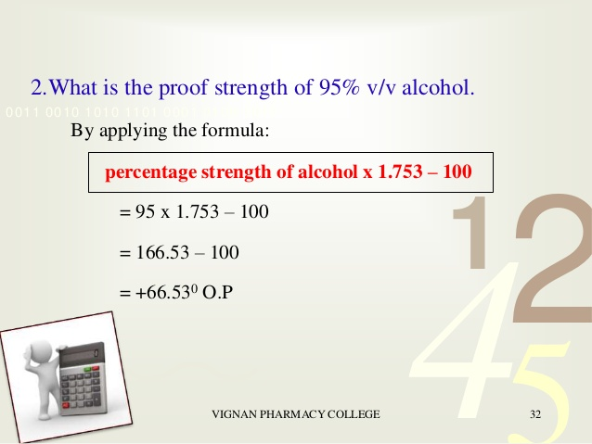

Slide 14
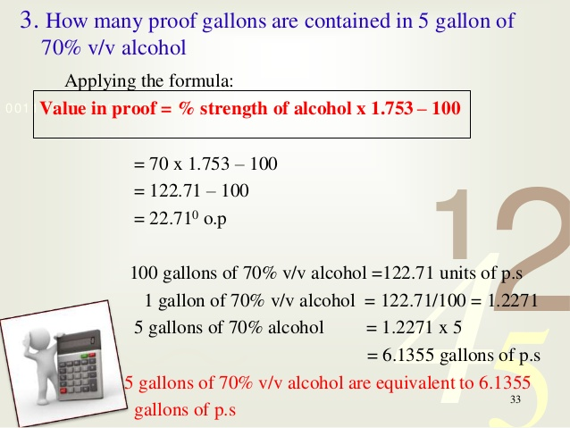

Slide 15
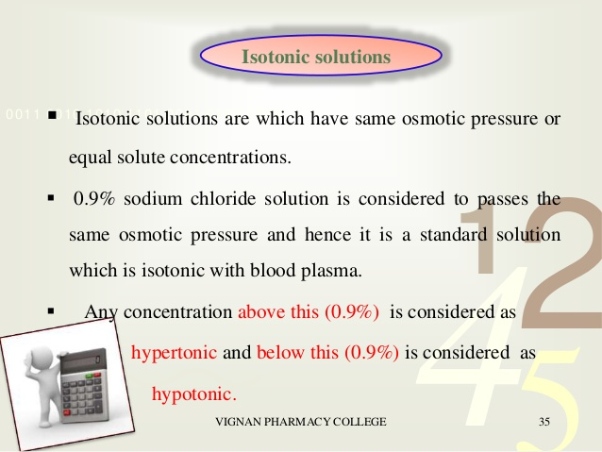

Slide 16
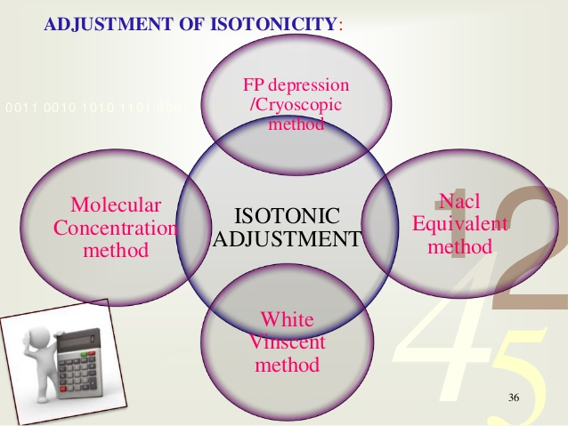

Slide 17
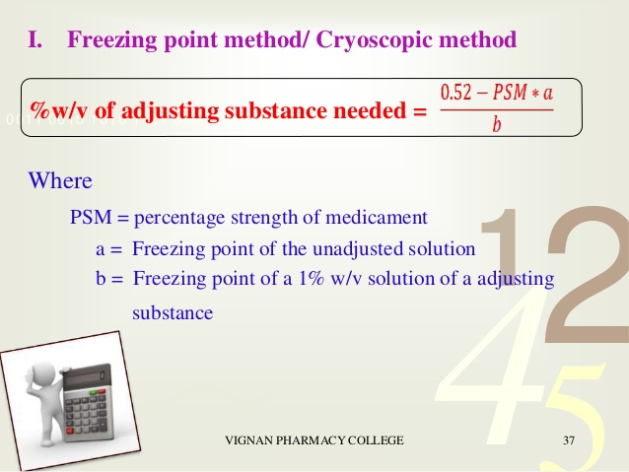

Slide 18
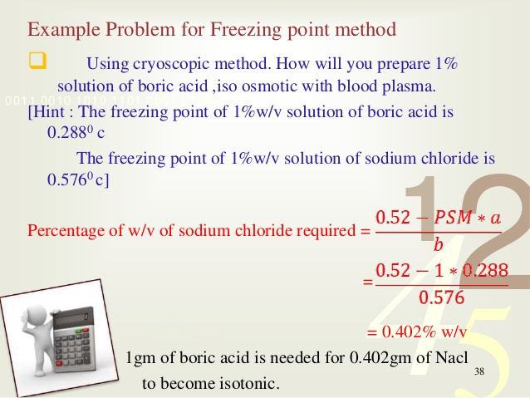

Slide 19
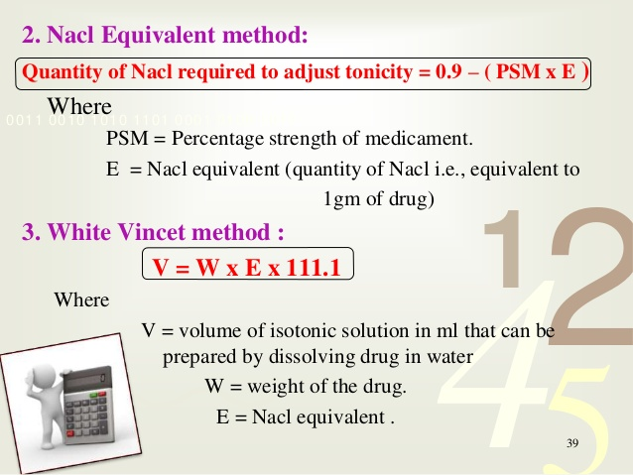

Slide 20
THANK YOU

