Slide 1
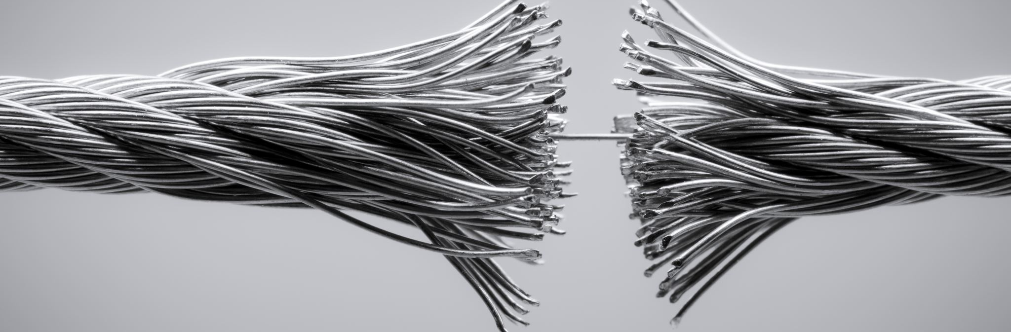
Title: Cable Jointing

Slide 2
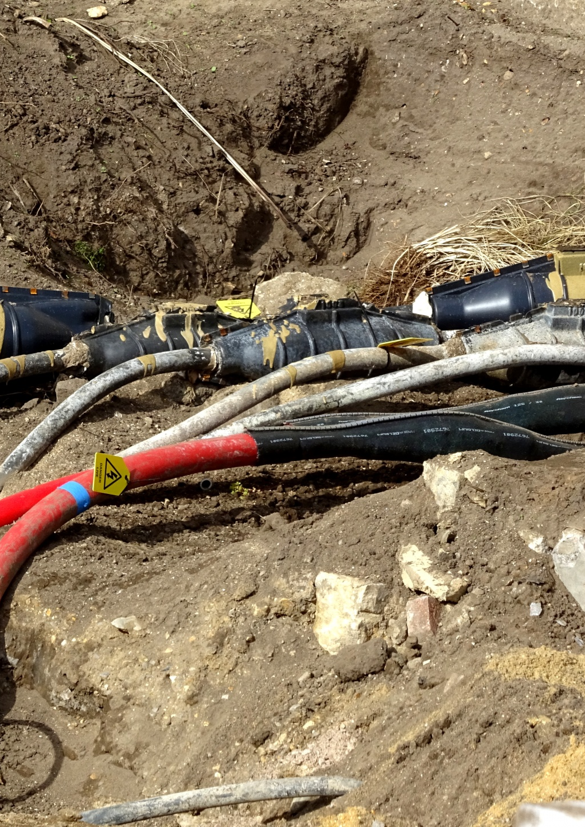
Slide 2: What is Cable Jointing?
Define cable jointing as the process of connecting two or more cables together
1
Explain that cable jointing is performed to extend or repair electrical cables
2
Emphasize the significance of maintaining electrical continuity and insulation during jointing
3

Slide 3
Slide 3: Types of Cable Jointing
Discuss the various types of cable jointing techniques
Mechanical joints: Such as crimping, clamping, or connectors
Soldering joints: Using molten metal to fuse the cable ends
Insulation displacement joints: Connecting cables by piercing insulation
Heat-shrink joints: Using heat to shrink a sleeve around the joint
Cold-applied joints: Utilizing cold-applied compounds or resins

Slide 4
Slide 4: Cable Jointing Process
Provide a step-by-step guide for cable jointing
Cable preparation: Cleaning, stripping, and trimming the cable ends
Connector or sleeve selection: Choose appropriate connectors or sleeves based on the joint type
Connector installation: Follow manufacturer guidelines for installing connectors or sleeves
Insulation and sealing: Apply insulation and sealing materials to ensure electrical insulation and protection
Testing and verification: Perform tests to ensure proper jointing and insulation

Slide 5
Slide 5: Importance of Proper Cable Jointing
Explain the significance of proper cable jointing
Electrical safety: Ensuring secure connections and insulation to prevent hazards
Reliability: Maintaining a continuous flow of electricity without interruptions
Performance: Ensuring optimal electrical performance and efficiency
Cost-effectiveness: Reducing the need for frequent repairs or replacements

Slide 6
Slide 6: Cable Jointing Best Practices
Highlight some best practices for cable jointing
Following manufacturer guidelines and industry standards
Using appropriate tools and equipment for jointing
Properly preparing the cables and ensuring cleanliness
Conducting thorough testing and verification after jointing
Regular inspection and maintenance of joints

Slide 7
Slide 7: Common Challenges and Troubleshooting
challenges encountered during cable jointing
Poor insulation or sealing
Incorrect cable preparation
Inadequate connector installation
Provide troubleshooting tips for addressing these challenges

