Slide 1
Cardiovascular System

Slide 2
introduction
Cardiovascular system consists of blood, heart & blood vessels.
Scientific study of the normal heart and diseases associated with it is cardiology.

Slide 3
The Blood Vessels
The cardiovascular system has three types of blood vessels:
Arteries (and arterioles) – carry blood away from the heart
Capillaries – where nutrient and gas exchange occur
Veins (and venules) – carry blood toward the heart.

Slide 4
Blood vessels

Slide 5
The Arteries
Arteries and arterioles take blood away from the heart.
The largest artery is the aorta.
The middle layer of an artery wall consists of smooth muscle that can constrict to regulate blood flow and blood pressure.
Arterioles can constrict or dilate, changing blood pressure.

Slide 6
The Capillaries
Capillaries have walls that allow exchange of gases and nutrients with tissue fluid.
Capillary beds are present in all regions of the body but not all capillary beds are open at the same time.
Contraction of a sphincter muscle closes off a bed and blood can flow through an arteriovenous shunt that bypasses the capillary bed.

Slide 7
The Veins
Venules drain blood from capillaries, then join to form veins that take blood to the heart.
Veins have much less smooth muscle and connective tissue than arteries.
Veins often have valves that prevent the backward flow of blood when closed.
Veins carry about 70% of the body’s total blood and act as a reservoir during hemorrhage.

Slide 8
The Heart
The heart is a cone-shaped, muscular organ
Location- between the lungs behind the sternum.
Pointed apex formed by tip of ventricles
Relatively small organ
Length-12cm
Wide 9cm at broad point
Thickness-6cm
Mass 250gm(f) 300gm(m)

Slide 9
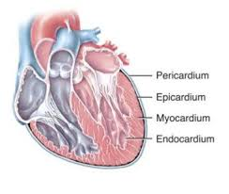
LAYERS OF Heart
The pericardium is the outer membranous sac filled with lubricating fluid. It surrounds & protects heart and is composed of dense irregular connective tissue.
Wall of heart consists of 3 layers:
Epicardium (external) blood vessels & lymphatic vessels present.
Myocardium (middle) composed of cardiac muscle tissue & makes up to 95% of heart wall.
Endocardium (inner) provides a smooth lining for chambers of heart & covers the valve.

Slide 10
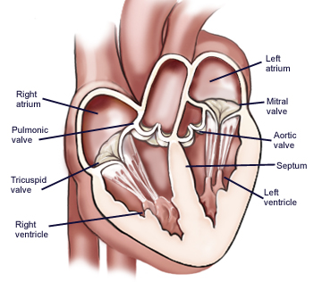
CHAMBERS OF HEART
The heart has four chambers:
Two upper thin-walled receiving chambers-atria
Two lower thick walled pumping chambers- ventricles.
Pouch like structure inside each atrium – Auricle.
The septum is a wall that divides the right and left sides.
Atrioventricular valves occur between the atria and ventricles:
the tricuspid valve found on the right
the bicuspid valve found on the left
both valves are attached to tendons like cords within the ventricles by chordae tendinae.

Slide 11
External anatomy of heart

Slide 12
Internal anatomy of heart

Slide 13
Passage of Blood Through the Heart
Blood follows this sequence through the heart: superior and inferior vena cava → right atrium → right ventricle (through tricuspid valve) → pulmonary semilunar valve → pulmonary trunk and arteries to the lungs→ pulmonary veins leaving the lungs → left atrium → left ventricle (through bicuspid valve) → aortic semilunar valve → aorta → to the body.

Slide 14
Passage of Blood Through the Heart

Slide 15
Coronary circulation
Nutrients are not able to diffuse from blood to cells of chambers of heart, so myocardium has its own network of blood vessels i.e. coronary / cardiac circulation.
Two coronary arteries i.e. left & right coronary arteries branch from aorta & supply oxygenated blood to myocardium.
While heart contracts, blood flows in coronary arteries & when heart relaxes, blood is propelled into capillaries then into coronary veins through coronary arteries due to high blood pressure.
In those capillaries blood provides oxygen to the myocardium & collects carbon dioxide.
Four principal coronary veins are great cardiac vein, middle cardiac vein, small cardiac vein, anterior cardiac vein.

Slide 16
Coronary artery circulation

Slide 17
Cardiac cycle
Each heartbeat is called as a cardiac cycle.
A cardiac cycle consists of systole & diastole of both the atria & ventricles.
In each cardiac cycle, both contract & relax alternatively by forcing the blood from high pressure to low pressure areas.
Heart rate is 75 beats/min.
A cardiac cycle lasts for 0.8sec.
The events during a cardiac cycle are
Atrial systole
Ventricular systole
Relaxation period

Slide 18
Atrial systole
Lasts about 0.1 sec, atria contracts & ventricles relax (ventricular diastole) at the same time.
Ventricular systole
Lasts about 0.3 sec, ventricles contract & atria relax(atrial diastole) at the same time.
Relaxation period
Lasts about 0.4sec, both atria and ventricles are relaxed.
Systole; the phase of contraction of heart.
Diastole; the phase of relaxation of heart muscles.

Slide 19
Autorhythmic fibers
Heart beats for lifelong because of its rhythmic electrical activity which is produced by autorhythmic fibers.
Autorhythmic fibers are self excitable which generates action potential repeatedly that initiates heart contraction, so heart can beat after removal from body.
These fibers produce 2 different functions:
They act as “pacemaker” i.e. they set the rhythm of electrical excitation that produce contraction of heart.
They provide a path for each cardiac cycle i.e known as cardiac conduction system

Slide 20
HEART CONDUCTION
Cardiac action potential propagates through the cardiac conduction system in the following steps:
The SA (sinoatrial) node, i.e. present in right atrial wall initiates the cardiac excitation. The AP propagates from SA node through gap junction by causing contraction of by both the atria.
Then AP reaches the AV (atrioventricular) node i.e. present in the interatrial septum. Here the AP slows & atria drains their blood into the ventricles.
The signal travels from the AV node through the atrioventricular bundle or bundle of his to the smaller right & left purkinje fibers i.e. towards apex of the heart.
The purkinje fibers rapidly conduct the AP upwards to contract the ventricles & push the blood upward.
The SA node initiates an action potential in every 0.6 seconds & sets the rhythm for each contraction. So it is known as the natural pacemaker.

Slide 21
Conduction system of heart

Slide 22
Action potential
An electrical signal propagates along the membrane of a neuron or muscle fiber is known as action potential.
The action potential is initiated by SA node.
It travels through the conduction system.
It excites the contractile autorhythmic fibers.
An action potential occurs in a contractile fiber as following phases:
Depolarisation
Plateau
repolarisation

Slide 23
Depolarization
Contractile fibers have stable resting membrane potential i.e. -90mV.
Voltage gated fast Na+ channels open, Na+ inflow occurs from interstitial fluid to cytosol.
Due to this electrochemical gradient rapid depolarization occurs which lasts for few miliseconds.
Plateau
Voltage gated slow Ca2+ channels open, Ca2+ inflow occurs from interstitial fluid to cytosol.
Ca2+ conc. increases inside the cytosol.
It lasts for 0.25 seconds.
Repolarization
Recovery of resting membrane potential.
Voltage gated K+ channels open, K+ outflow occurs from cytosol to interstitial fluid.
At the same time other channels are closed.
The conc. of ions is balanced.

Slide 25
ecg (Electrocardiogram)
An electrocardiogram (ECG) is a recording of the electrical changes produced by the heart muscle fibers during a cardiac cycle.
The instrument used to record the ECG is electrocardiograph.
It determines :
Conducting pathway
Size of heart
Damaged heart regions
Cause of chest pain
ECG shows 3 clear waves i.e. P wave, QRS wave, T wave

Slide 26
Waves of ecg
P wave
Small upward deflection.
Represents atrial depolarization .
Starts from SA node.
Increased wave = enlargement of atrium
QRS wave
Starts at a downward deflection, continues a large triangular wave, ends a downward wave.
Represents rapid ventricular depolarization.
Enlarged Q wave = myocardial infarction
Enlarged R wave = enlargement of ventricles
T wave
Dome shaped upward deflection.
Represents ventricular repolarization.
Flat T wave = insufficient oxygen supply

Slide 27
Intervals of ecg
PQ interval
Time from beginning of P wave to the beginning of QRS wave
Represents conduction time from atrial excitation to ventricular excitation
Enlarged PQ interval = coronary artery disease & rheumatic fever.
ST segment
Begins at the end of S wave & ends at the beginning of T wave.
Represents the depolarization of ventricular contractile fiber
Depressed = insufficient oxygen supply
Elevated = acute myocardial infarction
QT interval
Begins from QRS complex beginning to the end of T wave.
Represents the time between ventricular depolarization to repolarization.
Increased length = myocardial infarction, conduction abnormality

Slide 28
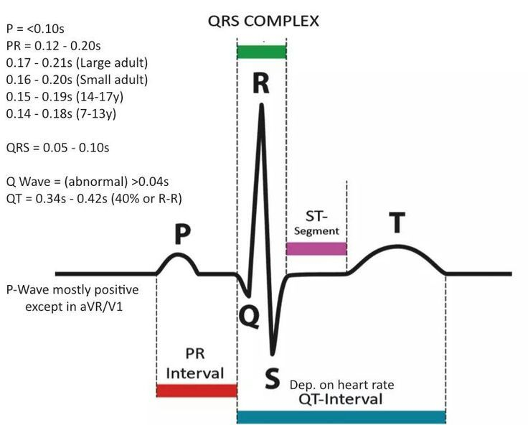

Slide 29
Cardiac output
It is the volume of blood ejected from the left ventricle into the aorta each minute.
CO = SV х HR
Stroke volume - the volume of blood ejected by the ventricles during each contraction.
Heart rate – the no of heart beats per minutes
CO= 70ml/beat х 75 beats/min
=5250 ml/min
=5.25l/min

Slide 30
Regulation by ans
A cardiac control center in the medulla oblongata regulates the action of CVS by the autonomic nervous system branches:
parasympathetic system (decreases heart rate)
sympathetic system (increases heart rate)

Slide 31
Regulation by hormone
Hormones epinephrine and norepinephrine from the adrenal medulla increase the heart rate & contractility.
Thyroid hormones also enhance cardiac contractility & increase heart rate.

Slide 32
Regulation by ions
Increased K+ or Na+ level in blood causes decrease in heart rate.
Increased Ca2+ leads to increased heart rate.

Slide 33
Cardiovascular Disorders

Slide 34
Atherosclerosis
Atherosclerosis is due to a build-up of fatty material (plaque), mainly cholesterol, under the inner lining of arteries.
The plaque can cause a thrombus (blood clot).
The thrombus can dislodge as an embolus
and lead to thromboembolism.

Slide 35
Angina pectoris
It is the ischaemic heart disease characterized by severe chest pain that radiate to left shoulder along the surface of left arm.
Pain is due to accumulation of metabolites in cardiac muscle.
arrythmia
An abnormality of rate or rhythm or site of origin of cardiac impulse or impulse conduction.

Slide 36
hypertension
An elevation of systolic and or diastolic BP above 140mm/Hg.
Hypertension is present when systolic pressure is 140 or greater or diastolic pressure is 100 or greater; diastolic pressure is emphasized when medical treatment is considered.
Congestive Heart failure
Heart is unable to provide adequate blood supply to meet the body’s oxygen demand.
The ventricles are not completely empty & results increased venous pressure.

