Slide 1
BASICS OF FINGERPRINTING
Classification and cataloguing of fingerprint record

Slide 2
Why classification is required
To establish a set protocol for searching, filing, and comparison purposes.
It provides an orderly method to go from the general to the specific.

Slide 3
Henry classification
Classification system named after Sir Edward Henry.
Originally consisted of four parts: primary, secondary, sub secondary, and final.
Now includes an FBI (U.S. Federal Bureau of Investigation) extension, which changes the original configuration from four to six categories. ( major and little)
After the introduction of technology and various automated fingerprint identification (AFIS) systems, this method has come to be known as the manual method.

Slide 4

Current components of henry
Key: The ridge count of the first loop appearing on the card, excluding little fingers.
Major: The ridge count or trace value of the thumbs.
Primary: The numeric value of each finger containing a whorl pattern.
Secondary: Capital letter indicating the pattern of index fingers.
Sub secondary: Values of counts and traces of loops and whorls of the index, middle, and ring fingers.
Final: Ridge count of loops appearing on the little fingers.

Slide 5
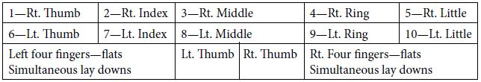
The known fingerprint card gives us the necessary information.
Information is inserted onto the card aka blocking the card.
Blocking the card consists of inserting the appropriate information consisting of numbers, letters, and symbols in the appropriate places on the card.
layout and position of the fingers on the fingerprint card :

Slide 6
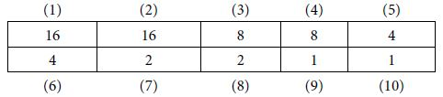
Primary
Numeric value of the finger where a whorl appears.
Whatever finger the whorl appears on, that finger assumes the given value.
Upon adding up the numbers, add 1 to the value.
Even number fingers, 2, 4, 6, 8, and 10 are registered in numerator and Odd number fingers 1, 3, 5, 7, and 9 are registered in denominator.
If all fingers have ,primary classification will be 32 over 32.
If no whorls appear on the card, primary classification will be 1 over 1.
Numeric chart for primary

Slide 7
Secondary
Indicates the pattern type of the index fingers and is always indicated by a capital letter.
  A = arch
  T = tented arch
  R = radial loop
  W = whorl
  U = ulnar loop
Registered as right hand over left hand on the classification line.
Placed immediately to the right of the primary classification.

Slide 8
Subsecondary
Grouping of ridge count and/or whorl trace symbols for the index, middle, and ring fingerprints
appearing on the card and it is indicated by letter.
Right hand is indicated above the line, the left hand is indicated below the line.
Placed to the immediate right of the secondary division on the card.

Slide 9
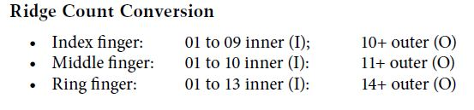
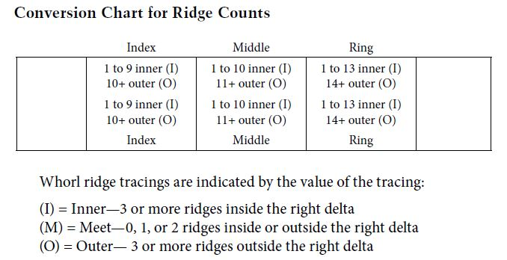

Slide 10
Major
Ridge count or ridge trace value of the thumbs, right hand over left hand.
Designated immediately to the left of the primary.
If there is an A or T in the thumbs, there will be no major classification.
Whorl trace values will be indicated by inner (I), meet (M), or outer (O).
Loop counts must be converted into small (S), medium (M), or large (L).

Slide 11
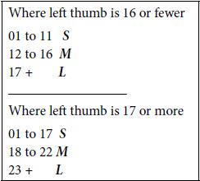
Always count the left thumb first. Based on the ridge count of the left thumb print, the right thumb designation can be determined based on the conversion chart.
Left thumb conversion (For ridge counts) :
  1 to 11 small (S)
  12 to 16 medium (M)
  17+ large (L)
For Right thumb : Refer the chart.
If a whorl appears in the left thumb print, use the smaller conversion chart to the right thumb.

Slide 12
Final
Ridge count of a loop appearing in the little fingers.
Right little finger is examined first to see the presence of loop. If there is no loop pattern in the right little finger, then the left little finger is examined.
If neither the right nor the left little fingers possess a loop, there will be no final.
Final can not consist of both fingers
In large whorl sections, whorls can also be counted but this is rare.

Slide 13
key
Ridge count of the first loop appearing on the card excluding the little fingers.
The designation for the key is always indicated above the line farthest to the left on the classification.

Slide 14
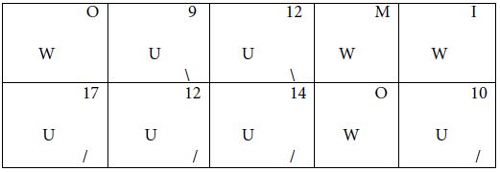

Classify the following ac. To modified henry classification with fbi extension

