Slide 1
Disinfectant
Deepankar ratha
Assistant Professor, CUTM,Rayagada.

Slide 2
Content
Terminology
Introduction of Disinfectants
Classification of Disinfectants
Mode of action of Disinfectants
Factors affecting Disinfection
Evaluation of Anti-microbial agents and Disinfectants

Slide 3
Terminology
Sepsis: Bacterial contamination.
Asepsis: Absence of significant contamination.
Antisepsis: Chemical destruction of vegetative pathogens on living tissue.
Sanitization: Lowering microbial counts on eating and Drinking utensils to safe level.

Slide 4
Terminology
Bactericidal: Chemical agents capable of killing bacteria.
Virucidal: Chemical agents capable of killing virus.
Fungicidal: Chemical agents capable of killing Fungi.
Sporicidal: Chemical agents capable of killing Spores.
Bacteriostatic: Chemical agents that inhibit the growth of bacteria but do not necessarily kill them.

Slide 5
Introduction of Disinfectants
Disinfection is the process of destruction or removal of micro- organisms and reducing them to the level not harmful to health.
Disinfection generally kills the sensitive vegetative cells but not heat resistant endospores.
If the object is inanimate (lifeless), such as working area, dishes, benches, etc. the chemical agent is known as disinfectants.
However if the object is animate (living) such as human body tissue, the chemical is known as antiseptic.
Disinfectants are usually bacteriocidal but occasionally they may be bacteriostatic.

Slide 6
An ideal disinfectant should have following properties.
Broad spectrum
Non toxic
Fast acting
Odourless
Surface compatibility
Economical
Easy to use
Soluble and miscibility
Not affected by the physical factors
Stable on storage

Slide 7
Classification of Disinfectants
The chemical agents are classified as follows:
Acids and alkalies
Halogens
Heavy metals
Phenol and its derivatives
Alcohols
Aldehydes
Quaternary ammonium compounds
Dyes
Detergents and Soaps.

Slide 8
1. Acids and alkalies
Generally, strong acids and alkali kill the bacteria but weak organic acids inhibit their growth.
2. Halogens
Chlorine, fluorine, bromine and iodine in the free state as well as their compounds strongly act as germicidal.
3. Heavy metals
The most widely used heavy metals are those of mercury, silver and copper.
Heavy metals and their compounds act as antimicrobially by combining with the cellular protein.
High concentration of salts of heavy metals like mercury, copper and silver coagulate cytoplasmic proteins, resulting in the damage or death of cell.
4. Phenol and its derivatives
Phenol is the chief products obtained by the distillation of the coal tar.
Phenol 1% has bactericidal action.
Many derivatives of phenol are more effective and less costly.

Slide 9
5. Alcohols
Alcohols have fairly rapid bactericidal action against vegetative bacteria when diluted to the concentration of 60% to 70% v/v with water.
Ethanol 60 to 70% v/v and isopropanol 50 to 60% v/v are used as skin disinfectants while methanol vapour has been used as fungicide.
The higher alcohols ( propyl, butyl, amyl etc) are more germicidal than ethyl alcohol.
Alcohols are used as preservatives in some vaccines.
6. Aldehyde
Formaldehyde (HCHO) is the main aldehyde used for disinfection.
Formaldehyde in solution is useful for sterilization of certain instruments.

Slide 10
7. Quaternary ammonium compound
Quaternary ammonium compounds are widely used for the control of microorganisms on floors, walls, nursing homes and other public places.
They are also used as skin antiseptics and as sanitizing agents in dairy, egg and fishing industries.
8. Dyes
A number of dyes have been used to inhibit the bacterial growth.
Basic dyes are more effective bactericides than acidic dyes.
Acridine and triphenylmethane dyes are commonly used as antimicrobial agents.

Slide 11
9. Detergents and soaps
They are widely used
emulsifiers.
as surface active agents, wetting agents and
They are classified into four main groups such as anionic, cationic, non-ionic and amphoteric.
The most important antibacterial agents are the cationic surface active agents. Eg: cetrimide, benzalkonium chloride etc.
Soaps and sodium lauryl sulfate are anionic compounds. Soaps prepared from saturated fatty acids are more effective against gram negative bacilli while those prepared from unsaturated acids have greater action against gram positive.
Nonionic detergents are not ionized. However these substances do not posses significient anti-microbial activity.
Amphoteric compounds have the detergent properties of anionic surfactants combined with disinfectant properties of cationic surfactants. Eg: Tego compounds.

Slide 12
Mode of action of Disinfectants
Alteration of membrane permeability.
Damage to protein.
Rupture of cell membrane.
Damage to nucleic acids.
Interfere with metabolic pathway.

Slide 13
Factors affecting disinfection
Concentration of disinfectant
Temperature
Time of contact
pH of environment
Surface tension
Formulation of disinfectant
Chemical structure of disinfectant
Types and number of micro-organisms present
Interfering substances in the environment 10.Potentiation, synergism, and antagonism of disinfactants.

Slide 14
1. Concentration of disinfectants
The lethal effect of bacterial population is increased by increasing the concentration of disinfectant.
However, the effectiveness is generally related to the concentration exponentially, not linearly.
There is optimum concentration of phenol at about 1%. Beyond this concentration, the disinfecting effectiveness becomes less.
The dilution coefficient can be calculated from the following equation:
n = logt₂-logt₁
logC₂-logC₁
Where
n=concentration exponent or dilution coefficient for disinfectant, t₁= the death time with disinfectant concentration C₁
t₂= the death time with disinfectant concentration C₂

Slide 15
2. Temperature
The lethal effect on bacterial population can be increased by increasing the temperature.
The effect of temperature on bactericidal activity may be expressed quantitatively by means of a temperature coefficient.
The temperature coefficient per degree rise in temperature is denoted by θ where as per 10⁰C rise in temperature is expressed by θ¹⁰or Q₁₀ values.
Thus θ
10
𝑡𝑖𝑚𝑒 𝑟𝑒𝑞𝑢𝑖𝑟𝑒𝑑 𝑡𝑜 𝑘𝑖𝑙𝑙 𝑎𝑡 𝑇⁰𝐶
^{or Q10=} 𝑡𝑖𝑚𝑒 𝑟𝑒𝑞𝑢𝑖𝑟𝑒𝑑 𝑡𝑜 𝑘𝑖𝑙𝑙 𝑎𝑡 (𝑇+100𝐶)
The value for Q₁₀for phenol is 4,which means that over the10⁰C range used to determine the Q₁₀the activity will be increased by factor 4.

Slide 16
3. Time of contact
Sufficient time of contact must be allowed for the disinfectant to exert its action.
4. pH of the environment
A change of pH during the disinfection process can affect the rate of growth inoculum.
A pH of 6-8 is optimal for the growth of many bacteria and the rate of growth declines on either side of the range.
Phenolic and acidic antimicrobial agents usually have greatest activity in acidic conditions.
Acridine dyes and quaternary ammonium compounds are usually more active in alkaline then in acidic solutions.
Amphoteric antimicrobials (Tego compounds) have optimum activities at widely differing pH values.

Slide 17
5. Chemical structure of disinfectant
Chemical structures of compounds affects the disinfectant activity.
Substitution of an alkyl chain upto 6 carbons in length in para position to phenolic –OH group increases activity but greater than 6 carbons in length decreases water solubility and disinfectant activity.
Generally, halogenation increases the antibacterial activity of phenol but nitration increases antibacterial activity and systematic toxicity also.

Slide 18
6. Types and number of micro-organisms present
The efficiency of disinfection greatly depends on the nature and the number of contaminating microorganisms and especially on the presence and absence of bacterial spores.
It can be seen that most vegetative bacteria are rapidly killed by most chemical disinfectants.
Bacterial spores are difficult to destroy but some disinfectants e.g aldehyde are sporicidal.

Slide 19
7. Interfering substances in the environment
Material such as blood, body fluids, pus, milk, food residues or colloidal proteins may reduce the effectiveness of disinfectant if present in small amounts.
The presence of oil and fat markedly reduces the disinfecting ability of phenolics.

Slide 20
8. Potentiation, synergism and antagonism of disinfactants
Potentiation of a disinfectant leads to enhanced antimicrobial activity.
Synergistics effects are often shown by two antimicrobial agents which is giving an increased activity.
Antagonism effects are often shown by two antimicrobial agents which is giving an decreased activity.

Slide 21
Evaluation of Anti-microbial agents and Disinfectants
Techniques and methods used for evaluation of Disinfectants
Tube dilution and agar plate method.
Cup plate method or Cylinder plate method.
Ditch- Plate method.
Gradient plate technique.
Phenol coefficient method (Rideal-Walker test)

Slide 22
1. Tube Dilution And Agar Plate Method
The chemical agent is incorporated into nutrient broth or agar
medium and inoculated with test micro-organisms.
These tubes are incubated at 30⁰C to 35⁰C for 2 to 3 days and then the results in the form of turbidity or colonies are observed.
The results are recorded and the activity of the given disinfectant is compared.

Slide 23
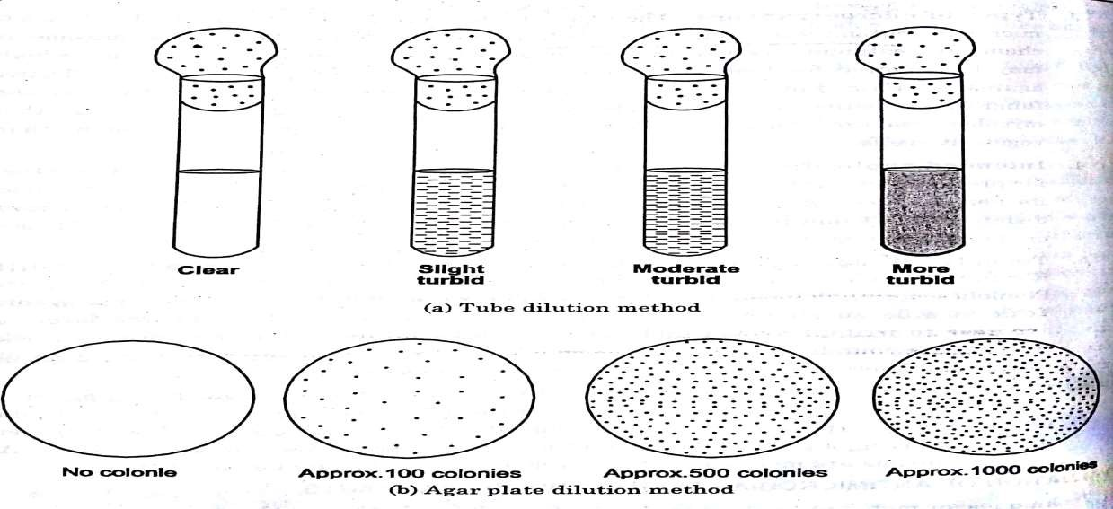
1. Tube Dilution And Agar Plate Method

Slide 24
2. Cup Plate or Cylinder plate Method
The nutrient agar is melted, cooled suitably, poured into petri dish.
Spread 0.2 ml of known concentration of inoculum on the surface of the solidified agar ( Spread Plate Technique).
Cups or cavities are made by using a sterile borer.
Now 0.2 ml of drug is poured into the cups of agar plate and then incubated at 37⁰C for 24 hr.
If the drug has any anti-bacterial effect it will show the zone of inhibition.

Slide 25
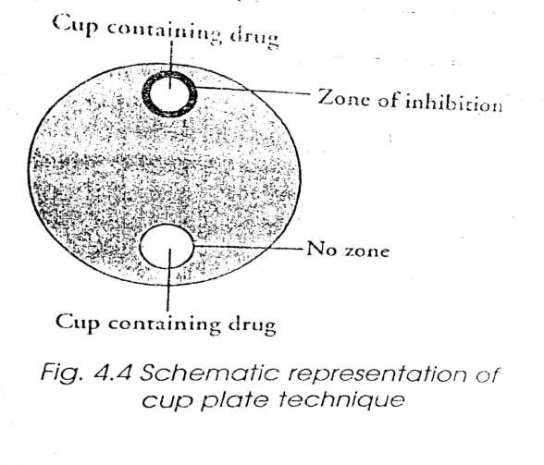
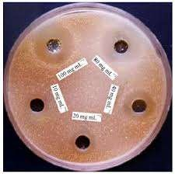
2. Cup Plate or Cylinder plate Method

Slide 26
3. Ditch-Plate Method
The nutrient agar is melted, cooled suitably, poured into petri dish.
The solidified media is cut with a sterile blade to make a ditch.
The drug is poured very carefully into the ditch.
Various microorganisms are streaked on the sides of the ditch.
This method is used to find out the potency of drug against various microorganisms by the means of inhibition of growth on streaked area.

Slide 27
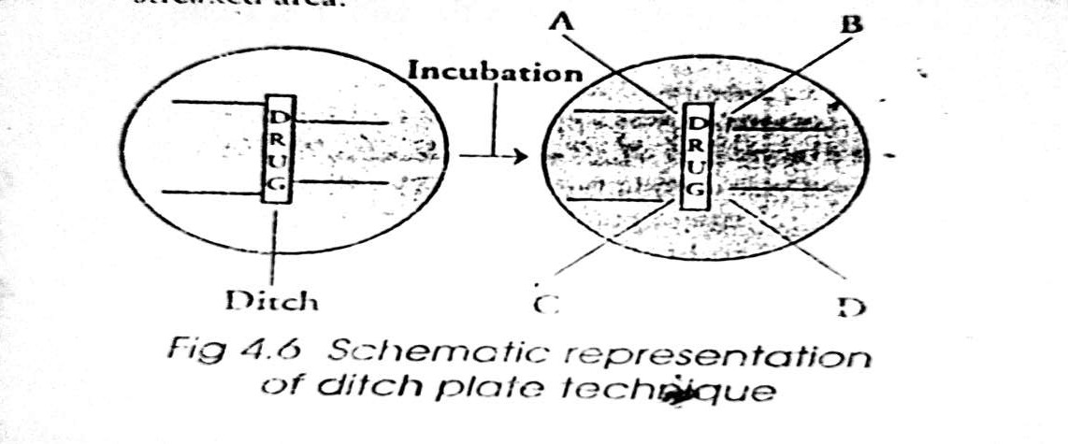
3. Ditch-Plate Method

Slide 28
4. Gradient Plate Technique
This technique is used to isolate the resistant mutants.
The petri dish is kept in slanting position and; a sufficient amount of melted nutrient agar is poured and solidified in slanting position.
Another layer of agar is poured over it, which contains antibiotic solution and solidified it.
After solidification, 0.2ml of bacterial culture was spreaded over the solid surface and incubated it at 37⁰C for 24 to 48 hr.
The microorganisms will grow, where the concentration of the drug is below the critical level.
The antibiotics get diluted on the lower layer and the gradient of concentration will be produced.
Thus the resistant mutant can be islated.

Slide 29
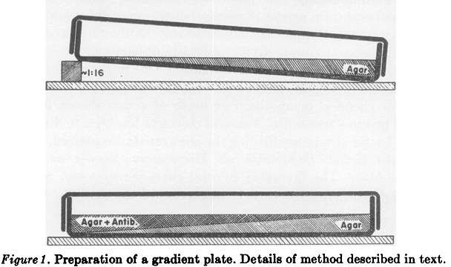
4. Gradient Plate Technique

Slide 30
5. Phenol Coefficient Method ( Rideal-Walker test)
Phenol coefficient test is suitable for testing disinfectants miscible with water and which exert their antimicrobial action in manner similar to that of phenol.
Test Organism: Salmonella typhi
Standard disinfectant: Phenol

Slide 31
Different dilutions of the test disinfectants and phenol are prepared and 5ml of each dilution is inoculated with 0.5 ml broth culture of the organisms for 24 hr.
All tubes (disinfectants + organisms and phenol + organisms)are placed in 17.5⁰C water bath.
Subcultures of each reaction mixture are taken and transferred to 5ml sterile broth after 2.5, 5, 7.5 and 10 min.
The broth tubes are incubated at 37⁰C for 48 to 72 hr and are examined for presence or absence of growth.

Slide 32
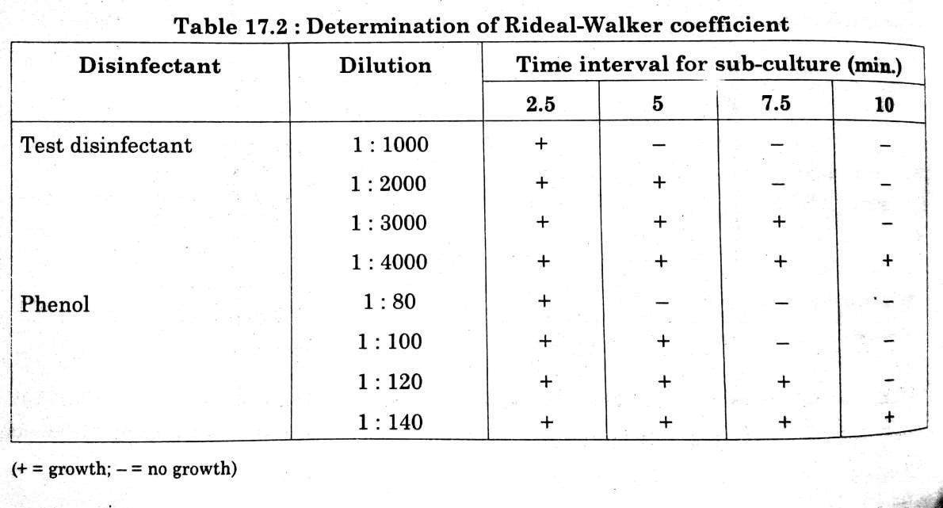

Slide 33
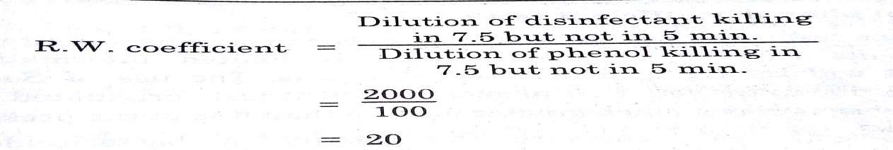
If a phenol coefficient or Rideal-Walker coefficient of a given test disinfectant is 1, it means that disinfectant has same effectiveness as phenol.
If a phenol coefficient or Rideal-Walker coefficient of a given test disinfectant is less than 1, it means that disinfectant is less effective than phenol.
If a phenol coefficient or Rideal-Walker coefficient of a given test disinfectant is more than 1, it means that disinfectant is more effective than phenol.
If the phenol coefficient of the test disinfectant is 20 it means that the disinfectant is 20
times more active than phenol.

