Slide 1
Electron Microscope
Deepankar rath,
Assistant Professor,
CUTM,Rayagada

Slide 2

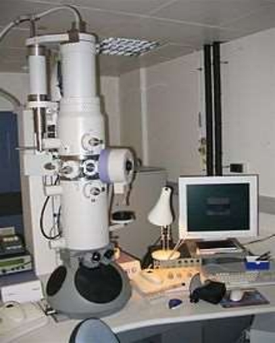
Electron microscope • An electron microscope is a
microscope that uses a beam of
accelerated electrons as a source
of illumination.
• The wavelength of an electron can
be up to 100,000 times shorter
than that of visible light photons.
• Electron microscopes have a
higher resolving power than light microscopes and can reveal the
structure of smaller objects
University of Agriculture Faisalabad – uaf

Slide 3
• It offers unique possibilities to gain insight into 1. Structure
2. Topology
3. Morphology
4. Composition of materials.

Slide 4
Advantages Of Electron Microscopy • To study objects of >0.2 micrometer.
• For analysis of subcellular structure.
• For study of intracellular pathogens & viruses. • For cell metabolism
• For study of minute structure in nature.

Slide 5
Types of Electron Microscope:
• There are basic 4 types of Electron Microscope:
1. Analytical Electron Microscopy (AEM)
2. Scanning Transmission Electron Microscope (STEM) 3. Scanning Electron Microscope (SEM)
4. Transmission Electron Microscope (TEM)

Slide 6
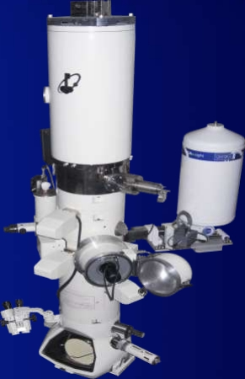
Transmission Electron microscope • Is a microscopy technique in
which a beam of electrons is
transmitted through an ultra-thin
specimen, interacting with the
specimen as it passes through it.
• A transmission electron
microscope can achieve better
than 50 pm
resolution and magnifications of
up to about 10,000,000x
University of Agriculture Faisalabad – uaf

Slide 7
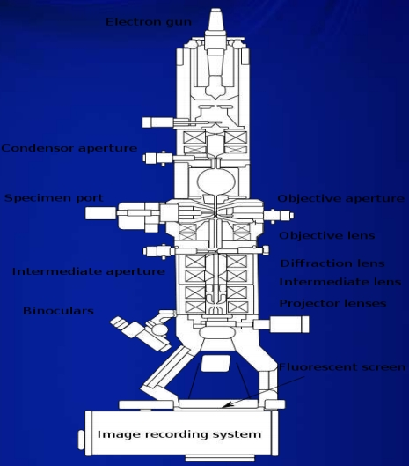

Slide 8
Types of TEM:
• Bright Field (BF) – BFTEM
• Dark field (DF) – DFTEM
• High Resolution TEM – HRTEM • Energy Filtered TEM – EFTEM • Electron Diffraction – ED

Slide 9
Techniques Of TEM: • There are 4 techniques of TEM:
– Negative staining
– Shadow casting
– Freeze fracture replication
– Freeze etching.

Slide 10
Applications Of TEM • It can be used for the study of:
– To examine a small column of atoms. – Cancer research
– Virology
– Pollution Nanotechnology
– Semiconductor research
– Chemical Identity
– Crystal orientation
– Electronic structure

Slide 11
Limitations of TEM:
• It is difficult to produce thin sample.
• Relatively time consuming process with a low throughput of samples.
• The structure of the sample may be change during the preparation process.
• Small field of view may not give conclusion result of the whole sample.

Slide 12
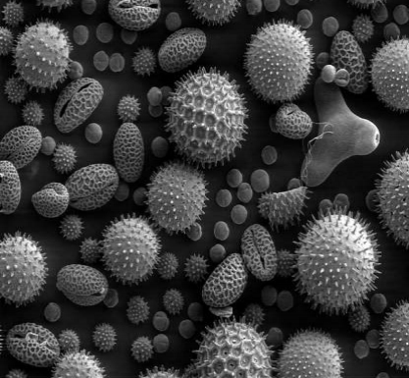
Scanning Electron Microscope (SEM)
• A scanning electron
microscope (SEM) is a type
of electron microscope that
produces images of a sample by
scanning it with a focused beam
of electrons.
• The electrons interact with atoms in
the sample, producing various
signals that contain information
about the sample's
surface topography and
composition.
University of Agriculture Faisalabad – uaf

Slide 13
• Types of signals produce by a SEM include:
– Secondary electrons
– Back scattered electrons (BSE)
– X-rays
– Light rays
• A standard SEM uses secondary electrons & back scattered electrons.

Slide 14
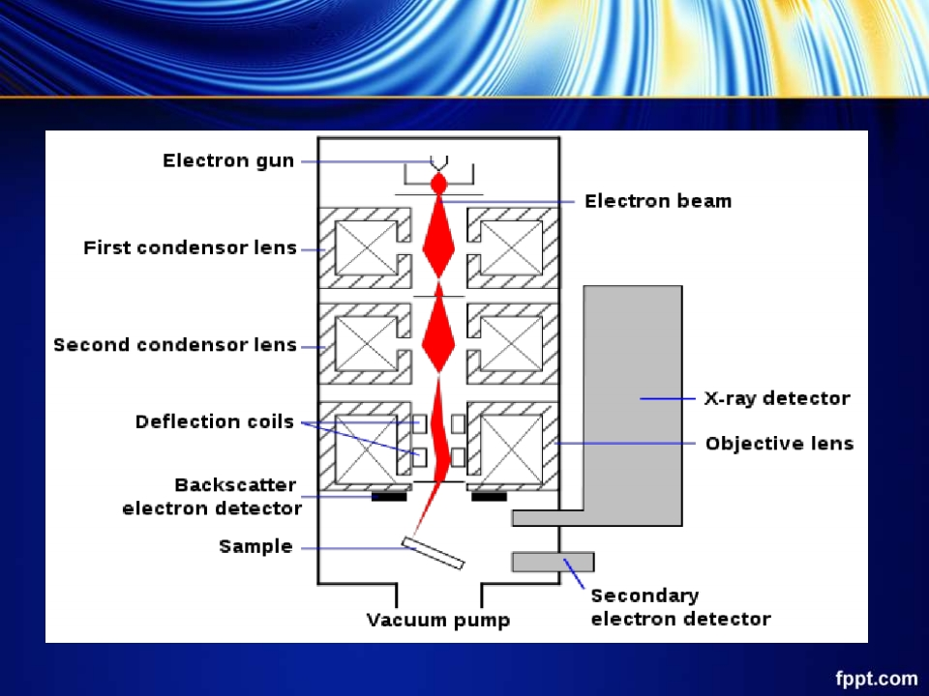

Slide 15
Advantages of SEM:
• Better resolution.
• Work with low voltages.
• High brightness source.
• Fast imaging.
• High count rates in X-ray analysis. • Easy to operate.

Slide 16
Applications of SEM:
• Use in ultra high vacuum, air, water & various liquid environment.
• Use for the live specimen examination.
• Use for the visualization of intra cellular changes.

Slide 17
Limitation of SEM:
• It cannot detect very light element (H, He & Li).
• It cannot detect elements with atomic numbers less than 11.

Slide 18

University of Agriculture Faisalabad – uaf

