Slide 1

FLOW OF FLUIDS
PREPARED BY: Dr Gurudutta Pattnaik PROFESSOR SoPLS, CUTM
1

Slide 2
FLUID FLOW
A fluid is a substance that continually deforms (flows) under an applied shear stress. Fluids are a subset of the phases of matter and include liquids, gases both.
Fluid flow may be defined as the flow of substances that do not permanently resist distortion.
The subject of fluid flow can be divided into fluid statics and fluid
dynamics.
Identification of type of flow is important in
Manufacture of dosage forms
Handling of drugs for administration

Slide 3
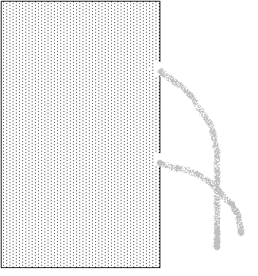


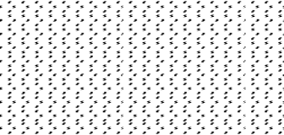
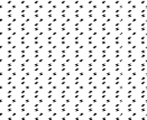


FLUID STATICS
Fluid statics deals with the fluids at rest in equilibrium,
Behavior of liquid at rest
Nature of pressure it exerts and the variation of pressure at different layers
Pressure differences between layers of liquids
h1
Point 1
Point 2
h2
3

Slide 4
Consider a column of liquid with two openings Which are provided at the
wall of the vessel at different height
The rate of flow through these opening s are different due to the pressure exerted at the different height
Consider a stationary column the pressure p_{s} is acting on the surface of the fluid, column is maintained at constant pressure by applying pressure
The force acting below and above the point 1 are evaluated
Force acting on the liquid
At point 1
=
+ Force excreted by the liquid
Force on the surface
Above point 1
Substituting the force with pressure x area of cross section in the above equation
Pressure at point 1 x Area =
Pressure on the surface x area
+ mass x acceleration
4

Slide 5
P₁S = P_{s}S + volume x density x acceleration
= P_{s}S + height x area x density x acceleration P₁S = P_{s}S + h₁ S ρ g
Since surface area is same
P₁ = P_{s} + h₁ ρ g
Pressure acting on point 2 may be written as
P₂ = P_{s} + h₂ ρ g
Difference in the pressure is obtained by
P₂ - P₁ = g (P_{s} + h₂ ρ ) – ( P_{s} + h₁ ρ) g
∆P = (P_{s} + h₂ ρ – P_{s} - h₁ ρ ) g
= ∆ h ρ g
5

Slide 6
FLUID DYNAMICS
Fluid dynamics deals with the study of fluids in motion
This knowledge is important for liquids, gels, ointments which will change their flow behavior when exposed to different stress conditions
MIXING
FLOW THROUGH PIPES
FILLED IN CONTAINER
6

Slide 7
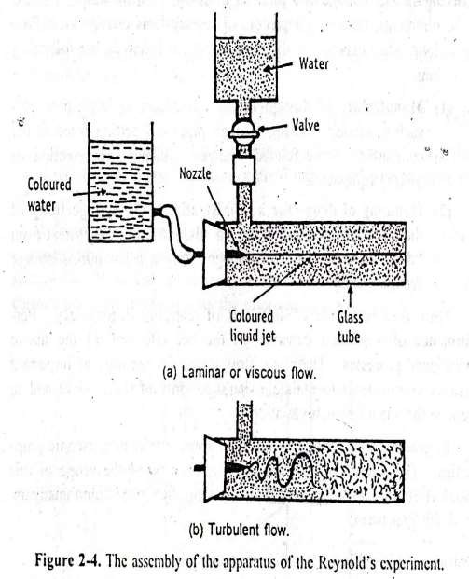
The flow of fluid through a closed channel can be viscous or turbulent and it can be observed by;
Reynolds experiment
Consider Glass tube which is connected to reservoir of water, rate of flow of water is adjusted by a valve, a reservoir of colored solution is connected to one end of the glass tube with help of nozzle colored solution is introduced into the nozzle as fine stream.
7

Slide 8
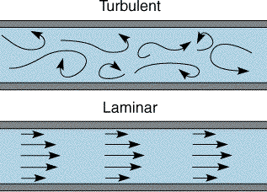
8

Slide 9
➔ Laminar flow is one in which the fluid particles move in layers or
laminar with one layer sliding with other.
➔ There is no exchange of fluid particles from one layer to other.
➔ When velocity of the water is increased the thread of the colored water disappears and mass of the water gets uniformly colored, indicates complete mixing of the solution and the flow of the fluid is called as turbulent flow.
➔ The velocity at which the fluid changes from laminar flow to turbulent
flow that velocity is called as critical velocity.
9

Slide 10
REYNOLDS NUMBER
In Reynolds experiment the flow conditions are affected by
Diameter of pipe
Average velocity
Density of liquid
Viscosity of the fluid
This four factors are combined in one way as Reynolds number
Reynolds number is obtained by the following equation
D u ρ
η
INERTIAL FORCES
MASS X ACCELERATION OF LIQUID FLOWING
= ------------------------------ =
----------------------------------------------------------
VISCOUS FORCES
SHEAR STRESS X AREA
Inertial forces are due to mass and the velocity of the fluid particles trying to diffuse the fluid particles
viscous force if the frictional force due to the viscosity of the fluid
which make the motion of the fluid in parallel
10

Slide 11
If Re < 2000 the flow is said to be laminar
If Re > 4000 the flow is said to be turbulent
If Re lies between 2000 to 4000 the flow change between laminar to turbulent
APPLICATIONS
Reynolds number is used to predict the nature of the flow
Stocks law equation is modified to include Reynolds number to study the rate of sedimentation in suspension

Slide 12
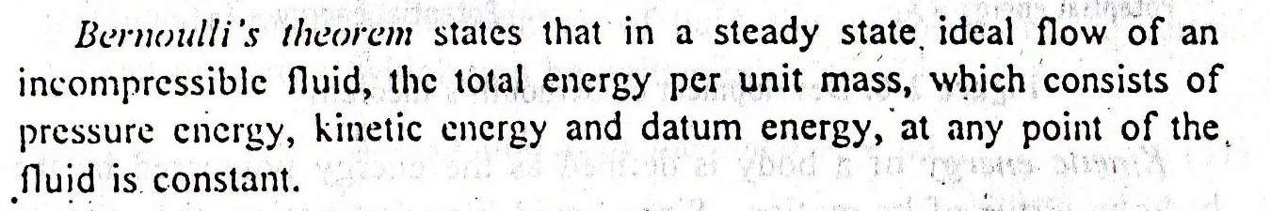
BERNOULLI'S THEOREM
When the principals of the law of conservation energy is applied to the flow of the fluids the resulting equation is called Bernoulli's theorem
Consider a pump working under isothermal conditions between points A and B as shown in figure;

Slide 13
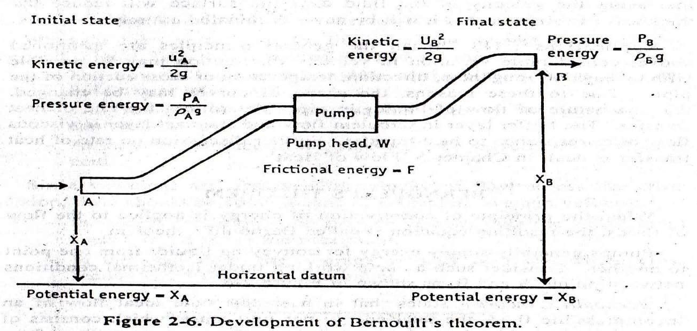

Slide 14
At point a one kilogram of liquid is assumed to be entering at this
point, pressure energy at joule can be written as
Pressure energy = P_{a} /g ρ _{A}
Where P_{a} = Pressure at point a
g = Acceleration due to gravity ρ _{A} = Density of the liquid
Potential energy of a body is defined as the energy possessed by
the body by the virtue of its position or configuration
Potential energy = X_{A}
Kinetic energy of a body is defined as the energy possessed by the body by virtue of its motion,
kinetic energy = U_{A} / 2g
2
Total energy at point A = Pressure energy + Potential energy+ Kinetic
energy

Slide 15
Total energy at point A = P_{a} /g ρ _{A} +X_{A} + U_{A} / 2g
2
According to the Bernoulli's theorem the total energy at point A is constant
Total energy at point A = P_{a} /g ρ _{A} +X_{A} + U_{A} / 2g = Constant
2
After the system reaches the steady state, whenever one kilogram of liquid enters at point A, another one kilogram of liquid leaves at point B
Total energy at point B = P_{B} /g ρ _{B} +X_{B} + U_{B} / 2g
2
INPOUT = OUT PUT
P_{a} /g ρ _{A} +X_{A} + U ² / 2g =P_{B} /g ρ _{B} +X_{B} + U ² / 2g
A B
Theoretically all kids of the energies involved in fluid flow should be accounted, pump has added certain amount of energy
Energy added by the pump = + wJ

Slide 16
During the transport some energy is converted to heat due to frictional
Forces
Loss of energy due to friction in the line = FJ
P_{a} /g ρ _{A} +X_{A} + U ² / 2g – F + W = P_{B} /g ρ _{B} +X_{B} + U ² / 2g
A B
This equation is called as Bernoulli's equation
Application
Used in the measurement of rate of fluid flow
It applied in the working of the centrifugal pump, in this kinetic energy is converted in to pressure

Slide 17
ENERGY LOSS
According to the law of conversation of energy ,energy balance have to be properly calculated
fluids experiences energy losses in several ways while
flowing through pipes, they are
  Frictional losses
  Losses in the fitting
  Enlargement losses
  Contraction losses

Slide 18
FRICTIONAL LOSSES
During flow of fluids frictional forces causes a loss in pressure Type of fluid flow also influences the losses
In general pressure drop will be
PRESSURE DROP α VELOCITY (u)
α Density of fluid(ρ)
α Length of the pipe (L)
α 1 / diameter of the pipe (D)
These relationships are proposed in Fanning equation for calculating friction losses
Fanning equation ∆p = 2fu²Lρ / D
F = frictional factor
For viscous flow pressure drop Hagen –Poiseullie equation
= 32 Luη / D²

Slide 19
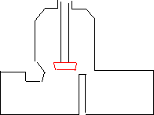

LOSSES IN FITTING
Fanning equation is applicable for the losses in straight pipe When fitting are introduced into a straight pipe, They cause disturbance in the flow, Which result in the additional loss of energy
losses in fitting may be due to
Change in direction
Change in the type of fittings
Tee fitting Equivalent length = 90
Globe valve equivalent length = 300
Equivalent length of fitting = Equivalent length x internal diameter
For globe valve
= 300 x 50
= 15 meter
That means globe valve is equal to 15 meters straight line, so this length is substituted in fanning equation

Slide 20


ENLARGEMENT LOSS
If the cross section of the pipe enlarges gradually, the fluid adapts itself to the changed section with out any disturbance So no loss of energy
µ1
µ1
µ2
µ2
If the cross section of the pipe changes suddenly then loss in energy is observed due to eddies These are greater at this point than straight line pipe
Than u₂< u₁
For sudden enlargement = ∆ H = (u₁ – u₂ )² / 2g
∆ H = loss of head due to sudden enlargement

Slide 21
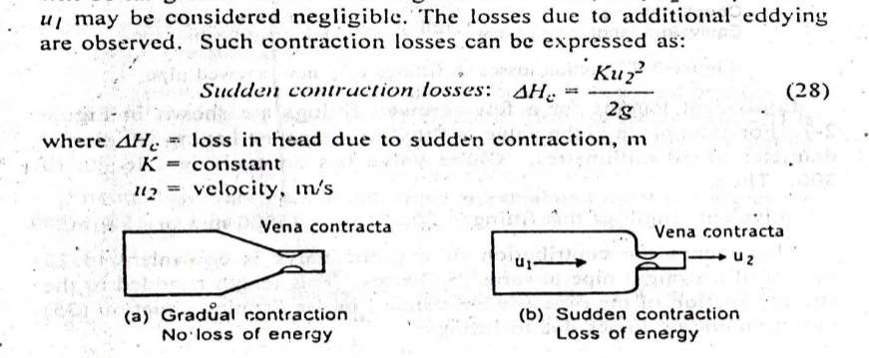
CONTRACTION LOSSES
If the cross section of the pipe is reduced suddenly the fluid flow is disturbed, the diameter of the fluid stream is less than the initial value of diameter this point of minimum cross section is known as vena contracta.
the velocity of fluid at smaller cross section will be greater than at larger cross section, u₂> u₁

Slide 22
MANOMETERS
Manometers are the devices used for measuring the pressure difference Different type of manometers are;
Simple manometer
Differential manometer
Inclined manometer

Slide 23
SIMPLE MANOMETER
This manometer is the most commonly used one
It consists of a glass U shaped tube filled with a liquid A- of density ρ_{A} kg /meter cube and above A the arms are filled with liquid B of density ρ_{B} .
The liquid A and B are immiscible and the interference can be seen clearly
If two different pressures are applied on the two arms the meniscus of
the one liquid will be higher than the other
Let pressure at point 1 will be P1 Pascal's and point 5 will be P2 Pascal's
The pressure at point 2 can be written as
= P₁+ (m + R ) ρ _{B} g
(m + R ) = distance from 3 to 5

Slide 24
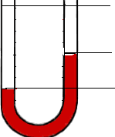
P1
P2
5
1
m
LIQUID B
4
R
3
2
Liquid A

Slide 25
Since the points 2 and 3 are at same height the pressure at 3 can be written as
Pressure at 3 =P₁+ (m + R ) ρ _{B} g Pressure at 4 can be written as
= P₂ + gm ρ _{B}
or
= P₁+ ρ _{B} ( m + R ) g- ρ _{a} R g
Both the equations should be equal
P₂ + gm ρ _{B} = P₁+ ρ _{B} ( m + R ) g- ρ _{a} R g
P₁ – P₂ = gm ρ _{B} - ρ _{B} ( m + R) g + ρ A R g
∆P = gm ρ _{B} - gm ρ _{B} - R ρ _{B} g + R ρ _{A}
=R (ρ _{A}- ρ _{B} )g

Slide 26
DIFFERENTIAL MANOMETERS
These manometers are suitable for measurement of small pressure differences
It is also known as two – Fluid U- tube manometer
It contains two immiscible liquids A and B having nearly same densities
The U tube contains of enlarged chambers on both limbs,
Using the principle of simple manometer the pressure differences can be written as
∆P =P₁ –P₂ =R (ρ_{c} – ρ_{A}) g

Slide 27
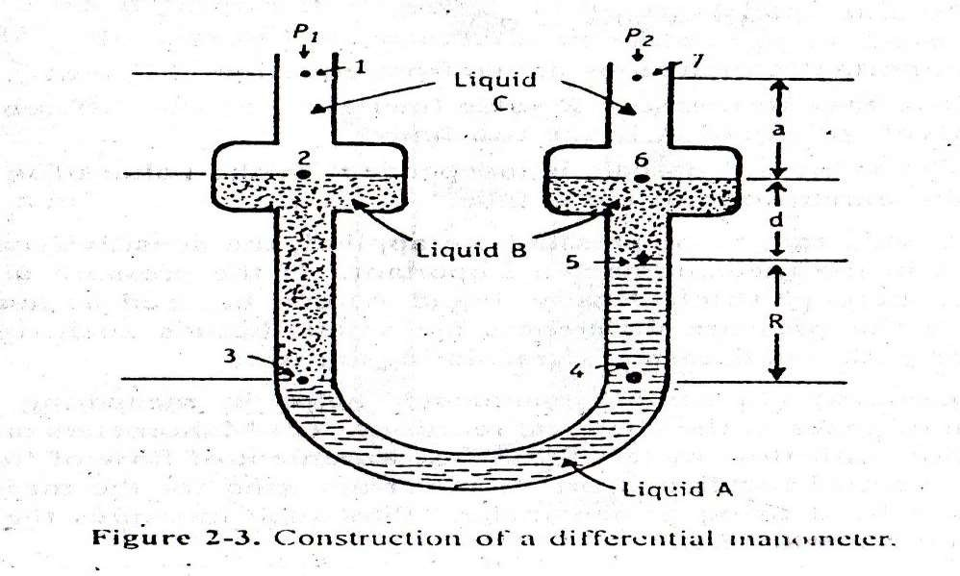

Slide 28
INCLINED TUBE MANOMETERS
Many applications require accurate measurement of low pressure such as drafts and very low differentials, primarily in air and gas installations
In these applications the manometer is arranged with the indicating tube inclined, as in Figure, therefore providing an expanded scale
This enables the measurement of small pressure changes with increased
accuracy
P₁ –P₂ = g R (ρ _{A} - ρ _{B}) sin α

Slide 29
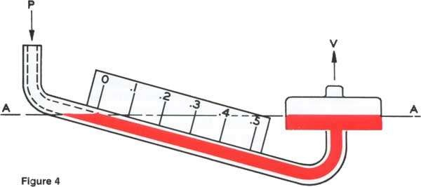

Slide 30
MEASUREMENT OF RATE OF FLOW OF FLUIDS
When ever fluid are used in a process it is necessary to measure the rate at which the fluid is flowing through the pipe,
Methods of measurement are
Direct weighing or measuring
Hydrodynamic methods
  Orifice meter
  Venturi meter
  Pitot meter
  Rotameter
Direct displacement meter

Slide 31
DIRECT WEIGHING OR MEASURING
The liquid flowing through a pipe is collected for specific period at any point and weighed or measured, and the rate of flow can be determined.
Gases can not be determined by this method.
ORIFICE METER
Principle:
Orifice meter is a thin plate containing a narrow and sharp aperture
When a fluid stream is allowed to pass through a narrow constriction the velocity of the fluid increase compared to up stream
This results in decrease in pressure drop and the difference in the
pressure may be read from a manometer
The velocity of the fluid at thin constriction may be written as
U₀ =C ₀ √ 2g ∆H

Slide 32
∆H = difference in height, can be measured by manometer C₀ = constant
U₀ = velocity of fluid at the point of orifice meter
CONSTRUCTION
It is consider to be a thin plate containing a sharp aperture through which fluid flows
Normally it is placed between long straight pipes
For present discussion plate is introduced into pipe and manometer is connected at points A and B
WORKING
Orifice meter is referred as the variable head meter, ie it measure the variation in the pressure across a fixed construction placed in the path of flow

Slide 33
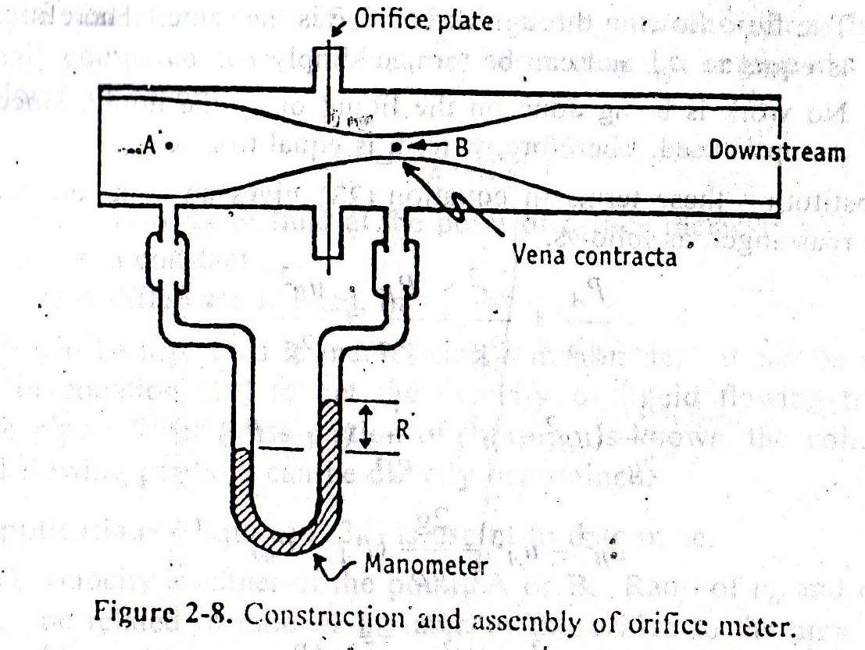

Slide 34
When fluid is allowed to pass through the orifice the velocity of the fluid at point B increase, as a result at point A pressure will be increased
Difference in the pressure is measured by manometer
Bernoulli's equation is applied to point A and point B for experimental conditions
√µ₀² –µ ² =C √2g ∆H
A 0
µ₀ = velocity of fluid at orifice µ_{A =} velocity of fluid at point A C₀ = constant
If the diameter of the orifice is 1/5 or less of the pipe diameter then µ_{A}
is neglected so, Applications
µ₀ = C₀ √2g ∆H
Velocity at either of the point A and B can be measured
Volume of liquid flowing per hour can be determined

Slide 35
VENTURI METER
Principle:
Venturi meter consist of two tapered sections in the pipe line with a gradual constriction at its centre.
When fluid stream is allowed to pass through the narrow throat the velocity of the fluid increases at the venturi compared to velocity of the upstream.
This results in decrease in the pressure head.
This resulting decrease in the pressure head is measured directly from the manometer.

Slide 36
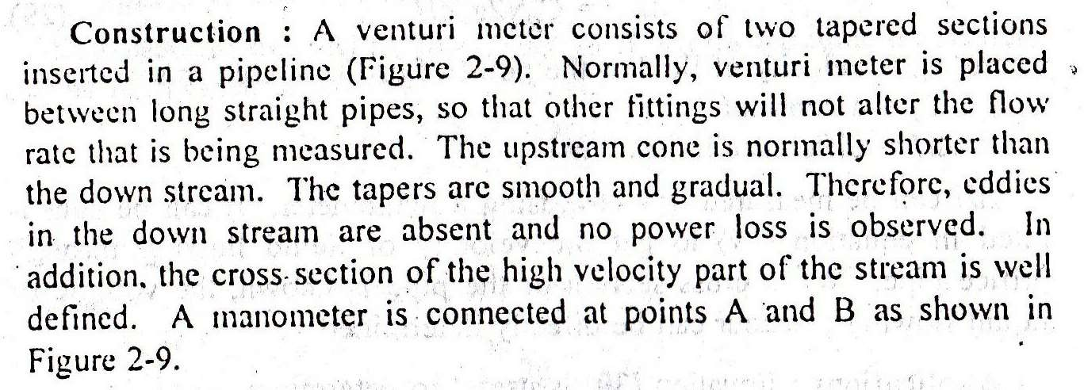

Slide 37
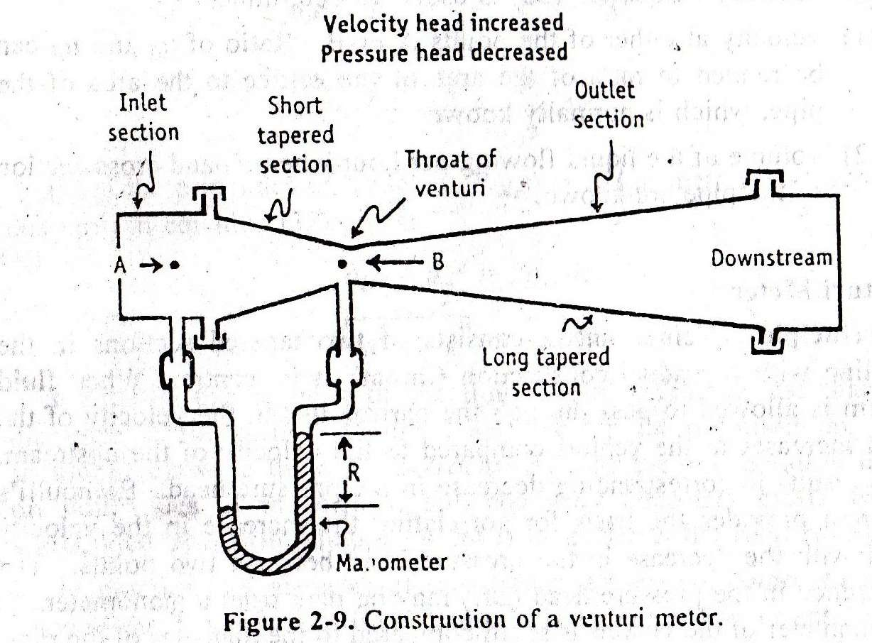

Slide 38
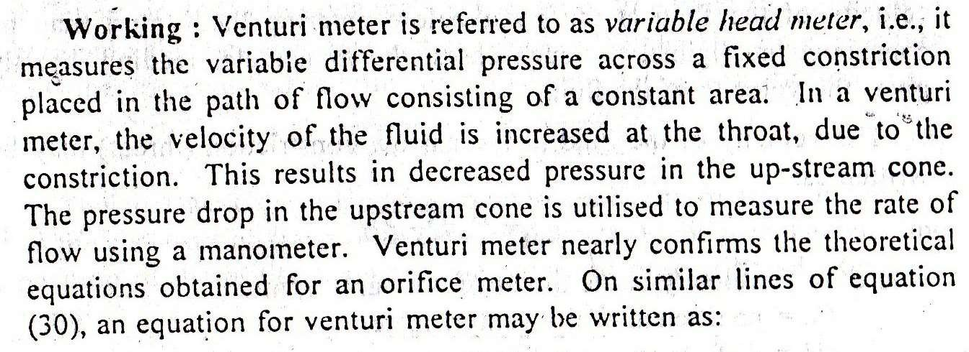
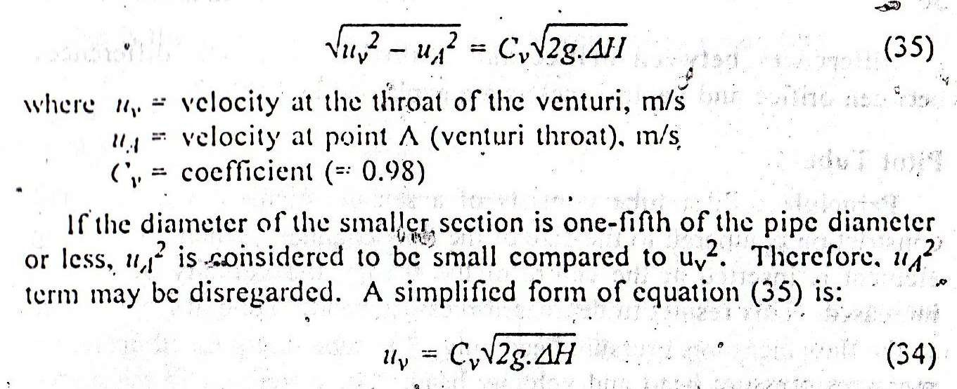

Slide 39
Disadvantages
Expensive
Need technical expert
Not flexible
Occupies more space
Advantages
Power loss is less
Head loss is negligible
Applications:
It is commonly used for liquids, specially for water.
It can also be used for the measurement of gases.

Slide 40
PITOT TUBE
Principle:
Pitot tube consists of sensing element with a small constriction compared to the size of the flow channel.
When the sensing element is inserted at the center of the stream, the velocity of flow is increased.
This results in decrease in pressure head.
∆H_{p} = u² /2g

Slide 41
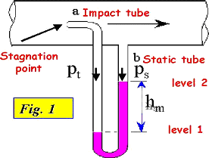
PITOT TUBE

Slide 42
Construction
It is also known as insertion meter or insertion tube
The size of the sensing element is small compared to the flow channel
The point of measurement may be at the center of the channel
One tube is perpendicular to the flow direction and the other is parallel to the flow
Two tubes are connected to the manometer
Working
Tube are inserted in the flow shown is the figure.
Pitot tube is used to measure the velocity head of the flow.
In this tube velocity of fluid is increased at the narrow constriction which results in decreased pressure.

Slide 43
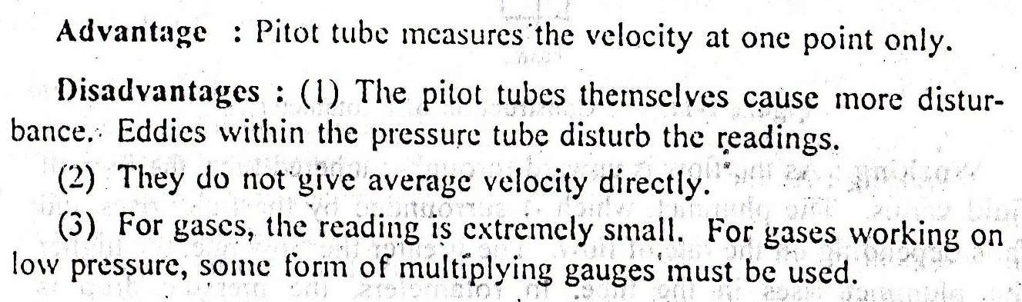
Tube at right angles to the flow measures pressure head only while the tube that points upstream measures pressure head and velocity head.
µ²= C_{v} √2g ∆H
C_{v} coefficient of Pitot tube

Slide 44
ROTAMETER
Principle:
Rotameter is known as area meter as it measures area of flow.
It consist of a vertical, tapered and transparent tube in which plummet is placed.
During the fluid flow through the tube the plummet rises and falls because of variation of flow.

Slide 45
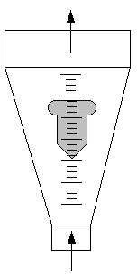
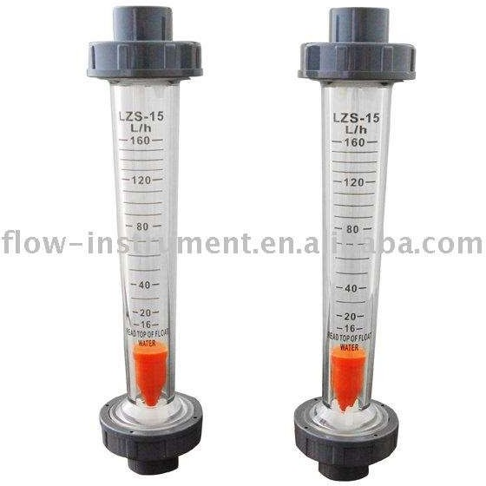

Slide 46
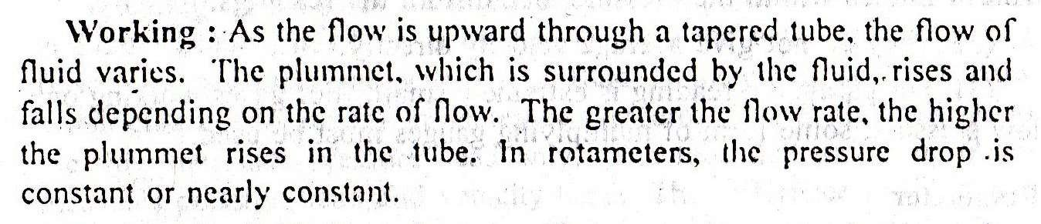
Construction
It consists of vertically tapered and transparent tube with narrow end down, in which a plummet is placed.
A solid plummet is placed in the tube. The diameter of the plummet is smaller than the narrowest part of the tube.
Floats/plummet is made up of glass, aluminium or plastic.
The tube is usually made of glass on which linear scale is given.
During the flow the plummet rise due to variation in flow
The upper edge of the plummet is used as an index to note the reading

Slide 47
